Slide 1
© Students of History - http://www.teacherspayteachers.com/Store/Students-Of-History

Slide 2
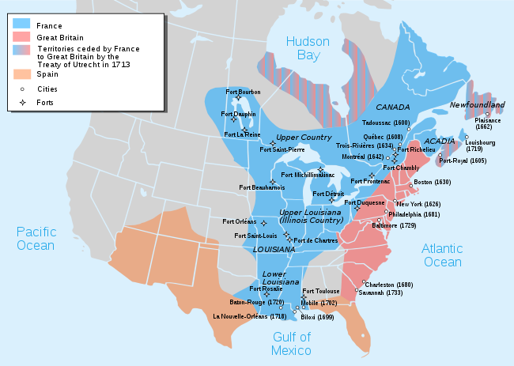

Slide 3
Colonial Clashes
The Ohio Valley became the main bone of contention between the British and French
Critical area into which the westward-pushing British colonists would inevitably penetrate
George Washington and other speculators secured legal “rights” to some 500,000 acres in the Ohio Valley region
At the same time, the French were constructing forts along the Ohio River
Summer of 1754
To secure Virginia’s claims, Washington was sent to the Ohio country
Clashes at the French Fort Duquesne and Washington’s Fort Necessity lead to War
lukerosa@gmail.com

Slide 4
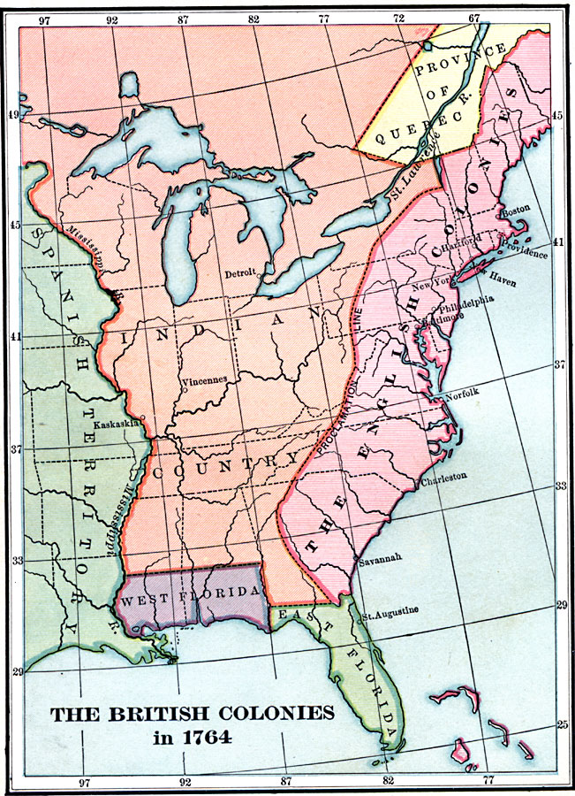
Post French-Indian War
For the first time in 50 years, England was at peace
Yet they had accumulated a massive amount of debt fighting all of these wars
Increased taxation of the colonies was seen as justified
After all, the British felt, many of these wars had been fought in the interest of protecting the colonies

Slide 5
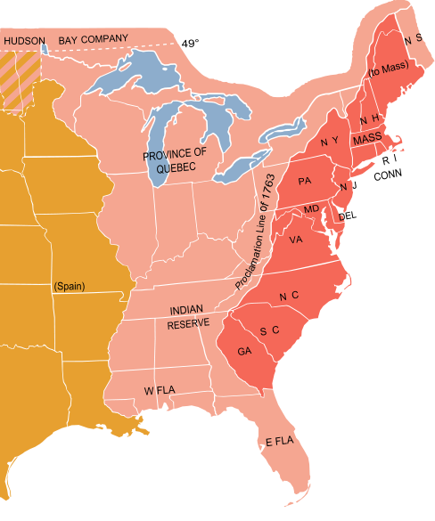
Proclamation of 1763
Forbid settlers to advance beyond the Appalachian Mts.
Allowed England (rather than the colonial gov’ts) to control westward expansion
Expansion would be on British terms, so it was a bit of a “check” towards the colonial governments
Most Indian tribes liked the line

Slide 6
Proclamation of 1763
Results:
Failed
Minimal effect on limited colonial expansion
Settlers continued to swarm across the boundary and to claim lands farther into the Ohio River Valley
It wasn’t policed by British troops

Slide 7
Sugar Act (1764)
Designed to eliminate the illegal sugar trade between the colonists and the French/Spanish West Indies
Strengthened enforcement on sugar, while lowering the duty on molasses, damaging the sugar grown in the colonies
Established courts in America to try smugglers
lukerosa@gmail.com

Slide 8
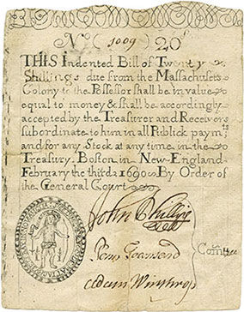
Currency Act (1765)
The colonists had been printing their own money beginning during the French and Indian War
Required colonial assemblies to stop issuing paper money and to retire on all paper money already in circulation
© Students of History - http://www.teacherspayteachers.com/Store/Students-Of-History

Slide 9
Colonial Response to Acts
Resented the new imperial regulations
But, they continued to be at odds with one another, as well
Tensions between the established societies of the Atlantic coast and the “backcountry”
Paxton Boys: descended on Philadelphia with demands for tax relief; threatened bloodshed
Regulator Movement: North Carolina; farmers of the Carolina upcountry who were opposed to higher taxes
2,000 regulators took on the governor’s forces in a virtual civil war

Slide 10
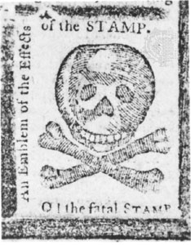
Stamp Act (1765)
Merchants and lawyers required to buy stamps for ships’ papers and legal documents
Tavern owners for licenses
Printers for newspapers
Actual stamp tax was not expensive, but the principle of the matter is what upset colonists
The precedent that it was setting angered the colonists
It was an outright effort to raise money
Patrick Henry (House of Burgesses) called for a repeal of the tax, or the king would face a mutiny

Slide 11
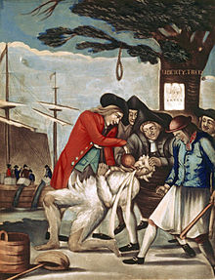
Sons of Liberty
Formed in 1765 in Boston, Mass
A terrorist organization of colonists who:
Attacked stamp agents
Destroyed the lieutenant governor’s home
They would go on to be a powerful, underground colonial terrorist group in Massachusetts

Slide 12
Townshend Acts
Charles Townshend was the new exchequer (British treasury secretary)
Enacted:
Quartering (Mutiny) Act of 1765
Required colonists to provide quarters and supplies for British troops in America
It was the providing of supplies, not the quartering, that angered colonists the most
Townshend Duties
Taxes on imports from GBR (lead, paint, paper, tea)
Townshend called them “external taxes”
Call them what you want, they had the same effect as a direct tax

Slide 13
Response to the Townshend Acts/Duties
In 1767, the Massachusetts Assembly circulates a letter of opposition
Has little effect until the British circulate a letter denouncing those who support the Assembly’s idea to stand up against every tax
Now people were taking notice of the Assembly’s letter!
Assembly votes 92-17 affirming their letter
Boycotts in Boston, New York, and Philadelphia against British goods subject to the Townshend duties
Townshend dies suddenly; his replacement repeals the duties

Slide 14
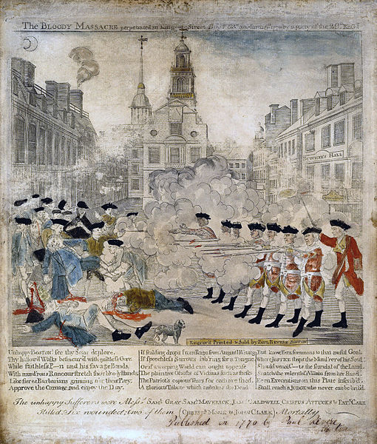
Boston Massacre (1770)
Before the news of the repeal even reached the colonies
The incident quickly transformed by local resistance leaders into the “Boston Massacre”
A graphic symbolism of British oppression and brutality
Soldiers tried and found guilty of manslaughter, but called murders by colonial propaganda

Slide 15
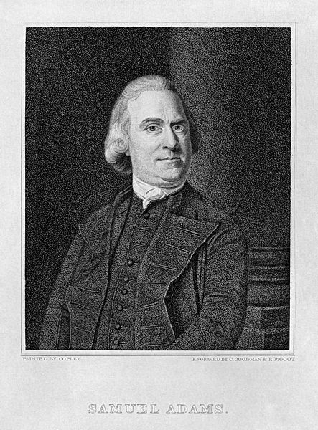
Committees of Correspondence
Proposed by Samuel Adams, the leader of the resistance movement in Boston in 1772
Proposed the creation of such committees in Boston to publicize the grievances against England throughout the colony
Other colonies did the same
It was, in essence, a propaganda campaign

Slide 16
The Psychology of Revolt
Gradually, a revolutionary outlook had gained a following
Where did the ideas for revolution come from?
Religious: Puritans had left England; this provided inspiration to separate from England
Foreign: English Whigs stood up against the Tories in England
Political: Enlightenment ideas; a new concept of what gov’t should be
Such arguments found little sympathy in the English

Slide 17
The Psychology of Revolt
No taxation without representation
Virtual (vs) Actual Representation
Where does ultimate power lay?
Colonists argued:
Parliament can legislate for England and for the empire as a whole, but colonial assemblies could legislate for individual colonies
English argued:
In any system of gov’t, there must be an ultimate authority
Since the empire is a single, undivided unit, there could be only one authority within it~ the King and Parliament

Slide 18
Tea Act (1773)
The early 1770s was pretty quiet, though it disguised growing resentment
Customs commissioners were increasingly intrusive
Pamphlets, leaflets, and books kept revolutionary sentiment alive
As of 1773,the British East India Company was on the verge of bankruptcy
The Tea Act was an attempt to save the company
Gave the company the right to export tea directly to the colonies without paying any of the navigation taxes that were imposed on colonial merchants
With this, the British company would be underselling the American companies in effect

Slide 19
Tea Act (1773)
The British had assumed the colonists would like the act, as it would lower the cost of tea
But resistance leaders argued that it was another example of the results of an unconstitutional tax
→ boycott of tea by many
The boycott was quite effective as a mobilizing revolutionary force
It linked colonies together through a common experience
Colonial women (as the principal consumers) were now leaders in the effort of the boycott

Slide 20
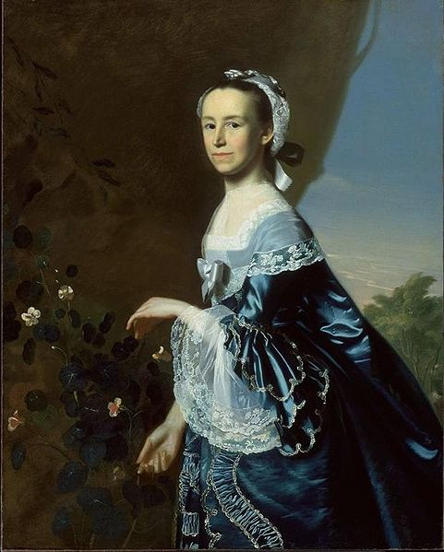
Daughter s of Liberty
Led by Mercy Otis Warren
Participated in anti-British riots
Helped spread pamphlets and literature against the British

Slide 21
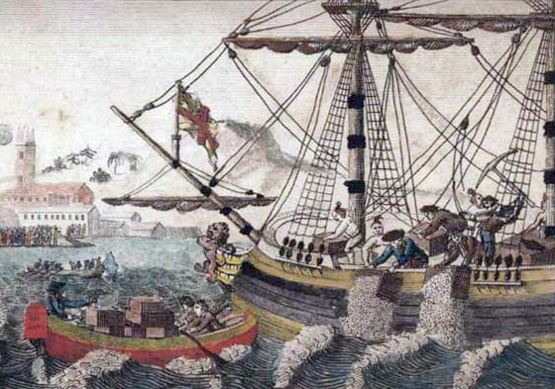
Boston Tea Party
Leaders in various cities had blocked entry of East India Company ships
December 16, 1773 - 3 groups of 50 men dressed as Mohawk Indians broke open tea chests and heaved them into the harbor
British demanded repayment for the property but Bostonians refused

Slide 22
Intolerable (Coercive) Acts
In response to the Boston Tea Party
The acts:
Closed the port of Boston
Reduced their self-government autonomy
Those accused of crimes now had to be tried in England
Must quarter troops
These acts made the inhabitants of Massachusetts a martyr to the other colonies
Sparked new resistance throughout the colonies

Slide 23
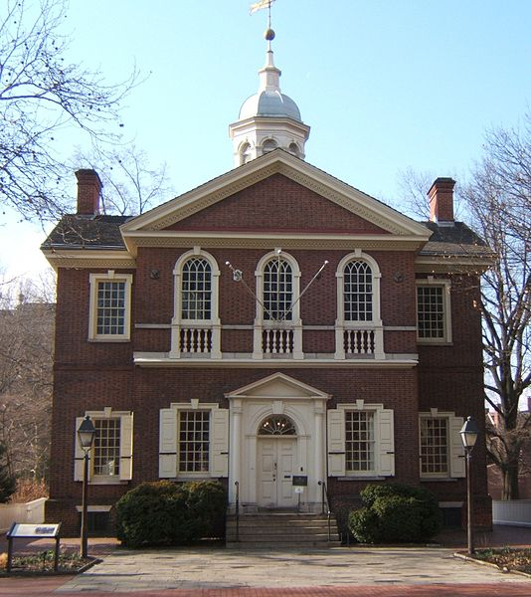
First Continental Congress
The royal governor had dissolved the Virginia Assembly
Representatives met privately and issued a call for a Continental Congress that would convene reps from all colonies to discuss the situation with England in September 1774

Slide 24
First Continental Congress
Representatives from all colonies (except Georgia) convened in Philadelphia
Made 4 major decisions
Rejected a plan for a colonial union under British authority
Endorsed a statement of grievances reflecting the conflicts among the delegates
Resolutions recommending that the colonists make military preparations for defense against an attack by the British
Agreed to non-importation, non-exportation, and non-consumptions as a means of stopping all trade with England

Slide 25
First Continental Congress
Through their reps, the colonies had reaffirmed their autonomous status within the empire and declared something close to economic war
© Students of History - http://www.teacherspayteachers.com/Store/Students-Of-History

