Slide 1
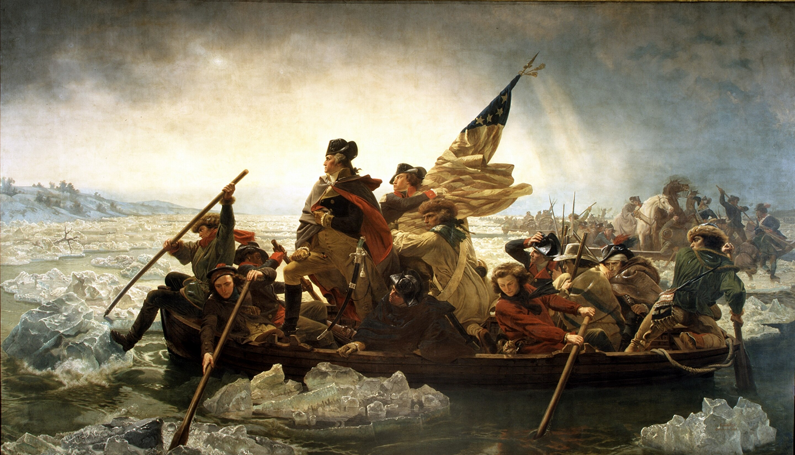
The American Revolution

Slide 3
Names and Terms You Should Know
French and Indian War
Benjamin Franklin
Albany Plan of Union
Treaty of Paris (1763)
King George III
Proclamation Line of 1763
Stamp Act
Taxation
Petition
Boycott
Stamp Act Congress
Samuel Adams
Sons of Liberty
Daughters of Liberty
John Adams
Tea Act
Boston Tea Party
Intolerable Acts
Enlightenment
Revolution
Militia
Patriots
Loyalists
Second Continental Congress
George Washington
Thomas Paine
Common Sense
Thomas Jefferson
Declaration of Independence
Unalienable rights
Grievances
Despotism
Battle of Trenton
Battle of Saratoga
Battle of Yorktown
Treaty of Paris (1783)
Chapter 2: The American Revolution

Slide 4
Standards Covered in this Chapter
SSUSH3 What were the causes of the American Revolution?
a. How did the French and Indian War and the 1763 Treaty of Paris lay the groundwork for the American Revolution?
b. What were the colonial responses to the Proclamation of 1763, the Stamp Act, and the Intolerable Acts, as seen in actions of the Sons and Daughters of Liberty and the Committees of Correspondence?
c. What was the importance of Thomas Paine’s Common Sense to the movement for independence?

Slide 5
Standards Covered in this Chapter
SSUSH4 What were the ideological, military, social, and diplomatic aspects of the American Revolution?
a. What were the intellectual sources for the Declaration of Independence, how was the Declaration organized, and what was its argument? What was the role of Thomas Jefferson and the Committee of Five in writing the Declaration?
b. What were the reasons for and what was the significance of the French alliance and other foreign assistance? How successful was the diplomacy of Benjamin Franklin and John Adams?
c. How successful was George Washington as a military leader? What was the influence of Baron von Steuben and the Marquis de La Fayette, and what was the significance of Valley Forge in the creation of a professional military?
d. What role did geography play in the Battles of Trenton, Saratoga, and Yorktown?
e. What were the roles of women, American Indians, and enslaved and free African Americans in supporting the war effort?
f. What was the significance of the Treaty of Paris in 1783?

Slide 6
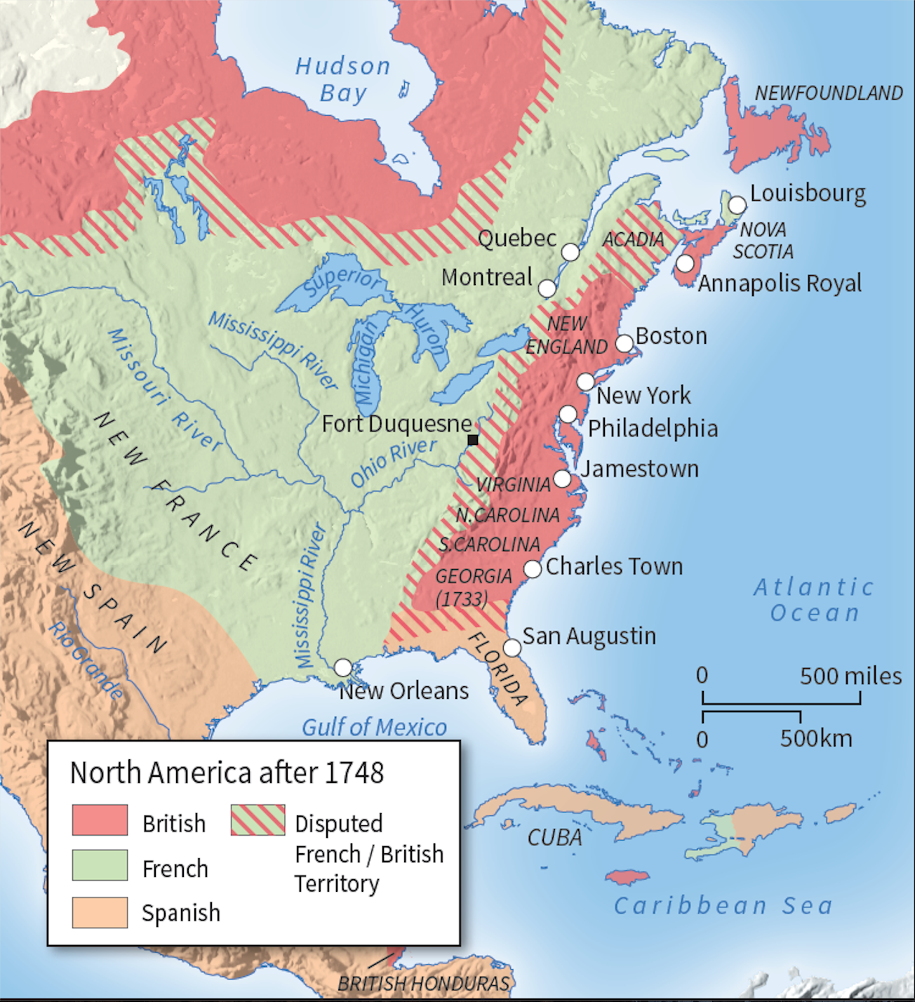
The French and Indian War | Two Empires Clash in the Ohio River Valley
The French had scattered settlements along the St. Lawrence River, Great Lakes, and Mississippi River.
Their claims reached from Canada southward through the center of the North American continent.

Slide 7
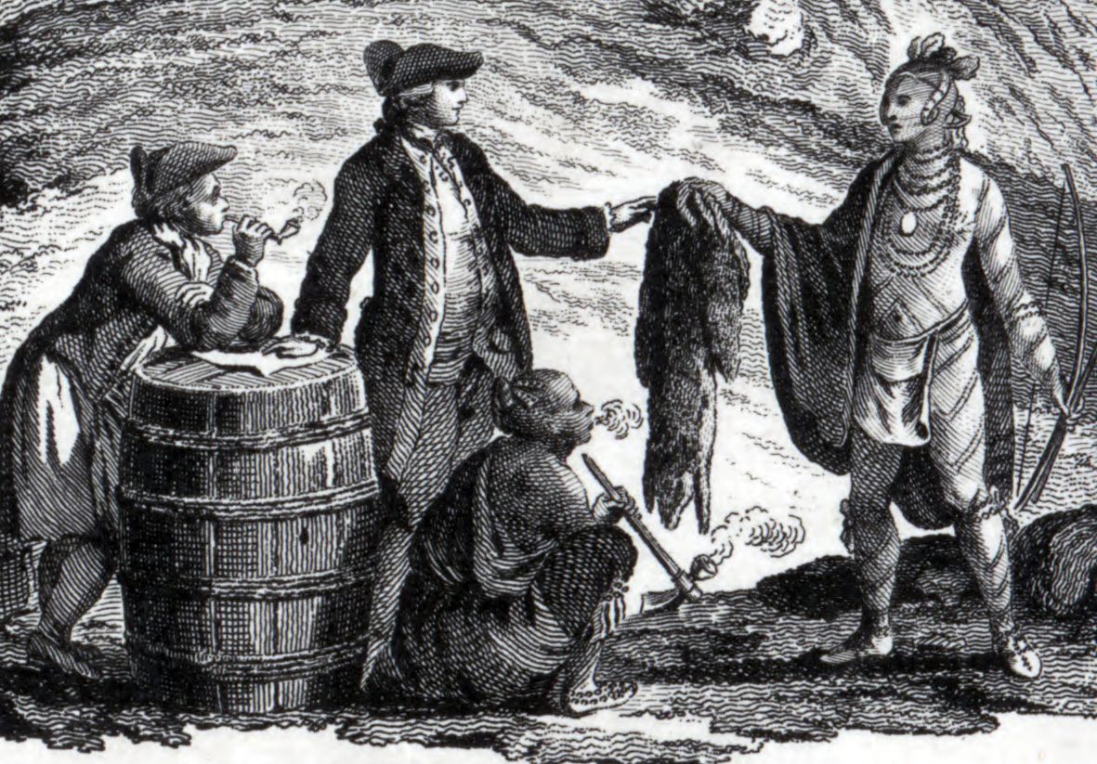
The French mainly used their territory for the profitable fur trade

Slide 8
The French and Indian War | Two Empires Clash in the Ohio River Valley
The British, on the other hand, had settlements along the Atlantic coast from Georgia to New Hampshire.

Slide 9
The French and Indian War | Two Empires Clash in the Ohio River Valley
FRENCH
As the French moved southward, they built forts and increased their trade with Indian tribes.
Meanwhile, British settlers were pressing westward.
As the territories of these European nations spread across the North American continent, they were bound to clash.
The British finally found themselves face to face with French colonists in the Ohio River Valley.
BRITISH

Slide 10
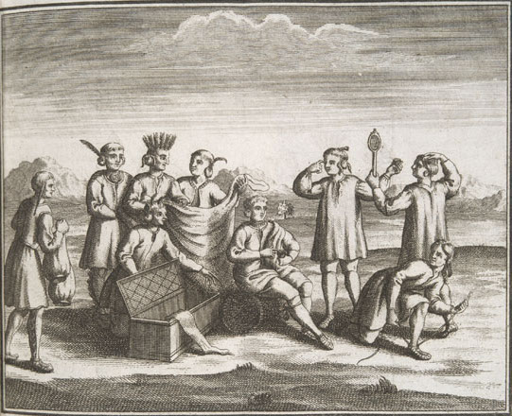
In 1749, the French sent a body of soldiers to warn local Indian tribes not to trade with the British.

Slide 11
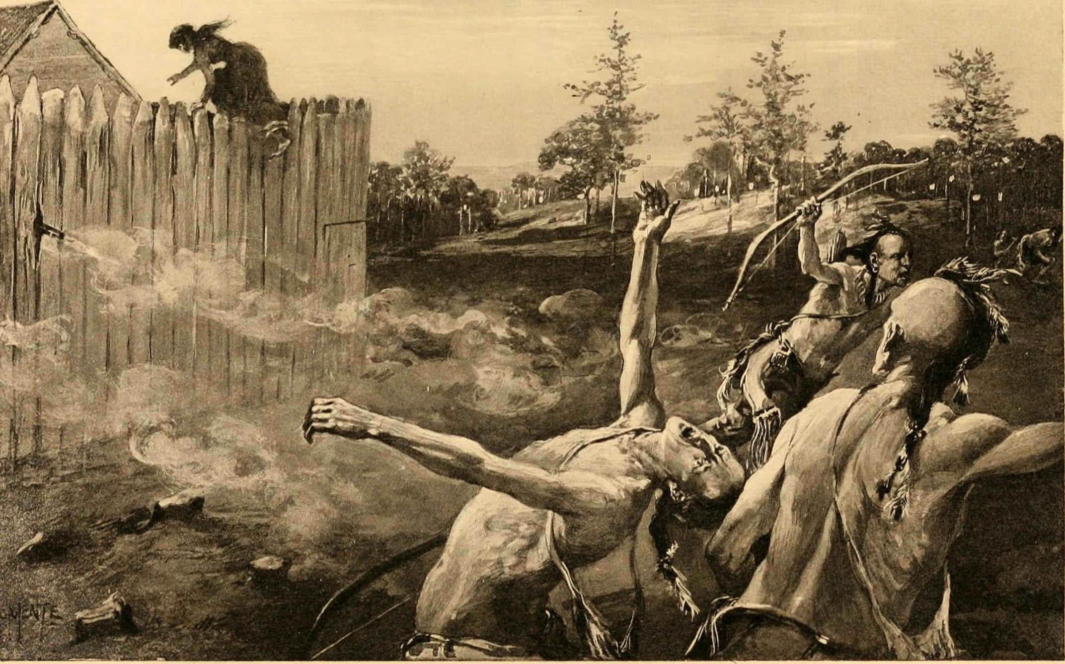
Two years later, the French sent another military force into the valley to build forts and to punish Indian tribes trading with the British.

Slide 12
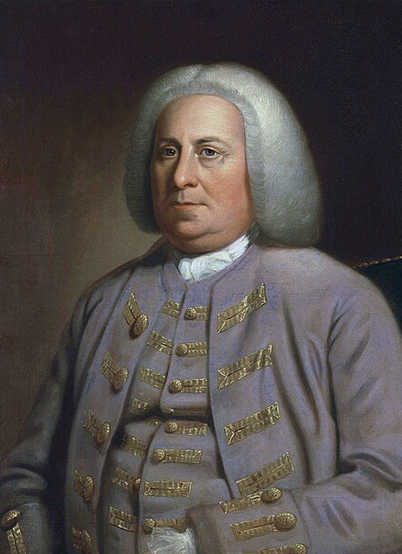
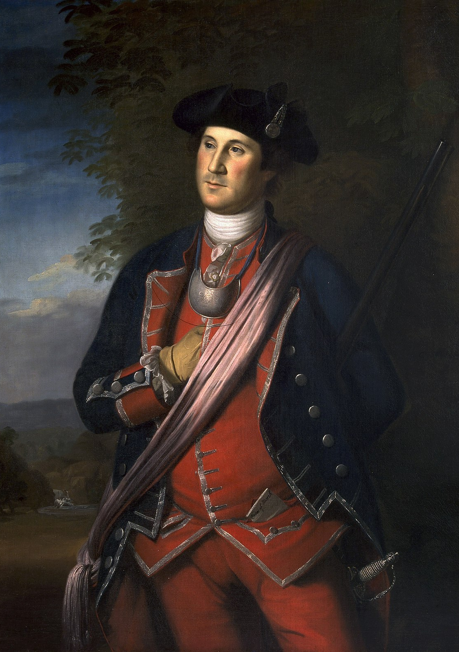
The French and Indian War
At the same time, the Governor of Virginia, who had invested in the Ohio Company, sent a young officer named George Washington to warn the French to withdraw.
Governor of Virginia Robert Dinwiddie
George Washington

Slide 13
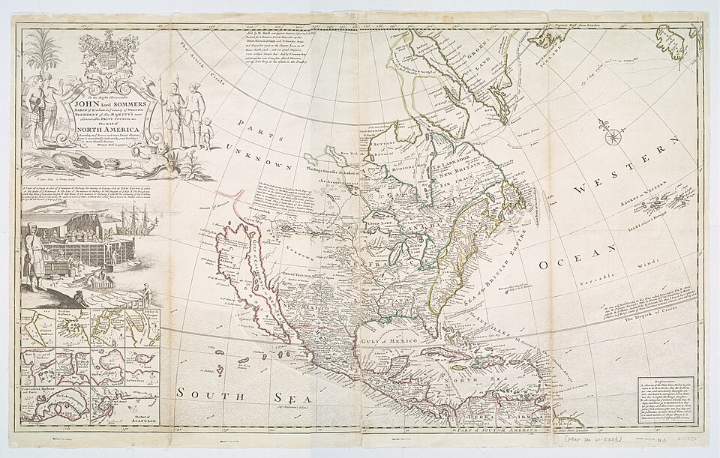
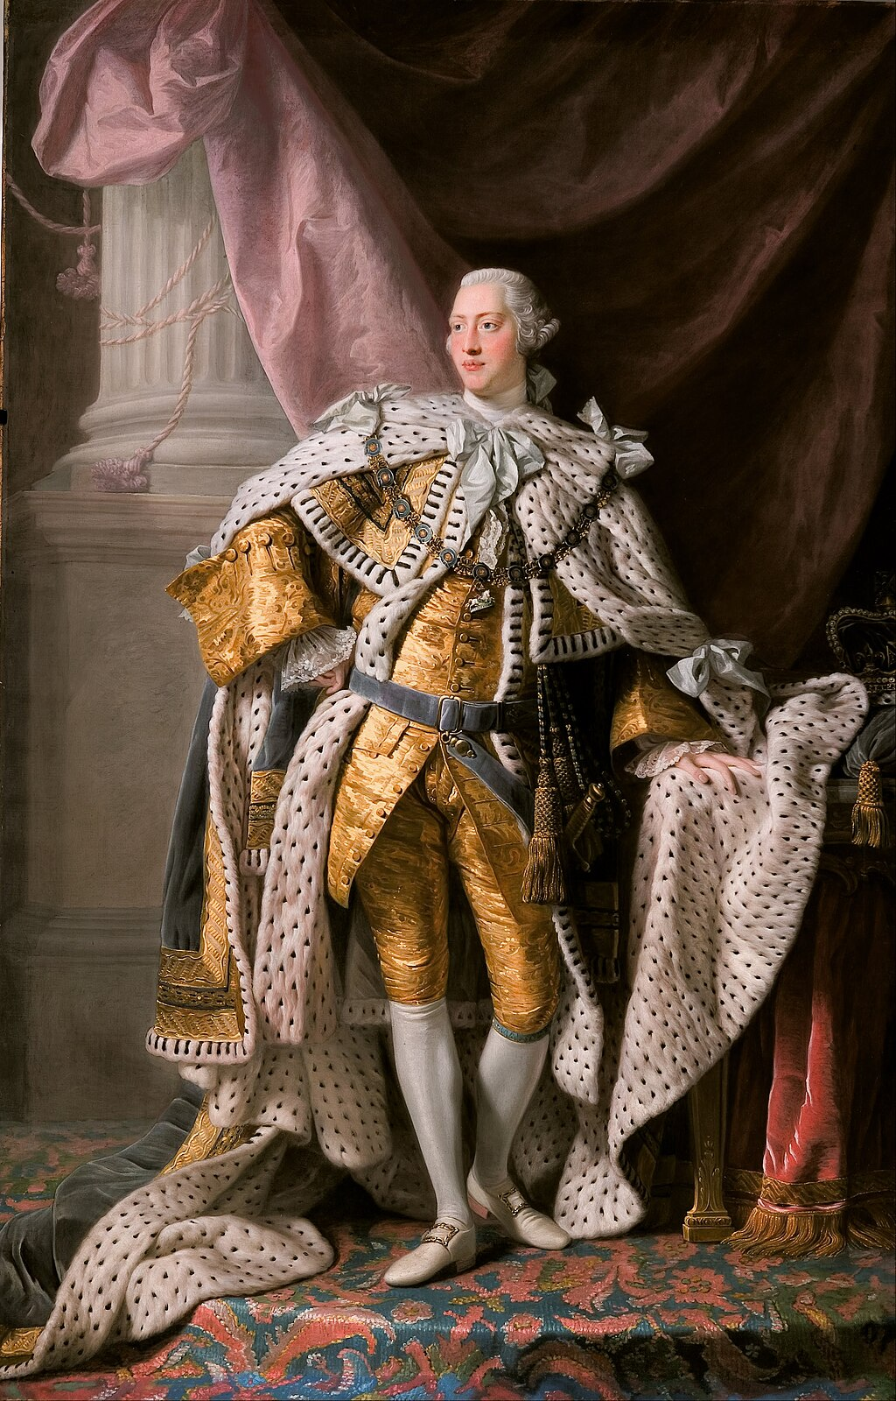
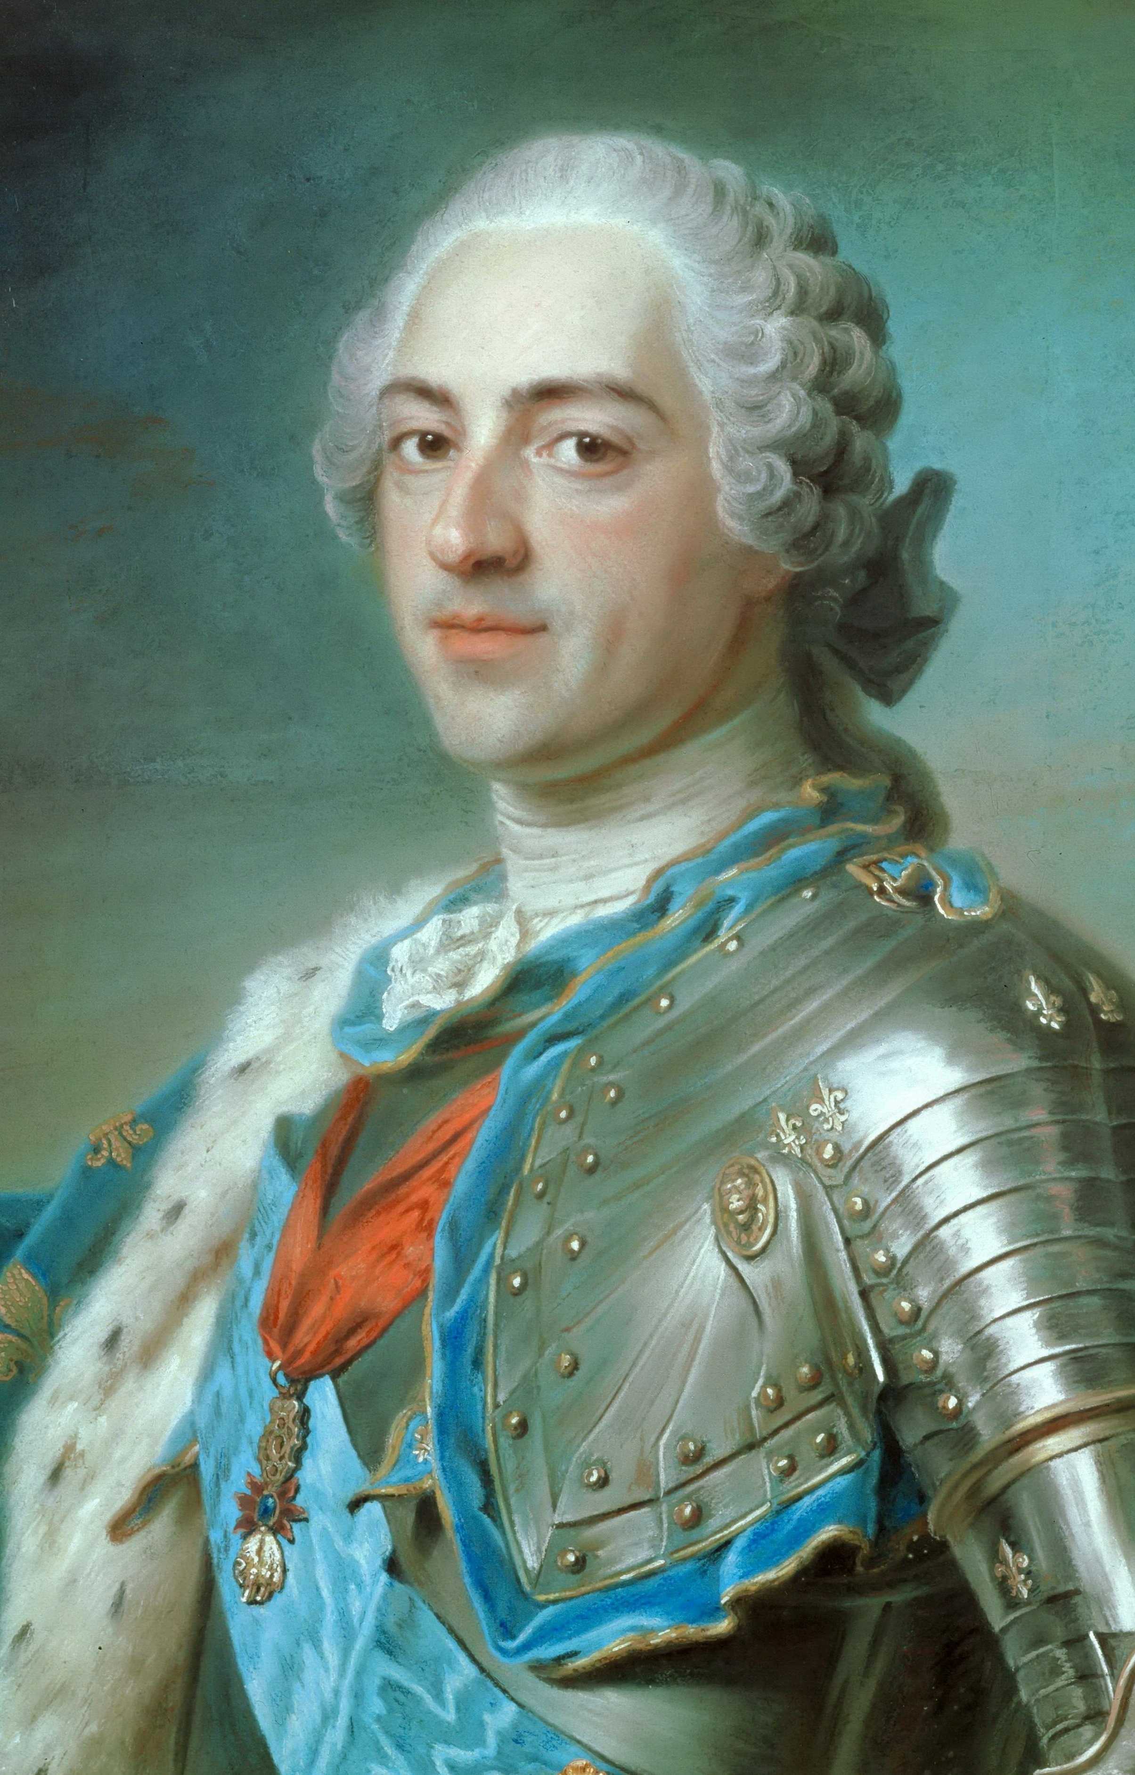
An exchange of gunfire took place between Washington’s force and French troops in May 1754.
This was actually the start of the French and Indian War (1754–1763). In this conflict, Britain and France fought for control of North America.
King George III, King of Great Britain and Ireland
Louis XV, King of France

Slide 14
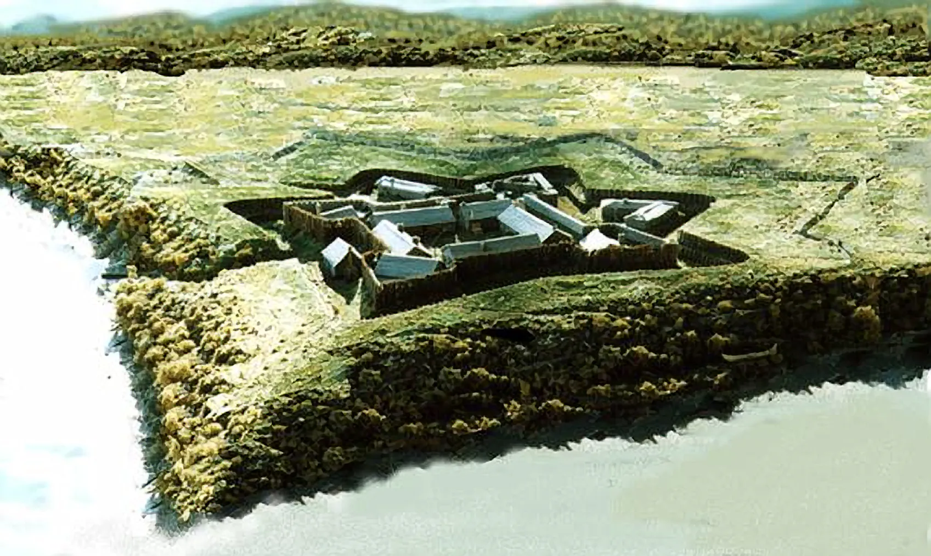
The French and Indian War The Conflict Spreads
Courtesy of Sébastien Paquin (Musée de Guerre d'Ottawa)
Fort Duquesne, a fort in the Ohio River Valley, came under the control of both the French and British during the war.

Slide 15
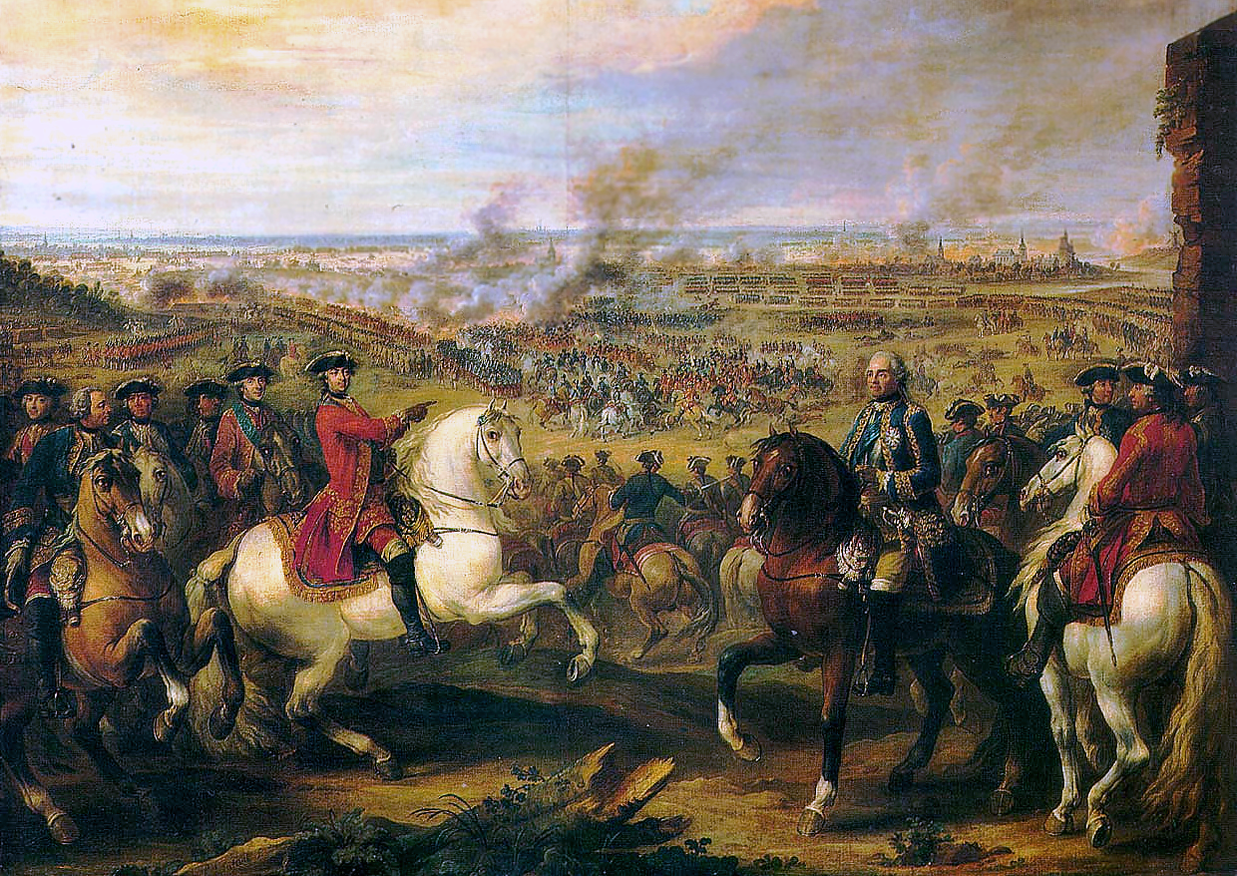
Outbreak of War in Europe
By the spring of 1756, the war had spread to Europe.
Europe’s three largest countries—Russia, Austria, and France—joined together to attack Prussia, a small but rising state in Germany.

Slide 16
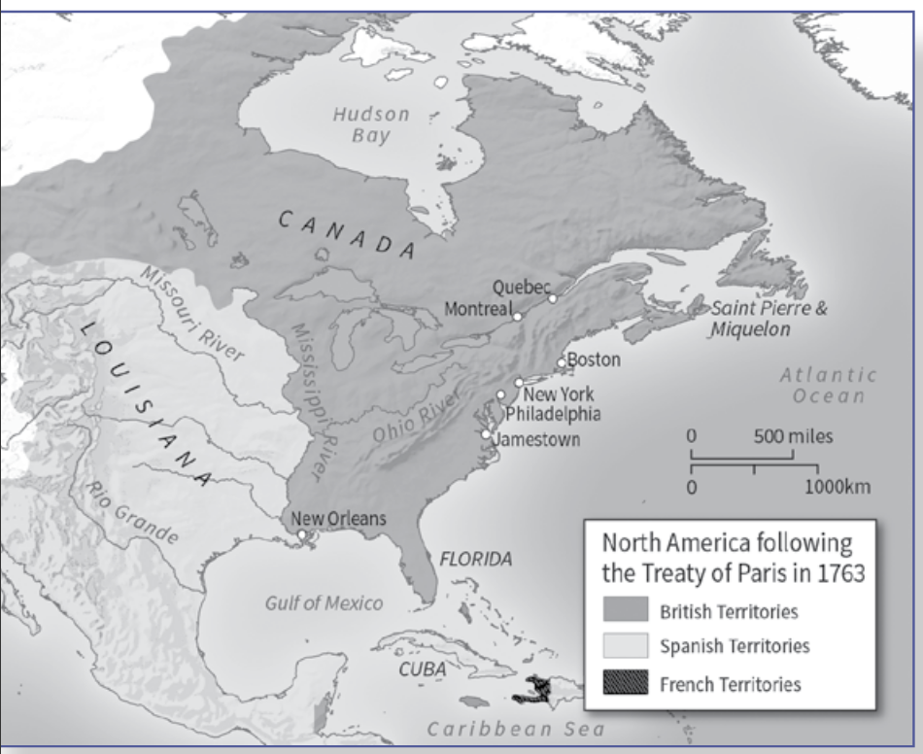

The Treaty of Paris (1763)
France lost the war and was forced to surrender its empire on the mainland of North America.
France surrenders Canada to Britain

Slide 17
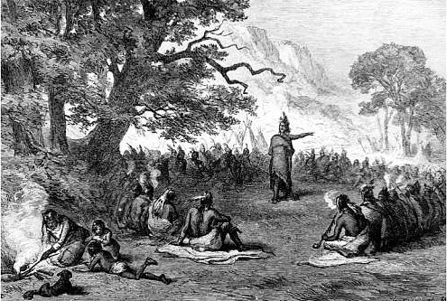
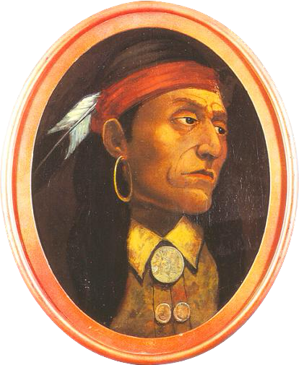
British Polices after the War Lead to Colonial Discontent | The Proclamation Line of 1763
Native American tribes were anxious about the defeat of the French.
Just as the war was ending, Chief Pontiac of the Ottawa tribe sent messages to other tribes asking them to unite against the British colonists.
Chief Pontiac of the Ottawa

Slide 18
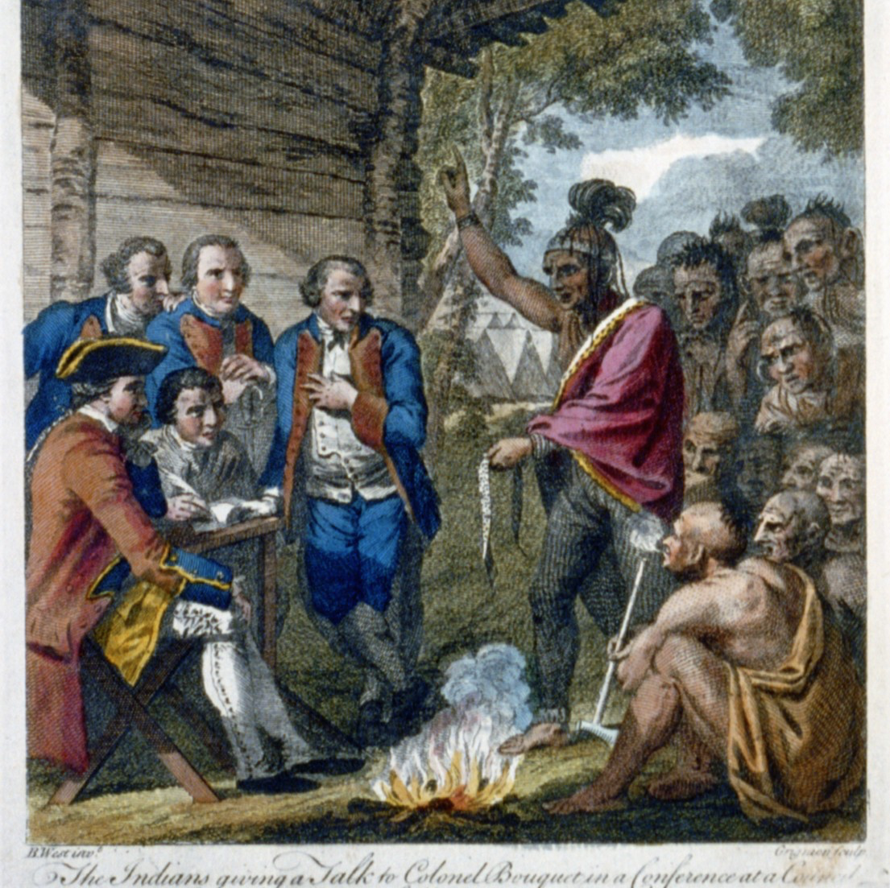
British Polices after the War Lead to Colonial Discontent | The Proclamation Line of 1763
This was the first time that so many different tribes had acted together, and they were able to capture eight forts along the frontier before they were defeated.

Slide 19
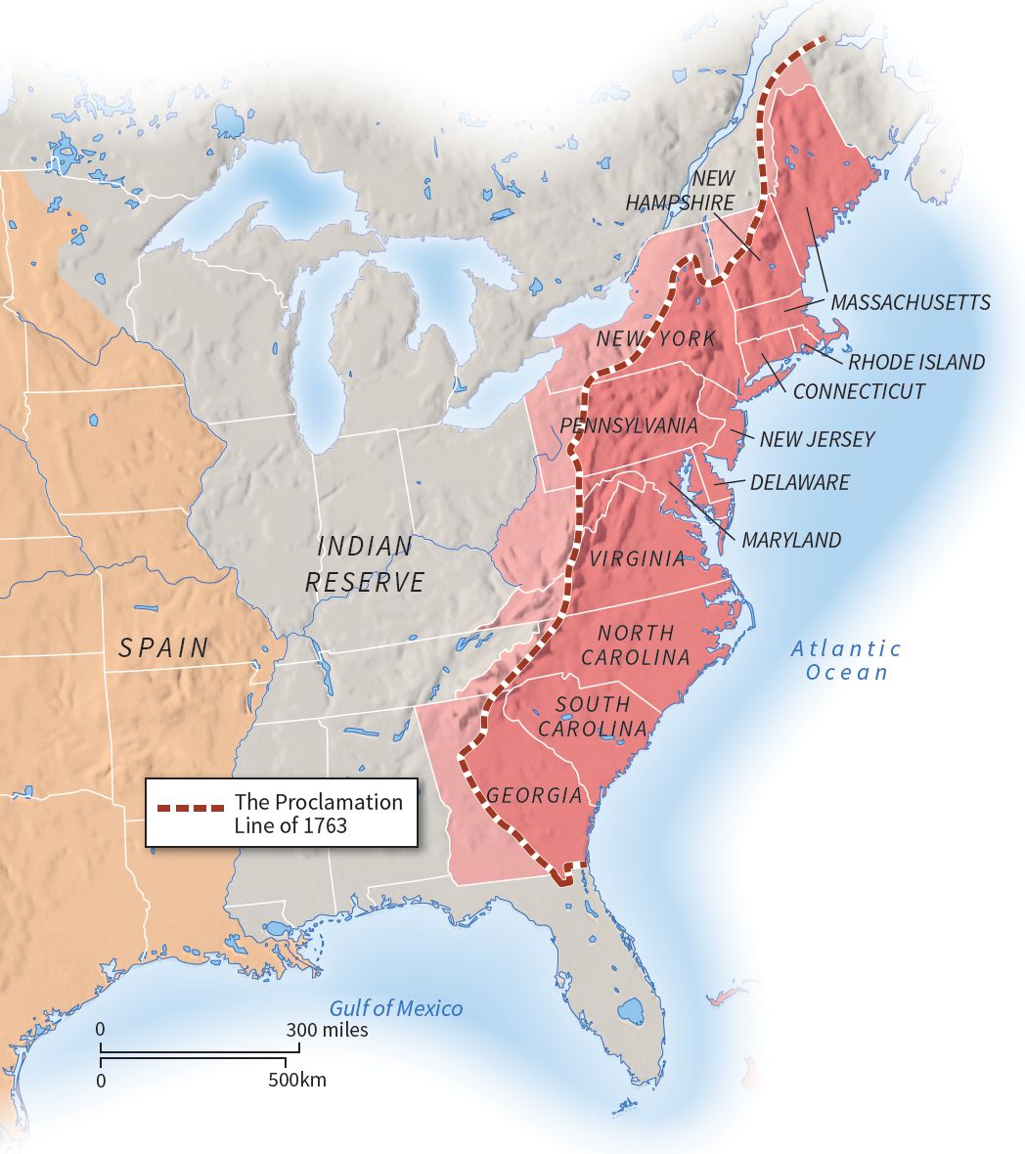
British Polices after the War Lead to Colonial Discontent | The Proclamation Line of 1763
To avoid future conflicts with native peoples, King George III issued the Proclamation of 1763.
This royal decree prohibited colonial settlement west of the Appalachian Mountains.
This annoyed colonists who thought that winning the French and Indian War would bring new opportunities for westward expansion.

Slide 20
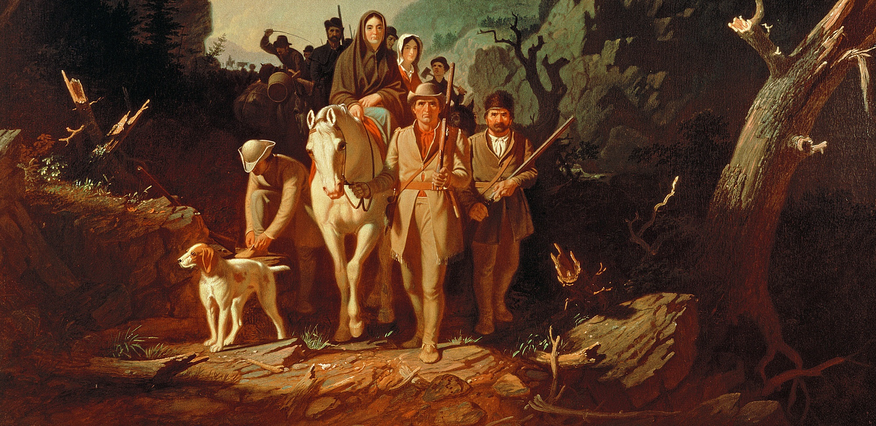
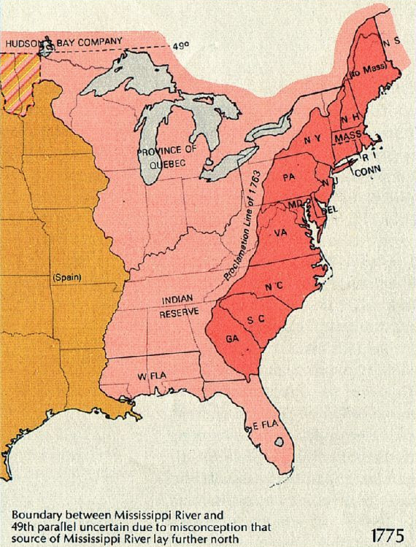
British Polices after the War Lead to Colonial Discontent
The Proclamation of 1763 created a line of settlement to protect the Indians. It was shocking, however, to those colonists who were looking forward to taking new lands in the Ohio River Valley.

Slide 21
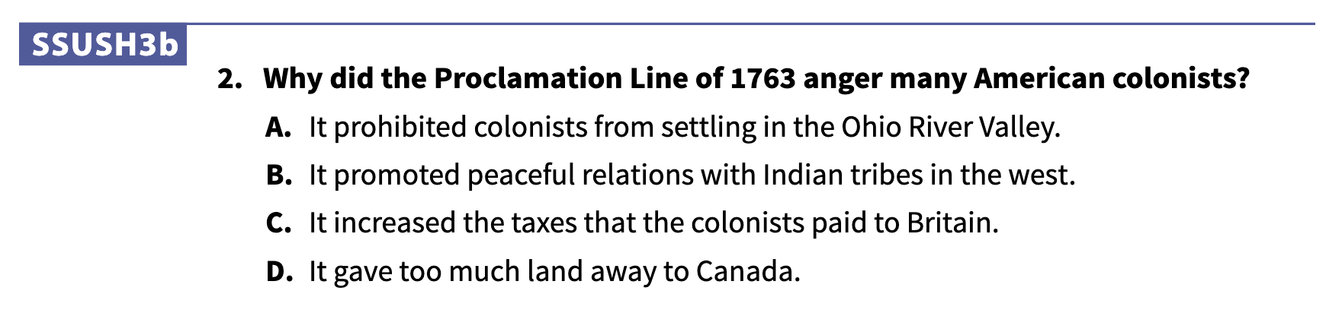

Slide 22
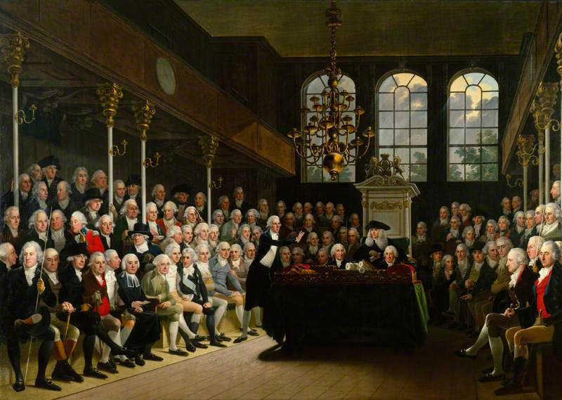
New Revenue Policies: Taxation and Protest
To make matters worse, Parliament decided to raise taxes on the colonists.
This was because, after fighting the war with France, the British government found itself deeply in debt.

Slide 23
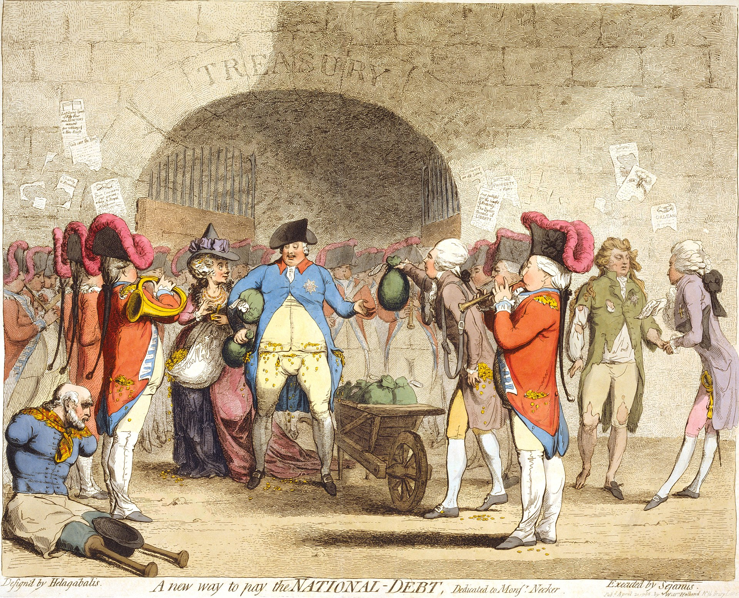
New Revenue Policies: Taxation and Protest
Since the colonies were so far from London, no attempt was made to obtain their prior consent (agreement) to these new taxes.

Slide 24
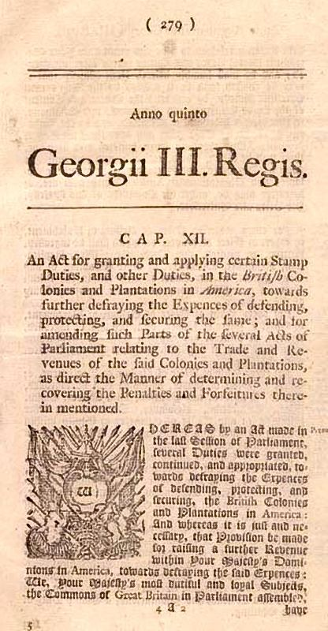
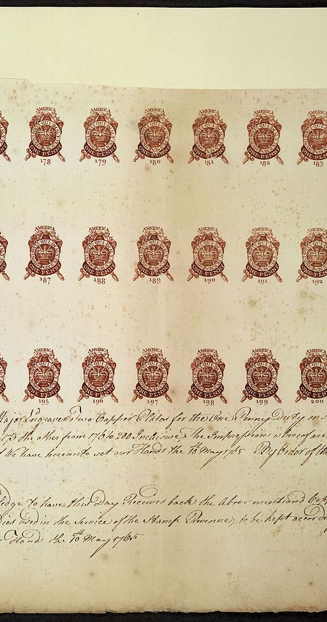
The Stamp Act
The first of these new taxes was the Stamp Act.
This law required every official document, newspaper or pamphlet in the colonies to have an expensive government stamp.

Slide 25
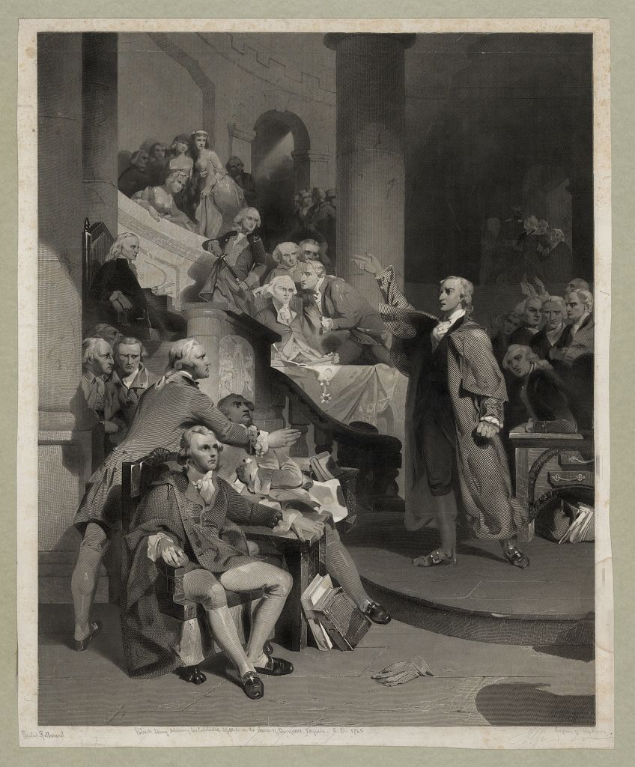
The Stamp Act
Colonial assemblies sent petitions to Parliament, arguing that the Stamp Act had been imposed without colonial consent.
Colonists boycotted British goods.

Slide 26
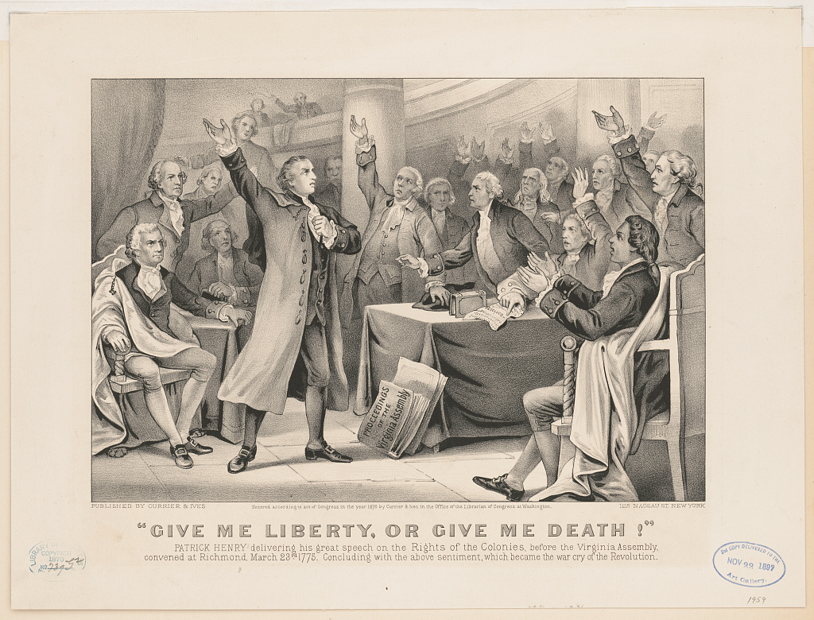
In the Virginia House of Burgesses, Patrick Henry, a young lawyer, introduced a series of resolutions against the Stamp Act.

Slide 27
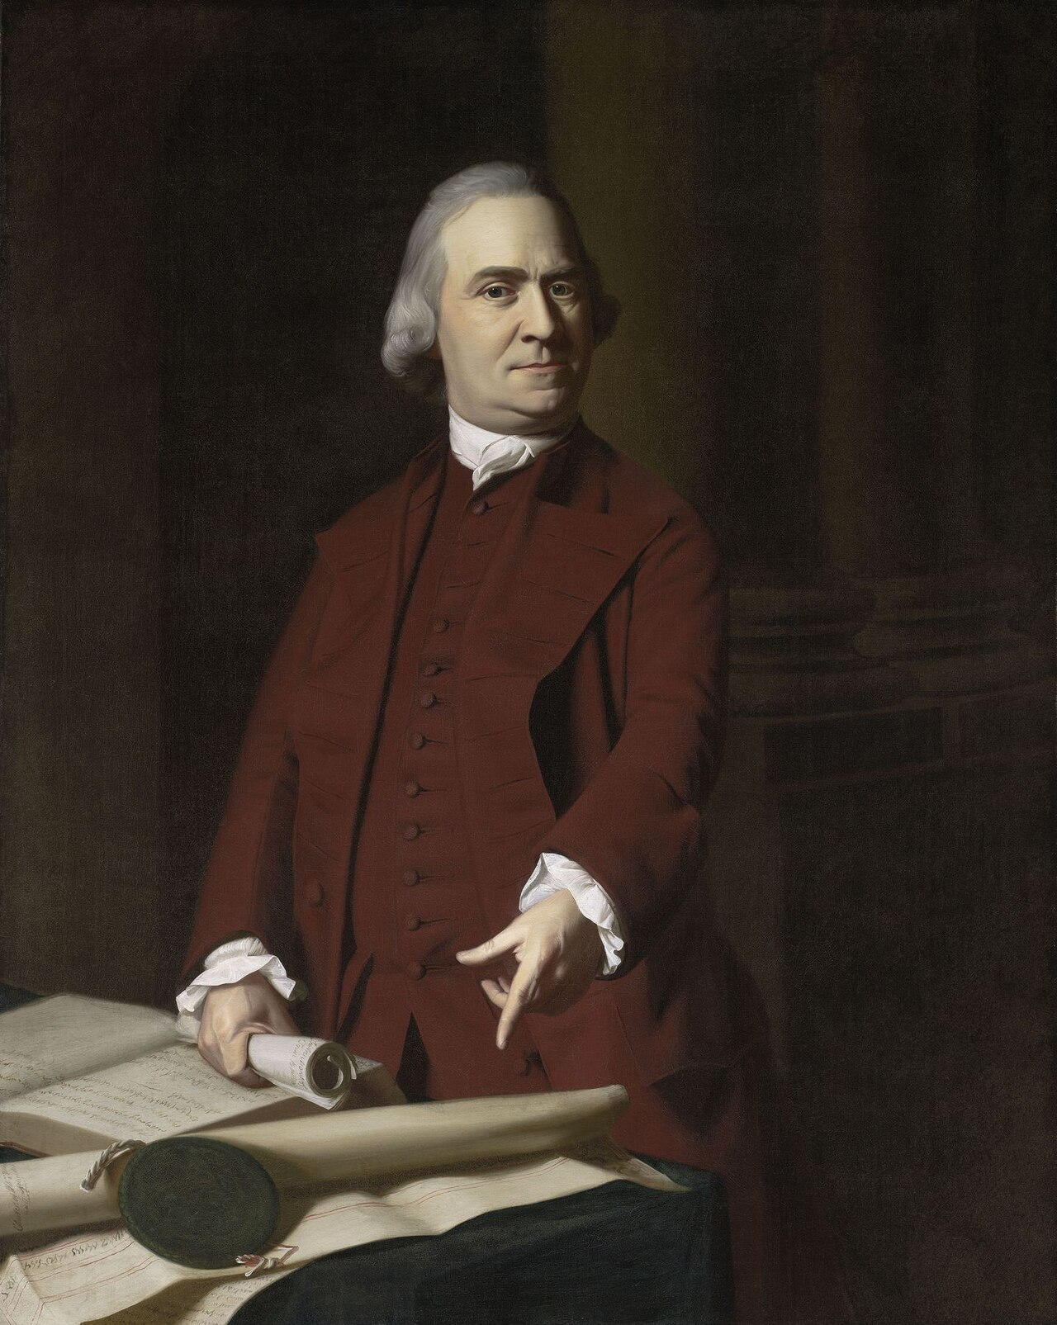
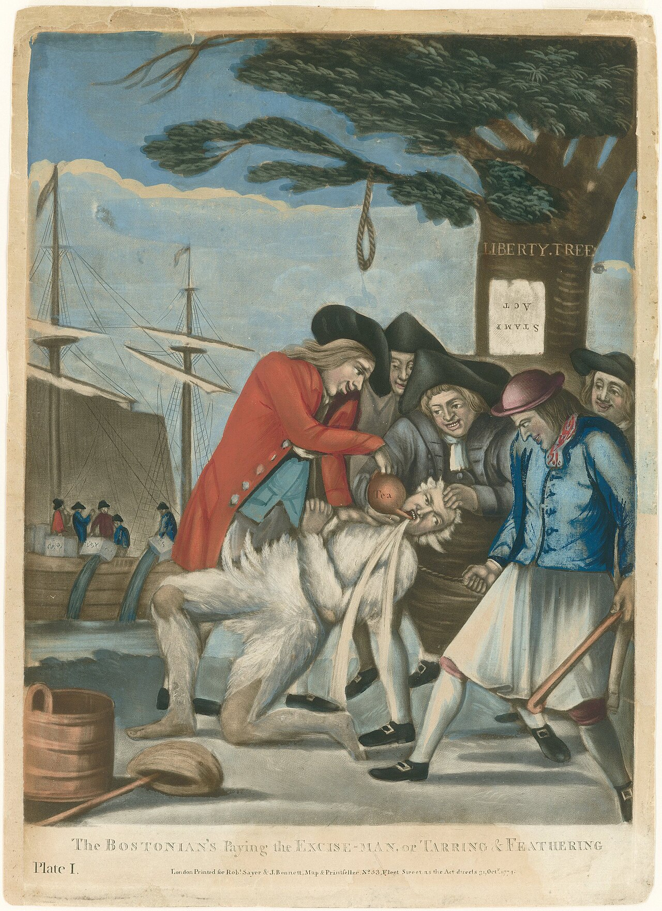
The Stamp Act
Samuel Adams formed the “Sons of Liberty” to protest British policies.
Some members of this group even set some buildings on fire and tarred and feathered tax collectors.

Slide 28
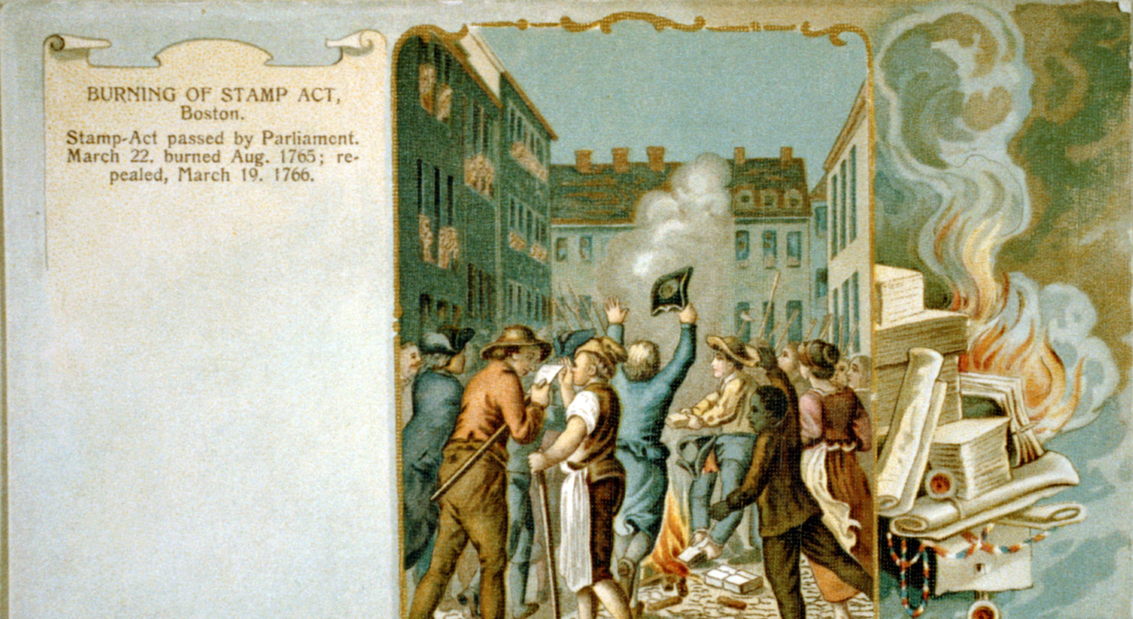

Slide 29
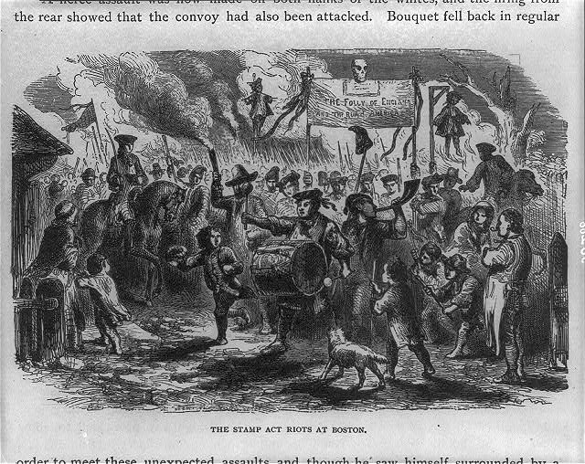
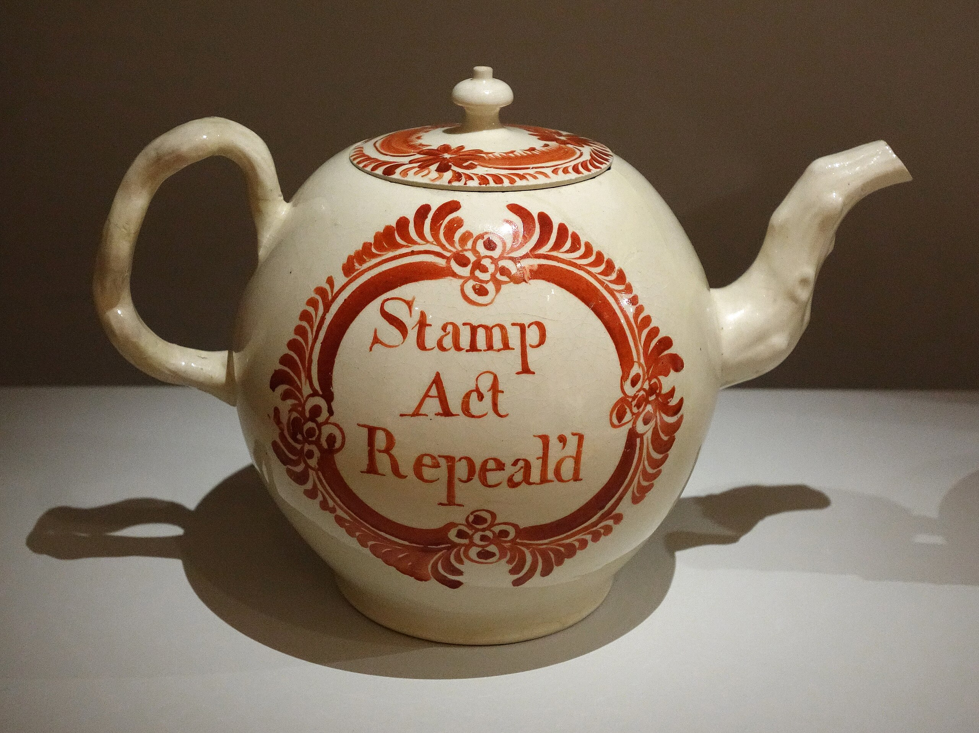
Repeal of the Stamp Act
The Stamp Act ended up hurting British businesses.
Parliament repealed the law.

Slide 30
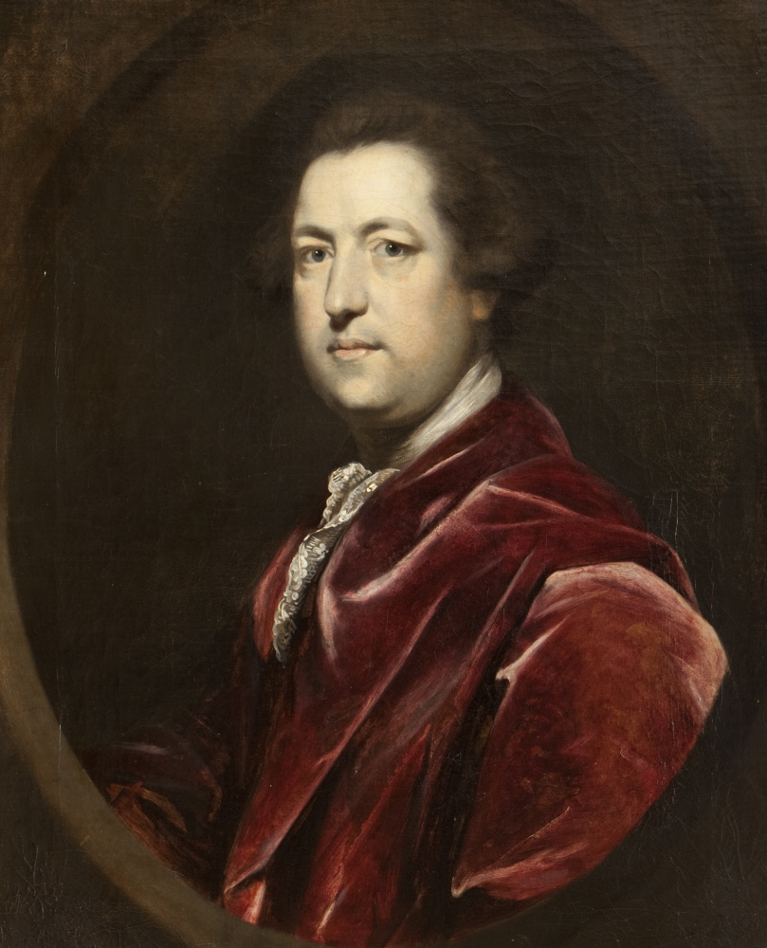
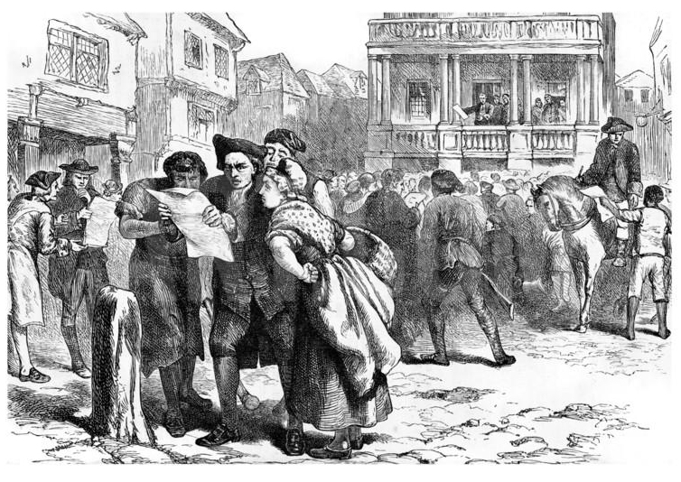
The Townshend Duties
Parliament then passed other laws, such as the Townshend Duties and the Tea Act.
The colonists organized resistance to these taxes as well, and violence between colonists and British officials escalated.
Charles Townshend

Slide 31
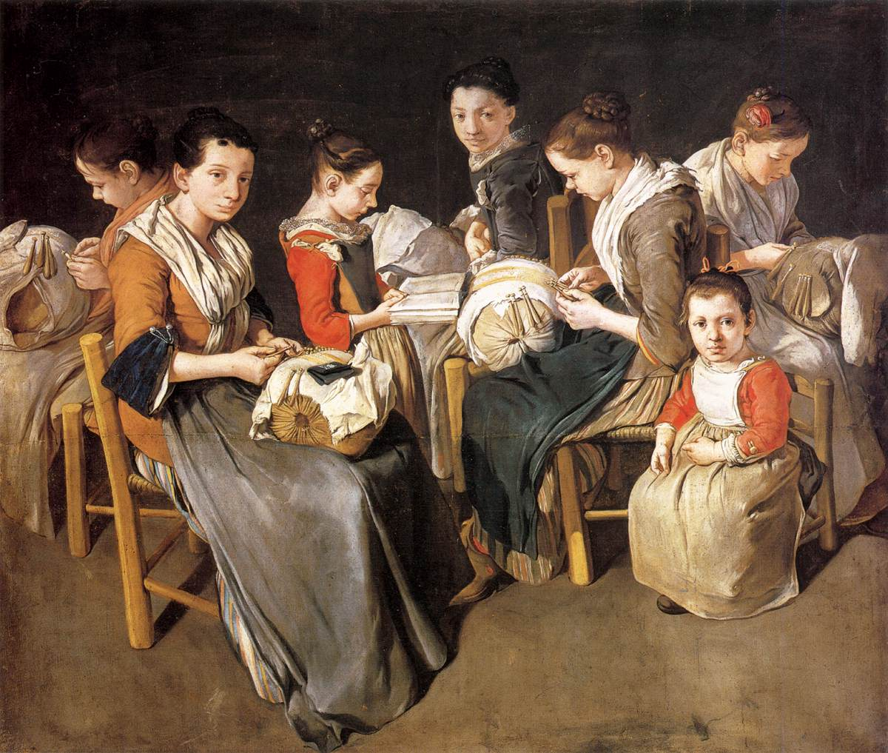
The Townshend Duties
The Daughters of Liberty had been established in 1765, just after the Sons of Liberty.
After the passage of the Townshend duties, these women helped the colonists boycott British goods by making cloth and other products that could be used in their place.

Slide 32
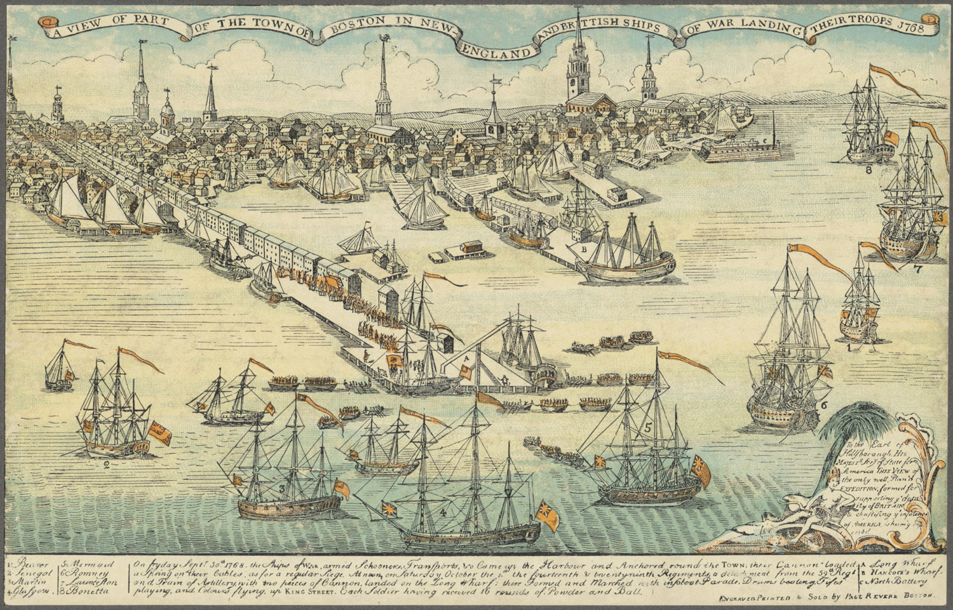
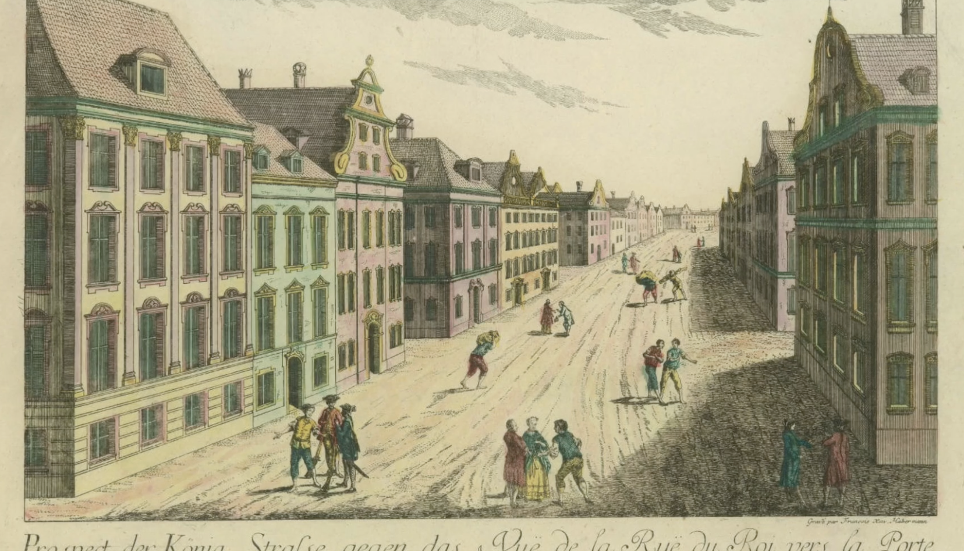
More British Troops Arrive
British troops landing in Boston in 1768
To enforce the Townshend Acts and to prevent further unrest, the British government sent more troops to North America.
Under the Quartering Act, these soldiers could be “quartered” in colonists’ homes.

Slide 33
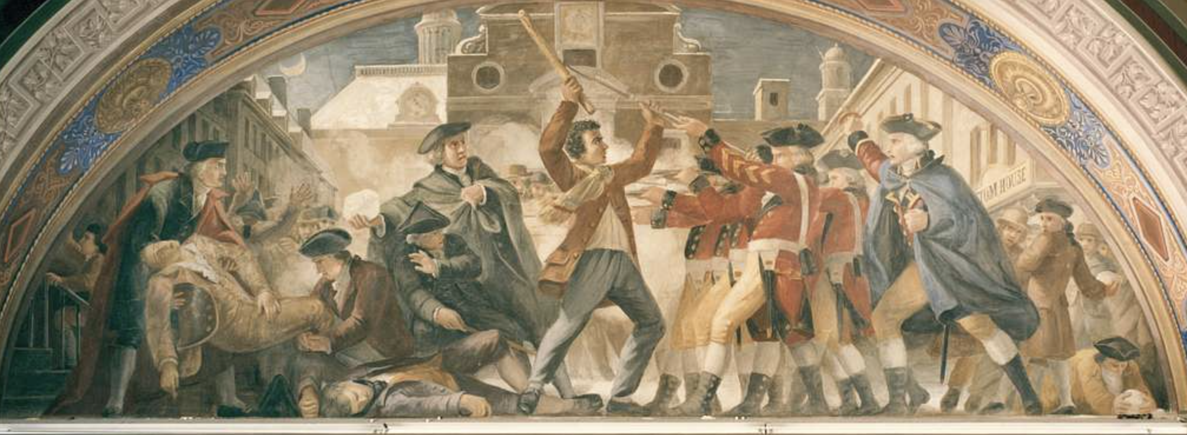
The Boston Massacre
These resentments boiled over in 1770 with the “Boston Massacre.” A crowd of colonists started throwing snowballs and stones at a group of British soldiers.

Slide 34
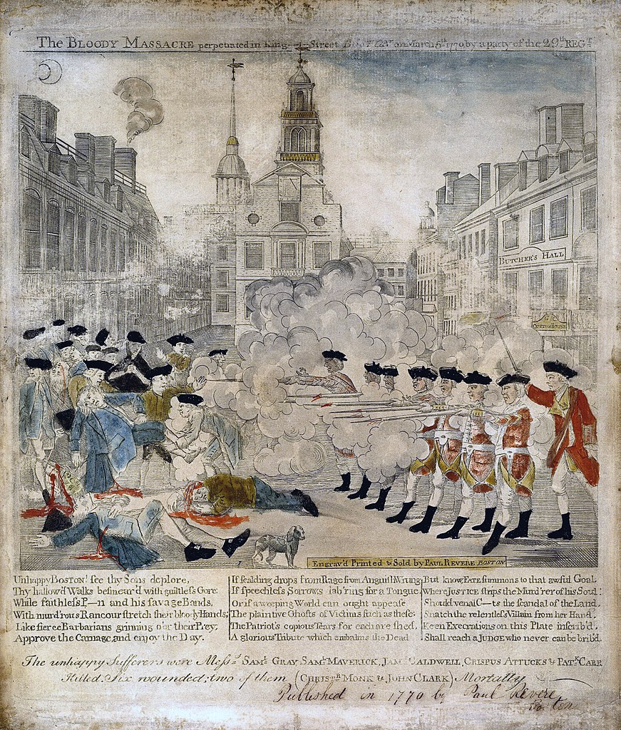
The Boston Massacre
The officer in charge warned his troops not to fire, but with all of the noise, one soldier just heard the word “FIRE!” The soldiers began shooting, and soon three colonists were dead.

Slide 35
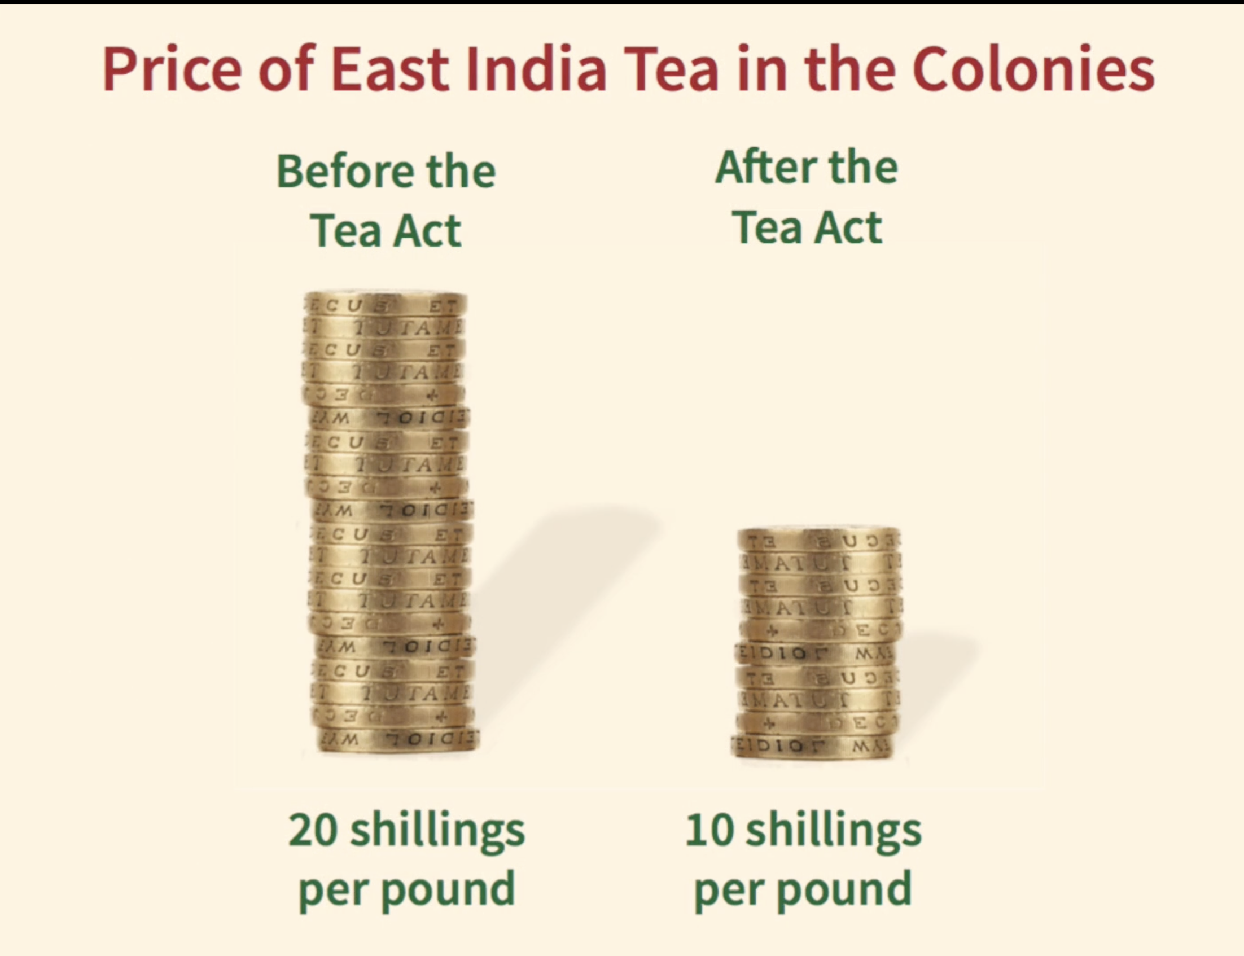
The Tea Act
Parliament finally repealed the unpopular Townshend duties.
In 1773, it passed a new Tea Act.
Although this law actually lowered the cost of tea in the colonies, it was still a tax imposed without colonial consent.

Slide 36
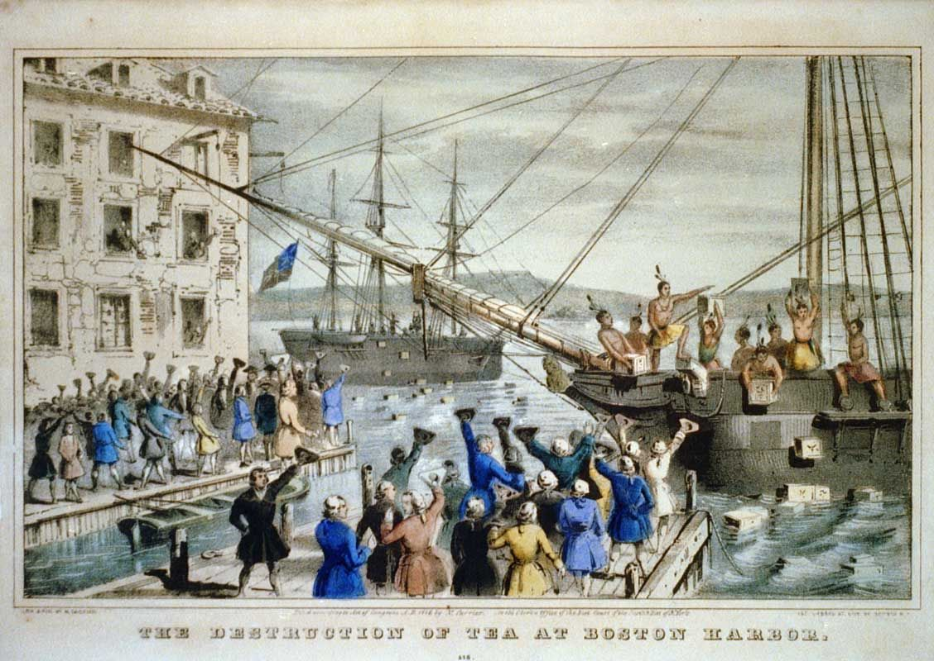
The Boston Tea Party
Colonists again protested. In an act of defiance, a group of colonists disguised as American Indians threw more than 300 chests of British tea into Boston Harbor during the “Boston Tea Party.”

Slide 37
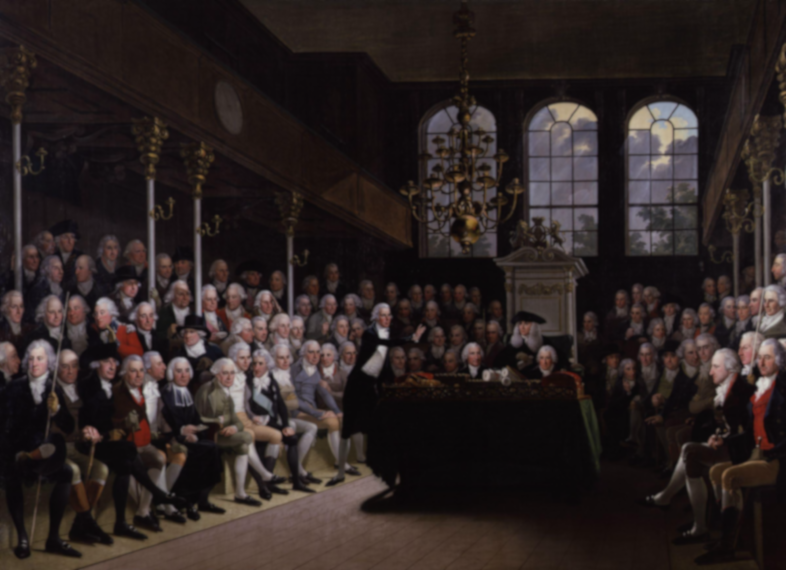
The Intolerable Acts (1774)
Outraged by this destruction of property, Parliament passed the Coercive Acts in 1774. These acts suspended the Massachusetts legislature until the tea was paid for.
Warships blockaded Boston Harbor, and the British government took on the power to appoint all public officials in Massachusetts.
The colonists called these acts the “Intolerable Acts.” Anger had reached its tipping point.
These British policies eventually led to the writing of the Declaration of Independence.

Slide 38
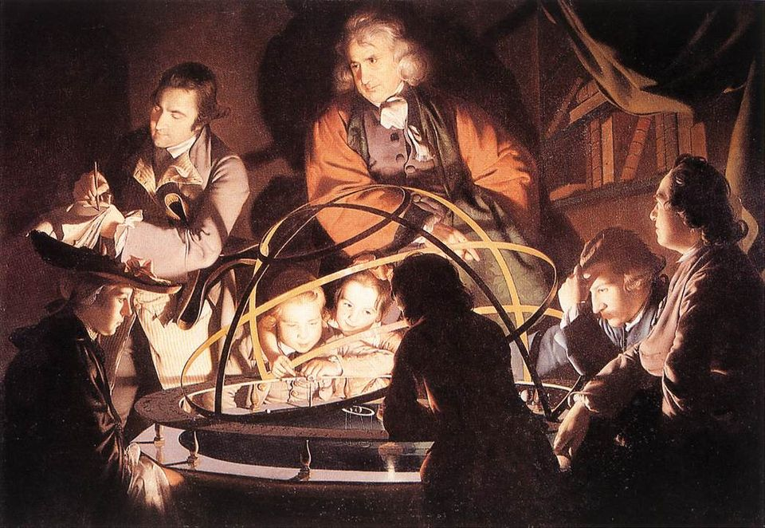
The Enlightenment and Colonial Ideas on Government
The Enlightenment influenced the colonists’ ideology (system of beliefs).
Enlightenment thinkers did not believe that kings and queens received their powers from God.

Slide 39
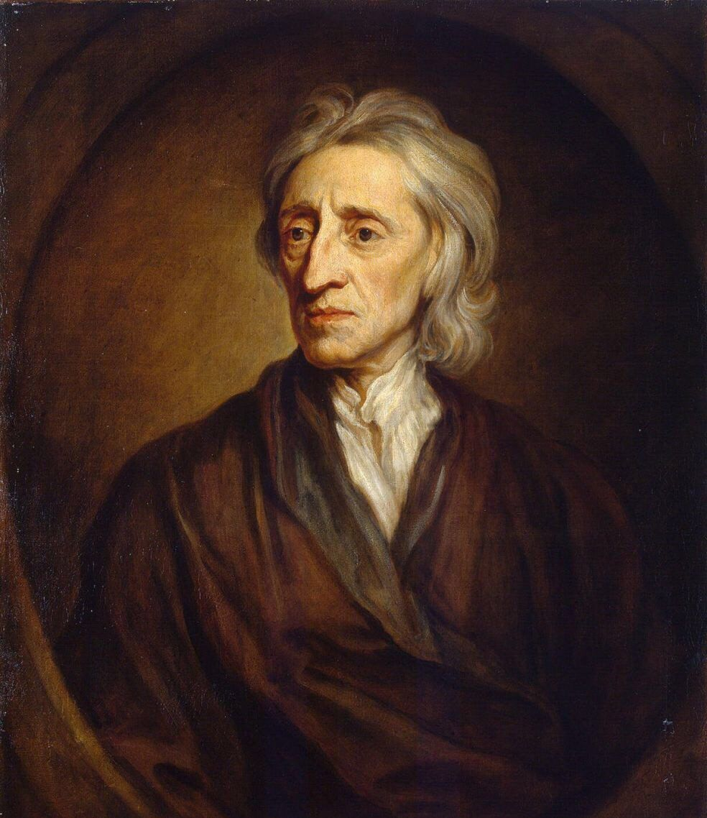
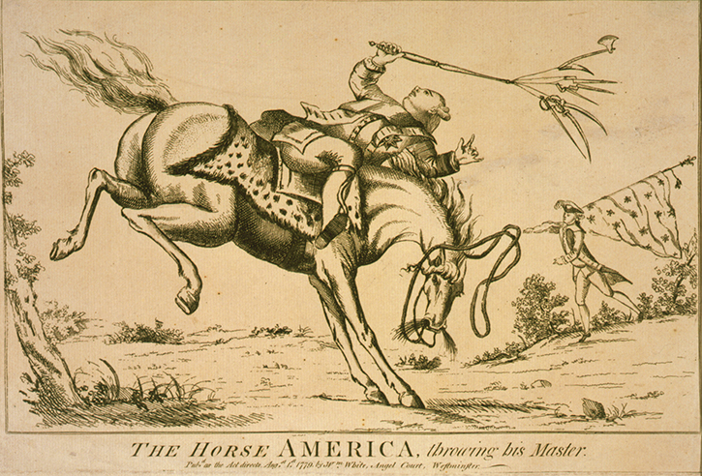
The Enlightenment and Colonial Ideas on Government
Instead, they accepted John Locke’s view that each government was created as part of a “social contract” between a people and their rulers.
If rulers did not respect the rights of their subjects, then the social contract was broken and the people had the right to overthrow their government.

Slide 40
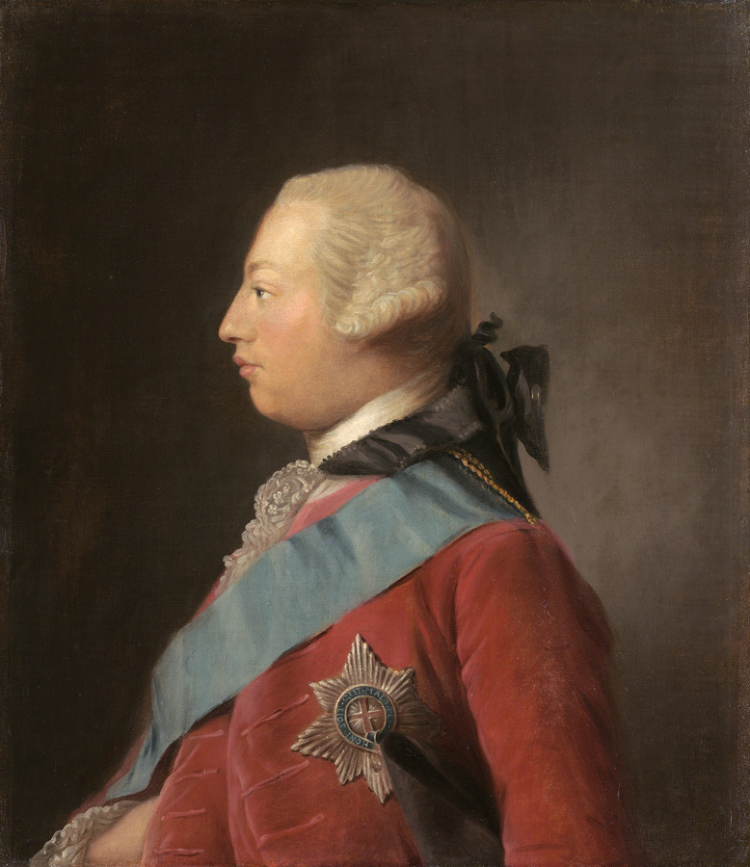
The Fighting Begins | The First Continental Congress
Because of all the troubles with Britain, the colonies decided to send representatives to Philadelphia for a “Continental Congress.” Each colony sent delegates except Georgia.
In September 1774, the First Continental Congress petitioned King George III to repeal the Intolerable Acts and planned a boycott.
King George III ignored the petition and condemned the colonists.
King George III

Slide 41
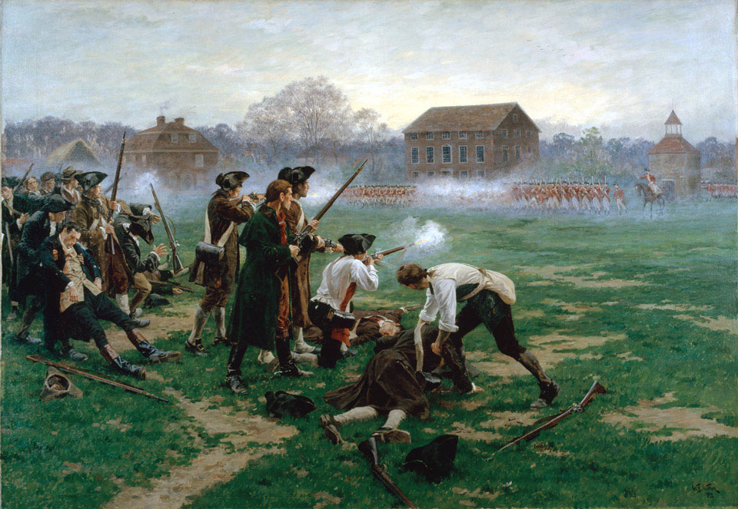
The Battles of Lexington and Concord—the “Shot Heard Round the World”
In April 1775, British troops marched to Lexington and Concord to arrest both Samuel Adams and John Hancock and to seize arms.
Patriot “minutemen” and British troops fired on each other, starting the American Revolution.

Slide 42
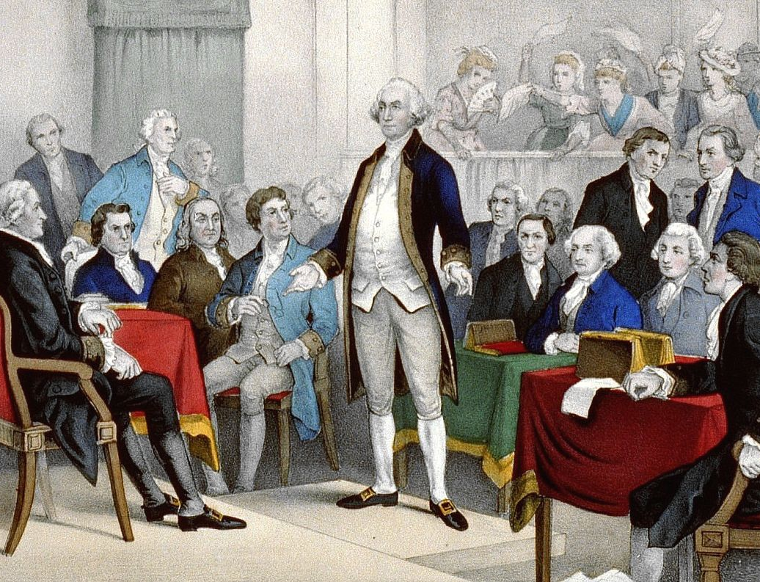
The Conflict Spreads | The Second Continental Congress
The Second Continental Congress met in Philadelphia in May 1775.
It created the Continental Army and appointed George Washington as its commander.

Slide 43
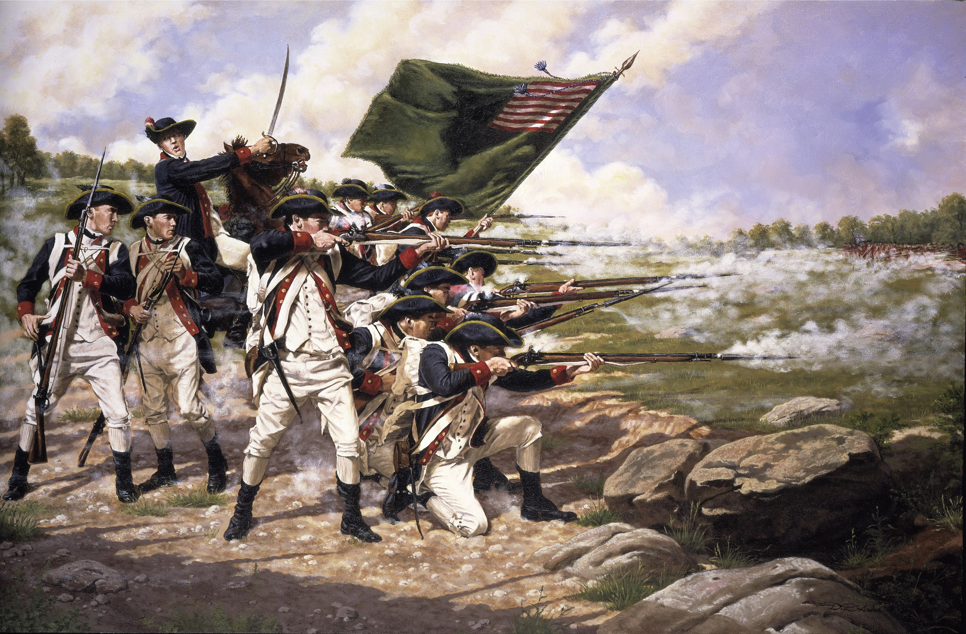
The Conflict Spreads
Washington immediately left for Boston. He placed captured British cannons high on a hill, forcing the British to leave the city.
Washington next marched his army to New York City. The British also landed there and defeated Washington at the Battle of Long Island.

Slide 44
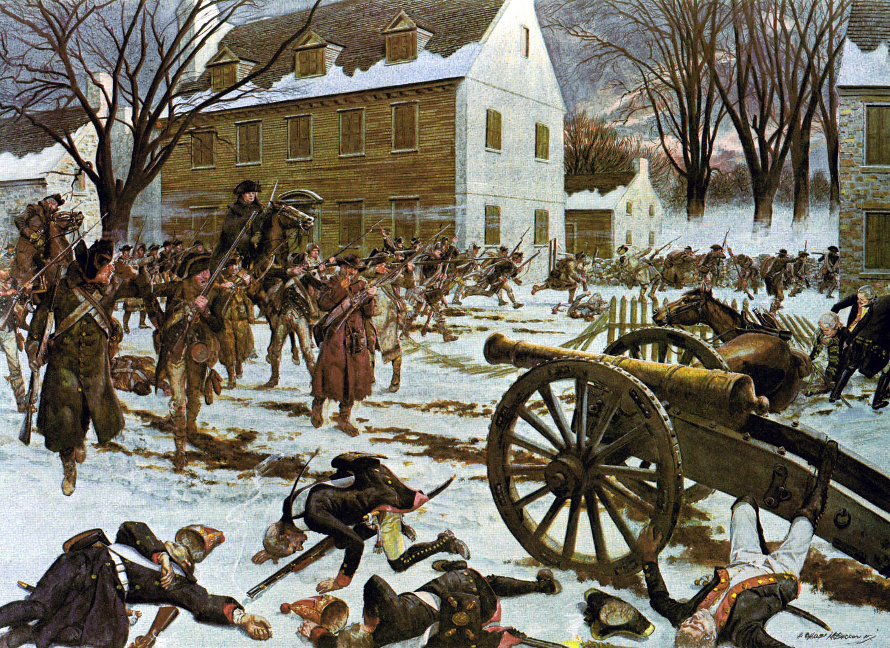
Washington retreated to New Jersey. He took his army back across the Delaware River to defeat Hessian troops at the Battle of Trenton on Christmas Day, 1775.

Slide 45
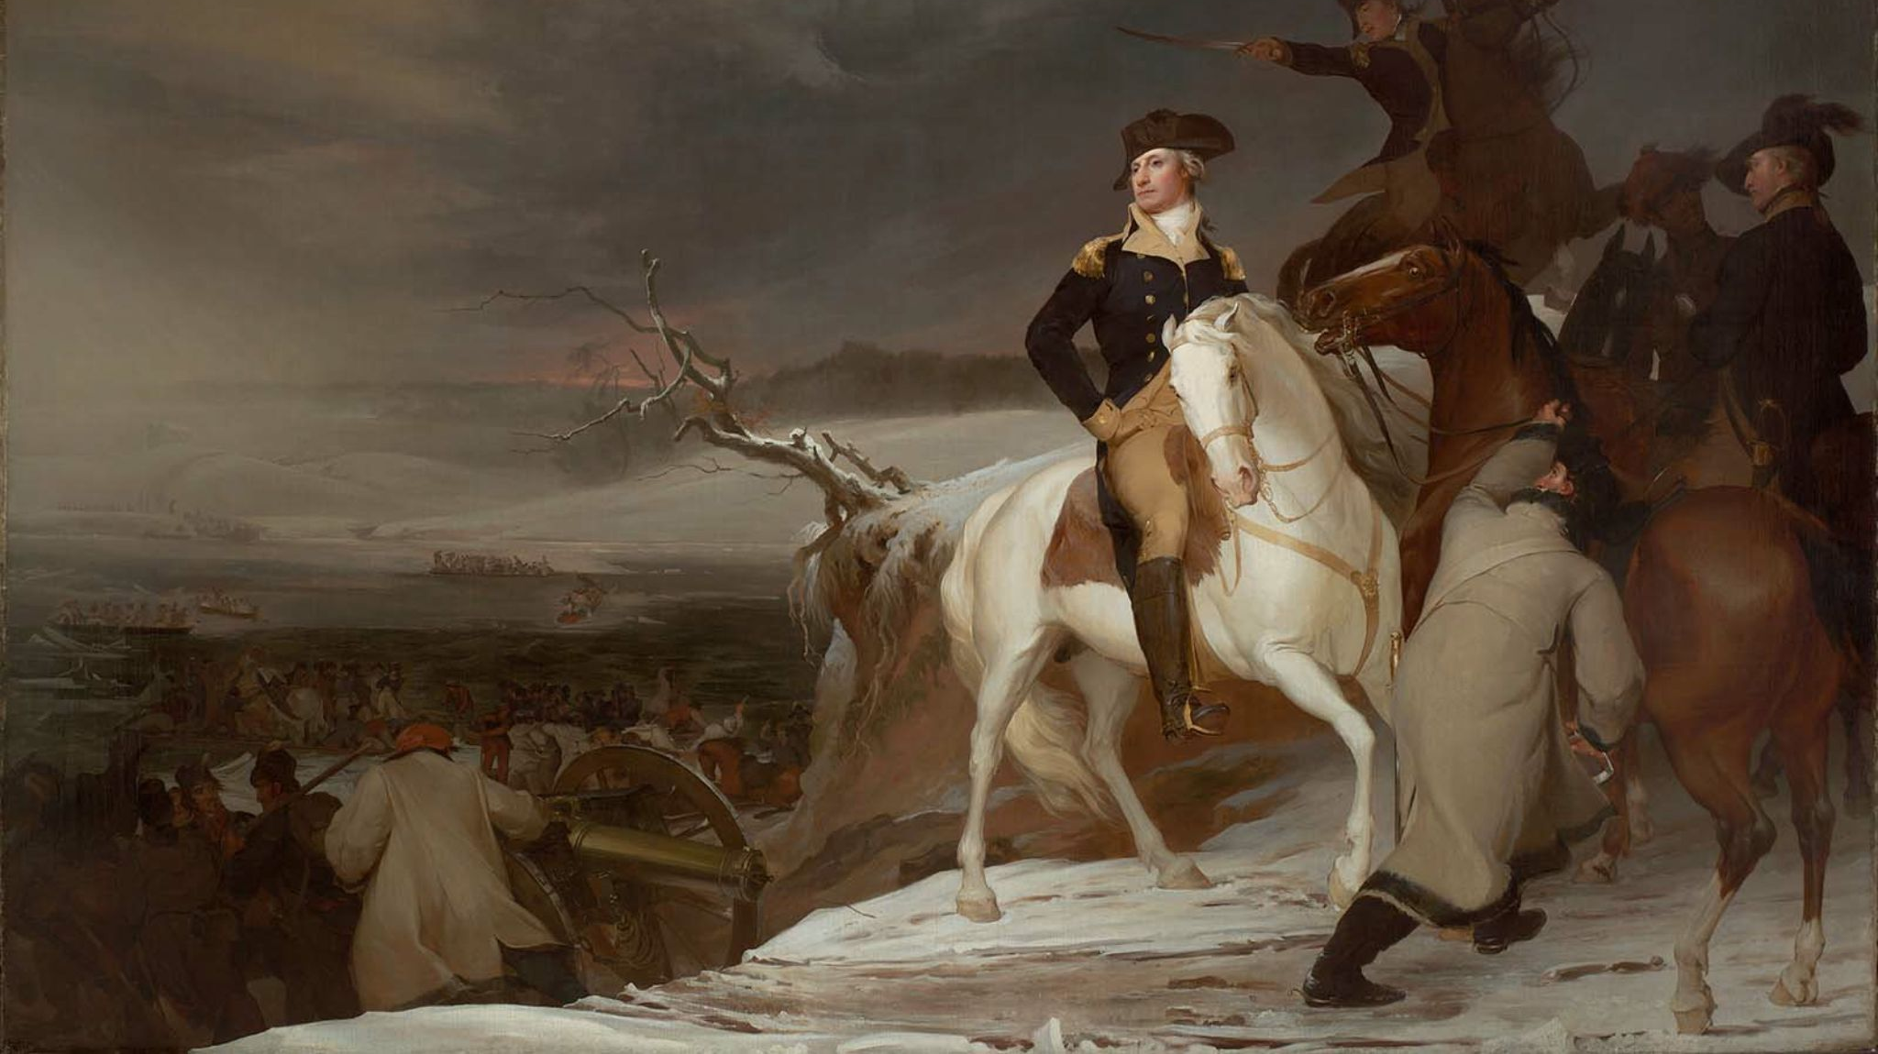
The Passage of the Delaware

Slide 46
Washington Crossing the Delaware

Slide 47

The Capture of the Hessians at Trenton, December 26, 1776

Slide 48


Americans Declare Their Independence | Thomas Paine’s Common Sense
In January 1776, Thomas Paine published “Common Sense.” This pamphlet argued in favor of colonial independence from Great Britain.
Paine also called for the colonists to create a democratic government rather than a monarchy.

Slide 49

Americans Declare Their Independence | The “Committee of Five”
In 1776, the Second Continental Congress began discussing American independence. A Committee of Five was appointed to write a public declaration explaining the reasons for independence.
Thomas Jefferson wrote most of the Declaration.
The Declaration announced a new theory of government: it explained that all people enjoy “unalienable rights”—life, liberty and the pursuit of happiness. Governments are established to protect these rights. Citizens therefore have a right to overthrow governments that destroy these rights.
Next, the Declaration listed the colonists’ many grievances against the King.

Slide 50

Americans Declare Their Independence
In its final paragraphs, the Declaration explained that the colonists had tried to resolve their differences peacefully, but that all their attempts had failed.
Therefore, the colonies declared their independence and stated that they were no longer part of the British Empire.
On July 4, 1776, the Declaration of Independence was signed by the members of the Second Continental Congress.

Slide 51

The War Continues
Two months after the Declaration was signed, the British army captured Philadelphia.
Washington spent the winter at Valley Forge, where Baron von Steuben and the Marquis de Lafayette helped him to train his troops.

Slide 52

The War Continues
British plans to divide the colonies in two through New York failed when General Burgoyne surrendered at Saratoga in 1777. After receiving this news, the French concluded an alliance with the Americans.
The scene of the surrender of the British General John Burgoyne at Saratoga

Slide 53

The Surrender at Yorktown
The British next took the war to the Southern Colonies.
In 1781, their troops were trapped at Yorktown by American and French forces.

Slide 54

The Final Phase of the War
The British surrendered and sought an end to the war. In 1783, the Treaty of Paris recognized American independence and granted the United States all lands east of the Mississippi River.

