Slide 1

03.19.2018
Agenda
Ticket in the Door
Ticket in the Door
Work period: Cornell notes
Wrap -up
Format your papers for Cornell notes
Topic: Sampling and Population
Drop Everything and Read!!!

Slide 2

MAKING AN INFERENCE
WHEN READING FOR INFORMATION - NONFICTION

Slide 3
INFERENCE
a decision reached on the basis of evidence in the reading and your own background knowledge.

Slide 4
Definitions
An inference IS an educated guess about the text.
An inference IS “reading between the lines.”
An inference is NOT
directly stated in
the text you’re
reading.

Slide 5
Definitions
Drawing a conclusion: is the outcome of making an inference.

Slide 6


Definitions
Prediction: is an outcome about the future that you have inferred.

Slide 7
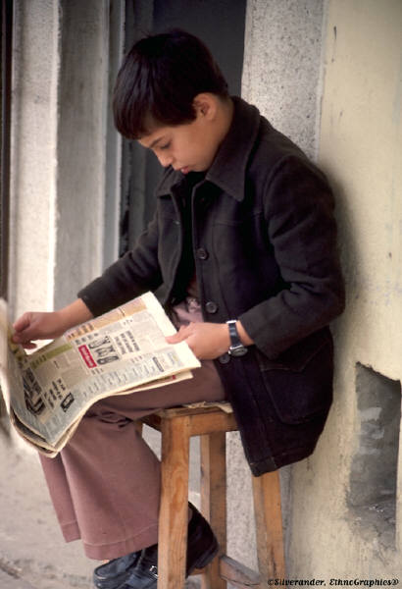
Definitions
The author/character implies, but you the reader infer when you make an educated guess.
Reader infers
Author implies

Slide 8
How do you know that you are being asked to make an inference?
One of these verbs will be used:
*suggest (Which answer does the text suggest is …)
*imply (Which answer does the author imply is …)
*infer (What can you infer from the text as the reason….)
*reasonably infer (What can you reasonably infer is…)
*suggested that (The author suggested that who…)
*with which would the author agree
(With which answer would the author agree as to…)
*which sentence would the author most likely use…(Which sentence would the author most likely use to explain…)

Slide 9
What Inferring Can do for You
*Define unknown words using context
clues
*Learn about a character
*Picture the setting
*Determine the author’s/character’s
feelings and bias
*Draw conclusions and make predictions
based on facts
*Use your prior knowledge to better
understand the reading

Slide 10
Let’s Go through These One at a Time.
Define unknown words using
Inference Context Clues
*
The resilient survivors were soon cracking jokes.
Can you guess what “resilient” means from the sentence?
A skilled reader uses context clues to “infer” the meaning of the word. He knows that the prefix “re” means again.
He knows the meaning of “survivors.” He “infers” from the fact that they are soon cracking jokes, that the survivor is doing fine now. “Resilient” must have to do with overcoming something.

Slide 11
Let’s Go through These One at a Time.
Learn about a character.
“My mother had to try to keep track of us. She finally took us and tied us all together so that we would stay together. And that’s the way we came off the boat.”
--A Swiss Immigrant
A skilled reader can infer from these words of the character about his belief that his mother wanted to keep them safe.

Slide 12
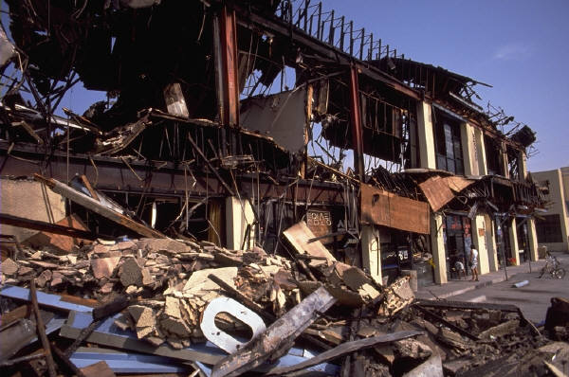
Let’s Go through These One at a Time.
Picture the setting
The French town was in shattered ruins: buildings were jagged shards now and rubble was scattered everywhere.
The skilled reader can infer from the details a picture of this devastation in his mind.

Slide 13

Let’s Go through These One at a Time.
Determine the author’s feelings and bias
“The credit card has risen as a new symbol of “status” that lets people rent a plane or boat or car …without having to pay a penny.” --TIME magazine
A skilled reader infers that TIME magazine was biased about the use of the new credit card. Wanting status, people would think they had to get a credit card and purchase as their neighbors did because of the magazine’s article. Credit cards have faults too—interest. Quotation marks can mean sarcasm.

Slide 14
Let’s Go through These One at a Time.
Draw conclusions and make predictions based on facts
President John F. Kennedy was shot and killed in a motorcade in Dallas, Texas on Nov. 22nd 1963.
A skilled reader can infer (conclude) that someone needs to take control of the United States government immediately.

Slide 15
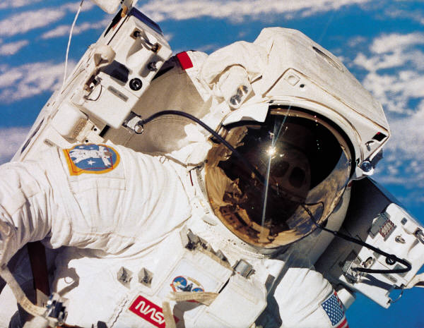
Let’s Go through These One at a Time.
Use prior knowledge to better understand the reading
John Glenn was the first American to successfully orbit Earth three times. He got a hero’s welcome comparable to the one Charles Lindbergh received 35 years before.
The skilled reader knows that Charles Lindbergh was the first to fly trans-atlantically. He knows how honored he was.

Slide 16
EXAMPLES OF INFERENCE
Example 1: “I have voted the same way for years. It’s the first time I’ve ever voted for the Green Party,” said one Alabama voter.
Using inference and prior knowledge, which party would you conclude that this voter previously voted for? (Answer on next slide.)

Slide 17
Answer: Republican
Example 2: His previous album was one of the year’s bestsellers, but it paled in comparison with his 1982 follow-up Thriller.
Who can you reasonably infer is the singer of this album? Pull from your previous knowledge.
Answer is on next slide.

Slide 18

Answer: Michael Jackson
Now take out a sheet of paper, write your name at the top, and number 1-20 down the left side. You will be “inferring” your answers, then we’ll swap and check.

Slide 19
INFERENCE NUMBER 1
A returning Vietnam veteran was asked to describe the country of Vietnam. He said, “It isn’t peace. And there is no honor.”
What does the veteran imply? Should the soldiers be coming home?

Slide 20
NUMBER 2
“Miss America” of 1921 stood only 5 feet 1 inch tall.
With which following statement would the author be more likely to agree.
In 1921 judges thought tall women were less attractive than shorter ones.
Miss America of 1921 was shorter than winners of more recent years.

Slide 21
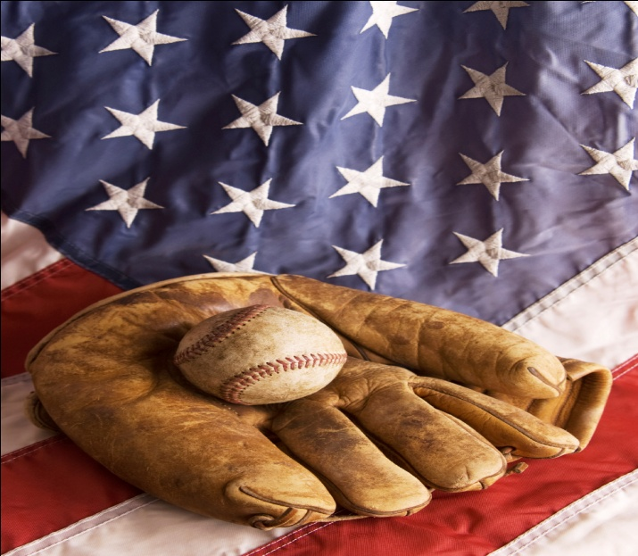
NUMBER 3
In the 1940s Joe DiMaggio was an American baseball hero. He gave Americans something to cheer about, relieving the fear they shared of the war.
The information above suggests that the war mentioned is WWII. True or false?

Slide 22
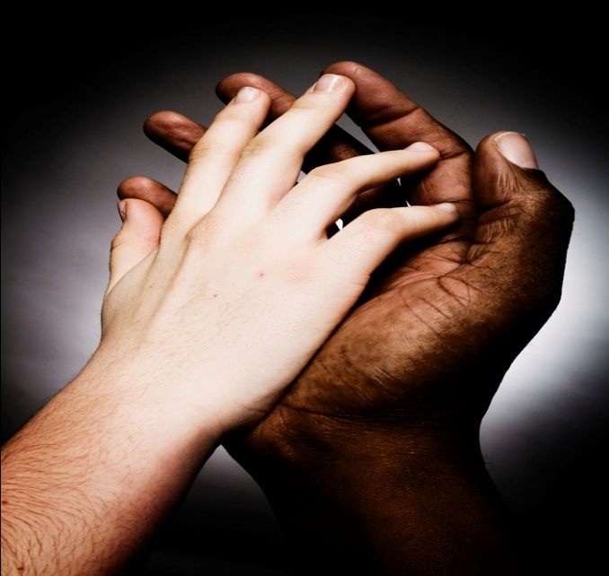
NUMBER 4
During a 1966 battle in the Vietnam War, an injured marine reaches for the hand of his buddy nearby. The war claims 33,000 American casualties that year.
What can you infer about his friend? Lived or died?

Slide 23
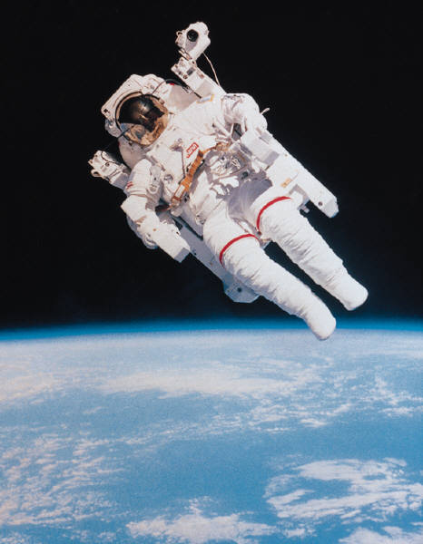
NUMBER 5
In February 1984 Bruce McCandless II, aboard the space shuttle Challenger, floated free untethered into space above Earth.
What can you infer about McCandless’s personality?

Slide 24


NUMBER 6
Thomas Edison once said that Theodore Roosevelt was the most striking figure in American life.
Do you feel the author is implying that we should believe Thomas Edison’s opinion?

Slide 25
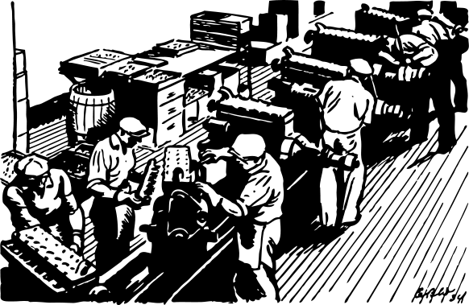

NUMBER 7
At the turn of the century, Henry Ford pioneered assembly line manufacturing.
Can you infer which century the author implies?
What particular assembly-line product did he pioneer? (You need 2 answers.)

Slide 26
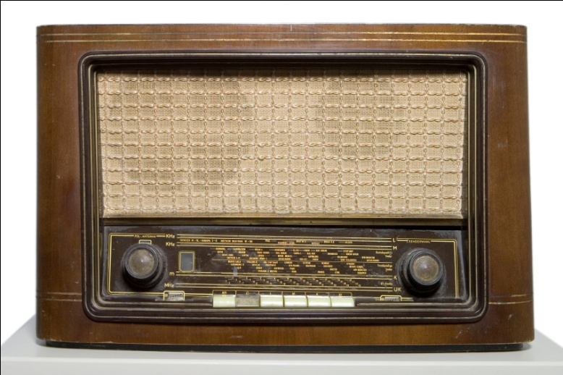
NUMBER 8
Radio became the most common communication medium in 1920. Three decades later television came along.
Inference: What would you infer about the sale of radios in the 1950’s? Increase or decline?

Slide 27
NUMBER 9
A woman walks into a hospital clutching her abdomen and cursing at her husband, who trails behind her carrying a large bag.
Inference: What’s wrong with the woman?

Slide 28

NUMBER 10
In 1915 no longer did a person have to pay the total price to drive a car off the lot. The installment plan began.
Inference: Did more or fewer people purchase a car with the installment plan?

Slide 29
NUMBER 11
During WWII while men were away, women began filling jobs that were needed to fight the war.
Inference: What job would have been needed more?
Choose from these:
Making plane parts or making car parts

Slide 30
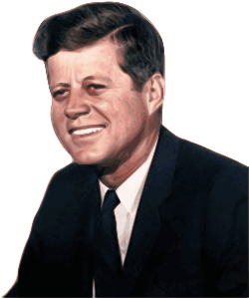
NUMBER 12
John F. Kennedy in 1963 said “And this nation, for all its hopes and boasts, will not be fully free until all its citizens are free.”
Inference: Is he referencing the freeing of Mexican-Americans or African-Americans?

Slide 31
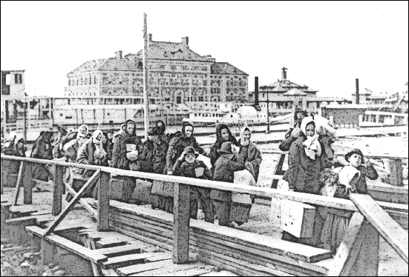
NUMBER 13
People came to Ellis Island around 1910 aboard ships.
Inference: Would these people be Americans or immigrants?

Slide 32
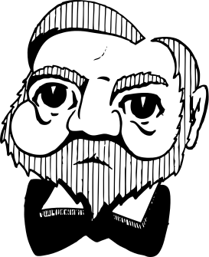
NUMBER 14
Andrew Carnegie made a fortune in steel. He distributed much of it to colleges, libraries, and foundations. Making him a great philanthropist.
Inference: What do you think “philanthropist” means?

Slide 33

NUMBER 15
In 1901 the National League was joined by a competing league known as the American League in baseball.
Inference: Would there have been problems between the two leagues?

Slide 34
NUMBER 16
There was a crowd of customers sampling the first ice cream cones at the St. Louis World’s Fair in 1904.
Can you infer what season it is?

Slide 35
NUMBER 17
The San Francisco Earthquake of 1906 is listed as a major event of the century.
Inference: Can you reasonably infer that many people died?

Slide 36
NUMBER 18
Piggly Wiggly grocery store was the first store where shoppers could get their own packaged foods. Before that the clerk had to weigh and package each item.
Inference: Did the customers like this change?

Slide 37
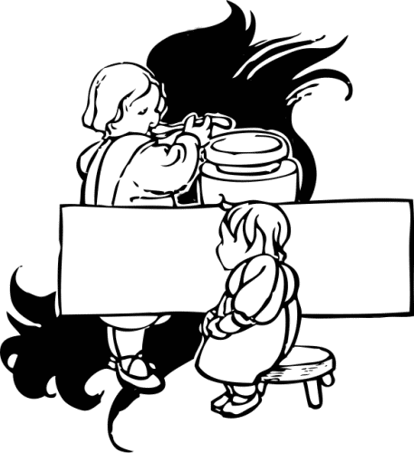
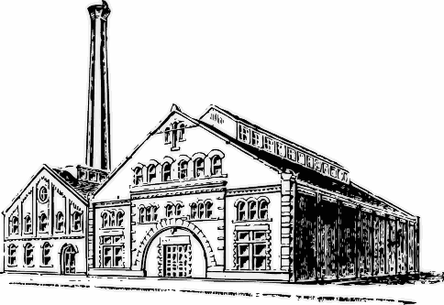
NUMBER 19
In 1913 twenty percent of children in America (some 4 or 5 years old) worked in mills, factories, and mines.
Inference: True or False?
The author is implying that this was acceptable in 1913 and also today.

Slide 38
NUMBER 20
“The only real game in the world is baseball,” said Babe Ruth in 1947.
Inference: Do you infer from this that Babe Ruth is biased or not?

Slide 39
LET’S SWAP PAPERS AND GRADE, PLEASE.
ANSWERS BEGIN ON THE NEXT SLIDE.

Slide 40
ANSWERS
1. No | 11. Plane parts
2. Two | 12. African Americans
3. True | 13. Immigrants
4. He died. | 14. Someone generous, gives a lot
Brave, Fearless | 15. Yes
6. Yes | 16. Summer
7. 20th century, automobile | 17. Yes
8. Decline | 18. Yes
9. She’s pregnant | 19. False
10. More | 20. Yes, biased

Slide 41
“Glued” Link http://www.youtube.com/watch?v=rW2g5cwxrqQ

Slide 42
Questions for “Glued”
For each of the questions on the next slide, I want you to answer each column.
ANSWER | HOW DO YOU KNOW?

Slide 43
Questions for “Glued”
How does the mother feel when she looks out of the window?
Why does the mother open the curtains?
Why does the son go upstairs?
How does she feel when she sees her son playing the Gameboy on the stairs?
Why did she throw the items away?
Why does she laugh as she is burning the items?
How must the mother feel when she looks out the window the next morning?
Why does she grab the baseball glove?
What is the boy doing outside?
How must the mother feel?
11 What made this a good video for us to make inferences?

Slide 44
Advanced Questions for “Glued”
Based on what she sees, what could the mother be thinking when she looks out the window in the beginning?
What reaction is the mother expecting when she opens the curtains?
What would you infer the son is feeling as he goes upstairs?
How does she feel when she sees her son playing the Gameboy on the stairs?
Why does she laugh as she is burning the items?
How must the mother feel when she looks out the window the next morning?
Does the mother think that grabbing the baseball glove will be well received by her son?
What is the boy doing outside?
In the end, what does the mother feel? Be specific.
Who would you infer the mother blames for the situation both she and the boy find themselves in? Why?
11 What made this a good video for us to make inferences?

Slide 45
Inference Strategies
So far, we’ve looked at how inferences are presented to us and you’ve made a lot of connections. Let’s look at HOW you’re making these connections.
There are 3 ways we make inferences (most of the time we don’t even know we’re inferring):
Story Clues (connecting different parts/clues within the same story or text)
Text-to-Self (relating what you’re reading with your own experiences.
Text-to-Text (prior knowledge you have of texts you have already read)

Slide 46
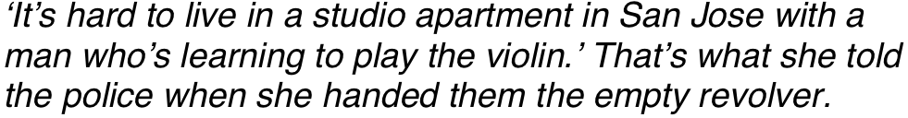
Super Short Story
ONLY
Completed with Inference:

Slide 47
Answer in Pairs
What do you think has happened?
Why did it happen?
What are the possible relationships between the violin player and the woman?
How does the story end?
Possible Discussion Ideas:
What facts did the story actually give?
Have you ever lived with someone who is learning to play an instrument?
Who was it?
Did they enjoy the experience?
What do you think San Jose might be like?

Slide 48
Inference Video
https://www.youtube.com/watch?v=tFRXsngz4UQ
Link to Worksheet Due 03/19/2018
https://www.mathworksheetsland.com/7/28drawinfer/matching.pdf

Slide 49
BOTTOM LINE:
TEXT IS NOT COMPLETE WITHOUT THE READER!

Slide 50
Can you create a scenario that can only be understood using inference?
Try it!

