Slide 1
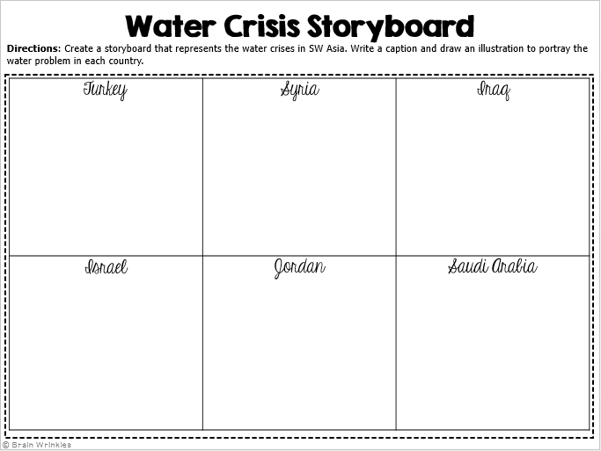
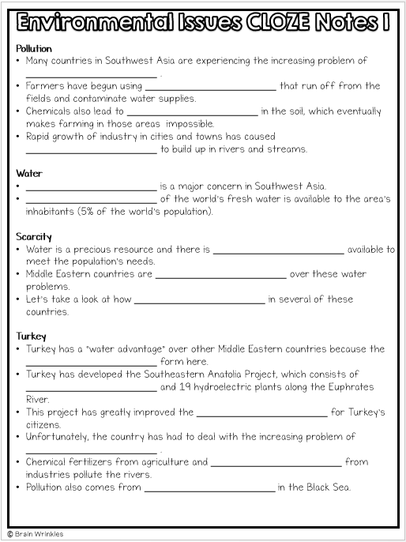
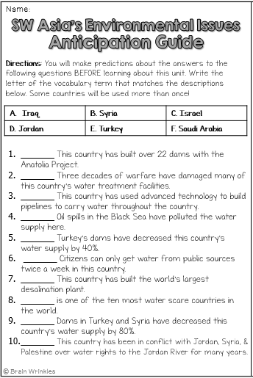
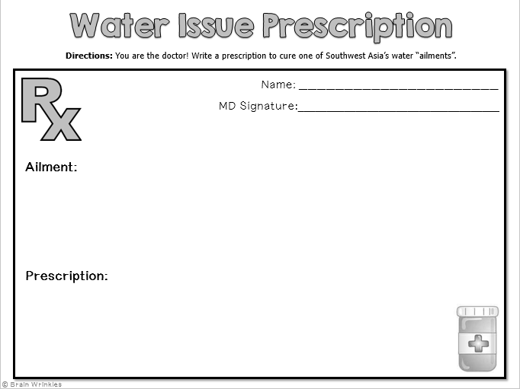
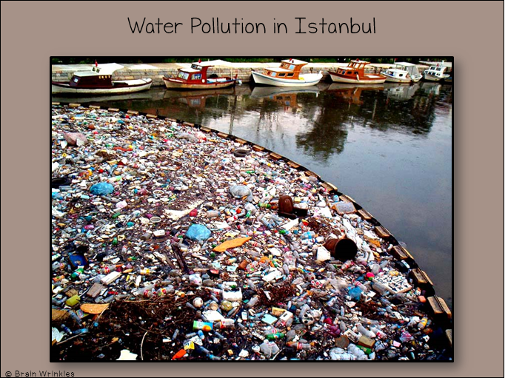
Southwest Asia’s
ENVIRONMENTAL ISSUES
ENVIRONMENTAL
ISSUES
Presentation, Graphic Organizers, & Activities

Slide 2
STANDARDS:
SS7G6 The student will discuss environmental issues across Southwest Asia (Middle East).
a. Explain how water pollution and the unequal distribution of water impacts irrigation and drinking water.
© Brain Wrinkles

Slide 3
TEACHER INFO: Anticipation Guide
Print off the Anticipation Guide for each student (two-per-page).
The students will complete the guide
BEFORE the presentation. Afterwards, give
the students a few minutes to look back
over their answers and make any
corrections.
Check the answers as a class AFTER the presentation.
Answer Key
1 | E
2 | A
3 | C
4 | E
5 | B
6 | D
7 | F
8 | D
9 | A
10 | C
© Brain Wrinkles

Slide 4
Name:
Name:
SW Asia’s Environmental Issues
Anticipation Guide
SW Asia’s Environmental Issues
Anticipation Guide
Directions: You will make predictions about the answers to the following questions BEFORE learning about this unit. Write the letter of the vocabulary term that matches the descriptions below. Some countries will be used more than once!
Directions: You will make predictions about the answers to the following questions BEFORE learning about this unit. Write the letter of the vocabulary term that matches the descriptions below. Some countries will be used more than once!
Iraq | B. Syria | C. Israel
D. Jordan | E. Turkey | F. Saudi Arabia
Iraq | B. Syria | C. Israel
D. Jordan | E. Turkey | F. Saudi Arabia
_______ This country has built over 22 dams with the Anatolia Project.
_______ Three decades of warfare have damaged many of this country’s water treatment facilities.
_______ This country has used advanced technology to build pipelines to carry water throughout the country.
_______ Oil spills in the Black Sea have polluted the water supply here.
_______ Turkey’s dams have decreased this country’s water supply by 40%.
_______ Citizens can only get water from public sources twice a week in this country.
_______ This country has built the world’s largest desalination plant.
_______ is one of the ten most water scare countries in the world.
_______ Dams in Turkey and Syria have decreased this country’s water supply by 80%.
_______ This country has been in conflict with Jordan, Syria, & Palestine over water rights to the Jordan River for many years.
_______ This country has built over 22 dams with the Anatolia Project.
_______ Three decades of warfare have damaged many of this country’s water treatment facilities.
_______ This country has used advanced technology to build pipelines to carry water throughout the country.
_______ Oil spills in the Black Sea have polluted the water supply here.
_______ Turkey’s dams have decreased this country’s water supply by 40%.
_______ Citizens can only get water from public sources twice a week in this country.
_______ This country has built the world’s largest desalination plant.
_______ is one of the ten most water scare countries in the world.
_______ Dams in Turkey and Syria have decreased this country’s water supply by 80%.
_______ This country has been in conflict with Jordan, Syria, & Palestine over water rights to the Jordan River for many years.
© Brain Wrinkles
© Brain Wrinkles

Slide 5
TEACHER INFO: CLOZE Notes
The next pages are handouts for the students to use for note-taking during the presentation. (Print front to back to save paper and ink.)
Check the answers as a class after the presentation.
© Brain Wrinkles

Slide 6
Pollution
Many countries in Southwest Asia are experiencing the increasing problem of _______________________ .
Per-capita availability of safe drinking water here is the _______________________ in the world.
Contaminated water sources have greatly reduced the amount of clean water _______________________ .
Causes
Southwest Asia’s biggest pollution problems come from _______________________ , agricultural runoff, and industrial waste.
_______________________ of industry in cities and towns has caused garbage and sewage to build up in rivers and streams.
Towns without proper sewer systems dump untreated human _______________________ into rivers.
_______________________ are washed into rivers or seep into groundwater.
Water
_______________________ is also a major concern in Southwest Asia.
_______________________ of the world’s fresh water is available to the area’s inhabitants (5% of the world’s population).
Scarcity
Water is a precious resource and there is _______________________ available to meet the population’s needs.
Middle Eastern countries are _______________________ over these water problems.
Let’s take a look at how _______________________ in several of these countries.
Turkey
Turkey has a “water advantage” over other Middle Eastern countries because the _______________________ form here.
Turkey has developed the Southeastern Anatolia Project, which consists of _______________________ and 19 hydroelectric plants along the Euphrates River.
This project has greatly improved the _______________________ for Turkey’s citizens.
Unfortunately, the country has had to deal with the increasing problem of _______________________ .
Chemical fertilizers from agriculture and _______________________ from industries pollute the rivers.
Pollution also comes from _______________________ in the Black Sea.
© Brain Wrinkles
Environmental Issues CLOZE Notes 1

Slide 7
Syria
The dams that Turkey built along the Euphrates have greatly _______________________ of water reaching Syria (40% less).
Syria already suffers from _______________________ , and irrigating new land is extremely difficult with the diminished water supply from the Euphrates.
In order to keep some water in the country, Syria has _______________________ along the river.
This has reduced the river’s flow into Iraq, thus causing _______________________ .
Iraq
The dams that Turkey & Syria built along the Euphrates have also greatly reduced the amount of water reaching Iraq (_______________________ ).
This has negatively impacted the country’s _______________________ .
Wheat and rice production has decreased dramatically, and many farmers are _______________________ .
Iraq also faces water pollution problems as a result of industry and _______________________ equipment.
Also, three _______________________ have caused damage to Iraq’s water treatment plants.
Israel
Since its creation in 1948, Israel has developed _______________________ and advanced farming techniques that have turned the once-barren desert land into farmland.
Because rainfall is down, Israel has to rely on drawing water from its _______________________ (underground layer of rock and sand that contains water).
Unfortunately, the aquifers are in jeopardy because more water is _______________________ than is replenished by rain.
Israel has been involved in many conflicts over water rights to the _______________________ with Syria, Jordan, and Palestine.
Jordan
Jordan is one of the ten most _______________________ countries in the world.
Jordan cannot meet the basic needs of its people and has to _______________________ supply.
Citizens can only get water _______________________ .
The country’s major surface water sources are shared with Israel and Syria, who leave only a _______________________ for Jordan.
Israel has _______________________ that redirect the river’s water away from Jordan and into its own lands.
Jordan & Israel have been involved in _______________________ over water rights.
© Brain Wrinkles
Environmental Issues CLOZE Notes 2

Slide 8
© Brain Wrinkles
Saudi Arabia
Saudi Arabia has a _______________________ and has struggled to meet the water needs of its growing population.
Water is scarce in the country, and what little water that is available is of poor quality because of _______________________ .
The country has built a number of _______________________ that provide most of the country’s drinking water.
Desalination is the process of taking _______________________ and using it for drinking water.
Environmental Issues CLOZE Notes 3

Slide 9
Pollution
Many countries in Southwest Asia are experiencing the increasing problem of water pollution.
Per-capita availability of safe drinking water here is the worst of any region in the world.
Contaminated water sources have greatly reduced the amount of clean water available for drinking.
Causes
Southwest Asia’s biggest pollution problems come from human sewage, agricultural runoff, and industrial waste.
Rapid growth of industry in cities and towns has caused garbage and sewage to build up in rivers and streams.
Towns without proper sewer systems dump untreated human waste directly into rivers.
Pesticides used in farming are washed into rivers or seep into groundwater.
Water
Water availability is a major concern in Southwest Asia.
Less than 1% of the world’s fresh water is available to the area’s inhabitants (5% of the world’s population).
Scarcity
Water is a precious resource and there is simply not enough available to meet the population’s needs.
Middle Eastern countries are constantly in conflict over these water problems.
Let’s take a look at how water is distributed in several of these countries.
Turkey
Turkey has a “water advantage” over other Middle Eastern countries because the Tigris and Euphrates rivers form here.
Turkey has developed the Southeastern Anatolia Project, which consists of 22 dams and 19 hydroelectric plants along the Euphrates River.
This project has greatly improved the standard of living for Turkey’s citizens.
Unfortunately, the country has had to deal with the increasing problem of water pollution.
Chemical fertilizers from agriculture and industrial wastes from industries pollute the rivers.
Pollution also comes from oil spills in the Black Sea.
© Brain Wrinkles
Environmental Issues CLOZE Notes 1

Slide 10
Syria
The dams that Turkey built along the Euphrates have greatly reduced the amount of water reaching Syria (40% less).
Syria already suffers from food shortages, and irrigating new land is extremely difficult with the diminished water supply from the Euphrates.
In order to keep some water in the country, Syria has also built dams along the river.
This has reduced the river’s flow into Iraq, thus causing more conflict.
Iraq
The dams that Turkey & Syria built along the Euphrates have also greatly reduced the amount of water reaching Iraq (80% less).
This has negatively impacted the country’s food supply.
Wheat and rice production has decreased dramatically, and many farmers are now without jobs.
Iraq also faces water pollution problems as a result of industry and petroleum drilling equipment.
Also, three decades of warfare have caused damage to Iraq’s water treatment plants.
Israel
Since its creation in 1948, Israel has developed new technology and advanced farming techniques that have turned the once-barren desert land into farmland.
Because rainfall is down, Israel has to rely on drawing water from its aquifers (underground layer of rock and sand that contains water).
Unfortunately, the aquifers are in jeopardy because more water is taken out than is replenished by rain.
Israel has been involved in many conflicts over water rights to the Jordan River with Syria, Jordan, and Palestine.
Jordan
Jordan is one of the ten most water scarce countries in the world.
Jordan cannot meet the basic needs of its people and has to ration the water supply.
Citizens can only get water two days a week.
The country’s major surface water sources are shared with Israel and Syria, who leave only a small amount for Jordan.
Israel has built pipelines that redirect the river’s water away from Jordan and into its own lands.
Jordan & Israel have been involved in military battles over water rights.
© Brain Wrinkles
Environmental Issues CLOZE Notes 2

Slide 11
© Brain Wrinkles
Saudi Arabia
Saudi Arabia has a desert climate and has struggled to meet the water needs of its growing population.
Water is scarce in the country, and what little water that is available is of poor quality because of salt water intrusion.
The country has built a number of desalination plants that provide most of the country’s drinking water.
Desalination is the process of taking salt out of seawater and using it for drinking water.
Environmental Issues CLOZE Notes 3

Slide 12
Southwest Asia’s
Environmental
Issues
Water Pollution & Unequal Distribution
© Brain Wrinkles

Slide 13
Pollution
Many countries in Southwest Asia are experiencing the increasing problem of water pollution.
Per-capita availability of safe drinking water here is the worst of any region in the world.
Contaminated water sources have greatly reduced the amount of clean water available for drinking.
© Brain Wrinkles

Slide 14
Causes
Southwest Asia’s biggest pollution problems come from human sewage, agricultural runoff, and industrial waste.
Rapid growth of industry in cities and towns has caused garbage and sewage to build up in rivers and streams.
Towns without proper sewer systems dump untreated human waste directly into rivers.
Pesticides used in farming are washed into rivers or seep into groundwater.
© Brain Wrinkles

Slide 15
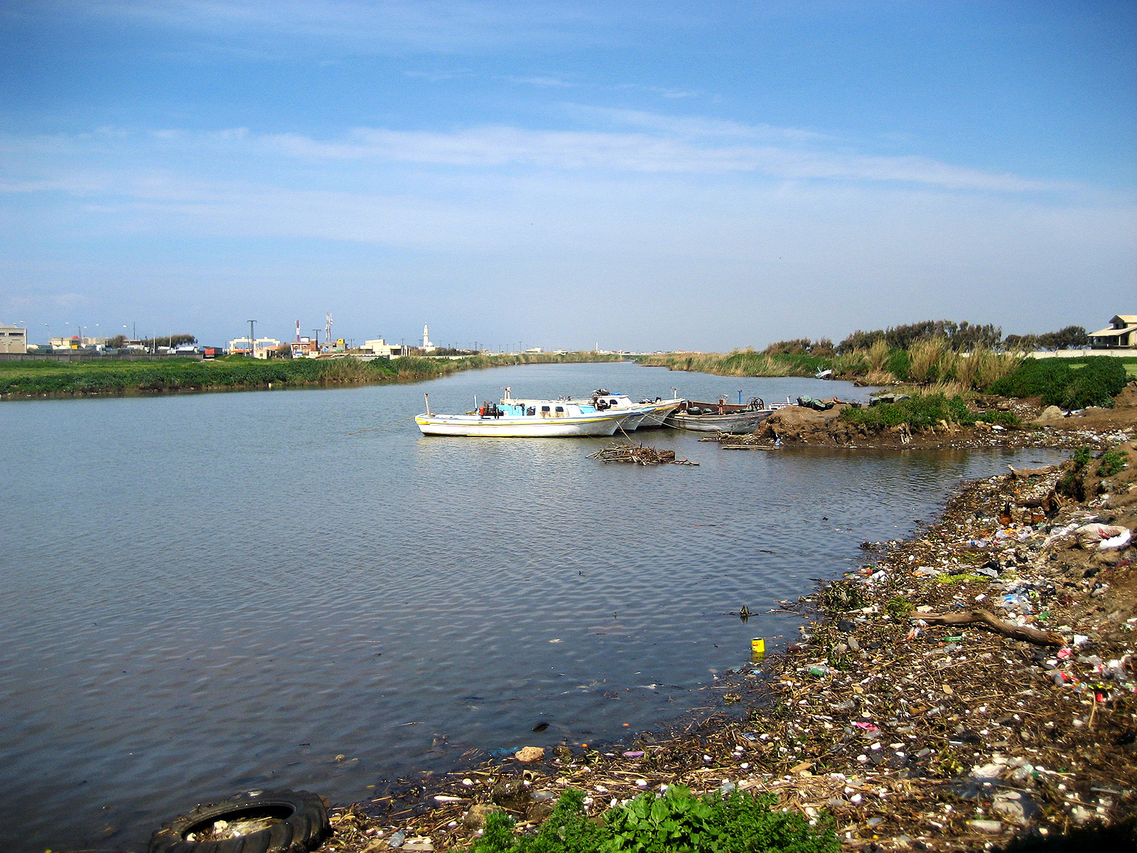
Tigris River Pollution
© Brain Wrinkles

Slide 16
Water?
Water availability is also a major concern in Southwest Asia.
Less than 1% of the world’s fresh water is available to the area’s inhabitants (5% of the world’s population).
© Brain Wrinkles

Slide 17
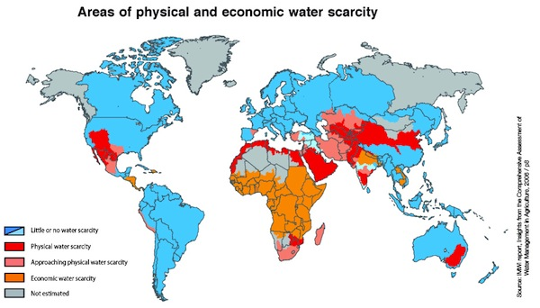
© Brain Wrinkles

Slide 18
Scarcity
Water is a precious resource and there is simply not enough available to meet the population’s needs.
Middle Eastern countries are constantly in conflict over these water problems.
Let’s take a look at how water is distributed in several of these countries.
© Brain Wrinkles

Slide 19
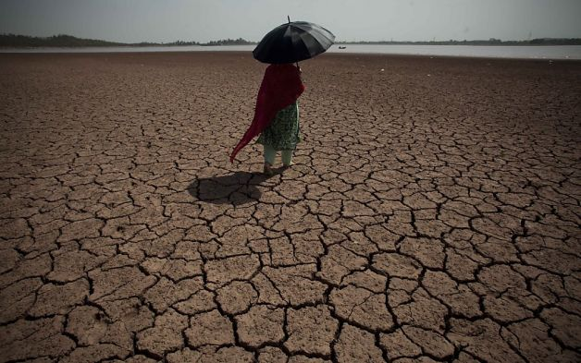
© Brain Wrinkles

Slide 20
Turkey
Turkey has a “water advantage” over other Middle Eastern countries because the Tigris and Euphrates rivers form here.
Turkey has developed the Southeastern Anatolia Project, which consists of 22 dams and 19 hydroelectric plants along the Euphrates River.
This project has greatly improved the standard of living for Turkey’s citizens.
© Brain Wrinkles

Slide 21
Turkey’s Ataturk Dam
© Brain Wrinkles

Slide 22
Turkey
Unfortunately, the country has had to deal with the increasing problem of water pollution.
Chemical fertilizers from agriculture and industrial wastes from industries pollute the rivers.
Pollution also comes from oil spills in the Black Sea.
© Brain Wrinkles

Slide 23
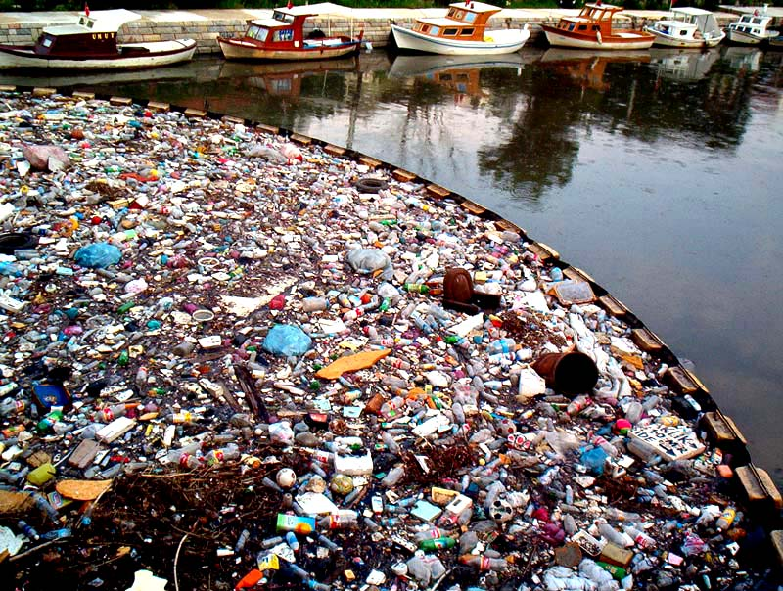
Water Pollution in Istanbul
© Brain Wrinkles

Slide 24
Syria
The dams that Turkey built along the Euphrates have greatly reduced the amount of water reaching Syria (40% less).
Syria already suffers from food shortages, and irrigating new land is extremely difficult with the diminished water supply from the Euphrates.
© Brain Wrinkles

Slide 25
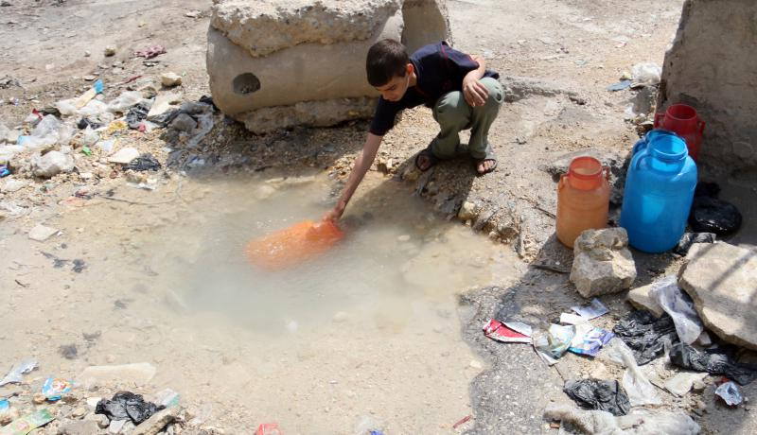
© Brain Wrinkles

Slide 26
Syria
In order to keep some water in the country, Syria has also built dams along the river.
This has reduced the river’s flow into Iraq, thus causing more conflict.
© Brain Wrinkles

Slide 27
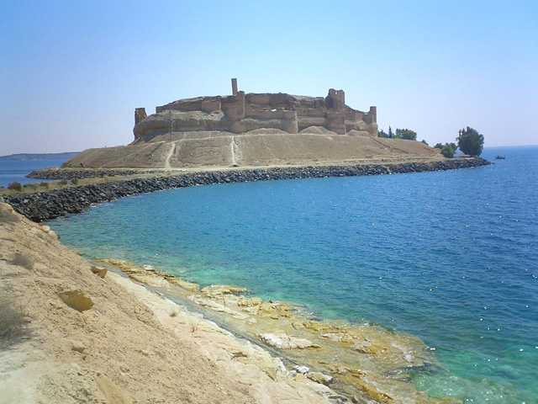
Lake Assad – Syria’s largest reservoir was created in 1974
© Brain Wrinkles

Slide 28
Iraq
The dams that Turkey & Syria built along the Euphrates have also greatly reduced the amount of water reaching Iraq (80% less).
This has negatively impacted the country’s food supply.
Wheat and rice production has decreased dramatically, and many farmers are now without jobs.
© Brain Wrinkles

Slide 29
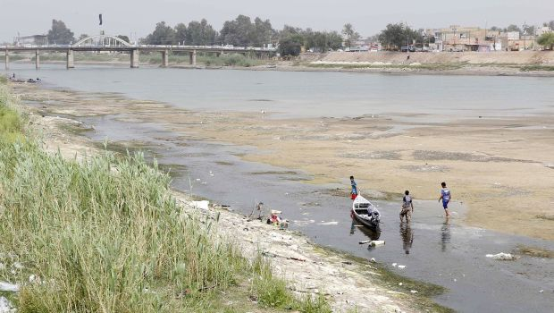
© Brain Wrinkles

Slide 30
Iraq
Iraq also faces water pollution problems as a result of industry and petroleum drilling equipment.
Also, three decades of warfare have caused damage to Iraq’s water treatment plants.
© Brain Wrinkles

Slide 31
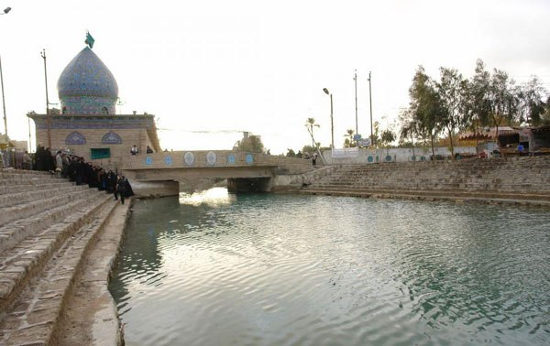
The Glory Canal (built by Suddam Hussein in 1993) was a disastrous project that diverted natural water flow from the country’s marshes and converted wetlands into desert.
© Brain Wrinkles

Slide 32
Israel
Since its creation in 1948, Israel has developed new technology and advanced farming techniques that have turned the once-barren desert land into farmland.
Because rainfall is down, Israel has to rely on drawing water from its aquifers (underground layer of rock and sand that contains water).
Unfortunately, the aquifers are in jeopardy because more water is taken out than is replenished by rain.
© Brain Wrinkles

Slide 33
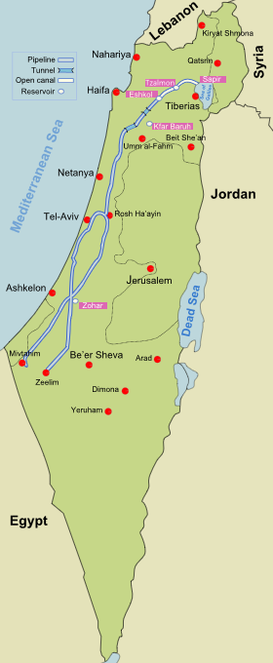
National Water Carrier of Israel –
A pipeline that transfers water from the Sea of Galilee to the highly populated center and arid south.
© Brain Wrinkles

Slide 34
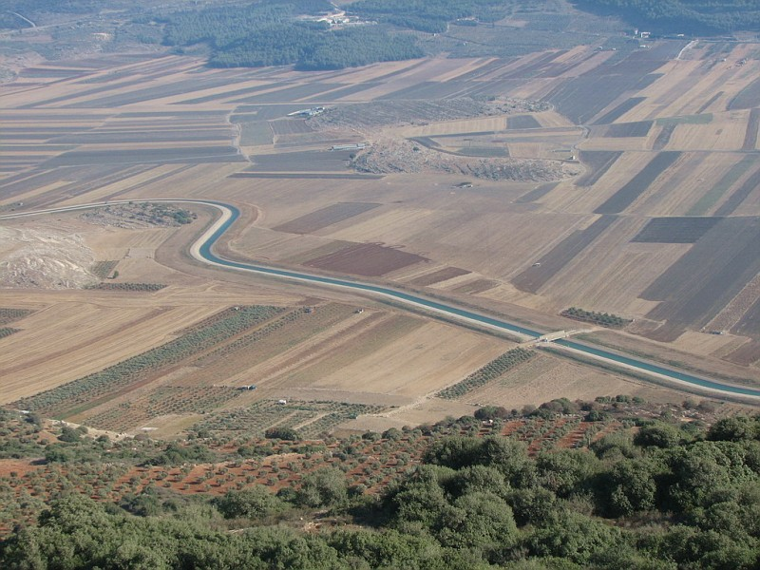
© Brain Wrinkles

Slide 35
Israel
Israel has been involved in many conflicts over water rights to the Jordan River with Syria, Jordan, and Palestine.
© Brain Wrinkles

Slide 36
Jordan
Jordan is one of the ten most water scarce countries in the world.
Jordan cannot meet the basic needs of its people and has to ration the water supply.
Citizens can only get water two days a week.
The country’s major surface water sources are shared with Israel and Syria, who leave only a small amount for Jordan.
© Brain Wrinkles

Slide 37
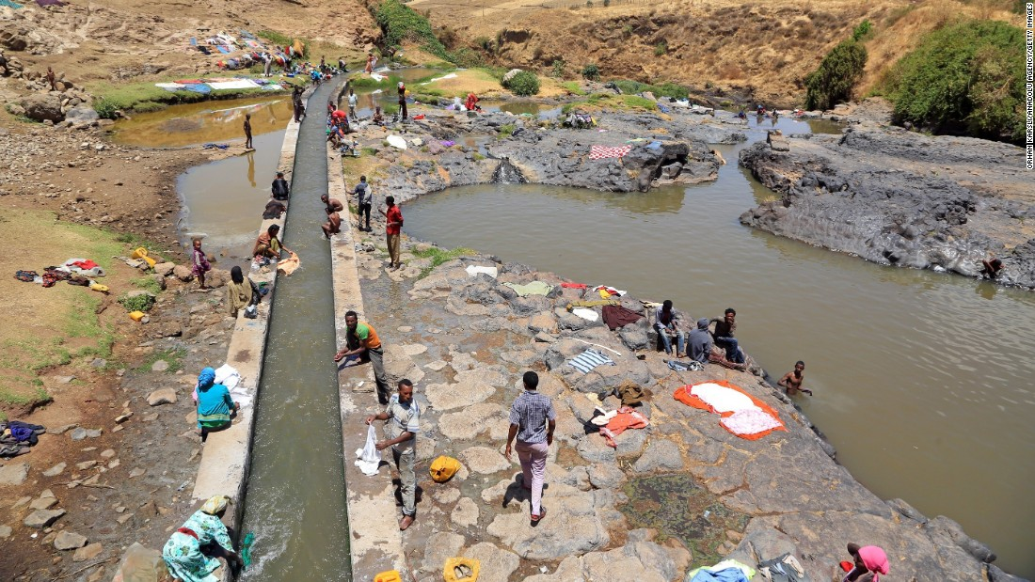
© Brain Wrinkles

Slide 38
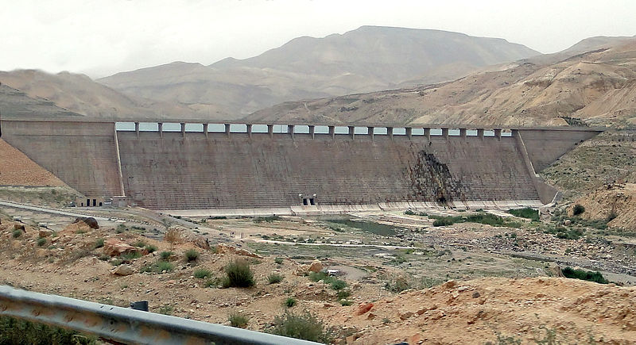
Mujib Dam, Jordan –
Desalinates brackish water from the Dead Sea
© Brain Wrinkles

Slide 39
Jordan
Israel has built pipelines that redirect the river’s water away from Jordan and into its own lands.
Jordan & Israel have been involved in military battles over water rights.
© Brain Wrinkles

Slide 40
Saudi Arabia
Saudi Arabia has a desert climate and has struggled to meet the water needs of its growing population.
Water is scarce in the country, and what little water that is available is of poor quality because of salt water intrusion.
© Brain Wrinkles

Slide 41
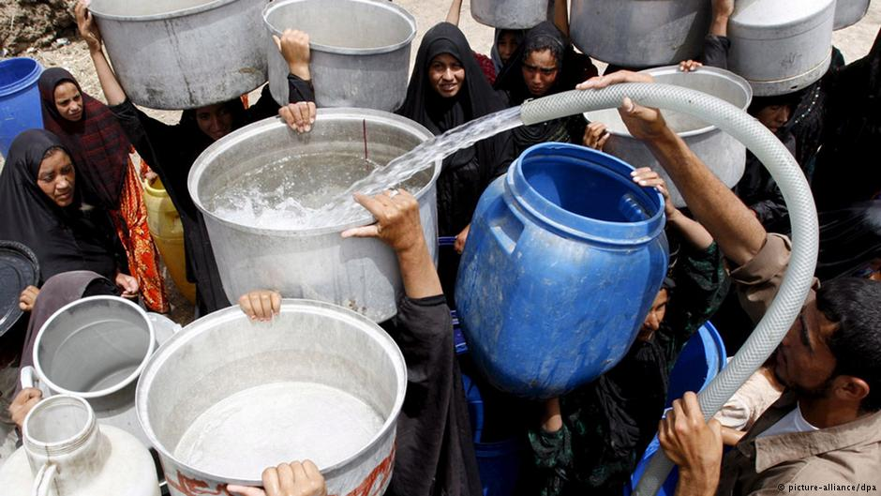
© Brain Wrinkles

Slide 42
Saudi Arabia
The country has built a number of desalination plants that provide most of the country’s drinking water.
Desalination is the process of taking salt out of seawater and using it for drinking water.
© Brain Wrinkles

Slide 43
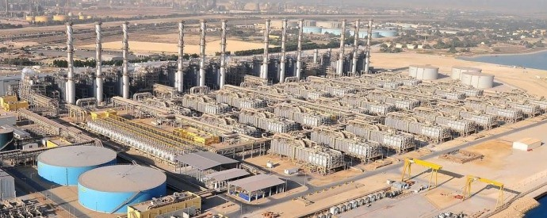
World’s Largest Desalination Plant – Jubail Industrial City, Saudi Arabia
© Brain Wrinkles

Slide 44
TEACHER INFO: Water Crisis Storyboard
Print out the Storyboard handout for each student.
The students will create a storyboard that represents the water crises in SW Asia.
They will write a caption and draw an illustration to portray the water problem in each country.
© Brain Wrinkles

Slide 45
Water Crisis Storyboard
Directions: Create a storyboard that represents the water crises in SW Asia. Write a caption and draw an illustration to portray the water problem in each country.
Turkey
Syria
Iraq
Israel
Jordan
Saudi Arabia
© Brain Wrinkles

Slide 46
TEACHER INFO: Bumper Sticker
Print out the Bumper Sticker handout for each student.
The students will choose one of the issues from the lesson and create a bumper sticker that educates others about the issue.
*You may want to show them a few examples of actual bumper stickers (from the internet).
© Brain Wrinkles

Slide 47
Bumper Sticker
Directions: Create a bumper sticker with a short statement or message convincing others who read it to solve one of the issues that we discussed in class.
The bumper sticker MUST have:
1. Thoughtful message or statement describing your choice of which issue to solve.
2. Colorful visual
3. Underneath your creation, describe the issue and your ideas for how it can be solved.
© Brain Wrinkles

Slide 48
TEACHER INFO: Water Issue Prescription
Print off Prescription handout for each student.
The students will write a prescription to cure one of SW Asia’s water “ailments”.
The “ailment” is where they will describe the issue and the “prescription” is where they will write their idea for solving it.
© Brain Wrinkles

Slide 49
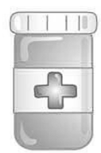
Water Issue Prescription
Directions: You are the doctor! Write a prescription to cure one of Southwest Asia’s water “ailments”.
Name: ______________________
MD Signature:___________________________________
Ailment:
Prescription:
© Brain Wrinkles

Slide 50
TEACHER INFO: TICKET OUT THE DOOR
Have the students write the answer to the question on the “ticket” and turn it in at the end of class.
I like to read over these & discuss answers at the beginning of the next class.
*There are 4 tickets per page.
© Brain Wrinkles

Slide 51
Name:
Name:
Ticket Out the Door
Ticket Out the Door
Why is the unequal distribution of water a problem in SW Asia?
Why is the unequal distribution of water a problem in SW Asia?
© Brain Wrinkles
© Brain Wrinkles
Name:
Name:
Ticket Out the Door
Ticket Out the Door
Why is the unequal distribution of water a problem in SW Asia?
Why is the unequal distribution of water a problem in SW Asia?
© Brain Wrinkles
© Brain Wrinkles

Slide 52
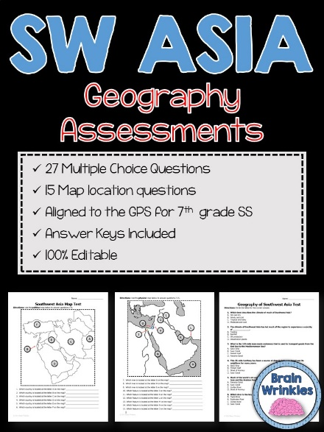
Thank You!
Thank you so much for downloading this file. I sincerely hope you find it helpful and that your students learn a lot from it! I look forward to reading your feedback in my store.
If you like this file, you might want to check out some of my other products that teach social studies topics in creative, engaging, and hands-on ways.
Best wishes,
Ansley at Brain Wrinkles

Slide 53
© Brain Wrinkles. Your download includes a limited use license from Brain Wrinkles. The purchaser may use the resource for personal classroom use only. The license is not transferable to another person. Other teachers should purchase their own license through my store.
This resource is not to be used:
By an entire grade level, school, or district without purchasing the proper number of licenses. For school/district licenses at a discount, please contact me.
As part of a product listed for sale or for free by another individual.
On shared databases.
Online in any way other than on password-protected website for student use only.
© Copyright Brain Wrinkles. All rights reserved. Permission is granted to copy pages specifically designed for student or teacher use by the original purchaser or licensee. The reproduction of any other part of this product is strictly prohibited. Copying any part of this product and placing it on the Internet in any form (even a personal/classroom website) is strictly forbidden. Doing so makes it possible for an Internet search to make the document available on the Internet, free of charge, and is a violation of the Digital Millennium Copyright Act (DMCA).
Thank you,
Ansley at Brain Wrinkles
Terms of Use
Clipart, fonts, & digital papers for this product were purchased from:

