Slide 1
VASCO NUNEZ DE BALBOA
THE SPANISH EXPLOER
BY DOMINIC ALEXANDER

Slide 2
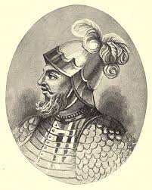
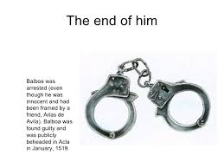
balboa(spanish exploer)
Was a spanish exploer who found land in south america.He came from spain .

Slide 3
His life

Slide 4
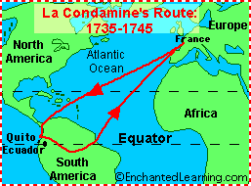
Balboa life
Lived 1475-1519.Married the daughter of careta.Was beheaded in 1519,and joined a group in 1501.

Slide 5
Goals!!!!!!!
Was to search for gold and pearls.Balboa had to find and concour land for spain(spanish).

Slide 6
OBSTACLES!

Slide 7
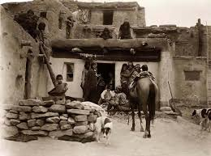
HIS OBSTACLES WERE …HE found lots of indian villages and concured them all.Another obstacle was that his ships sank and couldn’t get home.

Slide 8
Achievements

Slide 9
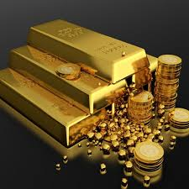
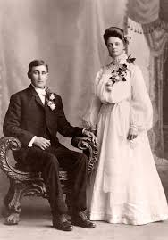
acheivments
His achievments were… Marrying careta,the daughter of a village.And he concured and destroyed lots of indian villages.Found land in south america .He also helped Spain cpncour land.

Slide 10
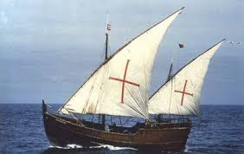
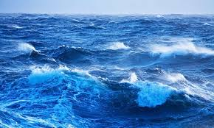
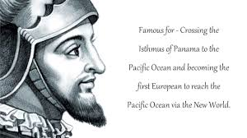
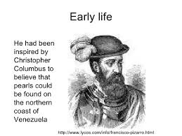
This man was beheaded in 1519.He was born in

Slide 11
Vasco Núñez de Balboa (c. 1475 – around January 12–21, 1519) was a Spanish explorer, governor, and conquistador. He is best known for having crossed the Isthmus of Panama to the Pacific Ocean in 1513, becoming the first European to lead an expedition to have seen or reached the Pacific from the New World.

