Slide 1
SESSION 1
Explore
Comparing Whole Numbers
Learning Target
Compare multi-digit numbers.
LESSON 2 • Compare Whole Numbers
Notes:
Purpose
Explore the idea that place value can be used to compare whole numbers greater than 1,000.
Understand that numbers can be broken apart by place.
Error Alert In this lesson, watch for students who:
compare numbers beginning with the ones place.
compare the leftmost digits of two numbers with different numbers of digits.
confuse the meaning of the symbols < and >.

Slide 2
Start
Same and Different
205
250
A
B
C
D
2,000
2,500
Notes:
START (Teacher’s Guide page 17)
WHY? Support students’ facility with recognizing the place value of digits in whole numbers.
Consider providing sentence starters to help students express their thinking:
_______ is/are different because _______.
_______ is/are the same because _______.
Possible Solutions
All have 2 in the greatest place.
A, B, and D have 5 in a different place.
A and B both have 2 hundreds.
C and D both have 2 thousands.

Slide 3
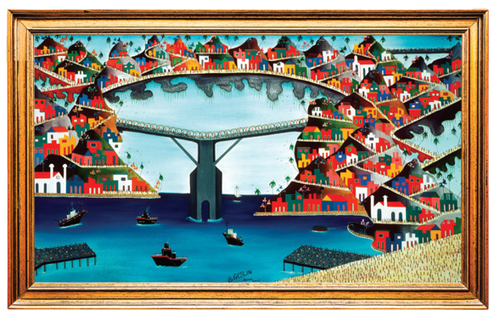
CONNECT TO CULTURE Optional
Paintings and flags are two popular types of art in Haiti. While some Haitian artists paint on traditional canvas, many also paint murals outside on walls and fences.
What paintings, murals, or interesting flags have you seen before?
Notes:
Connect to Culture (Teacher’s Guide page 16a)
Engage students in sharing what they know about the context before you add the information given here.
Paintings and flags are two popular types of art in Haiti. Paintings are often used to visually record Haitian history. While some Haitian artists paint on traditional canvas, many also paint murals outside on walls and fences. Flags are made from fine pieces of fabric where different designs are depicted with colorful sequins. Flags are also used in religious ceremonies. Ask students to talk about any paintings, murals, or interesting flags they have seen before.

Slide 4

Make sense of the problem
A museum has a collection of art from
Haiti. They have 1,347 paintings. They
have 1,295 flags.
How would you say this problem in your own words?
17
Notes:
Say It Another Way
After the problem is read, ask a student to paraphrase the problem in their own words. Student listeners show thumbs up/down to indicate if the paraphrase is complete and accurate. Ask any student who shows thumbs down to explain what is missing. The speaker then revises the original paraphrase.

Slide 5
Make sense of the problem
A museum has a collection of art from
Haiti. They have 1,347 paintings. They
have 1,295 flags. Do they have more
paintings or more flags?
What information is important based on what you need to find?
17

Slide 6
Solve and support your thinking
A museum has a collection of art from
Haiti. They have 1,347 paintings. They
have 1,295 flags. Do they have more
paintings or more flags?
Math Toolkit base-ten blocks, hundred thousands
place-value charts, number lines, index cards
17

Slide 7


Share your thinking with a partner
Ask your partner:
How did you get started?
Tell your partner:
I knew . . . so I . . .
17
Notes:
Common Misconception Look for students who are not comfortable using the concept of place value to explain which number is greater. As students present solutions, have them specify each digit’s value in both numbers.
Select and Sequence Student Strategies
One possible order for whole class discussion:
base-ten blocks that model 1,347 and 1,295
number lines marked with locations of 1,347 and 1,295
expanded form of the numbers 1,347 and 1,295
place-value charts that show 1,347 and 1,295

Slide 8

Compare class strategies
A museum has a collection of art from
Haiti. They have 1,347 paintings. They
have 1,295 flags. Do they have more
paintings or more flags?
17
Notes:
Allow students time to think by themselves before starting the discussion. Then call on students to share selected strategies.
Guide students to Compare and Connect the representations. Prompt students to check that their explanations are clear by pausing and asking classmates.
ASK How do [student name]’s and [student name]’s models show the value of each digit in the numbers?
LISTEN FOR The models show the number of thousands, hundreds, tens, and ones in each number.

Slide 9



Make connections and explain your thinking
Does the museum have more paintings or more flags? Explain which place value shows the collection with more pieces of art.
18
Notes:
Look for understanding that both numbers have the same number of thousands, so students need to compare hundreds to find which number is greater and, thus, which collection has more pieces of art.

Slide 10



Make connections and explain your thinking
You can use place value to compare numbers. Start with the greatest place-value position. Sometimes numbers you compare have the same number of digits. Sometimes they have different numbers of digits.
a. Circle the box with the greater
number of staples.
b. What place value helps you tell which box has more staples? Explain.
18
Notes:
Point out that sometimes students will need to compare numbers that have different numbers of digits, such as a three-digit and a four-digit number.
Students should be able to use place-value names as well as comparison terms greater than, less than, and equal to or same as to describe which box has the greater number of staples and to determine that the four-digit price is greater than the three-digit price.

Slide 11
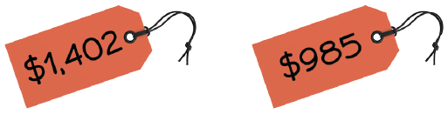
Make connections and explain your thinking
You can use place value to compare numbers. Start with the greatest place-value position. Sometimes numbers you compare have the same number of digits. Sometimes they have different numbers of digits.
c. Circle the greater price.
d. What place value helps you tell which price is greater? Explain.
18

Slide 12


Close: Exit Ticket
Was it easier to compare the number of staples or the two prices? Explain.
18
Notes:
Look for understanding that when comparing numbers with the same number of digits, start with the digit in the place with the greatest value, and when comparing numbers with different numbers of digits, the number with a greater number of digits is greater. Student responses should indicate that a number with 3 digits has hundreds as its greatest place and a number with 4 digits has thousands as its greatest place. Explanations should include that a three‑digit number is always less than a four-digit number.
Common Misconception If students think a four-digit number may be less than a three-digit number, then write a four-digit and a three-digit number in a place-value chart and discuss how a three-digit number has no thousands so is less than any four-digit number.

Slide 13
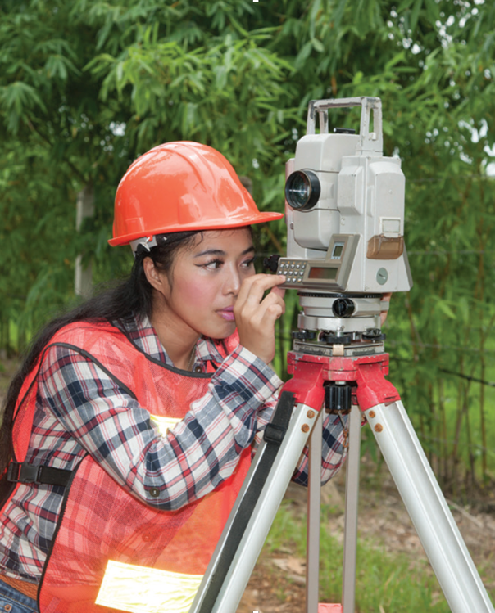
Real-World Connection
A surveyor is a person who measures dimensions and elevations of land.
A surveyor’s measurements help make maps, define boundaries, and record how the land changes.
When might it be useful to compare whole numbers?
Notes:
Real-World Connection (Teacher’s Guide page 19)
Read the real-world example below. Then ask students to think of other real-world examples when comparing whole numbers might be useful.
A surveyor is a person who measures dimensions and elevations of land. A surveyor’s measurements help make maps, define boundaries, and record how the land changes. For example, a surveyor may find that the elevation of a mountain has increased by several feet or the width of a river has decreased from an earlier measurement. The surveyor must be able to compare current measurements to earlier measurements to identify and check changes. The information is then used to update and make more accurate maps. Ask students to think of other real-world examples when comparing whole numbers might be useful.

Slide 14




Vocabulary
compare
19
Notes:
Ask students to circle com in the word compare. Share with students that com- is a Latin root that means “together” or “with.”
Explain to students that com- is found in many math words they may have heard or used, such as compare, combine, and compute. Encourage students to think about what these words mean in relationship to math. Restate their definitions using the words together or with. For example, compare means to put two or more things together to see how they are similar or different. Combine means to join two or more things together. Compute means to bring numbers together in a problem to find a solution.

Slide 15


Practice
Circle the lesser price. Explain how using place value helps you know this is the
lesser price.
19

Slide 16

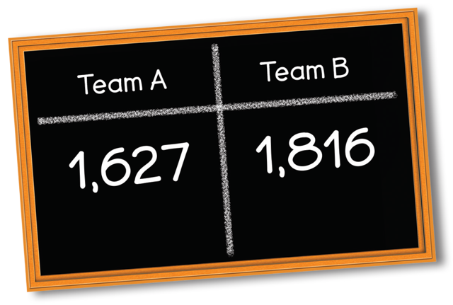
Practice
Solve the problem. Show your work.
Two teams are competing in a trivia game. Team A has 1,627 points. Team B has
1,816 points.
Which team has more points?
20
Notes:
Suggest that students read the problem with a partner and use Say It Another Way to hear the problem more than once and in more than one way. To confirm understanding, call on several students to rephrase important ideas so that everyone hears them.

Slide 17

Practice
Check your answer. Show your work.
20

Slide 18

Take a moment to think on your own.
Notes:
Individual Think Time (10 seconds to 2 minutes)
Provide students a short time to think about a question or problem before discussing with a partner, a small group, or the whole class.
Three Reads
After each read, provide students with think time to read the question and consider their answer.
Connect It
Give students think time before discussing as a class.
Facilitate Whole Class Discussion
After each strategy, allow individual think time for students to process the ideas.
Understand lessons
Model It
Read the problem and allow students plenty of think time to determine their answer.

Slide 19

Turn and talk with your partner about . . .
Notes:
Turn and Talk (30 seconds to 1 minute)
Give students a purpose, prompt, or product so that they know what to talk about and why.

Slide 20

REPEAT
Restate the idea to give everyone a chance to hear it, or hear it again.
Notes:
Four Rs: Repeat
Use one or a combination the Four Rs to support students in processing information and to facilitate classroom discussion.

Slide 21
REPHRASE
Restate the idea in your own words.
Notes:
Four Rs: Rephrase
Use one or a combination the Four Rs to support students in processing information and to facilitate classroom discussion.

Slide 22
REWORD
Restate the idea using academic or mathematical language.
Notes:
Four Rs: Reword
Use one or a combination the Four Rs to support students in processing information and to facilitate classroom discussion.

Slide 23
RECORD
Record ideas using words, numbers or pictures.
Notes:
Four Rs: Record
Record students’ ideas for reference. Use words, numbers, or pictures.

Slide 24

THREE READS
Read 1: What is the problem about?
Read 2: What are you trying to find out?
Read 3: What information is important?

Slide 25

CO-CRAFT QUESTIONS
What is the problem about?
What questions can you ask that
mathematics can answer?

Slide 26

NOTICE AND WONDER
What do you notice?
What do you wonder?

Slide 27

SAY IT ANOTHER WAY
How would you say this problem in your own words?

