Slide 1
SESSION 2
Develop
Rounding Whole Numbers
Learning Target
Round multi-digit numbers.
LESSON 3 • Round Whole Numbers
Notes:
Purpose
Develop strategies for rounding five- and six-digit numbers to different places.
Recognize that there are strategies for rounding multi-digit numbers to any place.
Error Alert In this lesson, watch for students who:
round to an incorrect place value.
round based on the digit in an incorrect place.
decrease an incorrect digit when rounding down.

Slide 2
Start
Which One Doesn’t Belong?
120 127 130
150 145 140
A
B
C
D
1,200 1,250 1,300
100 150 200
Notes:
START (Teacher’s Guide page 37)
WHY? Support students’ facility with recognizing halfway numbers when they round.
Consider providing a sentence starter to help students express their thinking:
_______ does not belong because _______.
Possible Solutions
A is the only group where the middle number is not halfway between the other two numbers.
B is the only group arranged from greatest to least.
C is the only group with four-digit numbers.
D is the only group that has a number where the first digit does not match the first digit of the other numbers.

Slide 3

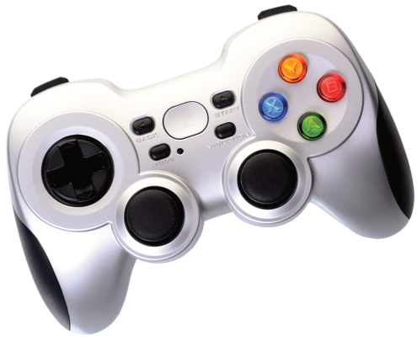
Make sense of the problem
A video game company spends $117,290
developing a new game.
How would you say this problem in your own words?
37
Notes:
Say It Another Way
Reinforce understanding that 117,290 needs to be rounded to two different places.

Slide 4
Make sense of the problem
A video game company spends $117,290
developing a new game. How much does
the company spend rounded to the nearest
ten thousand dollars? How much does the
company spend rounded to the nearest
thousand dollars?
What information is important based on what you need to find?
37

Slide 5
Solve and support your thinking
A video game company spends $117,290
developing a new game. How much does
the company spend rounded to the nearest
ten thousand dollars? How much does the
company spend rounded to the nearest
thousand dollars?
Math Toolkit hundred thousands place-value charts, number lines, index cards
37

Slide 6


Share your thinking with a partner
Ask your partner: Can you explain that again?
Tell your partner: I do not understand how . . .
37
Notes:
Encourage students to name the model or strategy they used as they discuss their solutions.
Support as needed with questions such as:
Could you explain what the problem is asking?
What models have you used before to solve this type of problem?
Common Misconception Look for students who get the same answer for rounding 117,290 to the ten thousands place as rounding it to the thousands place rather than getting a different answer for each part of the problem.
Select and Sequence Student Strategies
One possible order for whole class discussion:
place-value chart showing 117,290
number lines marked in thousands from 110,000 to 120,000 and in hundreds from 117,000 to 118,000
written descriptions using place-value reasoning
using the digit to the right of the rounding place

Slide 7

Compare class strategies
A video game company spends $117,290
developing a new game. How much does
the company spend rounded to the nearest
ten thousand dollars? How much does the
company spend rounded to the nearest
thousand dollars?
37
Notes:
Call on students to share selected strategies. As students present, ask them to justify their response by giving reasons for their ideas.
Guide students to Compare and Connect the representations. Encourage students to turn and talk to compare the different strategies presented.
ASK Where does your model show the two ten thousands and thousands that 117,290 is between? Why do some models show the two numbers that 117,290 is between and other models do not?
LISTEN FOR Students should recognize that accurate responses include that number lines and place-value charts use numbers and labels for place value so they show the thousands and ten thousands. Looking at the digit to the right of the rounding place uses place-value reasoning to compare digits, so it does not show those two numbers.

Slide 8

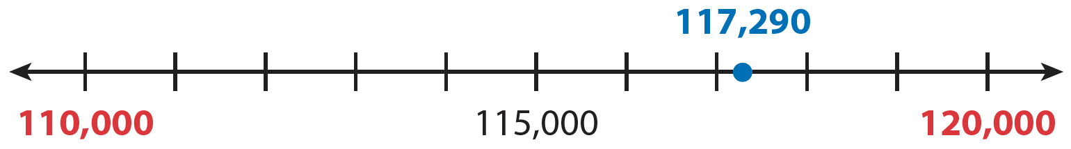
Compare strategies
You can use a number line to round $117,290 to the nearest ten thousand.
Find the closest ten thousands that are less than 117,290 and greater than 117,290.
117,290 is between 110,000 and 120,000.
38
Notes:
For a number line, prompt students to identify the two ten thousands that 117,290 is between and to identify the halfway number.
How is it helpful that 110,000 and 120,000 are the first and last numbers on the number line?
How does the halfway number help you find which ten thousand 117,290 is closer to?

Slide 9
Compare strategies
You can use place value to round $117,290 to the nearest thousand.
Find the closest thousands that are less than 117,290 and greater than 117,290.
Hundred Thousands | Ten Thousands | Thousands | Hundreds | Tens | Ones
1 | 1 | 7 | 0 | 0 | 0
1 | 1 | 7 | 2 | 9 | 0
1 | 1 | 8 | 0 | 0 | 0
117,290 has 7 thousands, so it is between 117,000 and 118,000.
There are 10 hundreds in each thousand. Halfway between 0 hundreds and 10 hundreds is 5 hundreds. The number 117,290 has 2 hundreds.
38
Notes:
For a place-value chart, prompt students to identify the two thousands that 117,290 is between and to identify the halfway number.
Why is 117,000 shown above 117,290 and 118,000 shown below it?
Why is the halfway number of hundreds identified?

Slide 10






Make connections and explain your thinking
Look at the first Model It. Which ten thousand
is 117,290 closer to: 110,000 or 120,000?
Which ten thousand does 117,290 round to?
To the nearest ten thousand, what amount
does $117,290 round to?
Look at the second Model It. Which thousand does 117,290 round to, 117,000 or 118,000? You can compare the number of hundreds in 117,290 to 5 hundreds to help you know
whether to round up or down.
To the nearest thousand, what amount does
$117,290 round to?
39
Notes:
Check for understanding that:
117,290 is closer to 120,000 than to 110,000, so round up to 120,000
117,290 is closer to 117,000 than to 118,000, so round down to 117,000

Slide 11

Make connections and explain your thinking
Choose any five-digit number. Write it here.
Explain how to round a five-digit number to the nearest ten thousand.
39
Notes:
Look for the understanding that identifying which of the nearest two ten thousands a five-digit number is closer to determines whether the number is rounded up or down.

Slide 12


Reflect on what you have learned
Look back at your Try It, strategies by classmates, and Model Its. Which models
or strategies do you like best for rounding greater numbers? Explain.
39
Notes:
Have all students focus on the strategies used to solve this problem. If time allows, have students share their responses with a partner.

Slide 13


Apply your thinking to a new problem
Mr. Gómez’s company collects 32,376 water bottles to recycle. Mr. Gómez rounds this amount to the nearest ten thousand. What number does Mr. Gómez round the number of water bottles to? Show your work.
Solution
40

Slide 14

Apply your thinking to a new problem
Gavin and his dad volunteer at a book drive for International Book Giving Day on February 14. The book drive collects 468,500 books.
To the nearest thousand, how many books does the book drive collect? Show your work.
Solution
40

Slide 15

Close: Exit Ticket
Round 649,418
to the nearest ten:
to the nearest hundred:
to the nearest thousand:
to the nearest ten thousand:
to the nearest hundred thousand:
40
Notes:
Students’ solutions should indicate understanding of:
rounding a multi-digit number to different places
rounding a multi-digit number with a “9” in the rounding place
applying prior knowledge to round to the hundred thousands place
Error Alert If students round to an incorrect place value, then have students circle the digit of the place they are rounding to and underline the digit that comes after it in 649,418. Remind them that if the underlined digit is 5 or greater, round up; otherwise round down.

Slide 16
Practice
EXAMPLE
Round 651,970 to the nearest thousand.
Hundred Thousands | Ten Thousands | Thousands | Hundreds | Tens | Ones
6 | 5 | 1 | 9 | 7 | 0
651,970 has 1 thousand, so it is
between 651,000 and 652,000.
There are 9 hundreds in 651,970.
Because 9 hundreds is greater than
5 hundreds, round up.
So, 651,970 rounded to the nearest
thousand is 652,000.
41

Slide 17

Practice
Look at the Example above.
a. Round 651,970 to the nearest ten thousand.
b. Round 651,970 to the nearest hundred
thousand.
41

Slide 18

Practice
Round 45,621 to each place given below.
a. to the nearest ten
b. to the nearest hundred
c. to the nearest thousand
d. to the nearest ten thousand
41

Slide 19

Practice
Round 452,906 to each place given below.
a. to the nearest hundred thousand
b. to the nearest ten thousand
c. to the nearest thousand
d. to the nearest hundred
e. to the nearest ten
41

Slide 20


Practice
The table below shows driving distances between U.S. cities. Round each number to the nearest hundred.
 | Actual distance (mi) | Rounded distance (mi)
Atlanta, GA to Los Angeles, CA | 2,173
Los Angeles, CA to Seattle, WA | 1,135
Atlanta, GA to Chicago, IL | 716
Chicago, IL to San Francisco, CA | 2,131
Look at the table in problem 4. Anish drives a distance between two cities in the table. Anish says he drives about 2,000 miles. Which cities could Anish have driven between? Show your work.
Solution
42

Slide 21


Practice
Write numbers in the boxes below to show rounding on a number line. What place value are you rounding to?
Solution
42

Slide 22

Take a moment to think on your own.
Notes:
Individual Think Time (10 seconds to 2 minutes)
Provide students a short time to think about a question or problem before discussing with a partner, a small group, or the whole class.
Three Reads
After each read, provide students with think time to read the question and consider their answer.
Connect It
Give students think time before discussing as a class.
Facilitate Whole Class Discussion
After each strategy, allow individual think time for students to process the ideas.
Understand lessons
Model It
Read the problem and allow students plenty of think time to determine their answer.

Slide 23

Turn and talk with your partner about . . .
Notes:
Turn and Talk (30 seconds to 1 minute)
Give students a purpose, prompt, or product so that they know what to talk about and why.

Slide 24

REPEAT
Restate the idea to give everyone a chance to hear it, or hear it again.
Notes:
Four Rs: Repeat
Use one or a combination the Four Rs to support students in processing information and to facilitate classroom discussion.

Slide 25
REPHRASE
Restate the idea in your own words.
Notes:
Four Rs: Rephrase
Use one or a combination the Four Rs to support students in processing information and to facilitate classroom discussion.

Slide 26
REWORD
Restate the idea using academic or mathematical language.
Notes:
Four Rs: Reword
Use one or a combination the Four Rs to support students in processing information and to facilitate classroom discussion.

Slide 27
RECORD
Record ideas using words, numbers or pictures.
Notes:
Four Rs: Record
Record students’ ideas for reference. Use words, numbers, or pictures.

Slide 28

THREE READS
Read 1: What is the problem about?
Read 2: What are you trying to find out?
Read 3: What information is important?

Slide 29
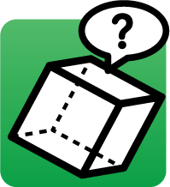
CO-CRAFT QUESTIONS
What is the problem about?
What questions can you ask that
mathematics can answer?

Slide 30

NOTICE AND WONDER
What do you notice?
What do you wonder?

Slide 31

SAY IT ANOTHER WAY
How would you say this problem in your own words?

