Slide 1
SESSION 3
Refine
Rounding Whole Numbers
Learning Target
Round multi-digit numbers.
LESSON 3 • Round Whole Numbers
Notes:
Purpose
Refine strategies for solving word problems involving rounding multi-digit numbers.
Refine understanding of rounding numbers up to six digits to any place.
Error Alert In this lesson, watch for students who:
round to an incorrect place value.
round based on the digit in an incorrect place.
decrease an incorrect digit when rounding down.

Slide 2
Start
What is 286,749 rounded to
the nearest hundred?
Notes:
START (Teacher’s Guide page 43)
WHY? Confirm students’ understanding of rounding whole numbers.
Before students begin to work, use their responses to the Start to determine those who will benefit from additional support. Use the Error Analysis table on Teacher’s Guide page 43 to guide remediation.

Slide 3
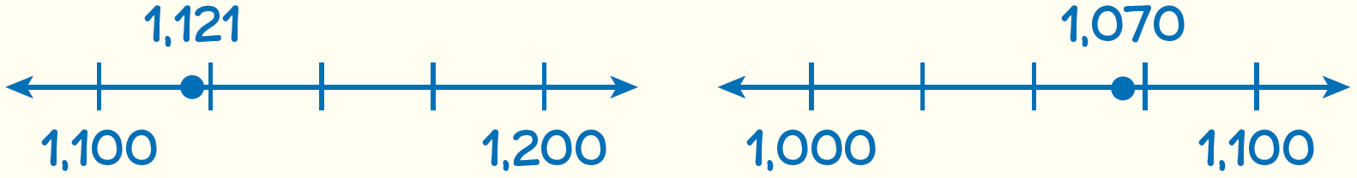
Example
EXAMPLE
The tallest building in Philadelphia is 1,121 feet tall. The tallest building in San Francisco is 1,070 feet tall. To the nearest hundred feet, what is the height of each building?
Look at how you could show your work using number lines.
Round each number to the nearest hundred.
The student used number lines to find which number of hundreds each height is closest to.
1,121 rounds down to 1,100.
1,070 rounds up to 1,100.
How can you decide which two hundreds a number is between?
Solution
43
Notes:
Guide students in understanding the Example. Ask:
Why is 1,121 rounded down? Why is 1,070 rounded up?
How does using a number line help you solve this problem? How else might you solve it?
Help all students focus on the Example and responses to the questions by reminding them that good listeners use engaged body language, such as looking at the speaker and nodding to show understanding.
Look for understanding that a four-digit number can be rounded to the nearest hundred by looking at a number line to find which number of hundreds it is closer to.

Slide 4


El Cerrito, California is a suburb in the
San Francisco Bay area. In October 2020, El Cerrito had 17,514 people registered to
vote. To the nearest thousand, how many people were registered to vote? Show your work.
How can you use the number of hundreds to round to the nearest thousand?
How did you decide whether to round up or round down?
Solution
43

Slide 5
CONNECT TO CULTURE Optional
Baleros have either a ball connected by string to a cup or a barrel with a small hole connected by string to a stick. The player swings the toy and tries to get the ball in the cup or the barrel onto the stick.
What is your favorite toy?
Notes:
Connect to Culture (Teacher’s Guide page 32a)
Engage students in sharing what they know about the contexts before you add the information given here.
Ask students if they have ever played with a balero. Baleros have either a ball connected by string to a cup or a barrel with a small hole connected by string to a stick. The player swings the toy and tries to get the ball in the cup or the barrel onto the stick. The balero presents a challenge that both children and adults enjoy.

Slide 6

Teresa owns a company that makes Mexican toys called baleros. One year they make 380,285 baleros. To the nearest ten thousand, how many baleros do they make? Show your work.
Which two ten thousands is 380,285 between?
Which digit do you look at to round to the nearest ten thousand?
Solution
44

Slide 7





A website streams 264,398 movies to its customers one year. To the nearest ten, how many movies does the website stream?
Which two tens is 264,398 between?
264,300
264,390
264,400
265,000
Efia chose as the correct answer. How did she get that answer?
Do you agree with Efia’s answer?
44

Slide 8
CONNECT TO CULTURE Optional
An international air balloon festival is held annually in Cappadocia, Turkey. Tourists can fly in the balloons or watch
from caves.
What festivals have you been to?
Notes:
Connect to Culture (Teacher’s Guide page 32a)
Engage students in sharing what they know about the contexts before you add the information given here.
Ask students if they have seen a hot air balloon. An international air balloon festival is held annually in Cappadocia, Turkey. This region is known for its towering rock formations called fairy chimneys. Tourists can fly in the balloons or watch from caves.

Slide 9


You can see over 100 balloons in the sky each day at a hot air balloon festival in Cappadocia, Turkey. The height of one balloon rounded to the nearest ten is
2,540 feet. Which could be the exact height
of the balloon? Choose all that apply.
2,535 feet
2,537 feet
2,545 feet
2,543 feet
2,400 feet
45

Slide 10

A renewable energy company sells 102,278 solar panels. To the nearest thousand, how many solar panels does the company sell?
100,000
102,000
102,300
103,000
45

Slide 11




Determine whether each original number is rounded to the nearest 100 or to the nearest 1,000 to make the new number.
Original
New
Nearest 100
Nearest 1,000
1,445
1,400
12,500
13,000
29,607
30,000
341,389
341,400
45

Slide 12

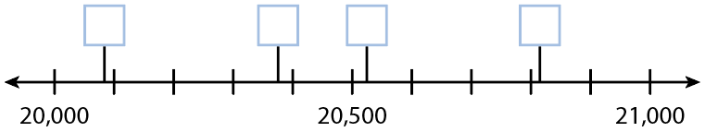
A is an unknown number. When you round A to the nearest thousand, you get 21,000. When you round A to the nearest hundred, you get 20,500.
Write A in the box that shows its location on the number line.
46

Slide 13

Round 5,563 to the nearest thousand, to the nearest hundred, and to the nearest ten. Suppose you can pay a $5,563 bill with a rounded amount. Which place value would you round to? Suppose you win a $5,563 prize and
you can choose a rounded amount. Which place value would you round to? Show your work.
46

Slide 14

Close: Exit Ticket
Choose a five-digit number that rounds to a six-digit number. Tell what place you round to and why your choice of five-digit number rounds to a six-digit number.
46
Notes:
Student responses should indicate an understanding of why a rounded number may have one more digit than the unrounded number.
Error Alert If students are unable to determine a five-digit number that rounds to a six-digit number, then have them write a five-digit number greater than 99,000, such as 99,700, in a place-value chart to see that rounding it to the nearest thousand results in 100,000, a six-digit number.

Slide 15

Take a moment to think on your own.
Notes:
Individual Think Time (10 seconds to 2 minutes)
Provide students a short time to think about a question or problem before discussing with a partner, a small group, or the whole class.
Three Reads
After each read, provide students with think time to read the question and consider their answer.
Connect It
Give students think time before discussing as a class.
Facilitate Whole Class Discussion
After each strategy, allow individual think time for students to process the ideas.
Understand lessons
Model It
Read the problem and allow students plenty of think time to determine their answer.

Slide 16

Turn and talk with your partner about . . .
Notes:
Turn and Talk (30 seconds to 1 minute)
Give students a purpose, prompt, or product so that they know what to talk about and why.

Slide 17

REPEAT
Restate the idea to give everyone a chance to hear it, or hear it again.
Notes:
Four Rs: Repeat
Use one or a combination the Four Rs to support students in processing information and to facilitate classroom discussion.

Slide 18
REPHRASE
Restate the idea in your own words.
Notes:
Four Rs: Rephrase
Use one or a combination the Four Rs to support students in processing information and to facilitate classroom discussion.

Slide 19
REWORD
Restate the idea using academic or mathematical language.
Notes:
Four Rs: Reword
Use one or a combination the Four Rs to support students in processing information and to facilitate classroom discussion.

Slide 20
RECORD
Record ideas using words, numbers or pictures.
Notes:
Four Rs: Record
Record students’ ideas for reference. Use words, numbers, or pictures.

Slide 21
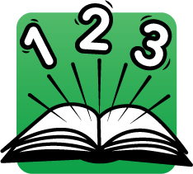
THREE READS
Read 1: What is the problem about?
Read 2: What are you trying to find out?
Read 3: What information is important?

Slide 22
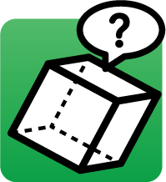
CO-CRAFT QUESTIONS
What is the problem about?
What questions can you ask that
mathematics can answer?

Slide 23

NOTICE AND WONDER
What do you notice?
What do you wonder?

Slide 24

SAY IT ANOTHER WAY
How would you say this problem in your own words?

