Slide 1
Georgia Milestones:
Let’s Experience Online Testing!

Slide 2
The Mission of the Richmond County School System Building a world-class school system through education, collaboration, and innovation.
The Vision of the Richmond County School System
The Richmond County School System will create a world-class, globally competitive school system where all students will graduate and are college/career ready.

Slide 3
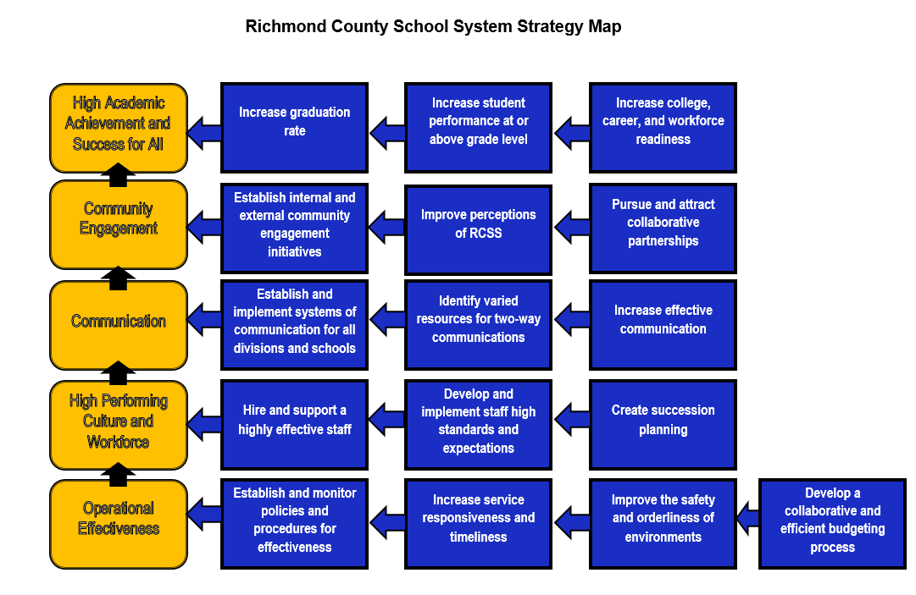

Slide 4
Guarantee High Academic Achievement for All
Ensure Communication and Collaboration within the Community
Provide a Safe, Orderly, and Healthy Learning Environment
District Focus
Students on track in Reading by end of 3rd grade
Students on track in Mathematics by end of 4th grade
Increase Graduation Rate for all students

Slide 5
District Goals
By the end of the 2017-2018 school year, the percentage of students performing on grade level in reading and math will increase from 40% to 50%.

Slide 6
**Make sure to use Google Chrome ONLY!
www.gaexperienceonline.com

Slide 21
Let’s try some tools!

Slide 24
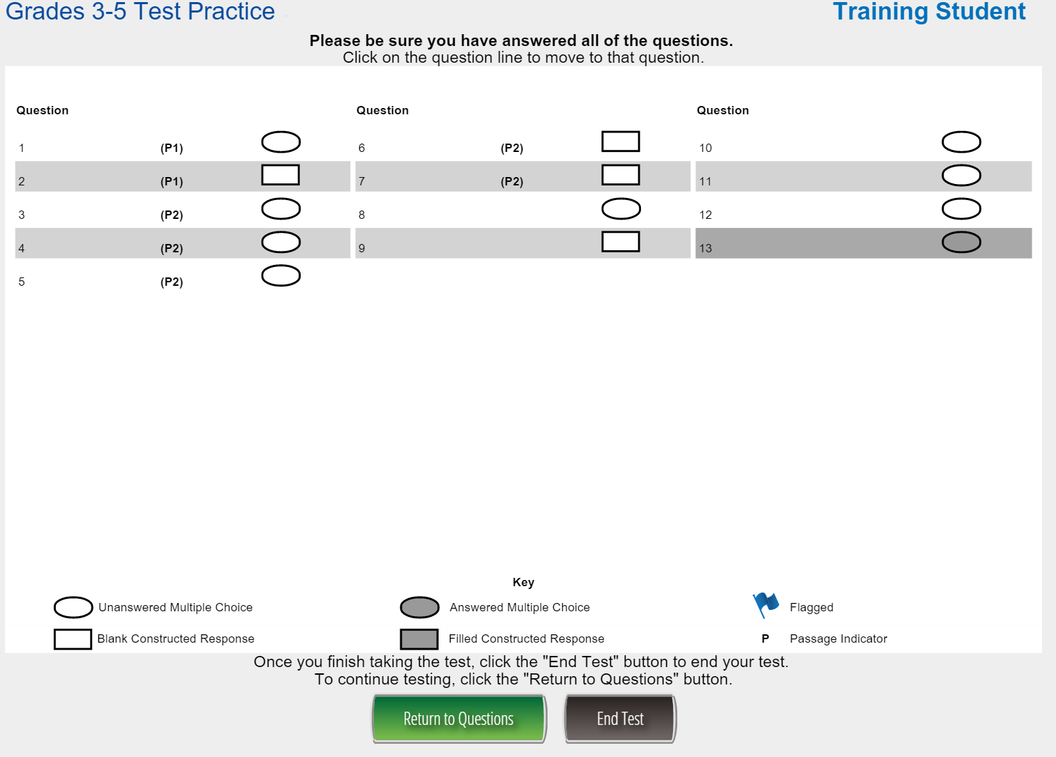

Slide 26
A few follow-up questions:
What was more difficult: the questions or working the computer??
How much easier would this be the 2nd or 3rd time you visit this site?
Other questions??

Slide 27
What’s at stake this year??
Determines promotion/retention status in grade 3 (reading only), grade 5 (reading and mathematics), and grade 8 (reading and mathematics)
Reading: a student who has a Below Grade Level Reading status will require remediation and retesting in ELA
Mathematics: a student who is classified as a Beginning Learner will require remediation and retesting in mathematics
The End of Course (EOC) measures serve as the final exam and comprise 20% of a student’s final course grade

Slide 28
Georgia Milestones Dates:
EOG | Week 1 Window: April 18-22 | Week 2 Window: April 25-29
Elementary: | Grade 3 (paper) Grade 4 (online) Make ups for Grades 3 & 4 | Grade 5 (online) Make ups for Grades 3, 4, 5
Middle: | Grade 6 (paper) Grade 7 (online) Make ups for Grades 6 & 7 | Grade 8 (online) Make ups for Grades 6, 7, 8
EOC | Week 1 Window: May 2-6 | Week 2 Window: May 9-13
Monday | Algebra (paper) Economics (online) | Physical Science (online) Biology (online)
Tuesday | Sections 1 & 2 American Lit (online) 9th Lit (paper) | Make ups for all parts
Wednesday | Section 3 American Lit (online) 9th Lit (paper) | Make ups for all parts
Thursday | Geometry (online) US History (paper)
Friday | Make up for Algebra, Econ, American Lit, 9th Lit, Geometry and US History

