Slide 1
Ancient Greece
SSWH3 Examine the political, philosophical, and cultural interaction of Classical Mediterranean societies from 700 BCE/BC to 400 CE/AD.
a. Compare the origins and structure of the Greek polis, the Roman Republic, and the Roman Empire.

Slide 2

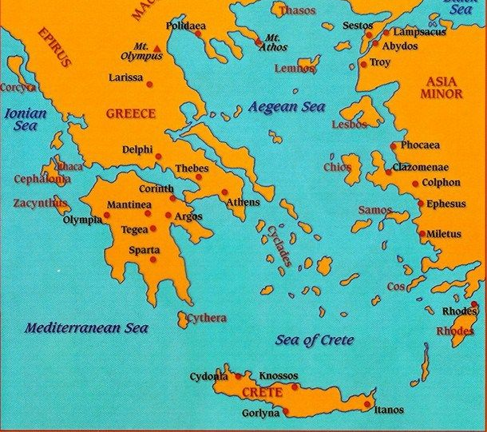


Map of Ancient Greece

Slide 3
Vocabulary
Hellenes – the word used to reference those born in Ancient Greece
Minoans – The first Greek civilization on the island of Crete.
Mycenaeans – A sea trading Greek civilizations that conquered Greek after the Minoans vanished
Polis – Greek word for city-state. The basic structure of Ancient Greek society
Athens – the polis that introduced the first democratic government
Sparta – the polis known for its warrior society.
Oligarchy – a form of government led by a few wealthy elites.
Democracy – a form of government in which elected officials make decisions for the people
Direct democracy- a form of government where citizens vote directly on laws.
Peninsula – a landmass surrounded by water on three sides.
Mount Olympus – The Home of the Greek Gods located in Northern Greece.

Slide 4


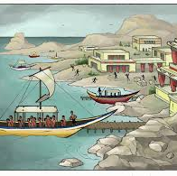

The Beginning of Ancient Greece -
The Minoans
Around 1750 B.C.E. - The Minoans built the first Greek civilization on the island of Crete in the eastern Mediterranean Sea.
The Minoans were sea traders who traveled to Egypt and Mesopotamia.
The Minoans learned about new ideas and technology from Egypt and Mesopotamia and adapted their culture based on these new ideas
HMMMMMM – May be the Greeks got their polytheistic religion and Gods from the Mesopotamia and Egypt

Slide 5
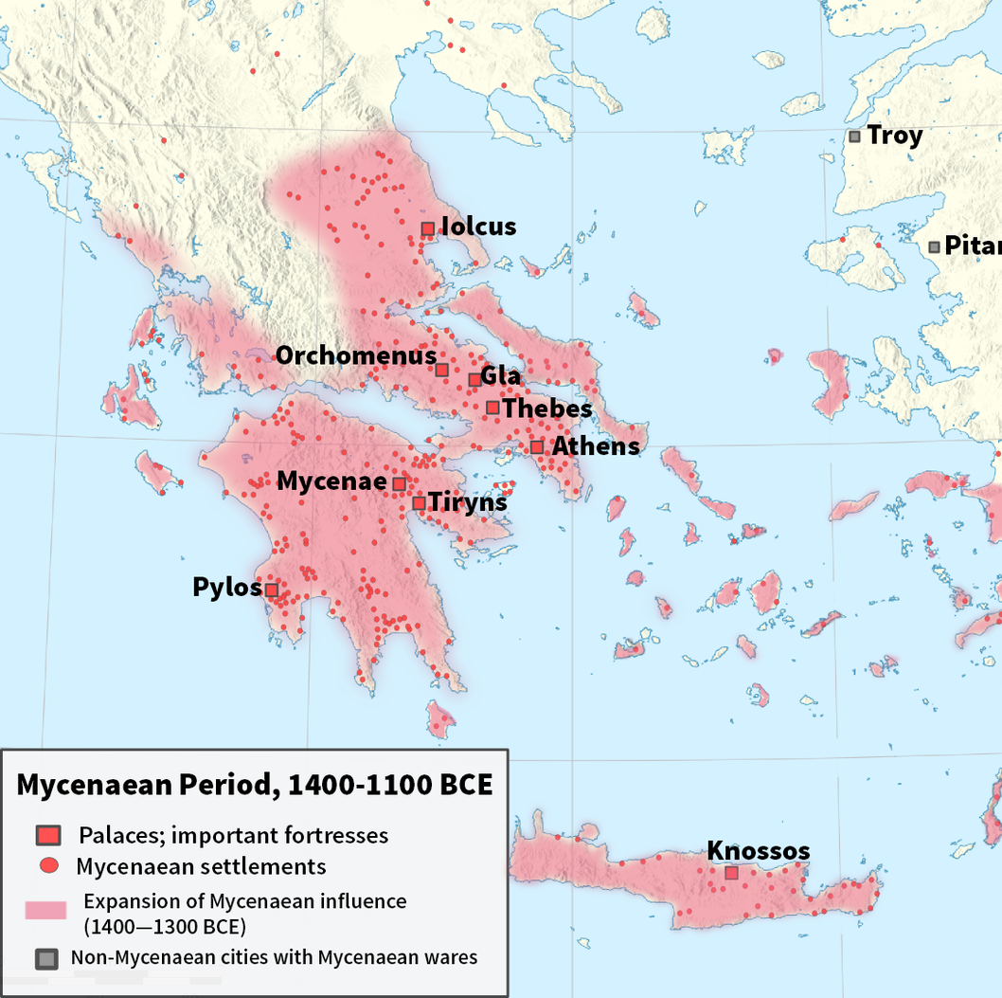
The Mycenaeans
Around 1400B.C.E - The Minoans disappeared. Possibly from a natural disaster according to Historians
The Mycenaeans were also sea traders and traded with not only Egypt and Mesopotamia, but also Silicy and Italy.
The Mycenaeans learned many skills such as writing, from the Minoans as well as other ideas and technology from Egypt and Mesopotamia.
These ideas and technology would have a lasting effect on Greek culture for the next millenia.

Slide 6
Legacy of the Mycenaeans
The Mycenaeans are best remembered for the Trojan War which took place around 1250 B.C.E.
In this war, the Mycenaeans defeated the trading city of Troy.
Much of what we know from this period comes from reading the epics of the poet Homer. An epic is a long poem that tells the story of a hero or heroes
The Iliad and the Odyssey gives us clues about the lives of the Ancient Greeks
https://www.youtube.com/watch?v=RbORIBYykuo - The Iliad and the Odyssey

Slide 7
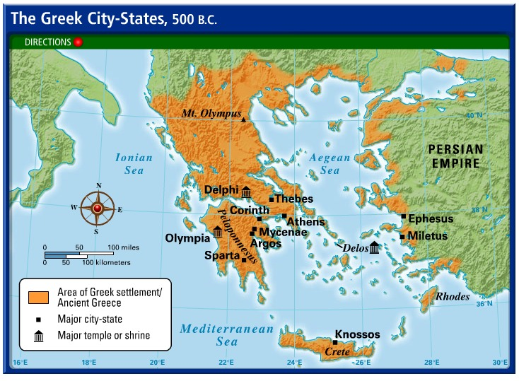
The Rise of Greek City States
Greece is made up of many isolated valleys and small islands
This geography prevented the Greeks from building a large empires like that of the Egyptians and Mesopotamians.
Instead, they built small city states that often fought with one another.

Slide 8
Governments of Ancient Greece
Between 750 B.C.E. and 500 B.C.E. - The Greek City States tried different forms of government.
At first city states were ruled by kings and queens = MONARCHY
The landowning nobles won power as time passed. = ARISTOCRACY
In some city states, a middle class of merchants, farmers, and artisans gained power. = OLIGARCHY

Slide 9
The Two Most Powerful City States -
Athens vs. Sparta
Athens -
Had a limited democracy, or gov't by the people
Only Male citizens could vote in the Assembly/Laws made by assembly
Traded with other city states
Education for Boys/ Woman inferior
Both shared same language/gods and religious beliefs
Sparta -
Sparta was a monarchy ruled by two kings
Sparta had a military society
Boys trained to be soldiers and girls were trained to be mothers of soldiers
Trade and Travel Outside of Sparta was not allowed
Only men born in Sparta and over the age of 30 were considered citizens
Shared language/gods and religious beliefs with Athens

Slide 10
The Persian War
Persian leader Xerxes leads a series of attacks on Greek City-States
1st – Battle of Thermophylae – Famous for its portrayal in the movie "300"
2nd – Battle of Marathon in which Pheidippides ran 26.2 miles to deliver the news of Athenian victory.
3rd - In 490 B.C.E. - The Persians Attacked the city-state of Athens and the Athenians were again victorious
Athens established themselves as a powerful city-state in Greece and believed the gods protected their city-state.

Slide 11
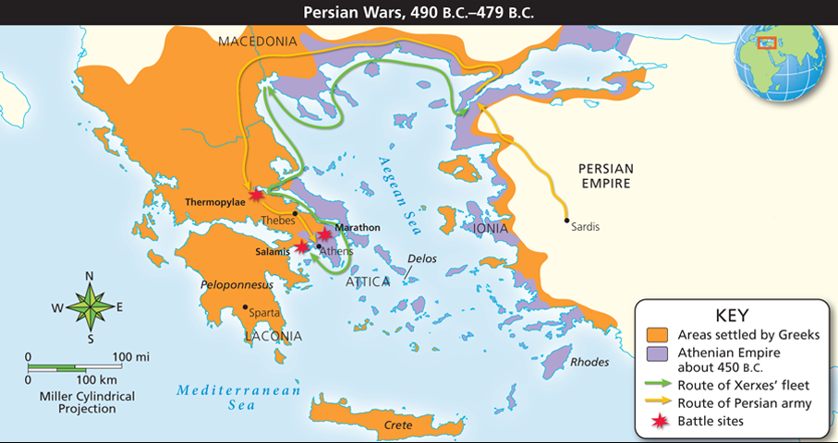

Slide 12
Age of Pericles
After the Persian defeat, Athens entered a Golden Age.
A wise leader named Pericles was named leader of the Athens.
Athens had a direct democracy which meant all that all male citizens had the right to vote and help run the government
Pericles pointed out that citizens had a special responsibility to participate in government.
Under the leadership of Pericles, Athens became the cultural center of Greece. Many thinkers, writers, and artists came to Athens during this time to take part in the growth of culture.

Slide 13
Impact of the Persian Wars
Athens organized the Delian League, an alliance with 150 Greek city-states and colonies in the Aegean region.
Athens used the Delian League to create an Athenian empire.
With Pericles as its leader, Athens enters into its Golden Age! But who was paying the bill? The members of the Delian League paid for Athens empire
Sparta will eventually form an opposing alliance with the neutral city-states

Slide 14
The Fall of Athens -
Peloponnesian Wars
Sparta and its allies resented Athenian wealth and power.
They formed a league to promote oligarchy while Athens and its allies promoted democracy.
The Peloponnesian Wars broke out between both sides in 431 B.C.E.
After 27 years of fighting, Sparta defeated Athens. Soon after, Sparta fell to Thebes, another Greek City-State.
Athenian democracy suffered tremendously and the city declined while Greek city-states fought for almost 50 years.

Slide 15
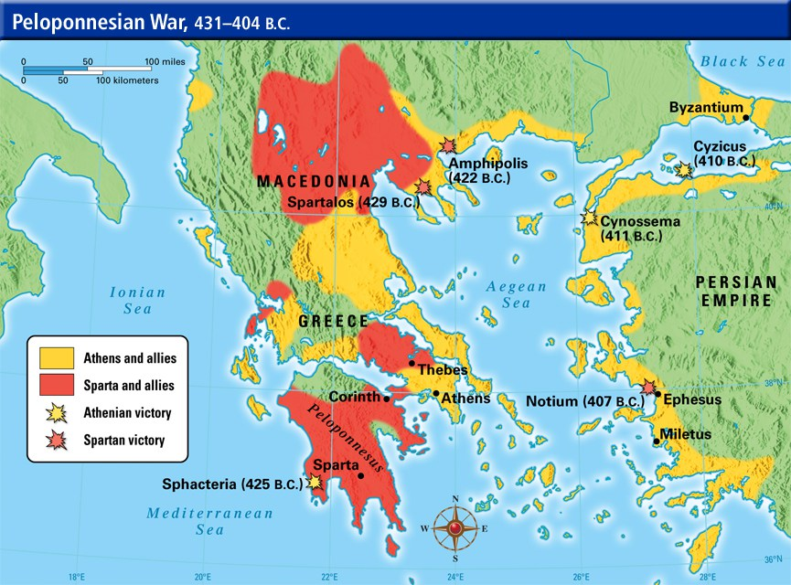

Slide 16
The Legacy of Greece
Philosophers/Inventors
Greek thinkers tried to understand the reasons for why things happened instead of blind faith of the gods.
The Greeks believed in beauty, balance, and order in the universe
3 famous Greek philosophers:
1. Socrates
2. Plato
3. Aristotle

Slide 17
Socrates vs. Plato
Developed the Socratic Method: Learning about beliefs and ideas by asking questions
The way to truth in life is through questioning everything around you
Student of Socrates, famous for "The Republic"
Believed government should control lives
Wanted a government ruled by the best men and women.
Divided society into three classes: workers, philosophers, and soldiers

Slide 18
Aristotle
Believed one strong and good philosopher king should rule
The influence of Aristotle’s work on the physical sciences such as physics, biology, and anatomy, spread far and wide throughout Greece
Aristotle was a student of Plato.
Alexander the Great became a student of Aristotle at Plato's Academy
“In all things of nature there is something of the marvelous.”
“Misfortune shows those who are not really friends.”
“He who has overcome his fears will truly be free.”

Slide 19
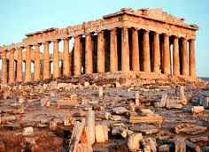
Greek Art
Greek art and architecture reflected the ideas of beauty, balance, and order.
Greek paintings and statues were life-like, but also idealistic, meaning they portrayed individuals in perfect form.
Ancient Greece were best known for their tragedies, or plays that told stories of human conflict. Others created comedies
To the left is the Parthenon, an important acropolis, or high city built as the city center in Athens. The Parthenon is a temple dedicated to the patron Goddess of the city, Athena.

