Slide 1
John Cabot
By:Luke Clark
Helper:Hunter Jones
Please Enjoy!

Slide 2
Achivements
John Cabot the Explorer. John Cabot, or Giovanni Caboto, was an Italian born navigator who explored the coast of Newfoundland for the English in 1497. Cabot has historically been credited with being the first European to land in North America since the Vikings.

Slide 3
Obstacles
John Cabot faced many difficulties like violent storms, strong winds, and food and water shortages. In fact, John Cabot was turned back on his first voyage due to storms, food shortages, and problems with his crew. However his second voyage with five ships and three hundred men was successful and it is believed that he landed on Newfoundland at Cape Bonavista. John Cabot was also lost at sea with his crew, ships, and possibly his son. They were never contacted again, so the cause and date of his death is unknown.

Slide 4
Reason
Reasons for Sailing. John Cabot was an English explorer who was sent to explore the "New World" by King Henry VII. England was anxious to explore the lands explored by Christopher Columbus. England was also interested in finding lands that the English could claim as colonies.

Slide 5
Why He Was Famous
Explorer and navigator John Cabot was born Giovanni Caboto in Italy around 1450. By 1495, he had moved to Bristol, England, with his family. He made a voyage in 1497 on the ship Matthew and claimed land in Canada—mistaking it for Asia—for King Henry VII of England.

Slide 6
Purpose
In Italy, he is known as Giovanni Caboto (which is his original name). Cabot was born in Italy but moved to England in 1495. At the request of King Henry VII of England, Cabot sailed to Canada in 1497, commanding the small ship called "Matthew."

Slide 7
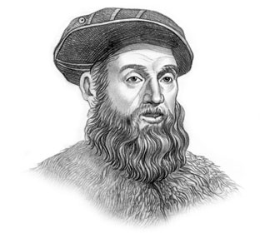
Other Facts
John Cabot Fact 1: John Cabot was born 'Giovanni Caboto', sometime around 1450 in Genoa Italy, to Giulio Caboto a spice merchant. The name Caboto is translated as 'coastal trader'.

Slide 8
Video About John Cabot
https://www.youtube.com/watch?v=pJOvmicAGjw
https://www.youtube.com/watch?v=Bz1KYNfaoSw
https://www.youtube.com/watch?v=xnr74CKyHiA
https://www.youtube.com/watch?v=TTKE_USotmo
https://www.youtube.com/watch?v=m7yBWrhLTDA

Slide 9
How He Died
The aim was to discover Japan. Cabot set out from Bristol with 300 men in May 1498. The five ships carried supplies for a year's travelling. There is no further record of Cabot and his crews, though there is now some evidence he may have returned and died in England.

Slide 10
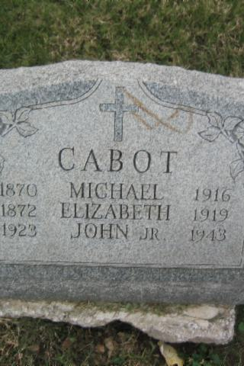
His Tomb Stone
Here Is John Cabot’s Tomb Stone!

Slide 11
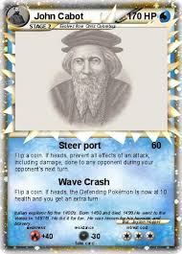
Funny Picture!!!
Here Is A Pokemon Card Of John Cabot Now If You Want TRY NOT TO LAUGH!!!!!!!!!!

Slide 12
When he wAs born
John Cabot (c. 1450, disappeared May 1498), born Giovanni Caboto, was a Venetian explorer and navigator known for his 1497 voyage to North America, where he claimed land in Canada for England.Aug 31, 2017

Slide 13
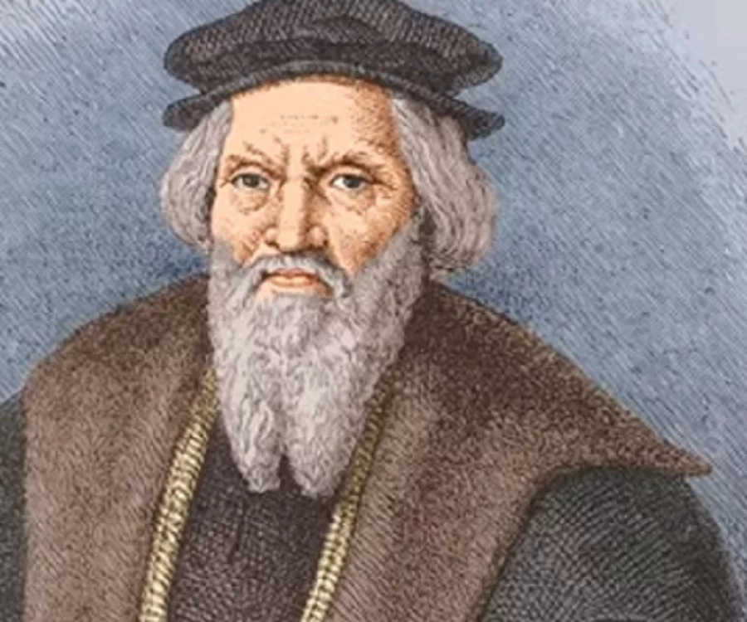
What He Looked Like
Here Is A Picture Of John Cabot Himself.

Slide 14
Credits
Made By:Luke Clark Special Thanks To:John Cabot For Making This Possible!!!!!!!!!!!!!!!! I Love Everyone Who Made This Happen I Hope You All Have A Good School Year And Cristmas Is Coming Soon So Be Naghty About Some History And MERRY CRISTMAS TO ALL :D!!!!!!!!!!!!!!!!!!!!!!!!!!!!!!!!!!!!!!!!!!!!!!!!!!!!!!!!!!!!!!!!!!!!!!!!!!!!!!!!!!!!!!!!!!!!!!!!!!!!!!!!!!!!!!!!!!!!!!!!!!!!!!

Slide 15
The End
I Hope You Enjoyed My PowerPoint On John Cabot And If You Did You Are A Good Person.

