Slide 1
Aftermath of WWII
Element: Explain allied Post-World War II policies; include formation of the United Nations, the Marshall Plan for Europe, and MacArthur’s plan for Japan.
Vocabulary: United Nations, Marshall Plan

Slide 2
Post-war Europe
Description:
London, Warsaw, Berlin suffered terrible destruction
War torn cities had displaced agriculture
Spread of famine and disease
Missing able bodied men to plant fields
First winter after the war there was no food, shoes or coats

Slide 3
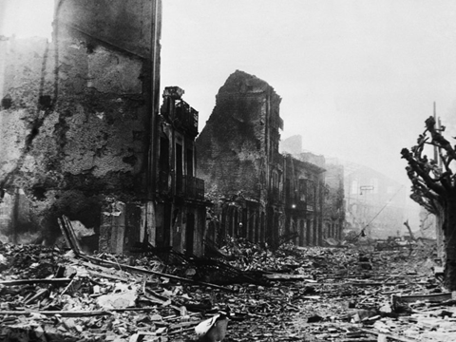

Slide 4
Post-War Europe
Nuremberg Trials:
International Military tribunal representing 23 nations that lasted from 1945 to 1946 in Nuremberg, Germany
trials on “crimes against humanity”
those found guilty were executed and their bodies were cremated at the concentration camp Dachau

Slide 5

What was Europe like after the war?
Discuss with an elbow partner.
Be prepared to share what your partner shared with you!

Slide 6
Formation of the UN
League of Nations
United Nations
Purpose:
International peacekeeping
Years of Service:
1919-1946
Member Nations:
23 nation members
Purpose:
International peacekeeping
Years of Service:
1945-
Member Nations:
192 nation members

Slide 7
Formation of the UN
League of Nations
United Nations
Accomplishments:
Health and economic advancements; failed to prevent World War II and was the reason for disbanding
Accomplishments:
Economic development and environmental protection

Slide 8
The United Nations
June 1945, 48 nations join together forming this international peace keeping body
  General Assembly: all member nations meet, 1 vote per nation
  Security Council: 11 members, 5 permanent members (U.S., Great Britain, U.S.S.R., France, and China)
    The real power of the UN

Slide 9
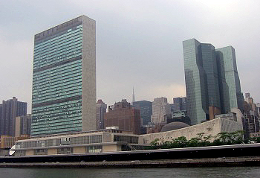
UN Headquarters in New York City

Slide 10

Stop and Think!
What is the purpose of the UN?
What is the difference between the League of Nations and the United Nations?

Slide 11
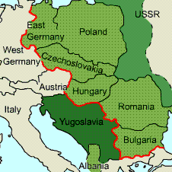
Soviets Build a Buffer
Nations:
Albania
Bulgaria
Hungary
Czechoslovakia
Romania
Poland
Yugoslavia
necessary as
“Wall of Protection”

Slide 12
Soviet Build a Buffer
Impact:
Stalin ignored his agreement at the Yalta conference and designated in each country a communist government
Truman pressed Stalin to live up to his agreement to FDR at Yalta to allow free elections in Eastern European countries
Stalin refused

Slide 13
Europe Divided
“…an iron curtain has descended across the continent. Behind that line lie all the capitals of the ancient states of Central and Eastern Europe…All these famous cities and the populations around them lie in the Soviet sphere and all are subject in one form or another, not only to Soviet influence but to a very high and increasing measure of control from Moscow”
        Winston Churchill, “Iron Curtain” speech, March 5, 1946

Slide 14
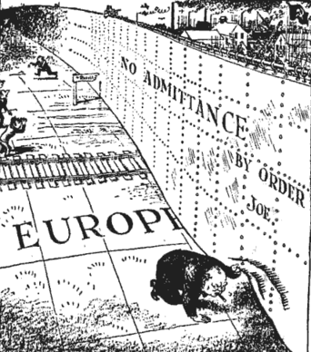
Division of the Allies
Iron Curtain:
speech given by Winston Churchill
figure of speech was representation Europe’s division into mostly democratic Western Europe and Communist Eastern Europe

Slide 15
Occupation of Berlin
following World War II
the Allies divided Germany into four occupation zones
rivalries for influence over the German territories led to disagreements during the occupation of Germany by the French, British, Russians, and Americans
all four powers split the German capital of Berlin into four zones as well

Slide 16
Germany Split in Two
East Germany along with half of the capital occupied by Soviets
  Communist government Renamed German Democratic Republic
West Germany occupied by US, France, and Britain
  Federal Republic of Germany

Slide 17
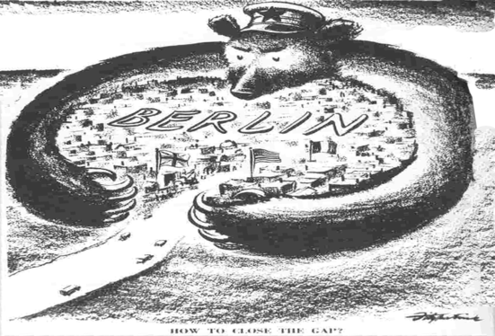
Berlin Blockade
1948-9
Berlin was on the Soviet side of the occupation
Soviets began to blockade any food into the city to force the other three out

Slide 18
Berlin Airlift
response to the Soviet blockade
U.S. did not want to start an armed conflict with the Soviet Union
U.S. and Great Britain responded by dropping supplies down to the people of Berlin, Germany via airplanes
Soviet Reaction to the Berlin Airlift
  Stalin declared that communism and capitalism could not coexist

Slide 19
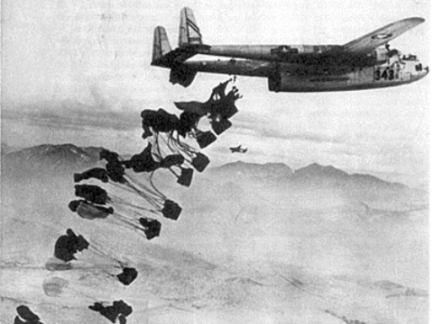

Slide 20
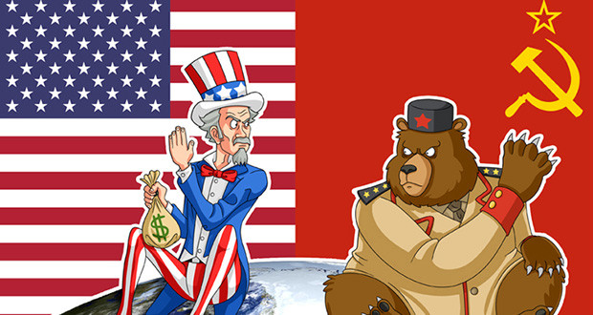
The Cold War – Stop and Think!
How did the “Cold War” impact Europe in years following World War II?
  List some specific examples

Slide 21
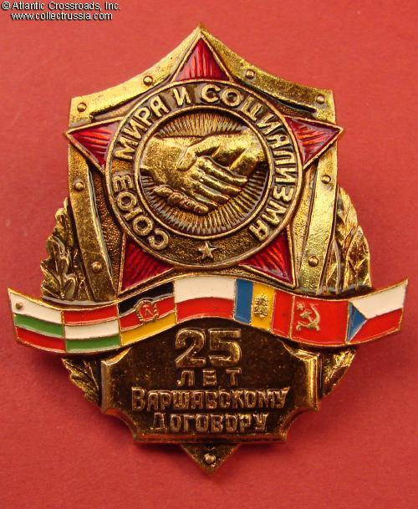
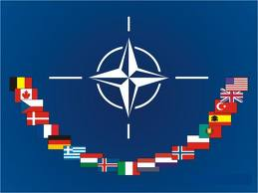
The World Chooses Sides
NATO
Warsaw pact

Slide 22
North Atlantic Treaty Organization (NATO)
provide for the mutual defense of Western Europe
NATO-like treaties concluded with Asia and Pacific nations
expansion of America’s military, economic, and diplomatic presence

Slide 23
Warsaw Pact
Soviet response to U.S. NATO
provided for the mutual defense of Eastern Europe

Slide 24
Greek Civil War
British informed the US they were no longer able to assist the Greeks in resisting the communist attempt to take
the US believed that communism would infiltrate those areas of Europe that were left weakened by the effects of World War II

Slide 25
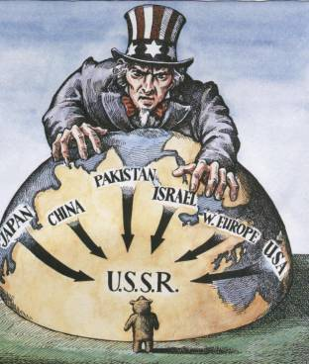
Containment Policy
key foreign policy until downfall of the Soviet Union in 1991
US pledged to protect world from communist expansionism
Methods:
  Military force
  Economic aid

Slide 26
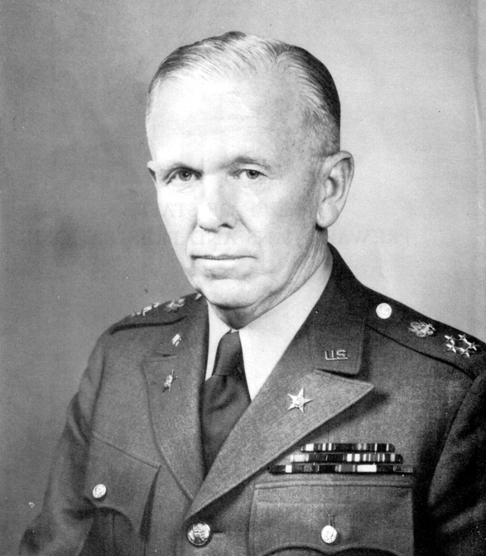
The Marshall Plan
George C. Marshall, the Secretary of State during the Truman Administration
European Recovery Program
combat negative economic impact of World War II

Slide 27
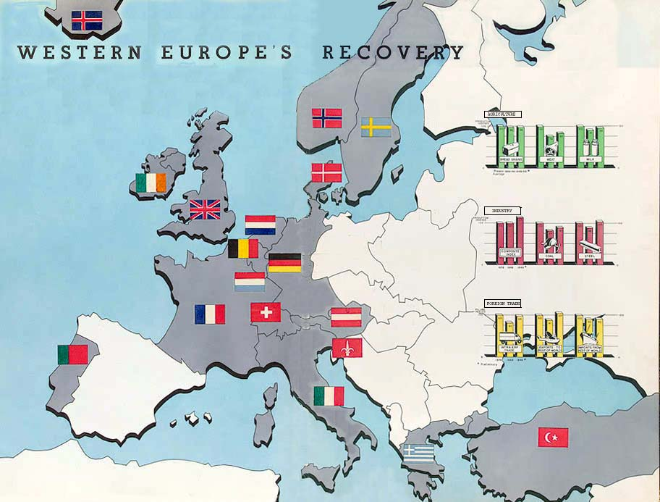
Marshall Plan
Major Aims:
to prevent spread of communism
to stabilize the international political order

Slide 28
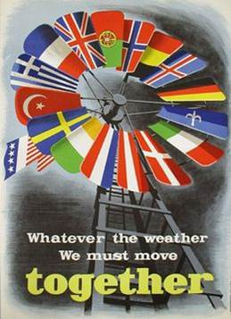
Marshall Plan
Impact:
in 4 years Congress appropriated $13.3 billion
aided 22 European nations
assisted American businesses by opening up European markets
helped stabilize European politics to resist communist infiltration

Slide 29

Stop and Think!
The Marshall Plan was an attempt by the United States to combat communism by using
A) military strength to control war ravaged Europe.
B) economic sanctions against communist countries in
Europe.
C) economic aid to countries in Europe to make
communism less attractive.
D) diplomatic sanctions against Soviets and other
communist countries in Europe.

Slide 30
Post-War Japan
Description:
Tokyo, Hiroshima, Nagasaki destroyed
General McArthur placed in charge of U.S. occupation
wanted to ensure peace and prevent a future war

Slide 31
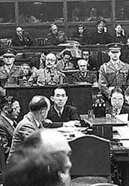
Goal of Occupation
Demilitarization:
disbanding of the Japanese armed forces
done quickly
only allowed a small police force
Held trials for war criminals
7 out of 25 accused sentenced to death by hanging, including Hideki Tojo (Japan’s Prime Minister)

Slide 32
Goal of Occupation
Reforms:
broaden land ownership
  huge estates sold to the government
  government then sold to tenant farmers at reasonable prices
  increase participation of workers and farmers
  creation of independent labor unions

Slide 33
Democratization
Role of Emperor:
before war the emperor viewed as divine
after surrender Hirohito declared he was not divine
Emperor became a figure head
transformed Imperial Japan into a constitutional monarchy similar to Great Britain
a government created by the people

Slide 34
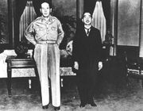
Gen. Macarthur and Emperor Hirohito

Slide 35
Democratization
Development of the Constitution:
most important achievement of occupation
drafted by McArthur and staff
the Diet (Japanese 2 house Legislative body) ran the government
had a prime minister (head of the majority party of parliament)

Slide 36
Democratization
everybody allowed to vote (men & women over age of 20)
creation of Bill of rights to protect basic freedoms
Article 9 - the Japanese could no longer make war, only fight if attacked

Slide 37
U.S. Occupation
March 1952 occupation was over
Japan agreed to a continuing U.S. military presence to protect their country in the absence of an armed force
bitter enemies became allies
new peace process known as “Nation Building”

Slide 38
Stop and Think!
What role did Douglas MacArthur play in implementing Allied policies after World War II?
A) He oversaw the post-war occupation of Japan.
B) He negotiated the founding of the state of Israel.
C) He directed the political division of Germany.
D) He organized the Yalta and Potsdam Conferences.

