Slide 1
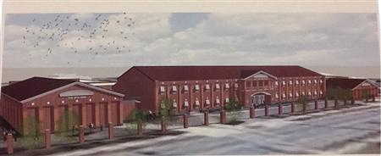
Lucy C. Laney High School School Council Meeting
December 18, 2024

Slide 2
Establish Roles
Time Keeper
Norms Monitor
Recorders

Slide 3
Meeting Norms
Begin and end on time
Keep an open mind
Respect everyone’s opinions
Stay on task

Slide 4
Purpose & Objective of School Council

Slide 6
School Council Leadership
Chair Person:
Co-Chair Person:
Secretary:

Slide 7
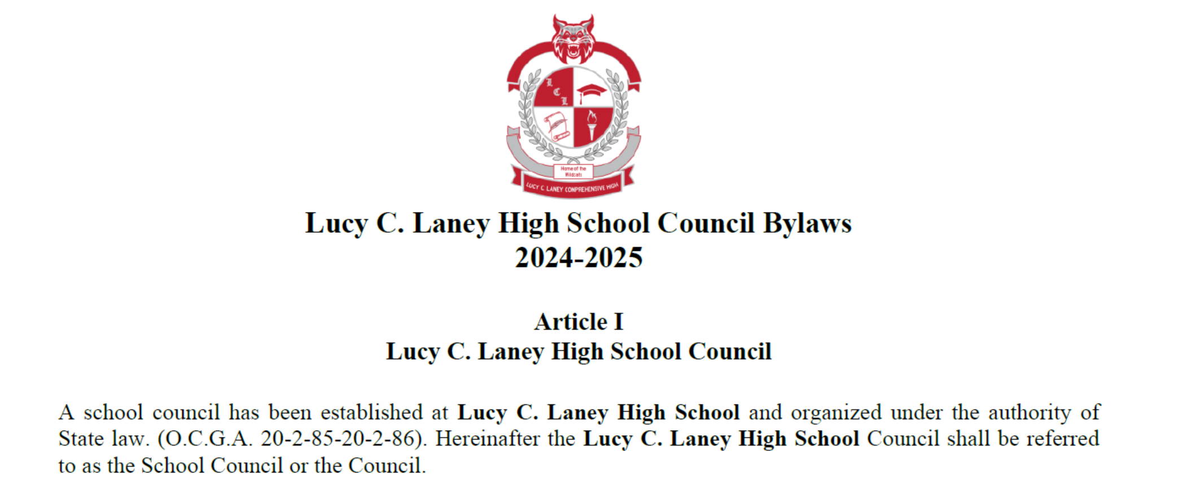

Slide 8
Discipline (OSS and ISS Suspension Days)
* As of October 29, 2024
TYPE | # of Days
In School Suspension | 249
Out of School Suspension | 332
Students > 10 days ISS | 1
Students > 10 days OSS | 1
M
Notes:
This slide should include major and minor referrals.
Include SWD suspensions, both in and out of school.

Slide 9
Discipline (Minor)
* As of October 29, 2024
Total Referrals: 663
M
Notes:
This slide should include major and minor referrals.
Include SWD suspensions, both in and out of school.

Slide 10
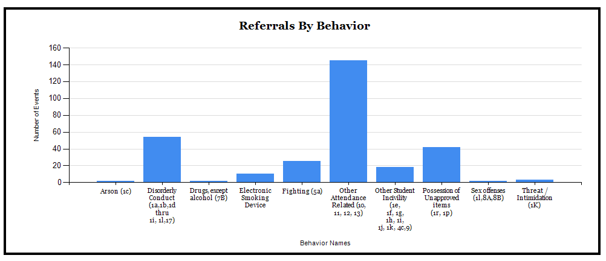
Discipline (Major)
* As of October 29, 2024
Total Referrals: 306
145
56
42
25
11
18
2
2
2
3
M

Slide 11
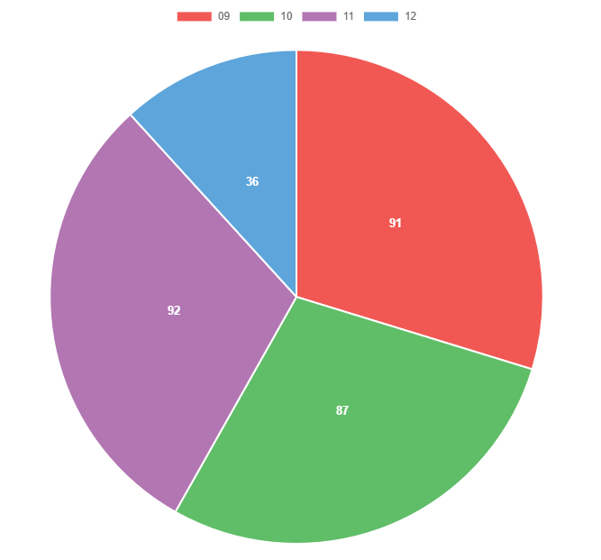
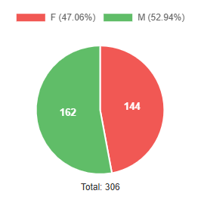
Discipline
* As of October 29, 2024
M
Notes:
This slide should include major and minor referrals.
Include SWD suspensions, both in and out of school.

Slide 12
Prevention/Intervention Strategies
Review data periodically to adjust coverage duty areas and monitor high traffic areas
Incentives for students who limit tardies and have limited referrals
Student conferencing with counselors and administrators
Behavioral observations and Behavioral Intervention Plans implemented as needed
Daily review of school expectations (W.I.N.)
M
Notes:
This slide should include major and minor referrals.
Include SWD suspensions, both in and out of school.

Slide 13
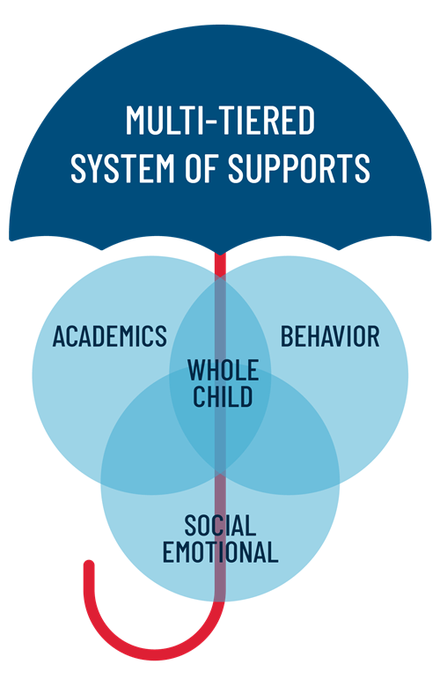
MTSS – Multi-Tiered Systems of Support
MTSS Focus
2025 off cohort
Meetings occur monthly
Tier 2 & 3 interventions
Resources
Reading and Math Remediation Courses
ST Math
Edmentum
 | Math | Reading | Behavior
Tier 2 | 24 | 18 | 1
Tier 3 | 11 | 9 | 0
O

Slide 14
Cohort Data
Cohort | On Track | At Risk | Valid Withdrawals | Drop Outs | Total | Graduation Rate
2025 | 100 | 64 | 44 | 41 | 249 | 48.78
2026 | 98 | 62 | 43 | 17 | 220 | 55.37
2027 | 128 | 55 | 29 | 9 | 221 | 66.67
2028 | 0 | 192 | 5 | 4 | 201 | 0
32 at-risk students should graduate in May 2025
26 at-risk students should graduate in July 2025
O

Slide 15
Literacy Initiative and/or Reading Campaign
L.I.T. @ Laney (1st & 3rd Tuesdays)
1 School 1 Book: Chaos Theory by Nic Stone
PINES Book Mobile (4th Thursdays)
Library collaboration with Maxwell Branch (2nd Thursdays) (JROTC)
August Circulation: 174; Patrons: 264; Classes:16
September Circulation: 482; Patrons: 422; Classes: 19
Lunch Bunch, Classes for citations and plagiarism, updated Manga and Lower Level
H

Slide 16
GMAS / EOC
Algebra C & C
Algebra: C & C
# Tested | Mean Score | Achievement Level
 |  | Beginning % | Developing % | Proficient % | Distinguished %
Made Desmos calculator part of daily rituals
Created anchor charts & reference sheets
Facilitating learning with Learning Plans for rigor
Collaboration of resources
Math Academy
Incorporating stations
ST Math & IXL for full year
Change in Dev & Above Algebra C &C | Change in Dev & Above Biology
197 | 462 | 69 | 24 | 6 | 1
Biology
# Tested | Mean Score | Achievement Level
 |  | Beginning % | Developing % | Proficient % | Distinguished %
9 | 9
Biology
Sticking close to pacing guide
Prepared for collaboration with resources and feedback
Pre/Post unit assessment
Hands on labs
Progress Learning
Learning Cycle for differentiated stations
172 | 467 | 61 | 24 | 13 | 2
F

Slide 17
GMAS / EOC
American Lit & Comp
# Tested | Mean Score | % Failed Reading | Achievement Level
 |  |  | Beginning % | Developing % | Proficient % | Distinguished %
American Lit. & Composition
Incorporating TITD grammar activities
Citing textual evidence lessons in Media Ctr.
Pre/Post district assessments
Do Now’s with test format & question types
Stations: grammar, writing, reading comprehension, remediation
IXL interventions
Progress Learning
Change in Dev & Above Am Lit
Change in Dev & Above US History
158 | 455 | 70 | 65 | 28 | 7 | 0
United States History
# Tested | Mean Score | Achievement Level
 |  | Beginning % | Developing % | Proficient % | Distinguished %
6 | 9
US History
Team teaching
Consultant
Pre/Post district assessments
Progress Learning
137 | 463 | 64 | 28 | 7 | 1
F

Slide 18
SAT & ACT
Plan of Action:
SAT & ACT Course
Khan Academy
SAT Prep Books
Math & Reading Switch
SAT & ACT Plan
1000 Club Bulletin Board
SAT & ACT Registration Day
SAT & ACT Deadline Reminders
Superstar Recognition
SAT & ACT Question of the Day
SAT & ACT Mock Assessment
SAT Evidence-Based Reading
School | 2022-2023 | 2023-2024 | Change
Laney High School | 456 | 469 | 13
SAT Math
School | 2022-2023 | 2023-2024 | Change
Laney High School | 415 | 444 | 29
Combined | 2023 | 2024 | Change
Laney High School | 871 | 913 | 42
ACT Composite
School | 2022-2023 | 2023-2024 | Change
Laney High School | 16.2 | 15.8 | 0.4
F

Slide 19
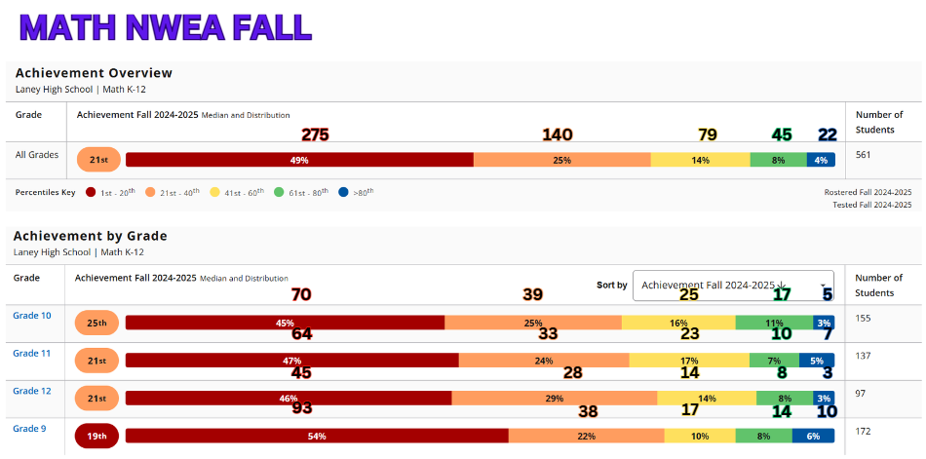
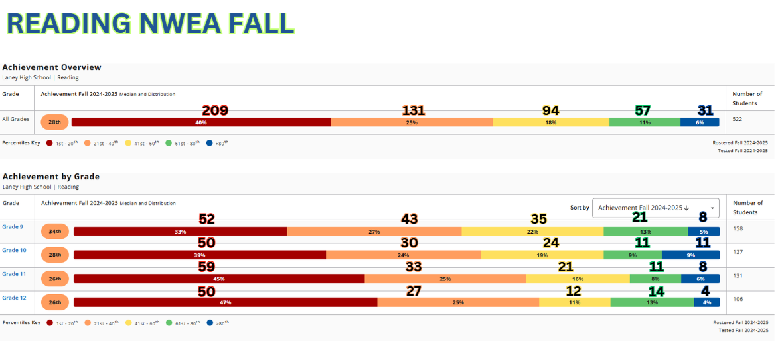
NWEA MAP (HS)
Data is used to formulate flexible groups utilizing RIT scores. Teachers use RIT scores to help determine instructional focus based on content area. Teachers use the Learning Continuum to assist in determining specific needs of each student and set goals.
Grade level with highest achievement percentage in Blue (>80th percentile): 10th - 11% (About 11 students)
Grade level with highest achievement percentage in Red (20th and less): 12th - 47% (About 50 students)
Grade level with most completed assessments: 9^{th-} - 158 students
11th Grade – Focus - Georgia Milestones Area: American Literature
Grade level with highest achievement percentage in Blue (>80th percentile): 9th - 6% (About 10 students)
Grade level with highest achievement percentage in Red (20th and less): 9th - 54-(About 93 students)
Grade level with most completed assessments: 9^{th-} - 172 students
9th Grade – Focus - Georgia Milestones Area: Algebra C&C
NWEA Map data is used to focus on our Tier 2 students scoring in yellow and orange. These groups are flagged for interventions and provided additional classroom supports.
Tier 1: Regular classroom instruction (majority of students). (Blue/Green)
Tier 2: Students who need additional help in small group settings. (Yellow)
Tier 3: Students needing intensive, individualized intervention. (Red)
B & B
Notes:
How are you using it?

Slide 20
SIP Goals
Goal 1: Increase the percentage of students performing at or above the developing level on the Georgia Milestones Assessment in all content areas by 6 percentage points, raising the school overall average from 37% to 43% by the end of the 24-25 SY.
Goal 2: Increase the percentage of students reading on grade level from 35% to 45%, as measured by the NWEA MAP Benchmark Assessment, by the end of the 24-25 SY.
Goal 3: Decrease the number of disciplinary referrals by 26%, reducing them from 542 to 400, by the end of the 24-25 SY.
Goal 4: Increase the 4-year Cohort Graduation Rate of 73.54% in 2024 to a 76.54% 4-year Cohort Graduation Rate in 2025.
F

Slide 23
Next Steps…
Incorporate instructional opportunities to inform the parent/guardians of instructional expectations.
Continue to build lasting relationships with parent/guardians in an effort to bridge the gap between home and school.
Broaden our community partnership in effort to have a greater impact on our students as well as the community.
Next School Council Meeting: TBD

Slide 24
#OneTeamAndWinning

