Slide 1
Forensics
Glass: Locating, Collecting, Identifying, and Comparing Samples of Glass

Slide 2
Glass
Common to most localities
Composed of silicon/metal oxides
Sand is primary in ordinary glass
Soda-lime glass
Boronsilicates

Slide 3
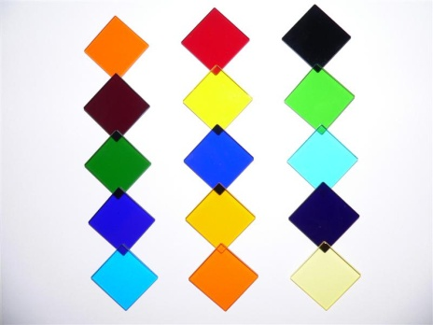
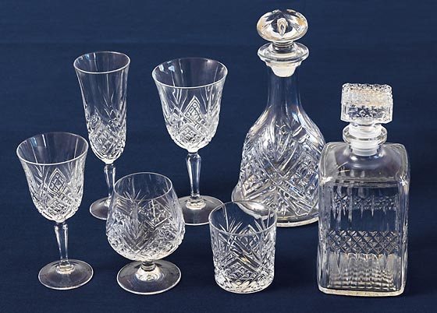
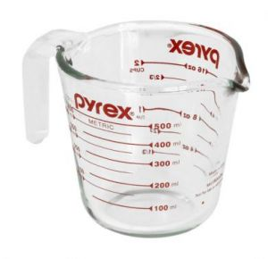
What Types of Glass Are There?
The primary uses for glass are in windows, containers, light bulbs and eyewear.
Borosilicate Glass (pyrex): 5% borax (Na₂B₄O₇) is added to resist breaking when heated or cooled.
Colored Glass: metal oxides or colloidal iron (Fe) & sulfur (S) are added to change its color.
Lead glass: Pb increases refractive index & density

Slide 4
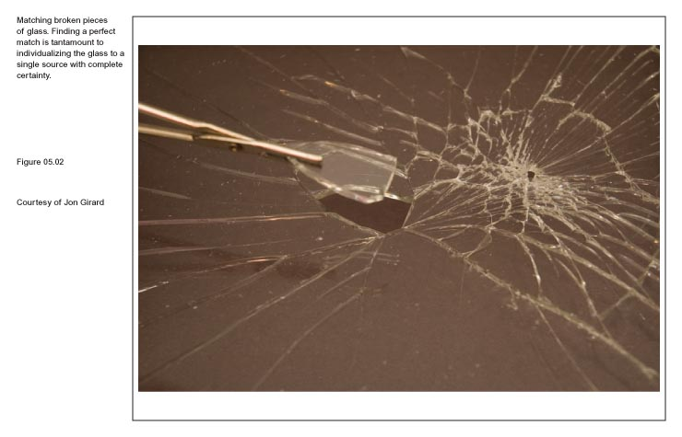
Because glass is amorphous, no two glass objects will break the same way.

Slide 5
Glass – Types
Flat glass: made by a “float glass process”, molten glass is floated on a pool of tin while cooling, commonly found in doors and windows.
Tempered:Rapid heating/cooling process, Side/rear windows on U.S. Autos,designed to break into tiny pieces, potassium (K) replaces sodium (Na) on the surface.
Laminated:Two sheets glass, Banded with plastic film, Windshields on U.S. Autos.

Slide 6
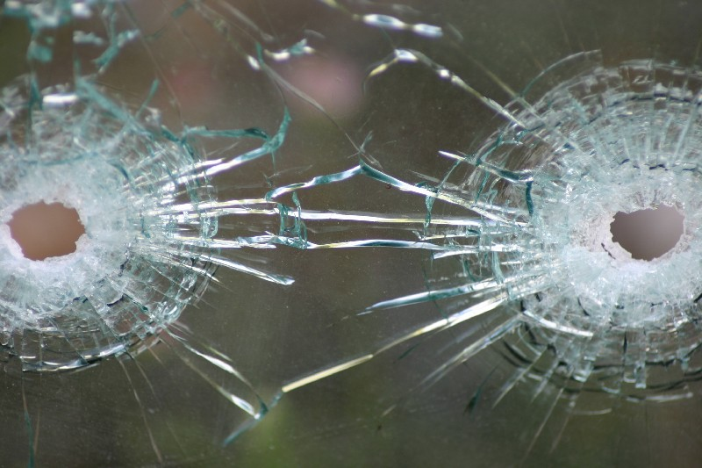
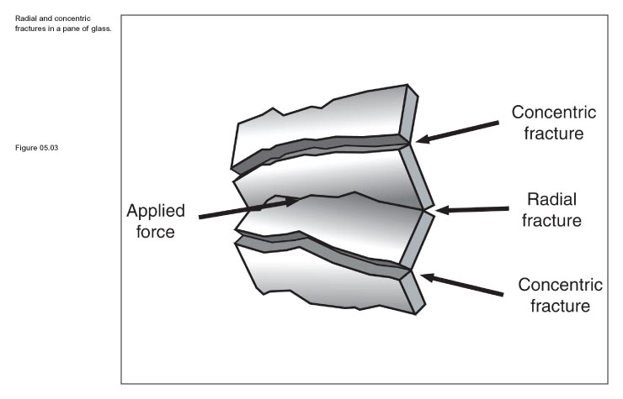
How Does Glass Break?
Radial cracks form first and are propagated in short segments on the side opposite the force.
Concentric cracks come later from continued pressure on the same side as the force applied.

Slide 7
Glass Fractures: Radial
Crack in glass extending outward, similar to spoke of a wheel at point of impact.
Radial fractures form right angles on reverse side of force.
Occur first on the side OPPOSITE of the force

Slide 8
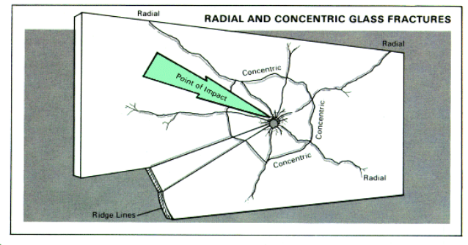
Glass Fractures: Radial
Crack in glass extending outward, similar to spoke of a wheel at point of impact.
Radial fractures form right angles on reverse side of force.
Occur first on the side OPPOSITE of the force

Slide 9
Glass Fractures: Concentric
Cracks in glass forming rough circle around point of impact.

Slide 10
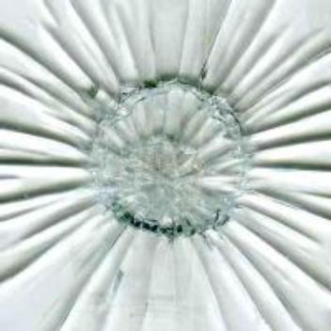
Glass Fractures: Concentric
Occur second and on the impact side

Slide 11
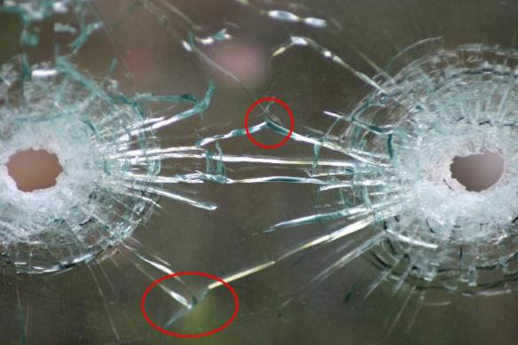
Fracture Patterns
A fracture pattern will stop when it encounters an existing fracture line

Slide 12
Glass Fractures
Investigators can/may determine:
Force
Velocity
Direction of impact
Object causing fracture

Slide 13
Collecting Glass
Must be thorough
Aware of transference
Must obtains samples for comparison
Use paper when packaging!
Sealable containers, large pieces

Slide 14
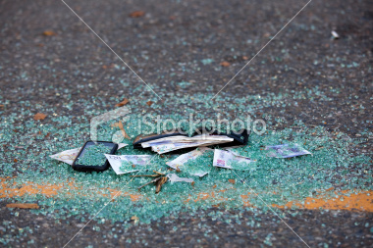
Identify/compare fragments
Can place suspect at scene of crime
Variety of tests
Not all tests performed
Comparing two samples
Determine if from same/different sources

Slide 15
Glass particles can be found at various crime scenes, such as breaking and entering, hit and run, vandalism, or murder.
Glass at a crime scene is analyzed to determine its color, surface characteristics, tint, thickness, density, chemical composition, and refractive index (RI).

Slide 16
Refractive index is tested by immersing glass in liquid. Match point is reached when there is minimal contrast between the liquid and glass.
Density is measured by flotation.

