Slide 1
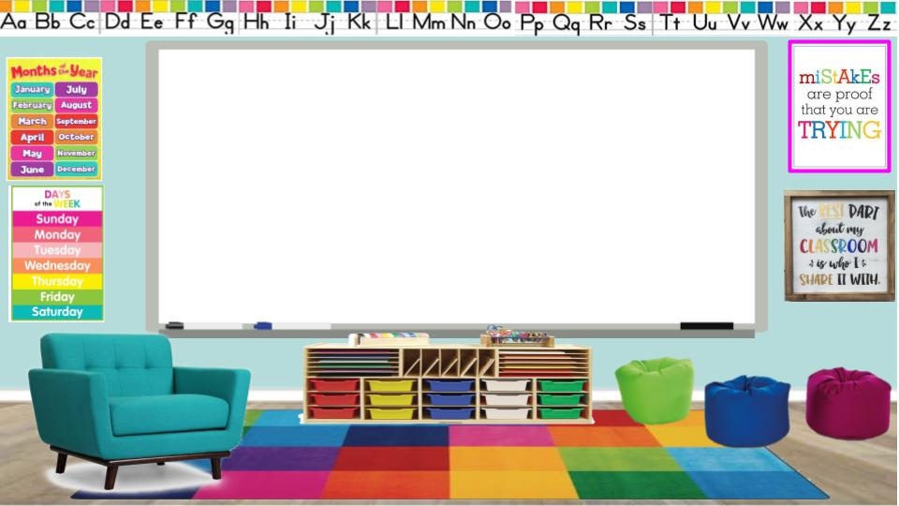
Virtual Learning Presentation
Ms. Morrall

Slide 2
Virtual Learning Supply List
2 composition & 2 spiral notebooks (wide ruled)
Crayons/markers/colored pencils
Copier Paper (white)/construction paper (colored)
Dry Erase Boards, Markers, & Dry Eraser or clean sock
3 Folders
Glue Sticks
Headphones
Index Cards
Kid- Friendly Scissors
2 Packs of Wide Ruled Paper
Pencils, Pencil Bag/Pouch, Pencil Sharpeners, Erasers
3 Plastic Pocket Folders (with pockets and prongs)
Sheet protectors
Technology (laptop/ tablet)
Stylus

Slide 3
Morning Virtual Learning Schedule
Time | Minutes | Subject
AM SCHEDULE
8:00-9:00 | 60 | Planning
9:00-10:30 Live Instruction | 90 | Mon. & Wed. ELA/Reading/SS |  | Tue. & Thur. Math/Science
10:30-10:40 | 10 | Brain Break
10:40-11:00 Live Instruction | 20 | Mon. & Wed. Math/Science | Tue. & Thur. ELA/Reading/SS

Slide 4
Afternoon Virtual Learning Schedule
PM SCHEDULE
1:00-2:30 Live Instruction | 90 | Mon. & Wed. ELA/Reading/SS | Tue. & Thur. Math/Science
2:30-2:40 | 10 | Brain Break
2:40-3:00 Live Instruction | 20 | Mon. & Wed. Math/Science |  | Tue. & Thur. ELA/Reading/SS

Slide 5
Virtual Learning Expectations
Be Attentive
Be Presentable
Be Engaged
Be Respectful
Be Prepared

Slide 6
How to Access the Virtual Learning Platform
Continue to the Next Slide to Learn How to Access Canvas in 3 Easy Steps
Next Slide

Slide 8
How to Navigate the Virtual Learning Platform
Click on the link to view videos on how to navigate through Canvas
All About Canvas

Slide 9
Live Learning
Click on this button from the homepage to enter your live instruction session.

Slide 10
Let’s Have a Great Year!!!

