Slide 1
Notes:
I Survived the Sinking of the Titanic, 1912

Slide 2
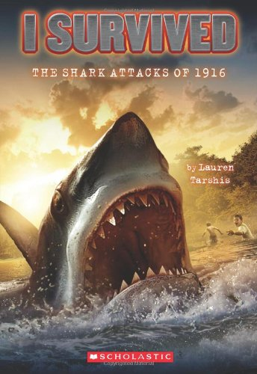
Part 1 | Part 2
Part 3 | Part 4
Notes:
I Survived the Shark Attacks of 1916

Slide 3
Chapters 1-4 | Chapters 5-7
Chapters 8-11 | Chapters 12-16
Notes:
I Survived Hurricane Katrina, 2005

Slide 4
Chapter 1 | Chapter 2 | Chapter 3 | Chapter 4
Chapter 5 | Chapter 6 | Chapter 7 | Chapter 8
Chapter 9 | Chapter 10 | Chapter 11 | Chapter 12
Chapter 13 | Chapter 14
Notes:
I Survived the Bombing of Pearl Harbor, 1941

Slide 5
Chapter 1 | Chapter 2 | Chapter 3 | Chapter 4
Chapter 5 | Chapter 6 | Chapter 7 | Chapter 8
Chapter 9 | Chapter 10 | Chapter 11 | Chapter 12
Chapter 13 | Chapter 14
Created by Veronica Menjivar-Alfa
Notes:
I Survived the San Francisco Earthquake, 1906

