Slide 1
Technology: Padlet, Jamboard, Flip, & More!
Collaborative Planning 10/19
Mr. Werth

Slide 2
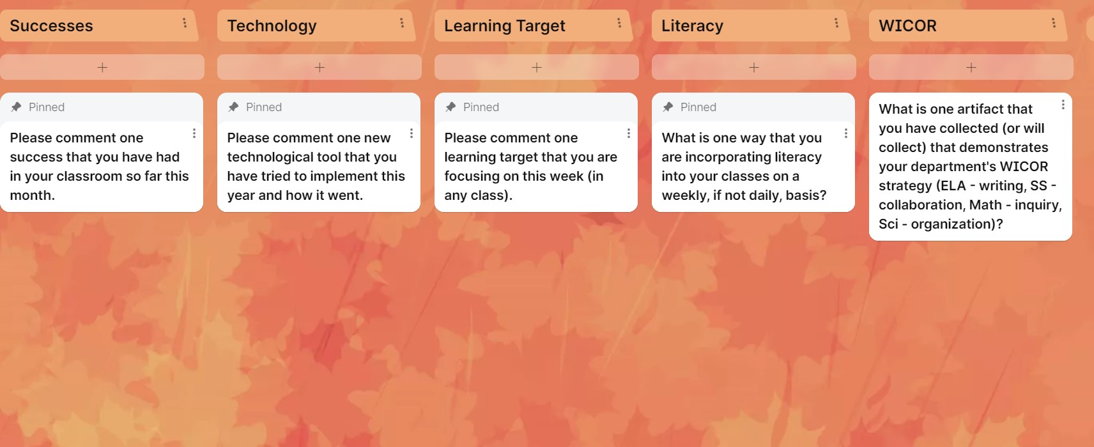
Padlet
Adding topics, subtopics, and media, and students can add comments and respond collaboratively

Slide 3
Jamboard
Slides where you can add text and media, and students can add sticky notes to have collaborative conversations

Slide 4
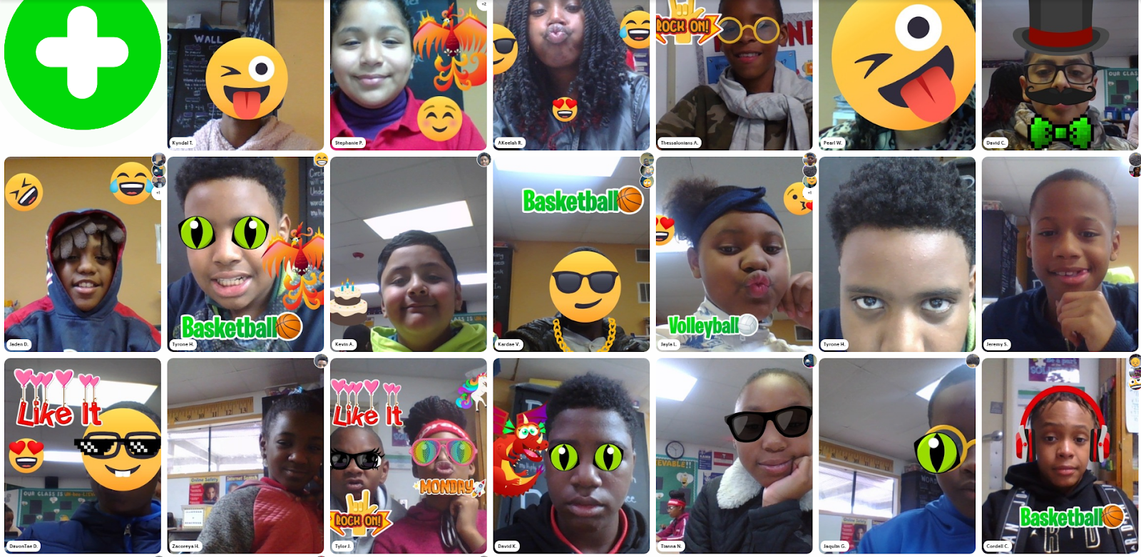
Flipgrid
Teacher posts a topic and content
Students post videos of a predetermined length regarding said topic
Students can respond to one another

