Slide 1
BELL RINGER: Analyze the poem Dreams written by Langston Hughes and answer the questions associated with the poem.
Hold fast to dreams For if dreams die Life is a broken-winged bird That cannot fly. Hold fast to dreams For when dreams go Life is a barren field Frozen with snow.
1. Define barren.
2. Describe the significance of the broken-winged bird and then explain how this poem can be applied to your life.

Slide 2
THE POWER OF DREAMS: Featuring the poetry of Langston Hughes
PRESENTED BY:
COACH STREETMAN

Slide 3
ENGAGEMENT

Slide 4
GEORGIA STANDARDS OF EXCELLENCE
SSPBF2 Compare different states of consciousness.
a. Identify altered states of consciousness, include: sleeping, dreaming, hypnosis, meditation, biofeedback, and mind-altering substances.

Slide 5
LEARNING TARGETS
1. I can analyze and describe the impact dreams have on our ability to attain certain goals.
2. I can analyze and describe key poems written by Harlem Renaissance poet Langston Hughes.

Slide 6
SUCCESS CRITERIA
1. We will know that we are successful when can analyze and describe the value of dreams and the significance of the poetry of Langston Hughes .

Slide 7
ATS: Google Langston Hughes:
List a MINIMUM of Five Facts about Langston Hughes:
1.
2.
3.
4.
5.

Slide 8
EXPLORE EXPLAIN AND ELABORATE

Slide 9
GEORGIA STANDARDS OF EXCELLENCE
SSPBF2 Compare different states of consciousness.
a. Identify altered states of consciousness, include: sleeping, dreaming, hypnosis, meditation, biofeedback, and mind-altering substances.

Slide 10
LEARNING TARGETS
1. I can analyze and describe the impact dreams have on our ability to attain certain goals.
2. I can analyze and describe key poems written by Harlem Renaissance poet Langston Hughes.

Slide 11
SUCCESS CRITERIA
1. We will know that we are successful when can analyze and describe the value of dreams and the significance of the poetry of Langston Hughes .

Slide 12
Langston Hughes Activity: Click on the image to access the Activity

Slide 13
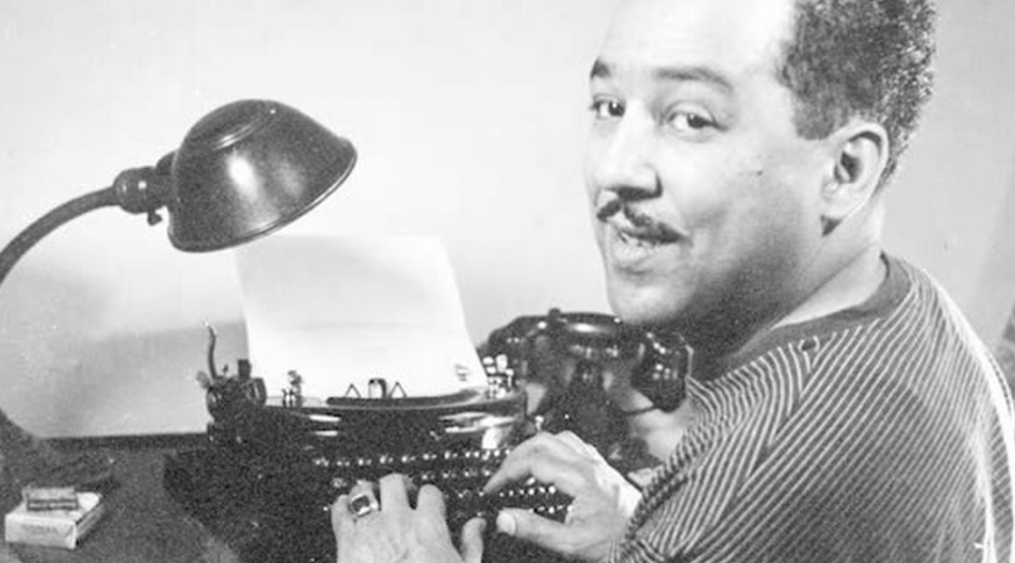
Assignment #2: Write a minimum of six bullet points that describe either Dreams or a Dream Deferred by Langston Hughes

Slide 14
EVALUATION

Slide 15
GEORGIA STANDARDS OF EXCELLENCE
SSPBF2 Compare different states of consciousness.
a. Identify altered states of consciousness, include: sleeping, dreaming, hypnosis, meditation, biofeedback, and mind-altering substances.

Slide 16
LEARNING TARGETS
1. I can analyze and describe the impact dreams have on our ability to attain certain goals.
2. I can analyze and describe key poems written by Harlem Renaissance poet Langston Hughes.

Slide 17
SUCCESS CRITERIA
1. We will know that we are successful when can analyze and describe the value of dreams and the significance of the poetry of Langston Hughes .

Slide 18
TICKET OUT THE DOOR
As you learned about the poetry of Langston Hughes consider the following:
Hughes in both poems expressed the power of managing dreams. Do you concur or do you disagree with his assessment of dreams. Please explain your response.

