Slide 1
BELL RINGER: Fill in the chart below. Explain how each entity in the first column could possibly become a source of stress for teens and young adults.
PROSPECTIVE STRESSORS | EXPLANATION #1 | STRESS SOURCE #2
FAMILY
ADHERENCE TO CERTAIN SOCIAL NORMS: (STYLE OF DRESS, LOOKS ETC.)
SCHOOL / ACADEMICS
PERSONAL COMPANION “SUGAR DUMPLIN”
SPORTS / EXTRACURRICULAR ACTIVITIES
SOCIAL MEDIA

Slide 2
COMPONENTS OF STRESS
PRESENTED BY:
THE HHS PSYCHOLOGY DEPARTMENT

Slide 3
ENGAGEMENT!

Slide 4
Engagement Instructions
1. Students will examine the standard and learning targets.
2. Students and instructor will discuss and review bell ringer.

Slide 5
Georgia Standards of Excellence PSYCHOLOGY
SSPBF3: Discuss the components of stress

Slide 6
LEARNING TARGET(S) PSYCHOLOGY
I CAN discuss and analyze the components of stress.

Slide 7
SUCCESS CRITERIA PSYCHOLOGY
We will know that we are successful when we are able to discuss and analyze the components of stress.

Slide 8
EXPLORE, EXPLAIN AND ELABORATE!

Slide 9
Explore, Explain, and Elaborate Instructions
1. Students will examine the standard and learning targets.
2. Students and instructor will discuss and review a series of reading passages and notes for this unit.
3. Students and instructor will complete a variety of activities for this unit.

Slide 10
Georgia Standards of Excellence PSYCHOLOGY
SSPBF3: Discuss the components of stress

Slide 11
LEARNING TARGET(S) PSYCHOLOGY
I CAN discuss and analyze the components of stress.

Slide 12
SUCCESS CRITERIA PSYCHOLOGY
We will know that we are successful when we are able to discuss and analyze the components of stress.

Slide 13
Stress & Health: The Basics
Two major classifications of stress…
Acute Stressors
Relatively short in duration with a clear endpoint
An encounter with a belligerent customer
A major exam
An impending natural disaster
Chronic Stressors
Relatively long in duration with no apparent endpoint
Persistent financial strains
A sick family member
A hostile boss

Slide 14
Stress & Health: Acute vs. Chronic Stressors Venn Diagram
ACUTE
STRESSORS
CHRONIC
STRESSORS

Slide 15
Stress & Health: Types of Stress

Slide 16
Stress & Health: Types of Stress
Frustration
Occurs in any situation in which the pursuit of some goal is thwarted
Insignificant (in terms of stress)
Traffic jam/difficult commute
Broken air conditioner
Significant (in terms of stress)
Failure and/or loss

Slide 17
Stress & Health: Types of Stress
Conflict
Occurs when two (or more) incompatible motivations or behavioral impulses compete for expression
Approach-Approach Conflict
A choice must be made between two attractive goals
Avoidance-Avoidance Conflict
A choice must be made between two unattractive goals
Approach-Avoidance Conflict
A choice must be made about whether to pursue a single goal that has both attractive & unattractive aspects
Often produce vacillation…

Slide 18
Stress & Health: Types of Stress
Life Changes
Any significant alterations to one’s circumstances that require readjustment
Social Readjustment Rating Scale (Holmes & Rahe, 1967)
Death of a spouse (100)
Divorce (73)
Marital Separation (65)
Jail Term (63)
Death of a close family member (63)
Personal injury or illness (53)
Marriage (50)

Slide 19
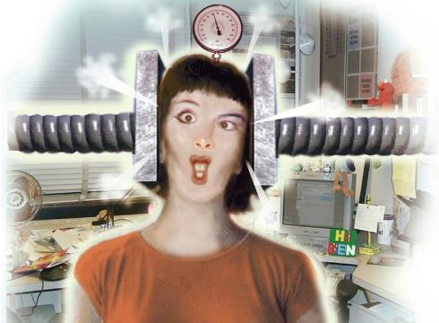
Stress & Health: Types of Stress
Pressure
Involves expectations or demands that one behave in a certain way
Salespeople
Professors
Stand-up comedians
Suburban homeowners
Teenagers

Slide 20
Stress & Health: Types of Stress Chart
TYPE OF STRESS | FRUSTRATION | CONFLICT | LIFE CHANGES | PRESSURE
BRIEF DESCRIPTION

Slide 21
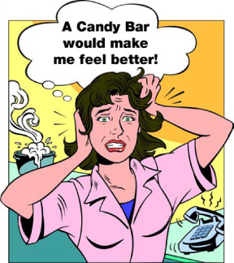
Stress & Health: Stress Responses
Part three

Slide 22
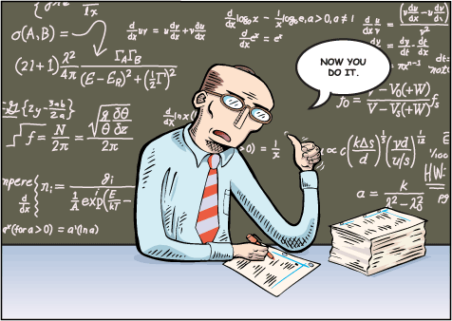
Stress & Health: Stress Responses
Behavioral Responses
Most behavioral responses to stress involve coping
Active efforts to master, reduce or tolerate the demands created by stress; can be helpful or maladaptive
Coping Mechanisms
Learned helplessness
Self-blame
Aggression
Catharsis
Self-indulgence
Defense mechanisms

Slide 23
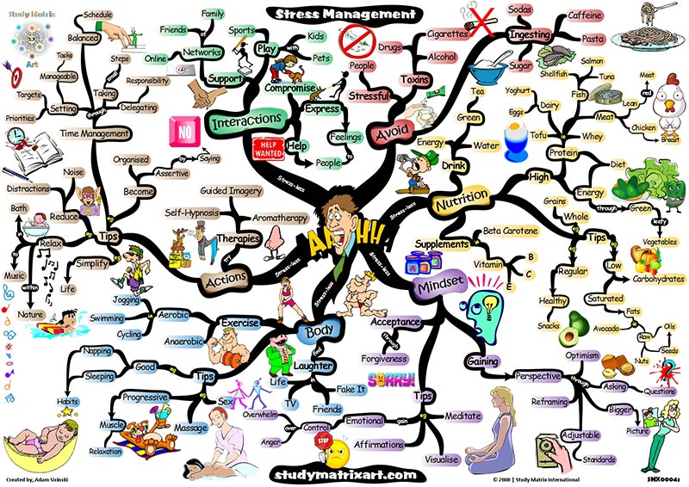
Stress & Health: Stress Responses
Constructive Coping
Healthy efforts to deal with stressful events
How?
Direct confrontation of the problem
Realistic appraisal of the stress & coping resources
Learning to recognize, and in some cases regulate, potentially disruptive emotional reactions to stress

Slide 24
Writing Activity
Write a paragraph that answers the questions:
Explain how you respond to stressful situations.
Does the way that you respond reduce your stress? Please explain your response.
__________________________________________________________________________________________________________________________________________________________________________________________________________________

Slide 25
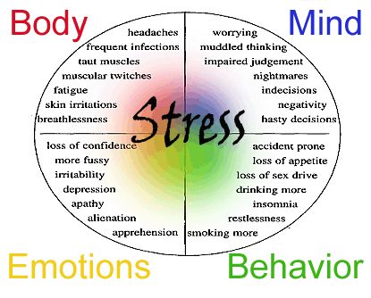
Stress & Health: Effects of Stress
Part four

Slide 26
Stress & Health: Effects of Stress
Psychological Effects
Burnout
Physical & emotional exhaustion, as well as cynicism and a lowered sense of self-efficacy
Generally brought on by work-related stress
Psychological problems & disorders
Poor academic performance, sleep disturbances, sexual difficulties, alcohol & drug abuse, etc.
Positive effects?
Resilience
Successful adaptation to significant stress & trauma

Slide 27
Stress & Health: Effects of Stress
Physical Effects
Heart disease
Specifically coronary heart disease (90% of heart related deaths)
Emotional reactions & depression also linked to heart disease
Immune functioning
Reduced immune activity
Asthma, cancer, chronic pain, common cold, herpes, IBS, migraine headaches, rheumatoid arthritis, skin disorders, ulcers, etc.

Slide 28
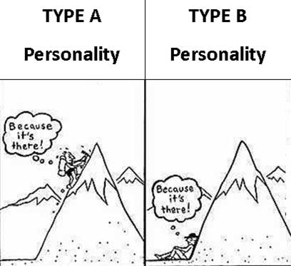
Stress & Health: Personality Factors

Slide 29
Stress & Health: Personality Factors
Type A
General Characteristics
Competitive & ambitious
Time urgency & impatience
Anger & hostility
Easily annoyed
In life…
Tend to be workaholics
Often successful, but frequently unsatisfied
Find it very difficult to relax/to do nothing
More prone to..?

Slide 30
Stress & Health: Personality Factors
Type B
General Characteristics
Less competitive & driven
Easygoing & slow to anger
Relaxed & amicable
Charismatic

Slide 31
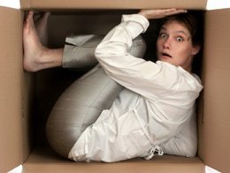
Stress & Health: Personality Factors
Type C
General Characteristics
People-pleasers
Peace-keepers
Often lonely
Find it difficult to express emotions, especially negative ones
More prone to..?

Slide 32
Stress & Health: Personality Factors
Type H (Hardy Personality)
General Characteristics
Type A individuals who thrive on stress
Different from the traditional Type A in three key ways…
Commitment
Control
Challenge

Slide 33
Stress & Health: Personality Factors
In conclusion…
If life gives you lemons…
Type A people get enraged & throw the lemons back, having a minor heart attack while doing so…
Type B people gather all of the lemons & make lemonade…
Type C people don’t say anything, but fume inside where no one can see…
Type H people gather the lemons, make lemonade, sell it, turn it into a franchise business & make millions…

Slide 34
Stress & Health: Personality Factors Summary
Write a summary that describes if your personality is closer to being an A, B,C, or H.
________________________________________________________________________________________________________________________________________________________________________________________________________________________________________________________________________________________________________________________________________________________________________________________________________________________________________________________________

Slide 35
EVALUATION!

Slide 36
EVALUATION STRATEGY
1. Students will examine the standard and essential questions.
2. We will complete a stress Circle Map.

Slide 37
Georgia Standards of Excellence PSYCHOLOGY
SSPBF3: Discuss the components of stress

Slide 38
LEARNING TARGET(S) PSYCHOLOGY
I CAN discuss and analyze the components of stress.

Slide 39
SUCCESS CRITERIA PSYCHOLOGY
We will know that we are successful when we are able to discuss and analyze the components of stress.

Slide 40
STRESS CIRCLE MAP
DESCRIBE SOME OF THE CAUSES OF STRESS AND THE VARIOUS WAYS THE INDIVIDUALS RESPOND TO STRESS.

