Slide 1
2019 Physical Education Standards Review Richmond County
Therese McGuire Program Specialist for Health and Physical Education (K-12)
Michael Tenoschok, Program Specialist for Health and Physical Education (K-12)

Slide 2
Key Messages
Georgia has new Physical Education Standards Georgia Physical Education Standards of Excellence (PE GSE)
The PE GSE outline what it takes to be physically educated
The PE GSE work in harmony. All must be a part of a quality physical education program.
The PE GSE guide local curriculum and local curriculum guides instruction
The PE GSE are the blueprint, roadmap and equalizer for physical education instruction.

Slide 3
Survey Information
Completed Surveys: 1483
Comments: Just under 250 comments
Mentioned for Consideration (Non-inclusive List)
Standard 3: Participates regularly in physical activity
Adjusting existing standards to better align to SHAPE America standards
Elements are narrow. More specificity
Standards need to be course specific for high school

Slide 4
The physically educated student defined:
The physically educated student has grade-level
appropriate comprehension and application of the
concepts and principles of motor skills, movement
patterns, tactics, and strategies. All of which
contribute to a physically literate and active lifestyle.

Slide 5
Georgia Standards of Excellence ( Present )
The Physically Educated Student:
1. Demonstrates competency in a variety of motor skills and movement patterns.
2. Applies the knowledge of concepts, principles, strategies, and tactics related to movement and performance.
3. Demonstrates knowledge and skills to help achieve and maintain a health-enhancing level of physical activity and fitness.
4. Exhibits responsible personal and social behavior that respects self and others in physical activity setting.
5. Recognizes the value of physical activity for health, enjoyment, challenge, self-expression and/or social interaction.

Slide 6
Georgia Standards
SHAPE Standards
1. The physically educated student demonstrates competency in a variety of motor skills and movement patterns.
2. The physically educated student applies the knowledge of concepts, principles, strategies, and tactics related to movement and performance.
3. The physically educated student demonstrates knowledge and skills to help achieve and maintain a health-enhancing level of physical activity and fitness.
4. The physically educated student exhibits responsible personal and social behavior that respects self and others in physical activity setting.
5. The physically educated student recognizes the value of physical activity for health, enjoyment, challenge, self-expression and/or social interaction.
1-The physically literate individual demonstrates competency in a variety of motor skills and movement patterns.
2-The physically literate individual applies knowledge of concepts, principles, strategies and tactics related to movement and performance.
3-The physically literate individual demonstrates the knowledge and skills to achieve and maintain a health-enhancing level of physical activity and fitness.
4-The physically literate individual exhibits responsible personal and social behavior that respects self and others.
5-The physically literate individual recognizes the value of physical activity for health, enjoyment, challenge, self-expression and/or social interaction.

Slide 7
Time Line
July 2018 – June 2019 | Professional Learning/Resource Development continued
2019-2020 | Implementation of Georgia Standards of Excellence for Physical Education

Slide 8
How to Read the GPS Code
PE6.1a
Physical Education
Grade 6
Standard #1
Element a
Notes:
This has been a source of confusion. Make sure participants are comfortable with the code.

Slide 9
Skills to Play the Game (1)

Slide 10
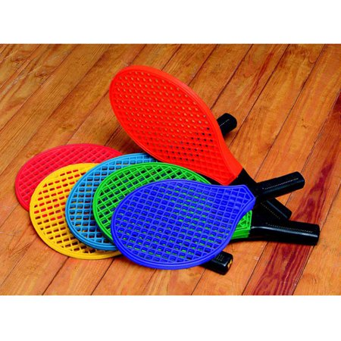
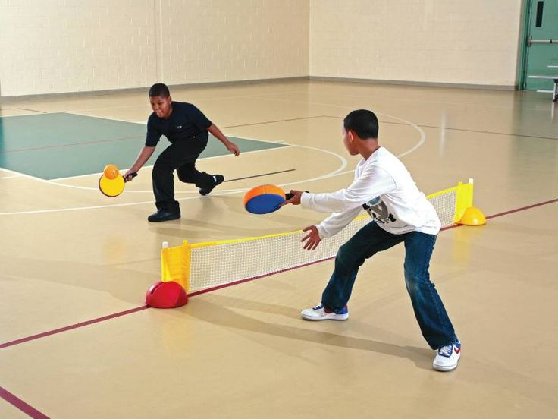
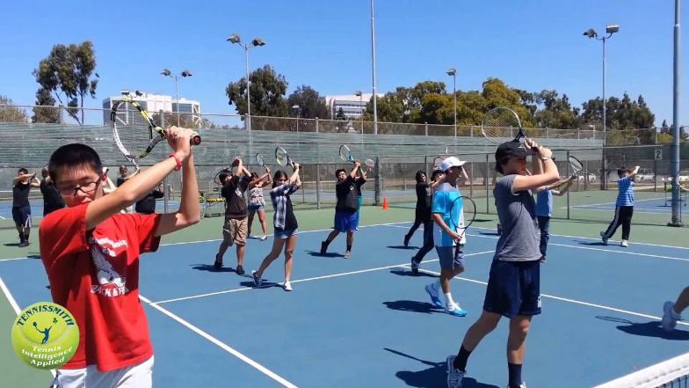
SKILLS (1)

Slide 11
Strategies to Excel at the Game (2)

Slide 12
STRATEGIES (2)

Slide 13
Fitness levels to Succeed at the game (3)

Slide 14
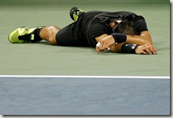
FITNESS (3)
This Photo by Unknown Author is licensed under CC BY-NC-ND
This Photo by Unknown Author is licensed under CC BY-NC-ND

Slide 15
Rules/Etiquette to play the game fairly/safely (4)

Slide 16
Rules/Etiquette (4)

Slide 17
Joy and Value: of the Game (5)

Slide 18
Joy and Value (5)
I TENNIS

Slide 19
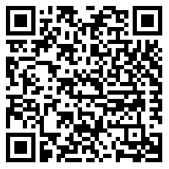
Georgia Physical Education Standards of Excellence
https://www.georgiastandards.org/Georgia-Standards/Pages/Physical-Education.aspx

Slide 20
Knowledge Check

Slide 21
Identify badminton court markings.
Remember and recite the cues for shooting.

Slide 23
Follow the rules and etiquette of Dribble Tag so that everyone is safe and has fun.
Follow all rules and etiquette when participating in a physical education class basketball game. (without teacher prompting)

Slide 25
Focus your skill practice on how to throw and catch a disc.
Demonstrate quick footwork and court positioning by quickly moving from starting position to return each shuttle, then back to starting position.

Slide 27
Analyze the physical activity for enjoyment and challenge, identifying reasons for a positive or negative response.
Rank the enjoyment of participating in each of the different physical activities from this semester.

Slide 29
Walk or run at a target rate zone intensity level.
Discuss the benefits and challenges of using technology such as heart rate monitors and activity trackers as tools to support an active lifestyle.

Slide 31
Standards Activity

Slide 32
Next Step: Map It

Slide 34
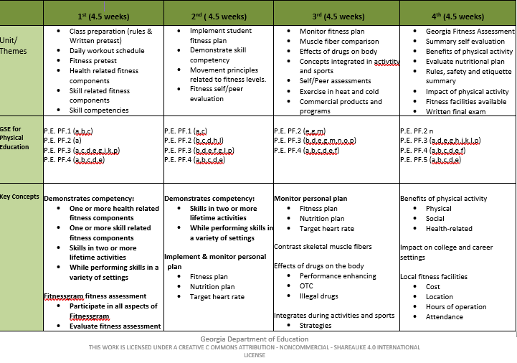

Slide 35
Step 2

Slide 39
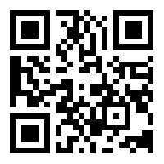
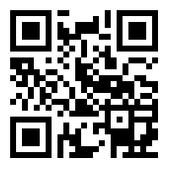
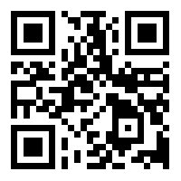
Resources
Georgia Standards of Excellence
https://www.georgiastandards.org/Georgia-Standards/Pages/Physical-Education.aspx
Georgia AHPERD
https://www.gahperd.org
Georgia SHAPE
http://www.georgiashape.org/
OPEN
https://openphysed.org/

Slide 40
This Photo by Unknown Author is licensed under CC BY-NC-ND

Slide 41
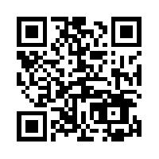
Please evaluate today’s session
Georgia Department of Education Evaluation Survey
Session: Richmond County Georgia Standards of Excellence
Physical Education Professional Learning
Presenter: Therese McGuire
http://gadoe.org/surveys/CI-3WVZ6RW
or scan

Slide 42
Contact Information
Therese McGuire Program Specialist Health & Physical Education Georgia Department of Education tmcguire@doe.k12.ga.us
Mike Tenoschok Program Specialist Health & Physical Education Georgia Department of Education mtenoschok@doe.k12.ga.us

