Slide 1
Student Engagement and Motivation

Slide 2
Gallery Walk As you come in, please grab a sticky note and respond at least once on each piece of chart paper
What has been your biggest challenge so far this year?
What has been your greatest success so far this year?
How do you engage your students daily and combat apathy?
What is one new strategy you want to try in your classroom?

Slide 3
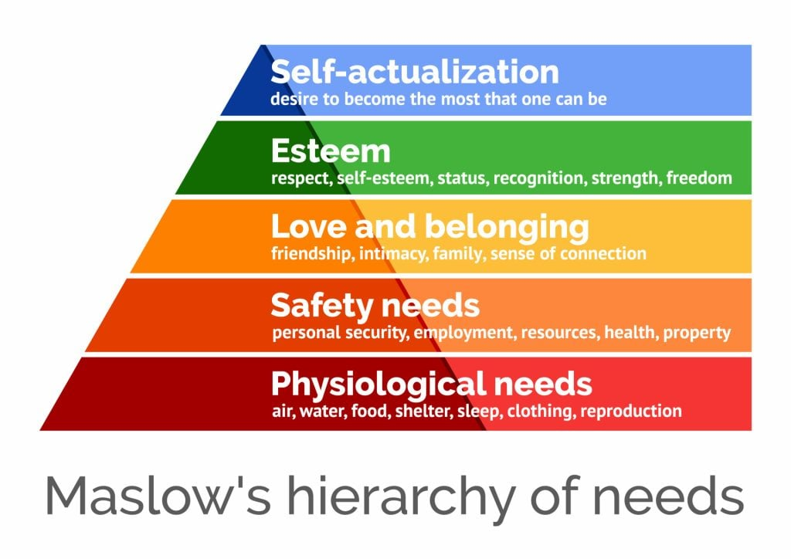
Equity
How are we ensuring that our students are being taught equitably?
Does every student have an equal opportunity to learn?
How do you know?
Hierarchy of Needs
If we have students on every level, what types of things are you doing in the classroom to support them?

Slide 4
Timing
Please take a minute on a sticky note and write down your daily timing breakdown estimate
Bellringer, Direct Instruction, Guided Practice, Independent Practice, and Closure.
How many minutes do you spend on each of these per class period?
What are students doing during Direct Instruction and Guided Practice?
Example:
Bellringer (5 mins)
Direct Instruction (10 mins)
Guided Practice (15 mins)
Independent Practice (15 mins)
Closure (5 mins)

Slide 5
Aggressive Progress Monitoring
The teacher should be actively moving around the room, checking on student progress and checking for understanding. Perhaps create a simple checklist that you can complete in 5 minutes as you walk around the room (ex. Does the student have questions 1-5 done, yes or no; has the student annotated the text to any capacity, yes or no, etc.)

Slide 6
Positive Reinforcement
Rewards / incentives
Notes of encouragement
Words of affirmation
Accentuate the positives
Focus on the good behavior, do not tolerate the bad behavior

Slide 7
Relationships
Building positive relationships with students and then leaning on those relationships to help with management
Develop positive rapports with your students
Increase the rigor in your class
Lean on those relationships to quell discontent about the increased rigor

Slide 8
Purposeful Scaffolding and Differentiation
If a student does not possess the tools necessary to complete on-grade-level work, you must provide them with the tools.
Grouping – put your strongest students together and give them an elevated assignment; put one strong person in each group and allow others to feed off their effort and engagement; try out different things.
Word banks, formula sheets, or spend time building scaffolding
Create routines, but do not become stagnant. Continue to be creative and innovative in your activities to promote student engagement.

Slide 9
Eliminating Apathy
Students need to know their purpose. They need to feel loved and supported, but they also need to be pushed. Students need to be moving and working from bell to bell and understand that the elevated rigor is because that is what they need to succeed. If we do not hold them to the highest standard possible, we are only perpetuating the disservices that have allowed our students to fall so far behind in the first place. It starts with us.

Slide 10
How to Build Thinking
Give thinking tasks
Frequently form visibly
random groups
Use vertical non- permanent surfaces (ex. whiteboard, chart paper)
De-front the classroom
Answer only keep-thinking questions
Give thinking task early,
standing, and verbally
Give check-your-
understanding questions
Mobilize knowledge (keep students moving and examining peer work)

Slide 11
How to Build Thinking
Asynchronously use hints
and extensions to maintain
flow
Consolidate from the bottom (start with basic concept, use student work to progress upward)
Have students write
meaningful notes
Evaluate what you value
Help students see
where they are and
why they are going
Grade based on data
(not points)

Slide 12
Stations
Students need rigid and rigorous timing.
~40 mins after direct instruction
12 minutes per station
Create clear, visible groups within the room
Group students intentionally (by level, where you can focus your time on the lowest group OR combine multiple levels, where there is a leader in each group to help keep them on task, etc.)
Set goals for each group, make them attainable and measurable

