Slide 1
Advanced Math Interactive Notebook
2020-2021
Add your own decorations here!
Mr. Werth

Slide 2
Table of Contents
Chapter 1
Date | Title | Page #
 | 1.1: Powers and Exponents
 | 1.2: Order of Operations
 | 1.3: Prime Factorization
 | 1.4: Greatest Common Factor
 | 1.5: Least Common Multiple
 | Chapter 1 Checklist

Slide 3
Table of Contents
Table of Contents
Chapter 2
Date | Title | Page #
 | 2.1: Multiplying Fractions
 | 2.2: Dividing Fractions
 | 2.3: Dividing Mixed Numbers
 | 2.4: Adding and Subtracting Decimals
 | 2.5: Multiplying Decimals
 | 2.6: Dividing Whole Numbers
 | 2.7: Dividing Decimals
 | Chapter 2 Checklist
Chapter 3
Date | Title | Page #
 | 3.1: Ratios
 | 3.2: Using Tape Diagrams
 | 3.3: Using Ratio Tables
 | 3.4: Graphing Ratio Relationships
 | 3.5: Rates and Unit Rates
 | 3.6: Converting Measures
 | Chapter 3 Checklist

Slide 4
Table of Contents
Table of Contents
Chapter 4
Date | Title | Page #
 | 4.1: Percents and Fractions
 | 4.2: Percents and Decimals
 | 4.3: Comparing and Ordering Fractions, Decimals, and Percents
 | 4.4: Solving Percent Problems
 | Chapter 4 Checklist
Chapter 5
Date | Title | Page #
 | 5.1: Algebraic Expressions
 | 5.2: Writing Expressions
 | 5.3: Properties of Addition and Multiplication
 | 5.4: The Distributive Property
 | 5.5: Factoring Expressions
 | Chapter 5 Checklist

Slide 5
Table of Contents
Table of Contents
Chapter 6
Date | Title | Page #
 | 6.1: Writing Equations in One Variable
 | 6.2: Solving Equations Using Addition or Subtraction
 | 6.3: Solving Equations Using Multiplication or Division
 | 6.4: Writing Equations in Two Variables
 | Chapter 6 Checklist
Chapter 7
Date | Title | Page #
 | 7.1: Area of Parallelograms
 | 7.2: Area of Triangles
 | 7.3: Areas of Trapezoids and Kites
 | 7.4: Three-Dimensional Figures
 | 7.5: Surface Area of Prisms
 | 7.6: Surface Area of Pyramids
 | 7.7: Volumes of Rectangular Prisms
 | Chapter 7 Checklist

Slide 6
Table of Contents
Table of Contents
Chapter 8
Date | Title | Page #
 | 8.1: Integers
 | 8.2: Comparing and Ordering Integers
 | 8.3: Rational Numbers
 | 8.4: Absolute Value
 | 8.5: The Coordinate Plane
 | 8.6: Polygons in the Coordinate Plane
 | 8.7: Writing and Graphing Inequalities
 | 8.8: Solving Inequalities
 | Chapter 8 Checklist
Chapter 9
Date | Title | Page #
 | 9.1: Introduction to Statistics
 | 9.2: Mean
 | 9.3: Measures of Center
 | 9.4: Measures of Variation
 | 9.5: Mean Absolute Deviation
 | Chapter 9 Checklist

Slide 7
Table of Contents
Table of Contents
Chapter 10
Date | Title | Page #
 | 10.1: Stem-and-Leaf Plots
 | 10.2: Histograms
 | 10.3: Shapes of Distributions
 | 10.4: Choosing Appropriate Measures
 | 10.5: Box and Whisker Plots
 | Chapter 10 Checklist
SC READY REVIEW
Date | Title | Page #

Slide 8
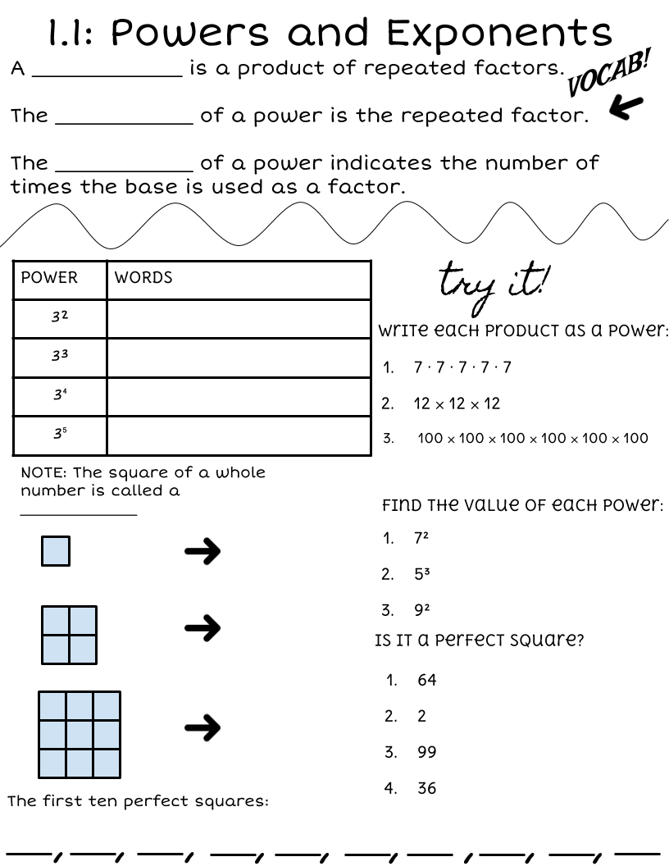
Word Bank:
Make copies of this box and type in it!
1
2

Slide 9
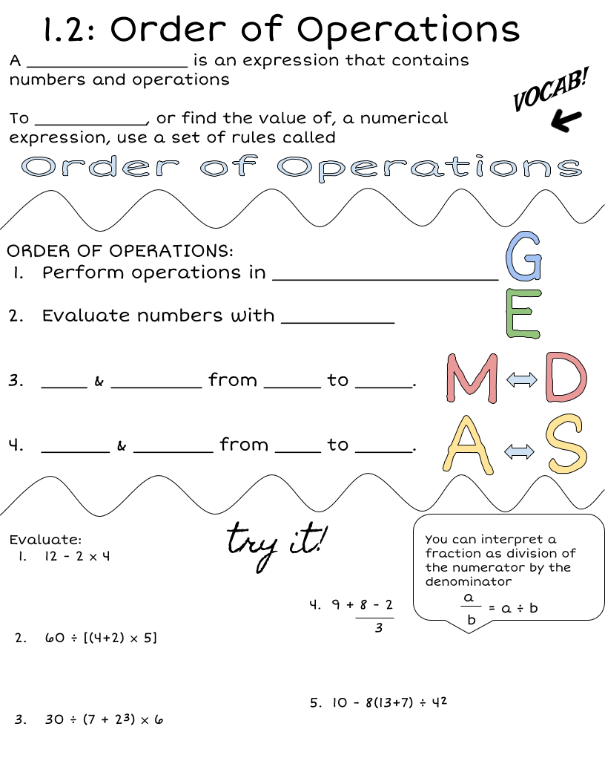
Word Bank
Make copies of this box and type in it!
3
4

Slide 10
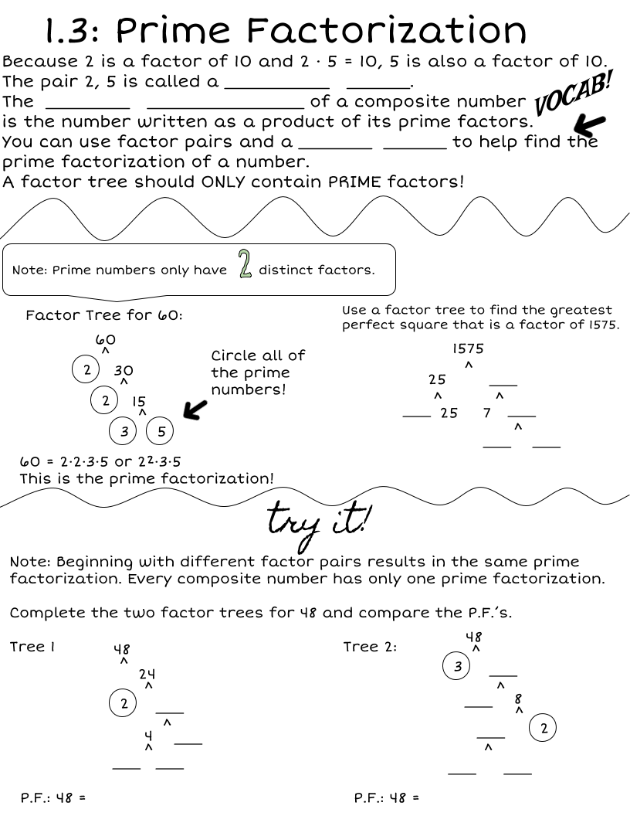
Word Bank
Make copies of this box and type in it!
5
6

Slide 11
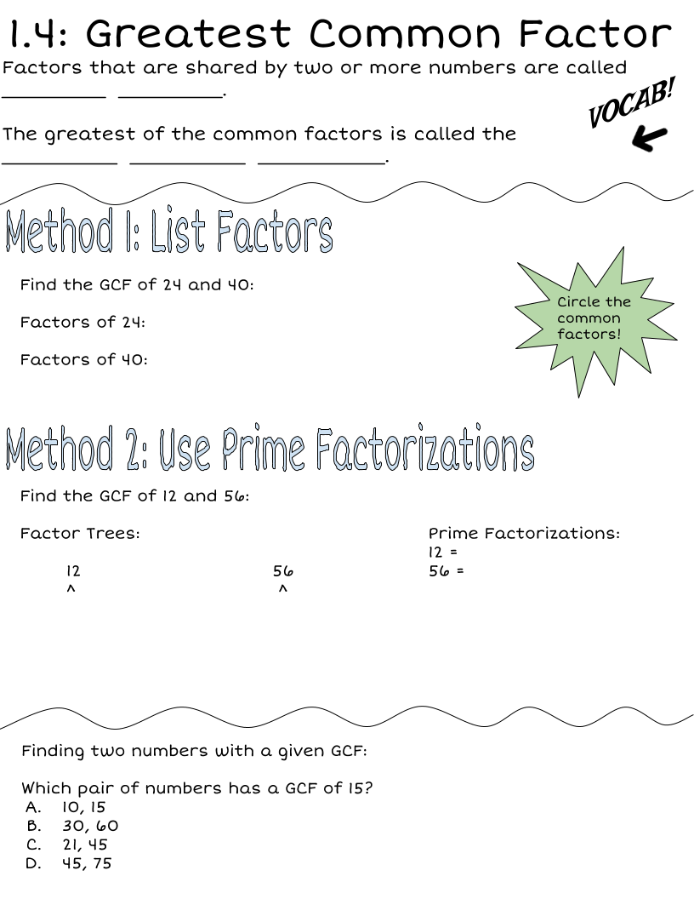
Word Bank
Make copies of this box and type in it!
5
6

Slide 12
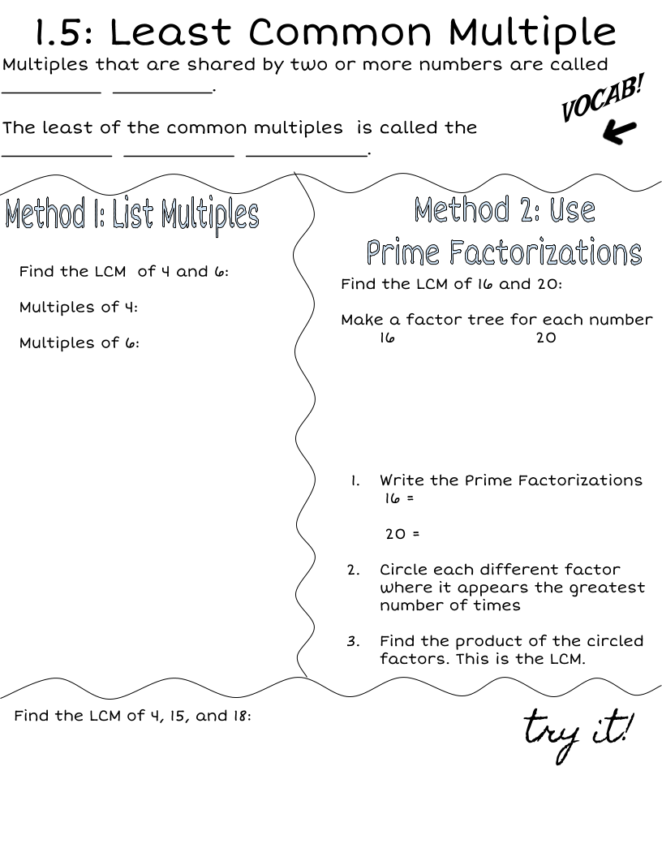
Wordbank:
Make copies of this box and type in it!
5
6

Slide 13
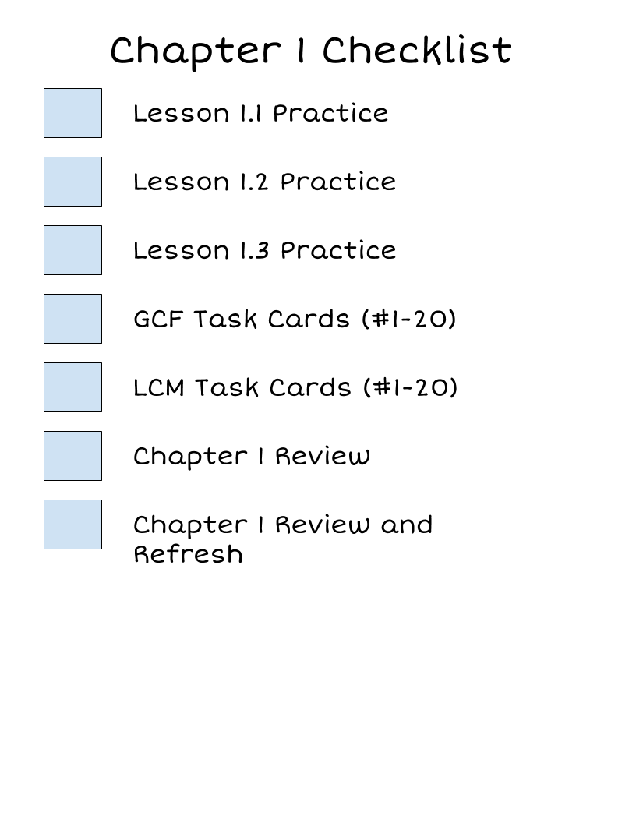
What are you missing?
Grades
Chapter 1A Quiz
Chapter 1B Quiz
Chapter 1 Test
Chapter 1 Notebook Check
5
6

Slide 14
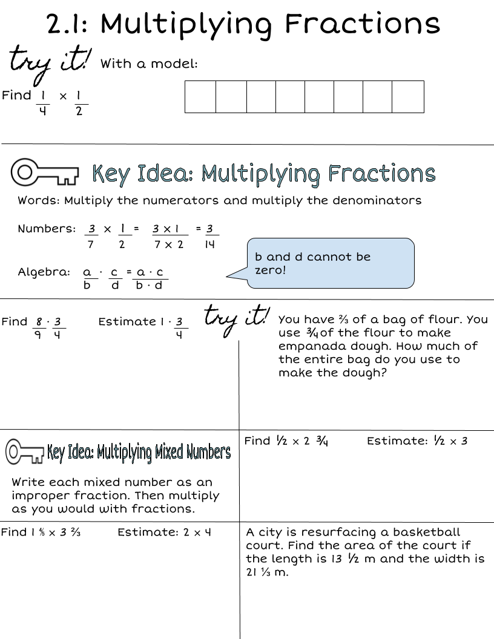
Wordbank:
Make copies of this box and type in it!
9
10

Slide 15
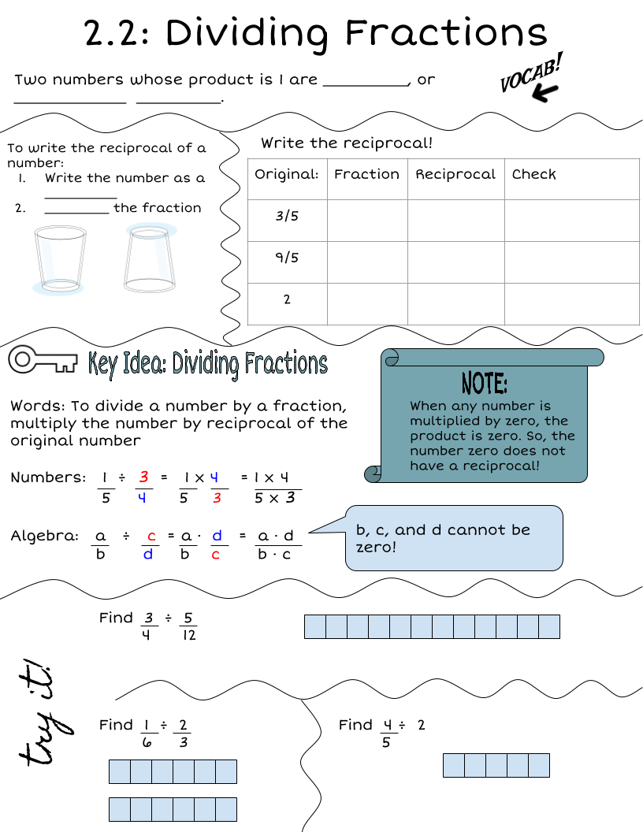
Wordbank:
Make copies of this box and type in it!
12

Slide 16
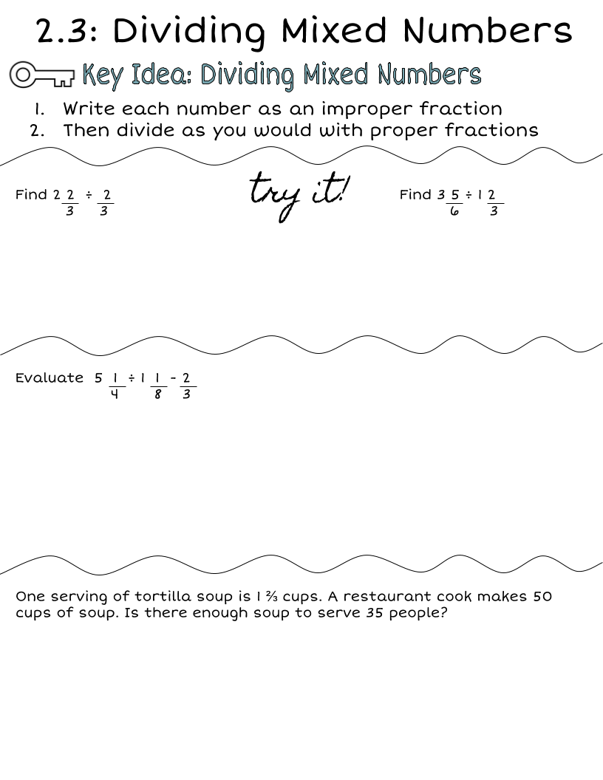
Wordbank:
Make copies of this box and type in it!
12

Slide 17
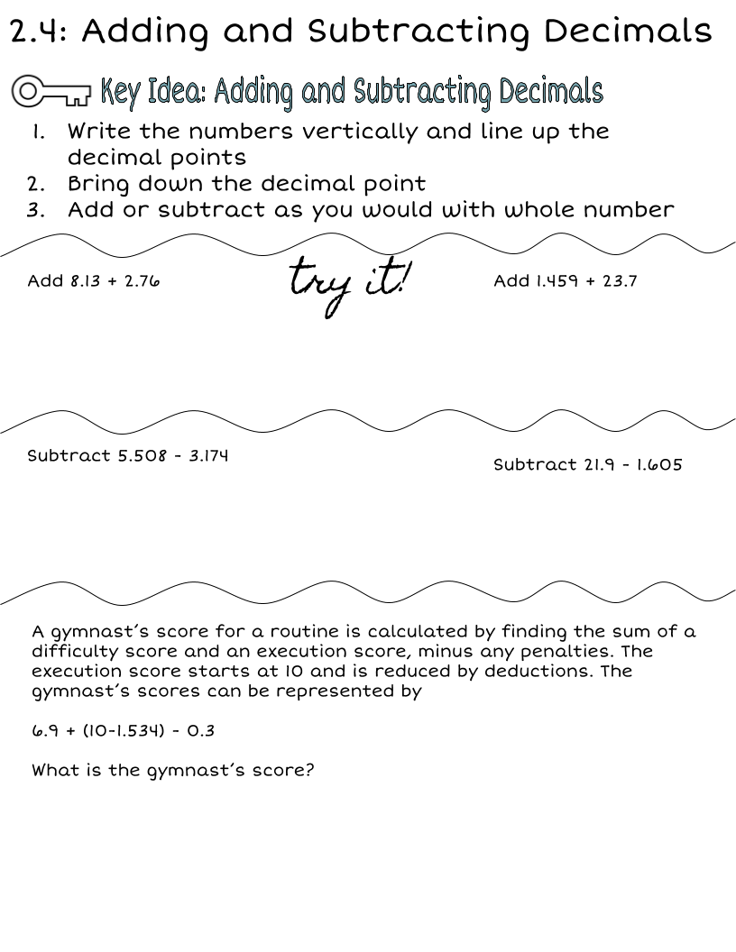
Wordbank:
Make copies of this box and type in it!
12

Slide 18
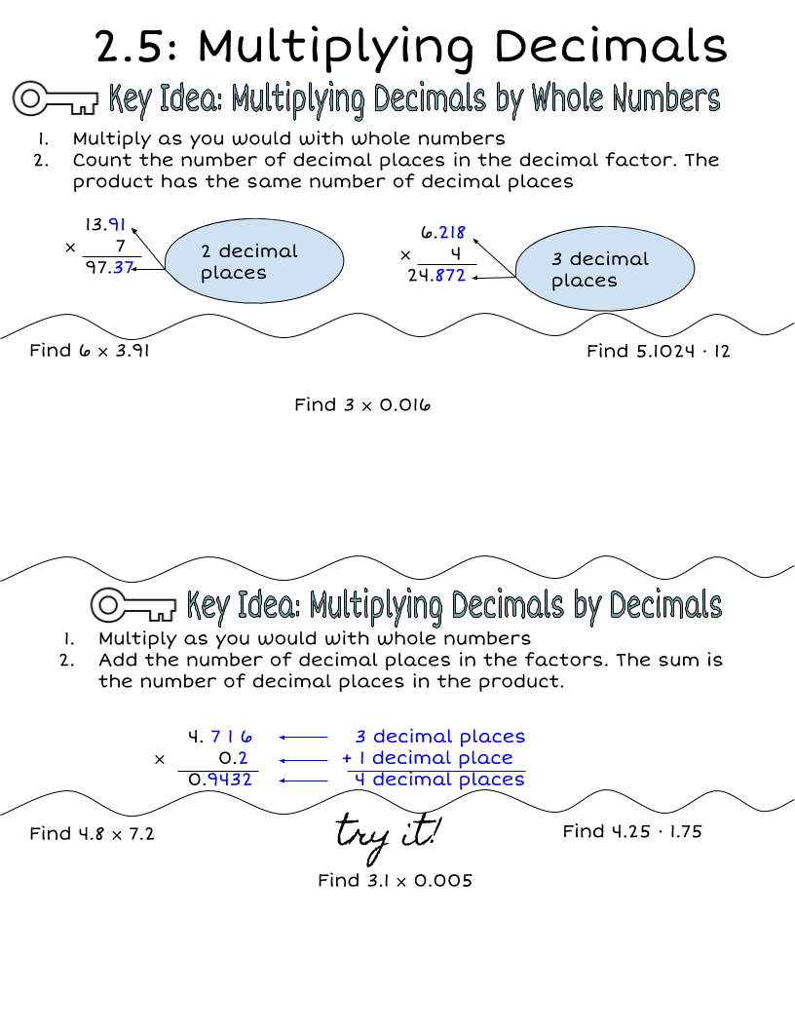
Wordbank:
Make copies of this box and type in it!
12

Slide 19
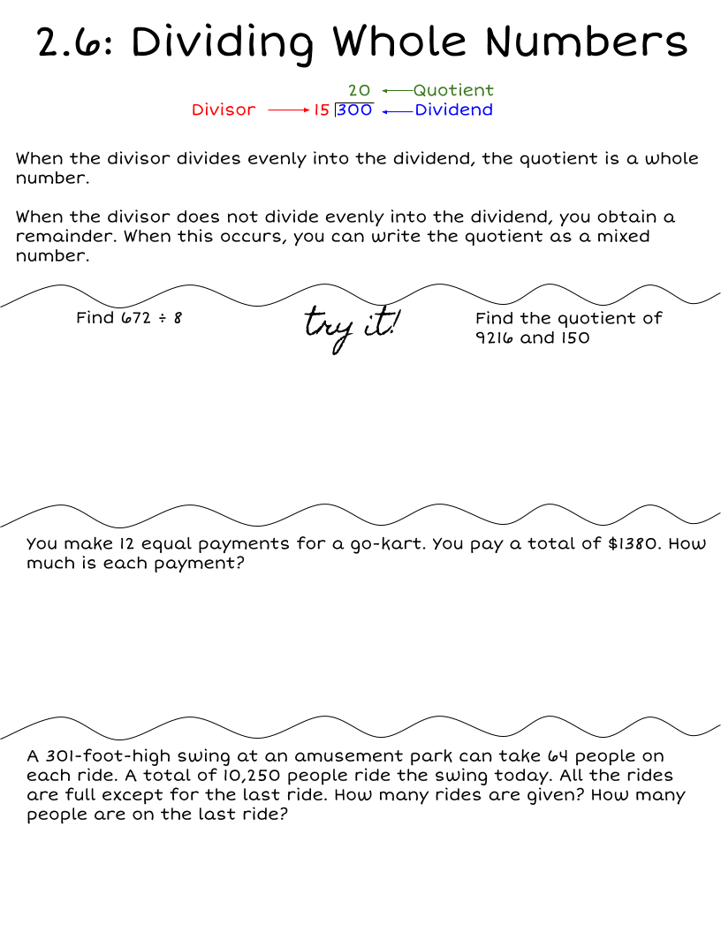
Wordbank:
Make copies of this box and type in it!
12

Slide 20
Wordbank:
Make copies of this box and type in it!
12

Slide 21
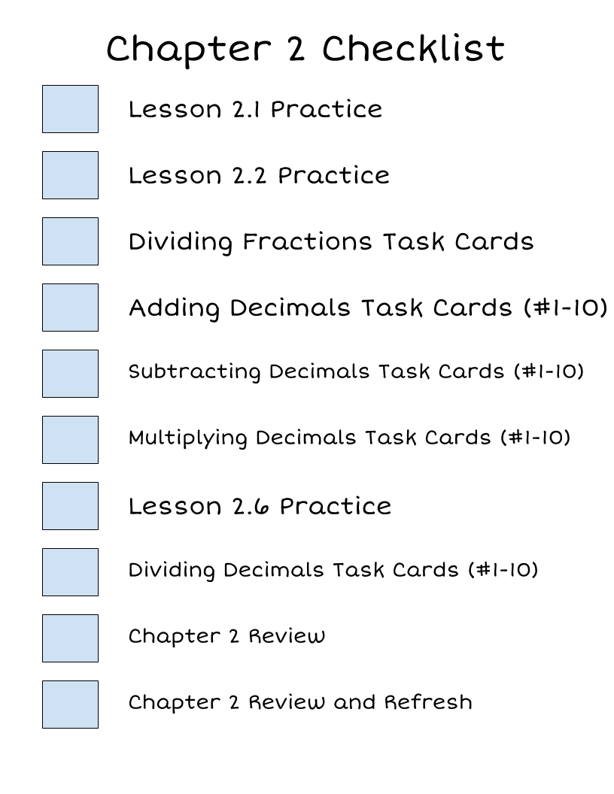
What are you missing?
Grades
Chapter 2A Quiz
Chapter 2B Quiz
Chapter 2 Test
Chapter 2 Notebook Check
12

Slide 22
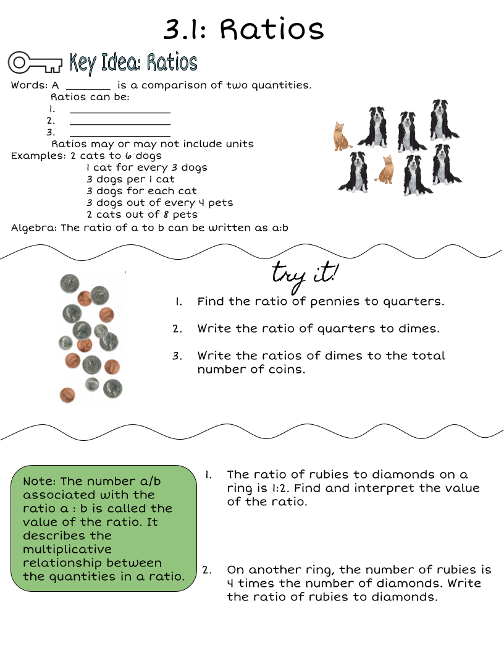
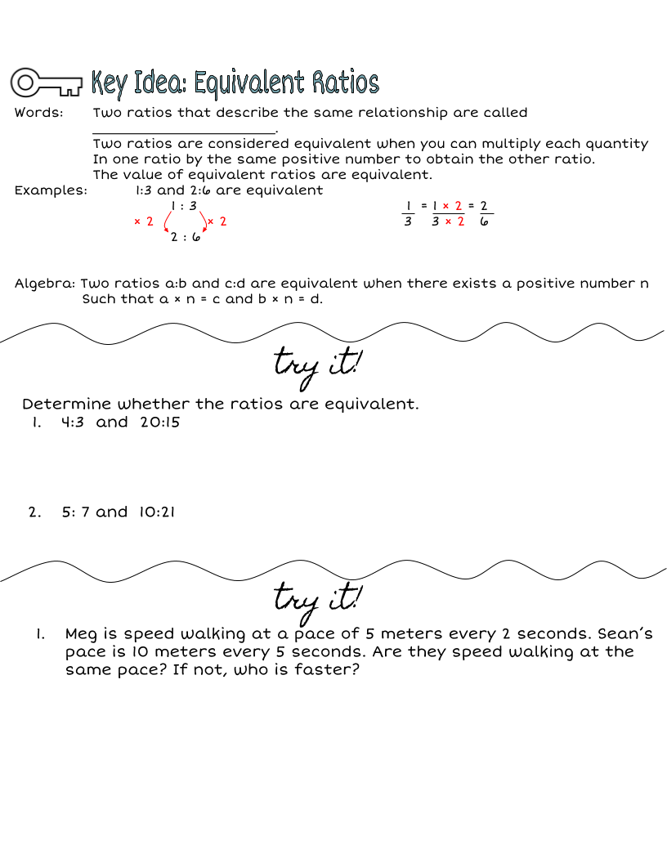

Slide 23
Wordbank:
Make copies of this box and type in it!

Slide 24
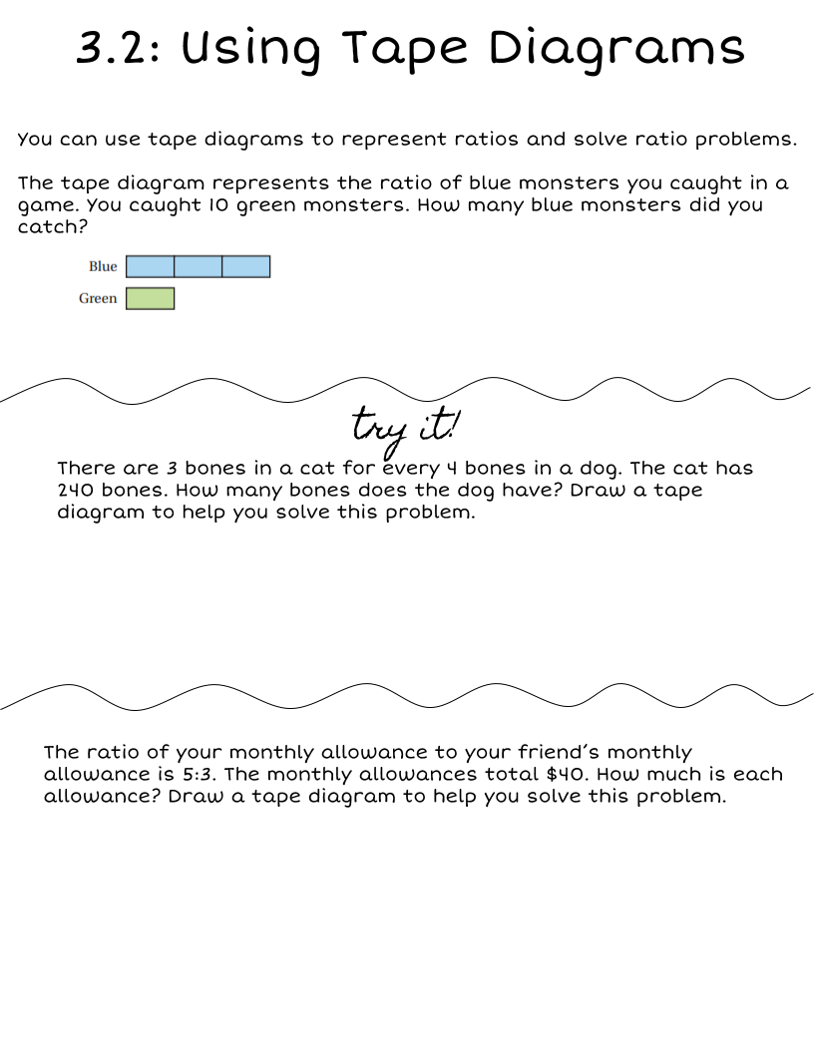
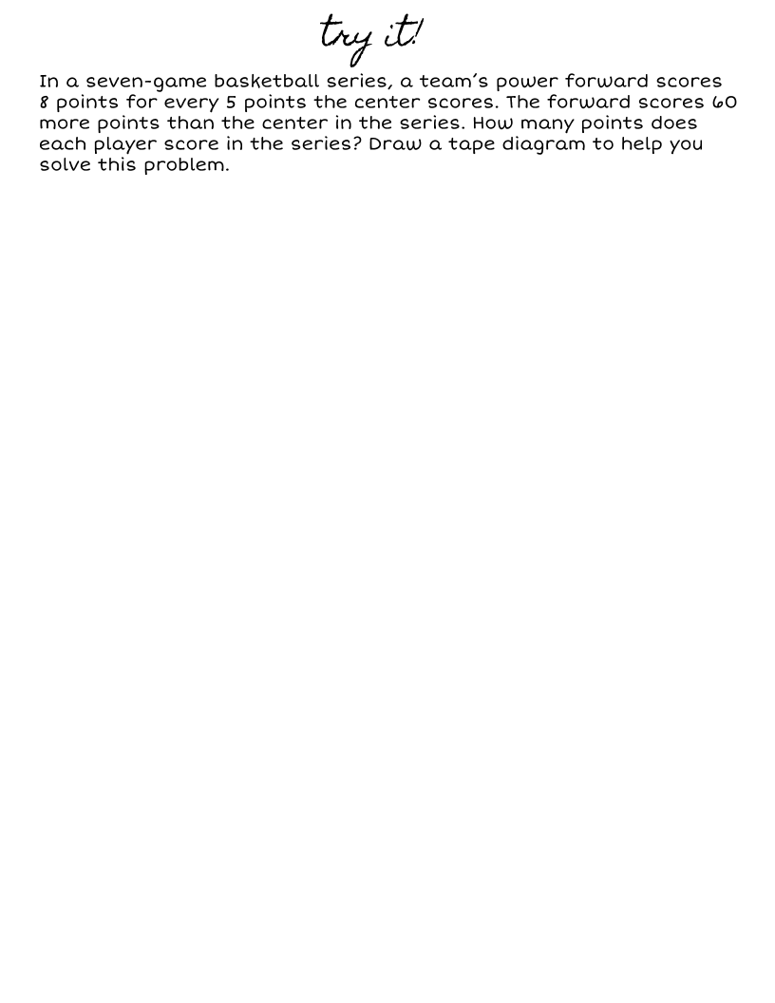
Wordbank:
Make copies of this box and type in it!

Slide 25
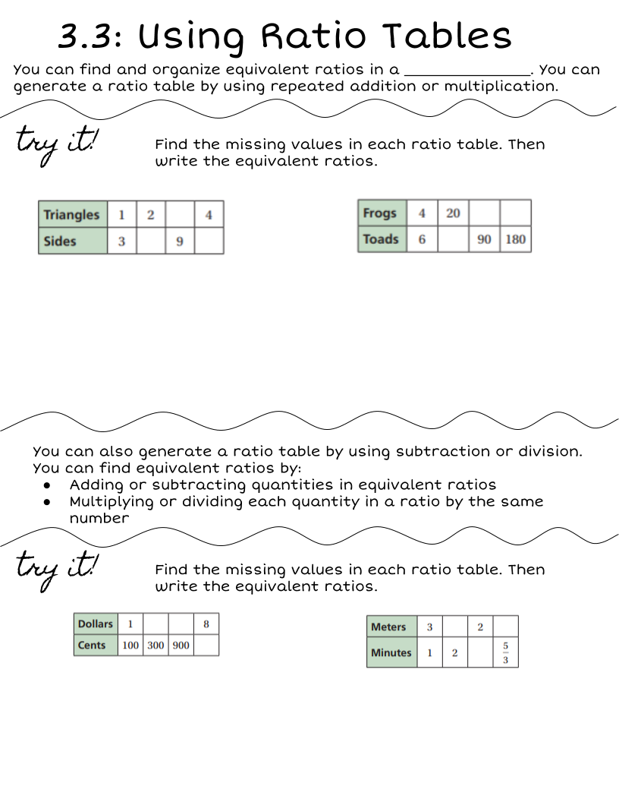
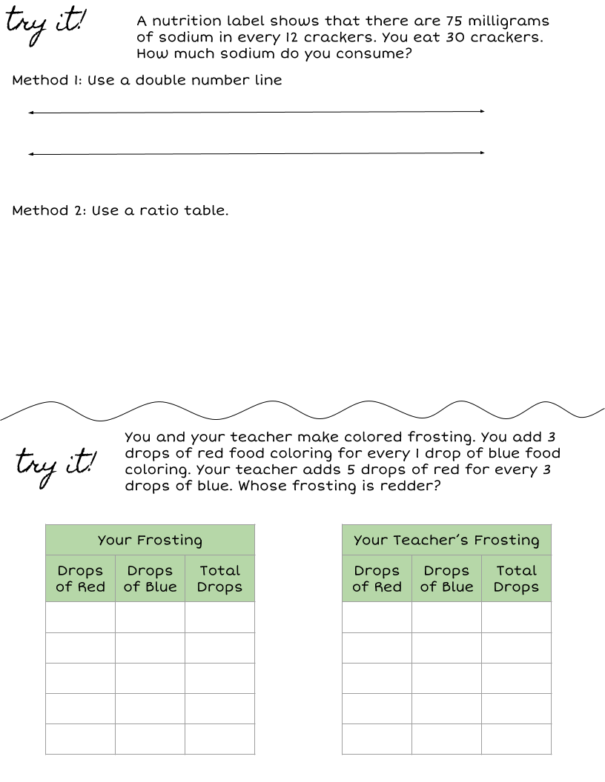

Slide 26
Wordbank:
Make copies of this box and type in it!

Slide 27
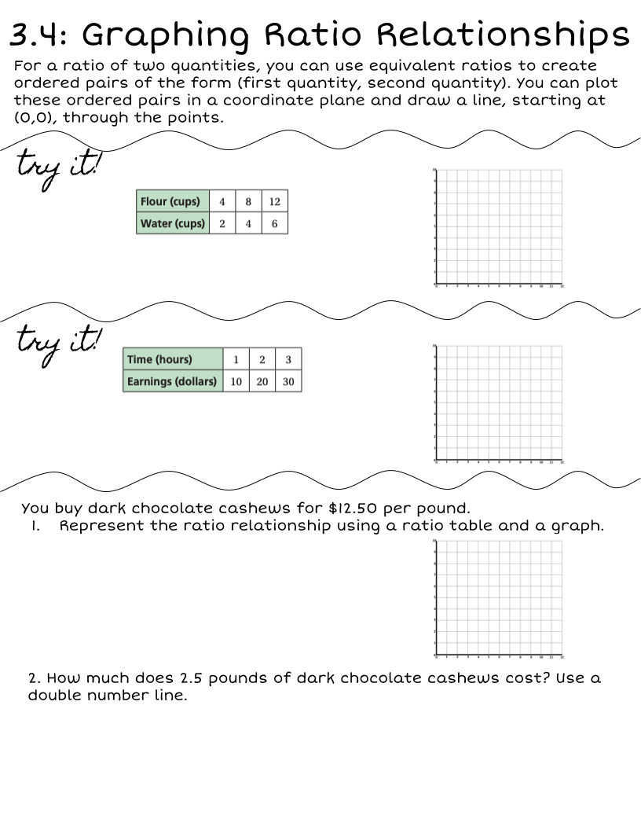
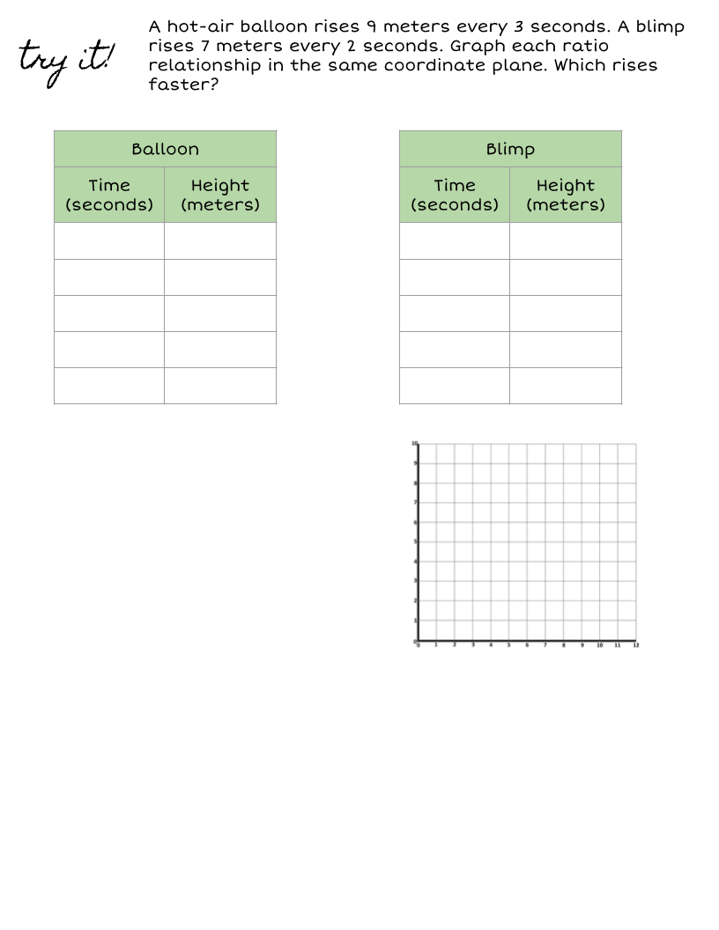

Slide 28
Wordbank:
Make copies of this box and type in it!

Slide 29
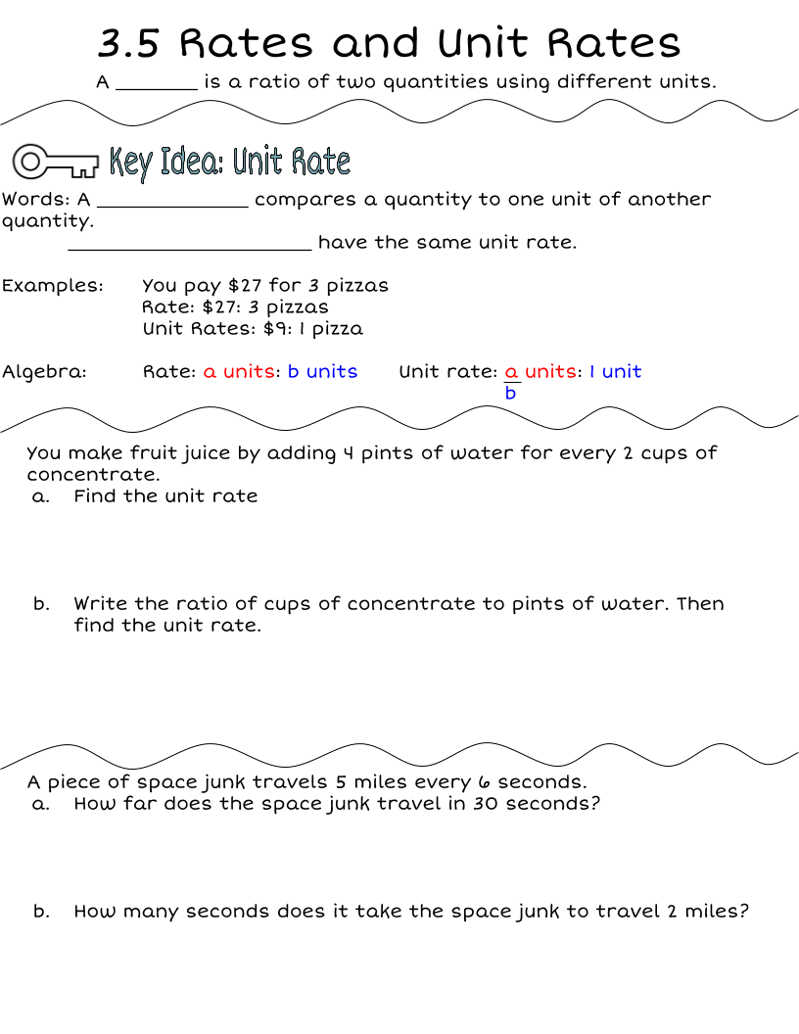
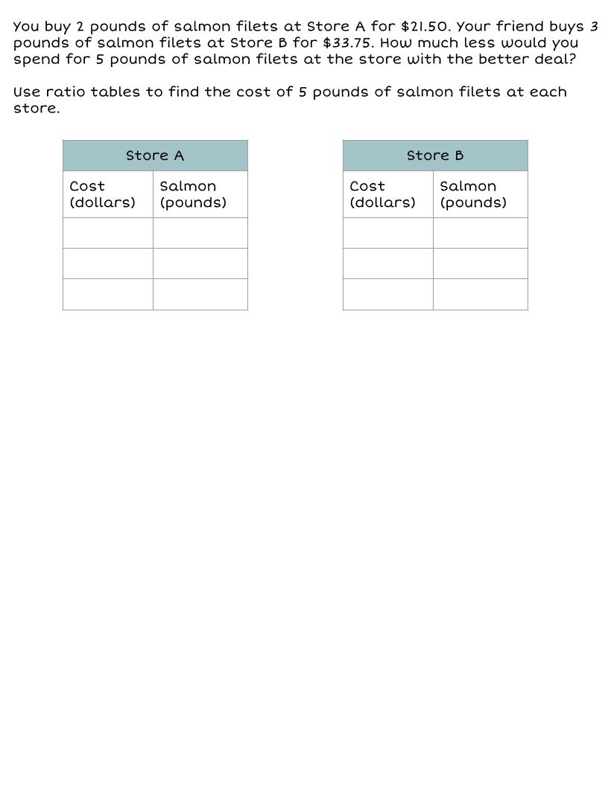
Wordbank:
Make copies of this box and type in it!

Slide 30
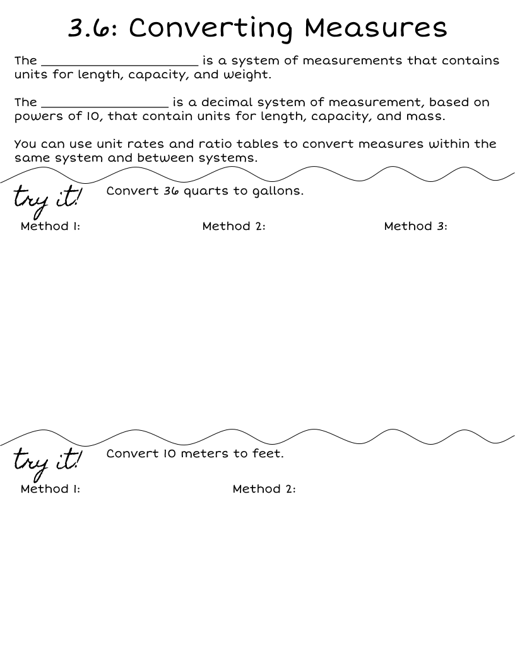
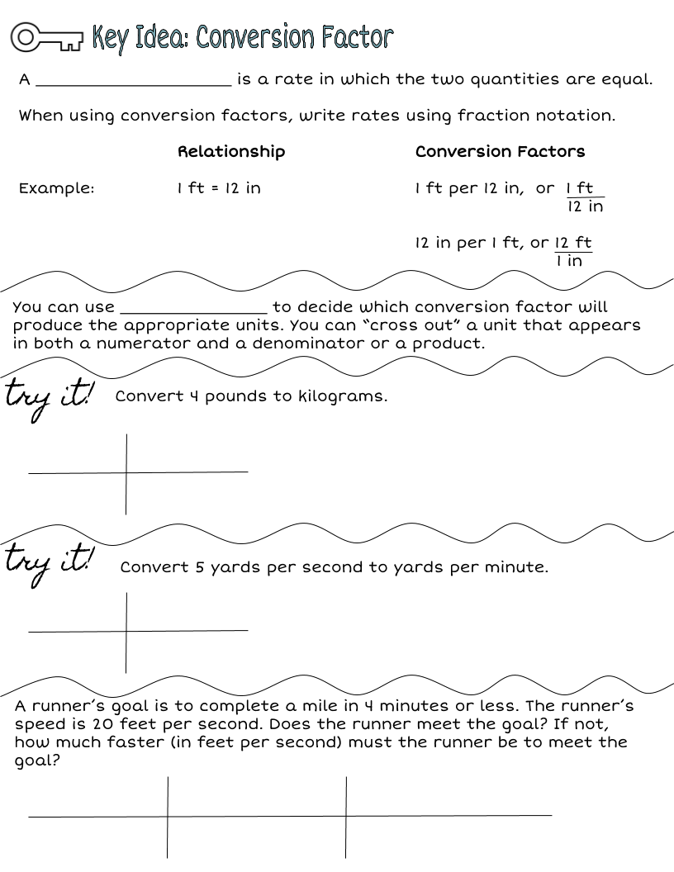

Slide 31
Wordbank:
Make copies of this box and type in it!

Slide 32
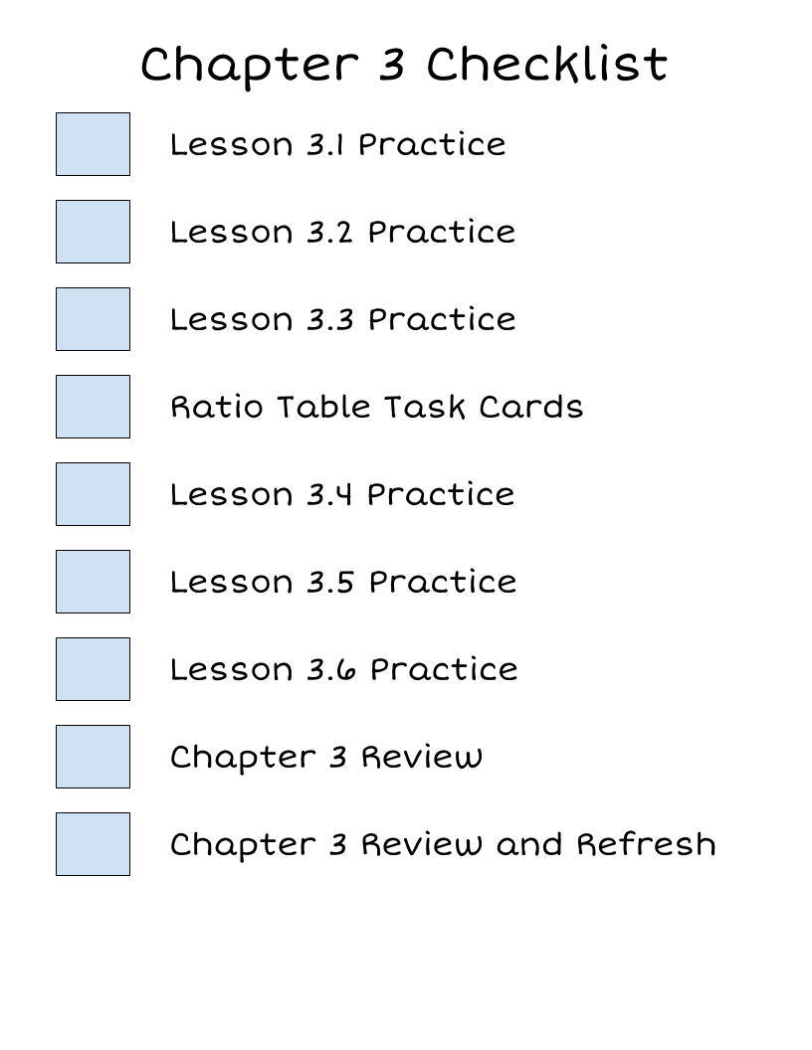
What are you missing?
Grades
Chapter 3A Quiz
Chapter 3B Quiz
Chapter 3 Test
Chapter 3 Notebook Check

Slide 33
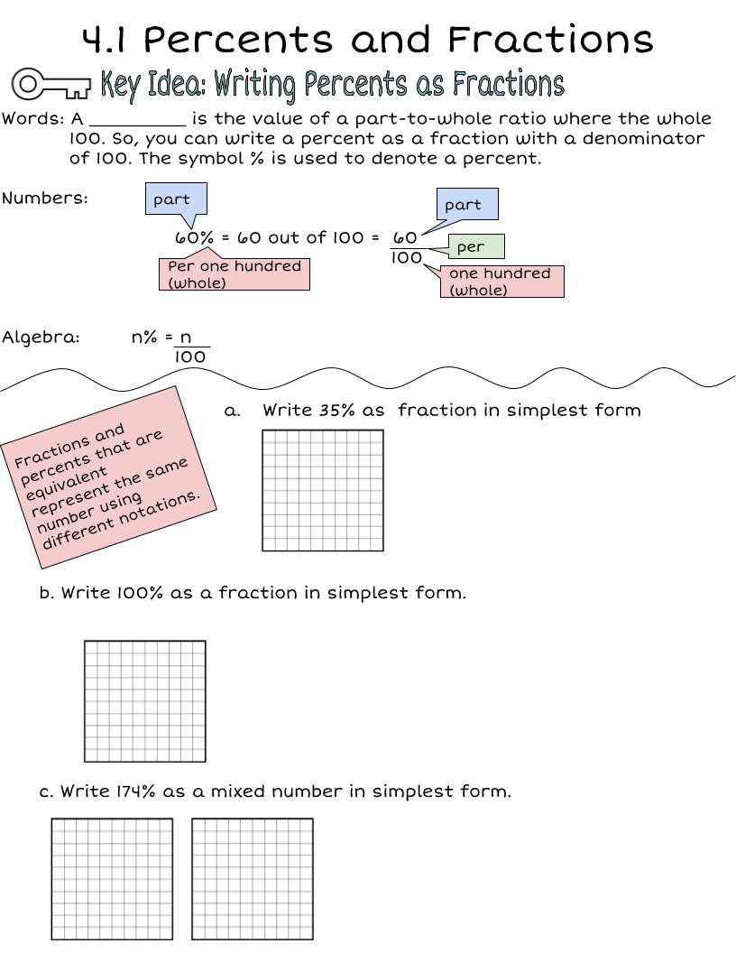
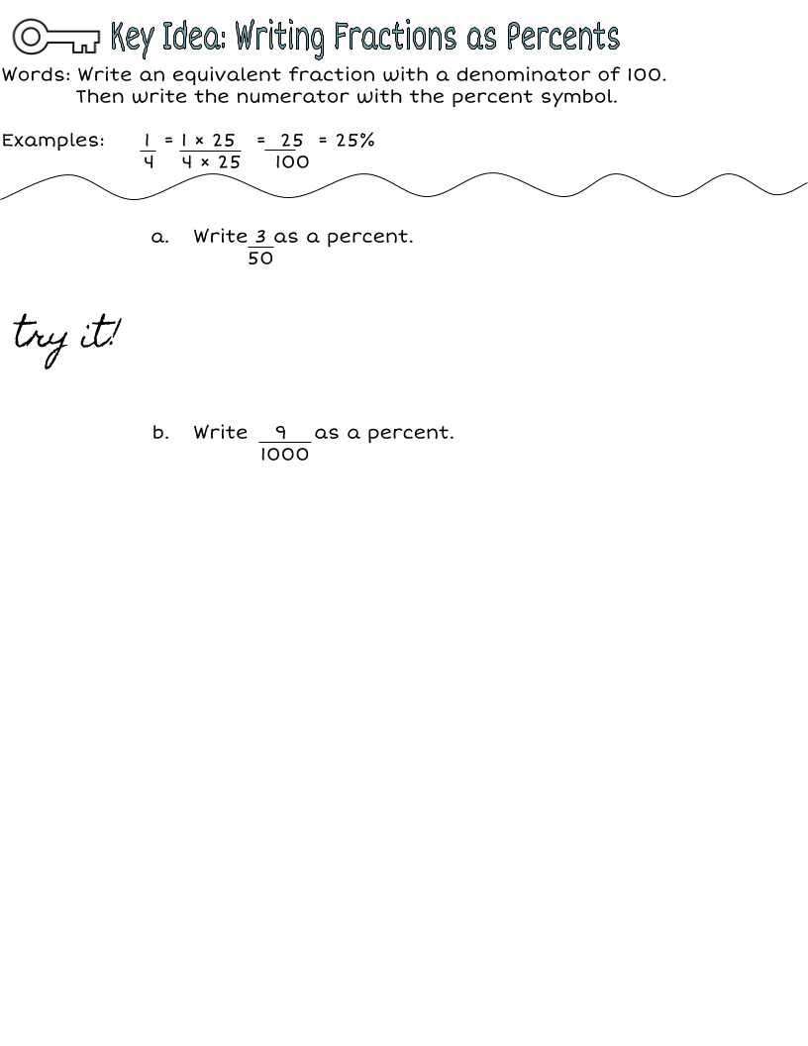
Wordbank:
Make copies of this box and type in it!

Slide 34
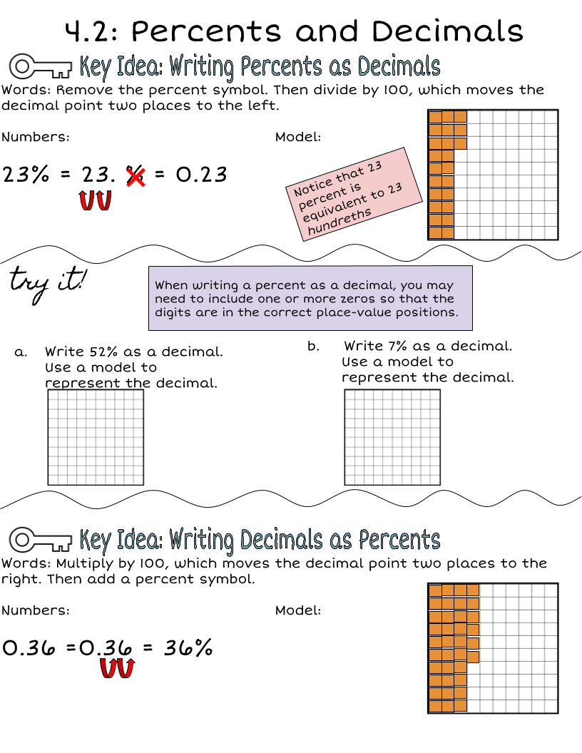
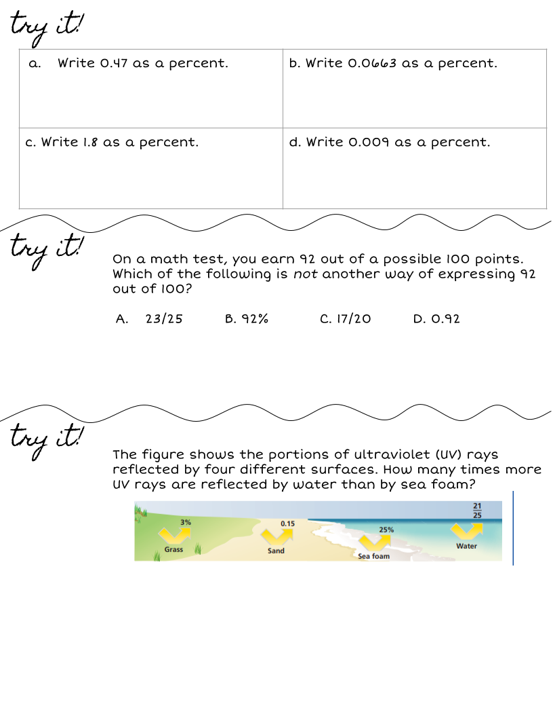

Slide 35
Wordbank:
Make copies of this box and type in it!

Slide 36
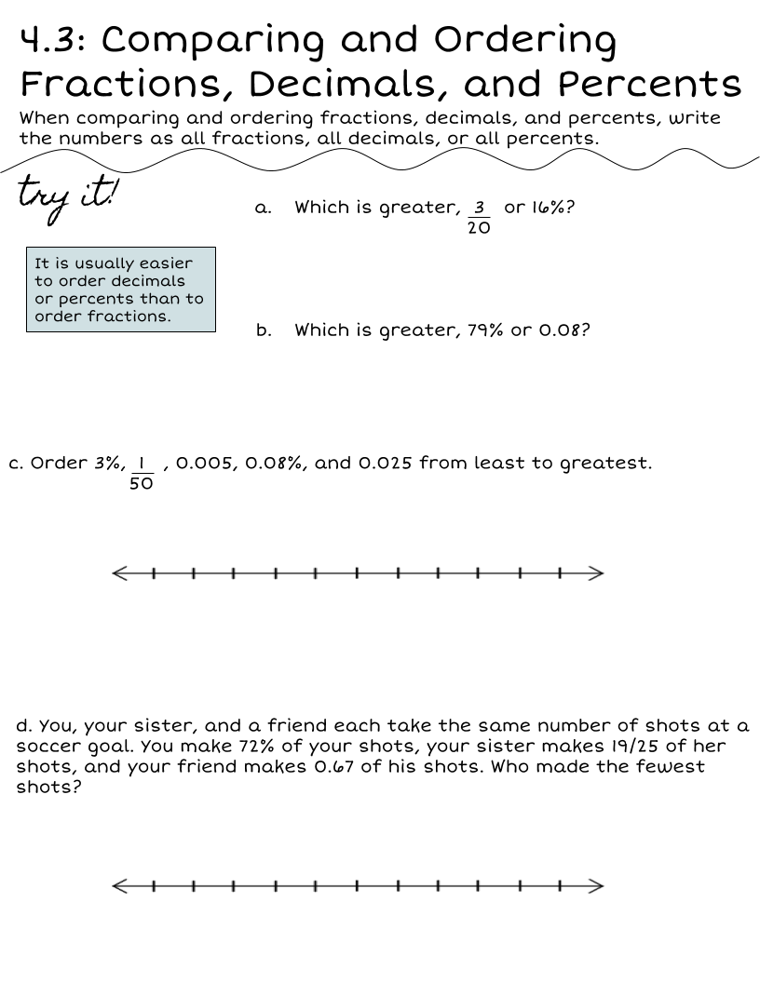
Wordbank
Make copies of this box and type in it!

Slide 37
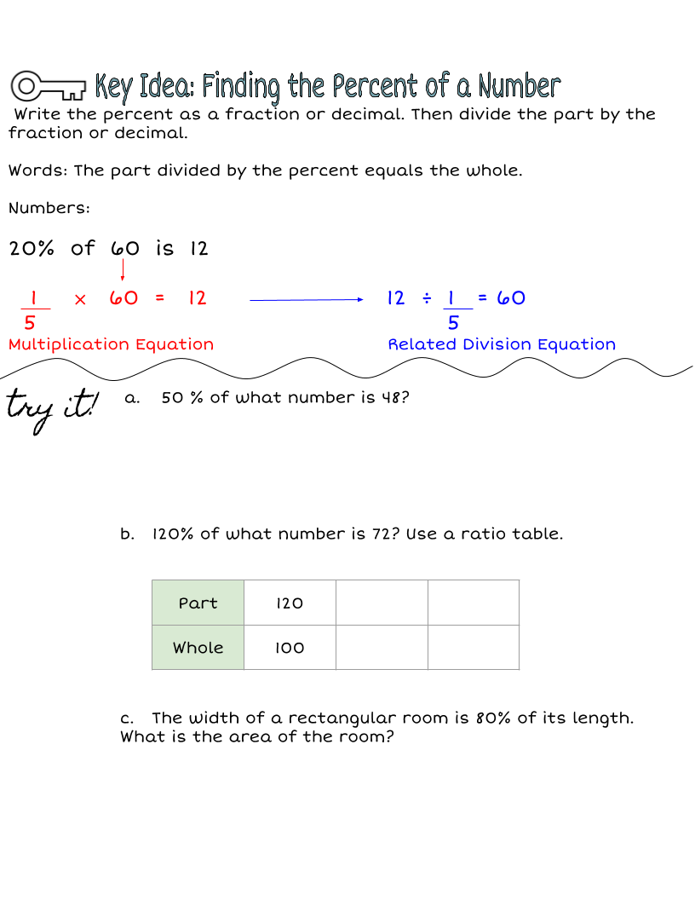

Slide 38
Wordbank:
Make copies of this box and type in it!

Slide 39
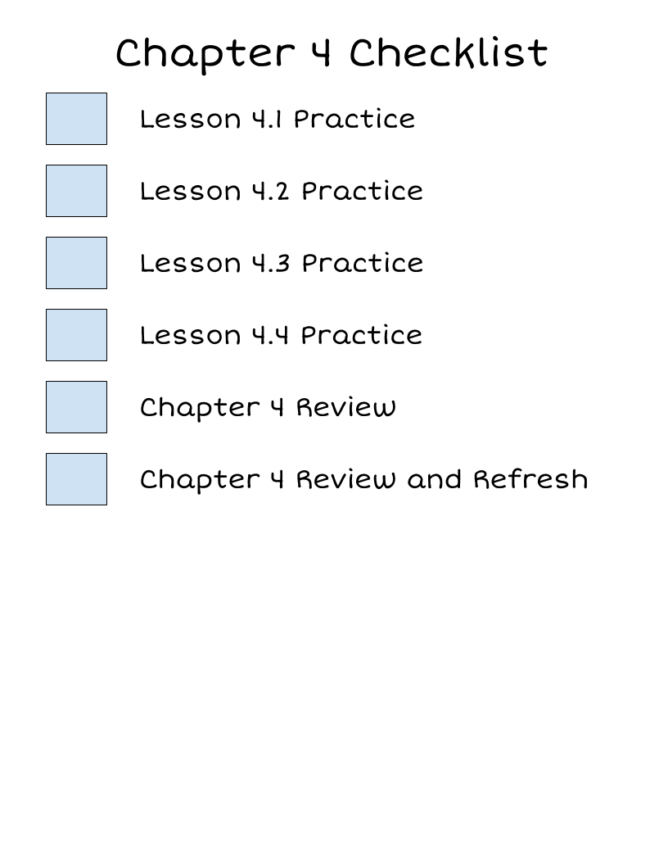
What are you missing?
Grades
Chapter 4A Quiz
Chapter 4B Quiz
Chapter 4 Test
Chapter 4 Notebook Check

Slide 40
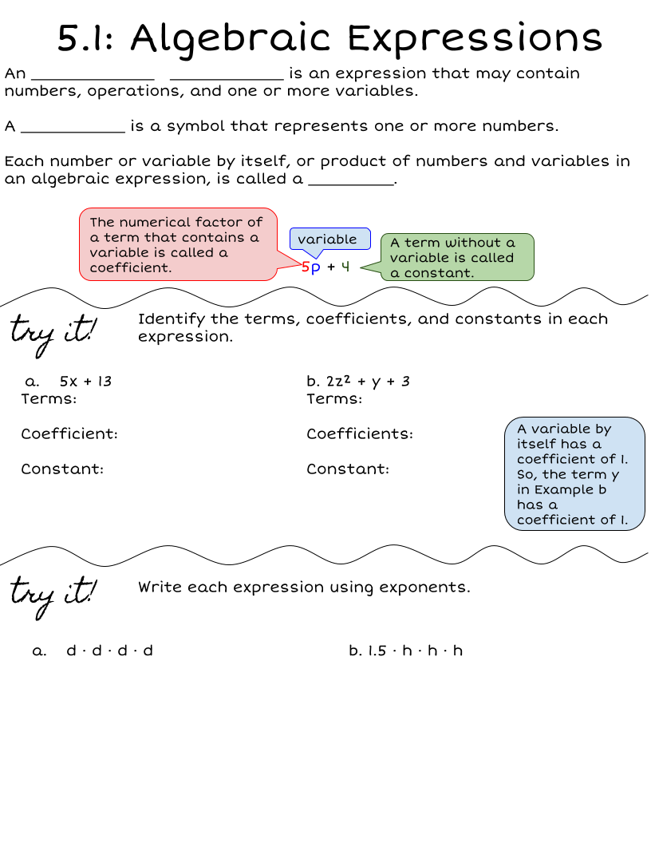
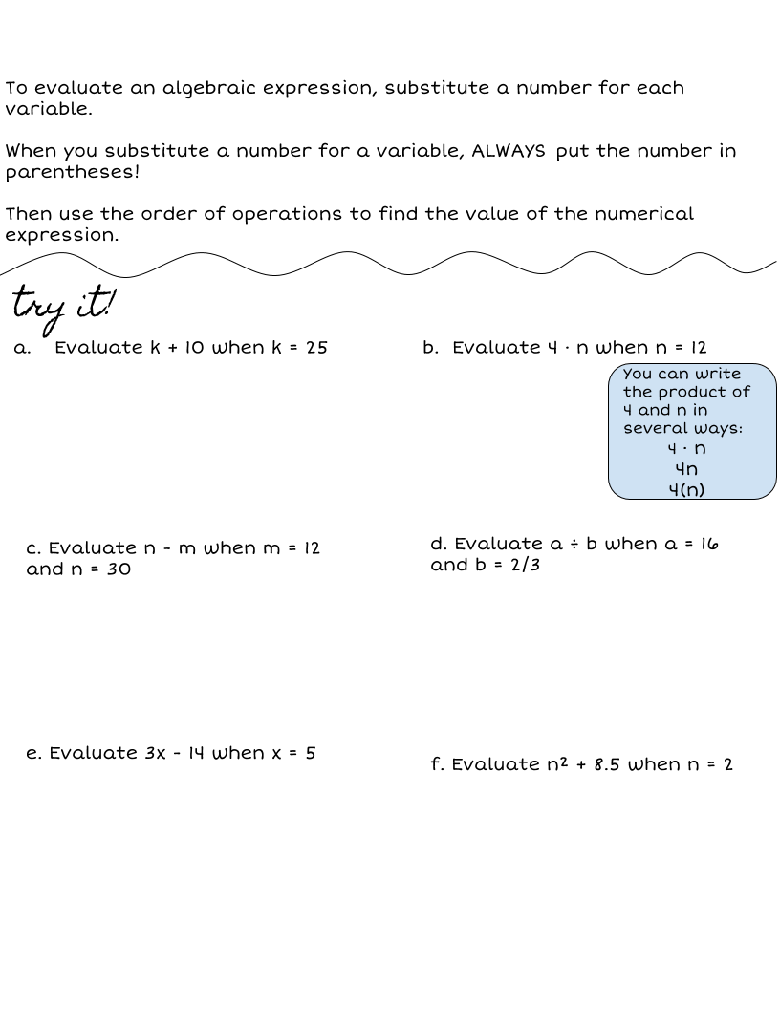

Slide 41
Wordbank:
Make copies of this box and type in it!

Slide 42
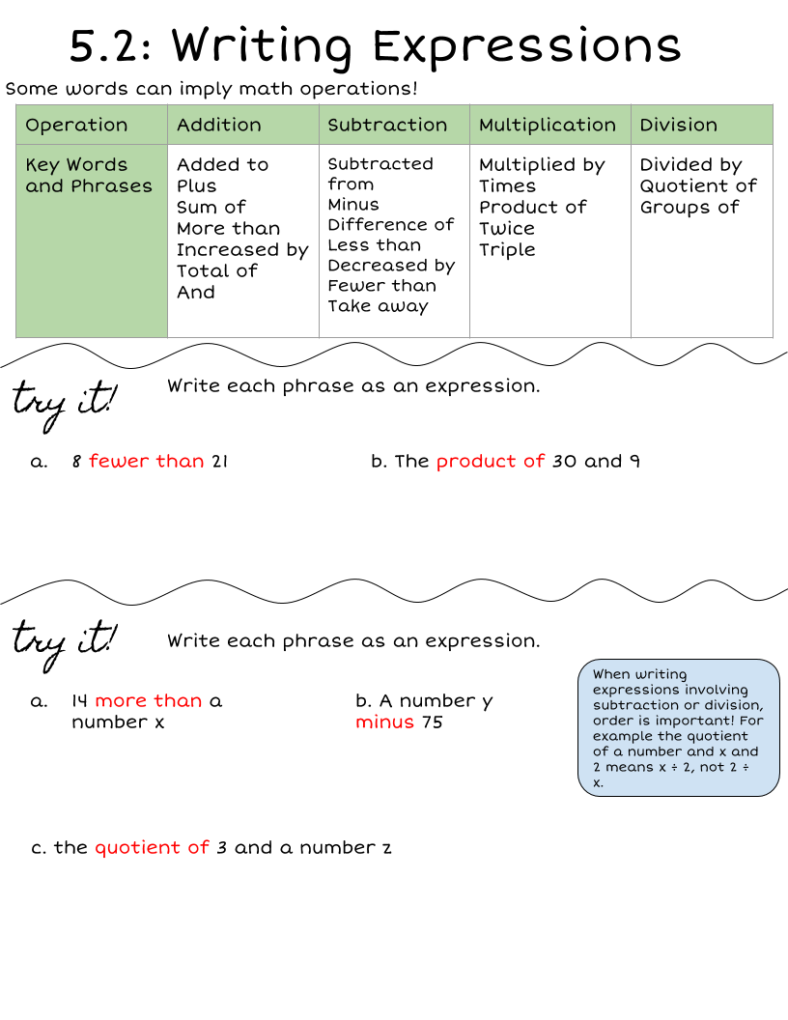
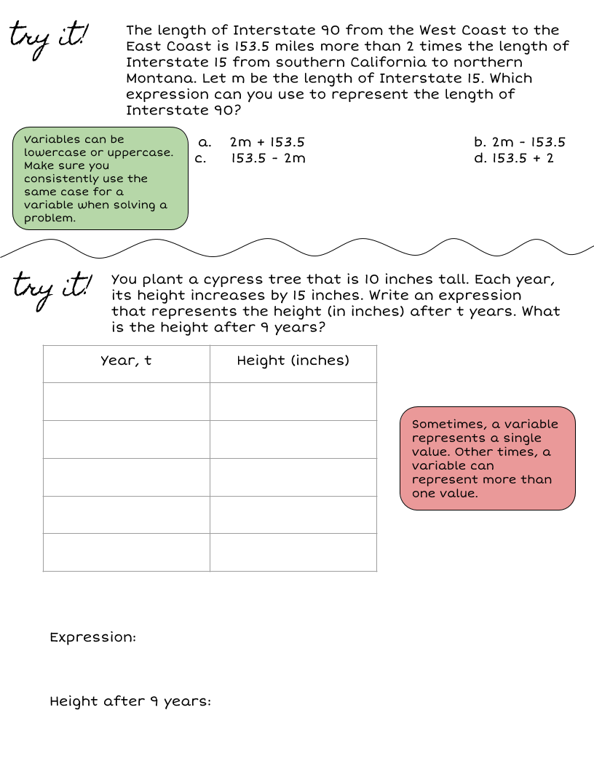

Slide 43
Wordbank:
Make copies of this box and type in it!

Slide 45
Wordbank:
Make copies of this box and type in it!

Slide 46
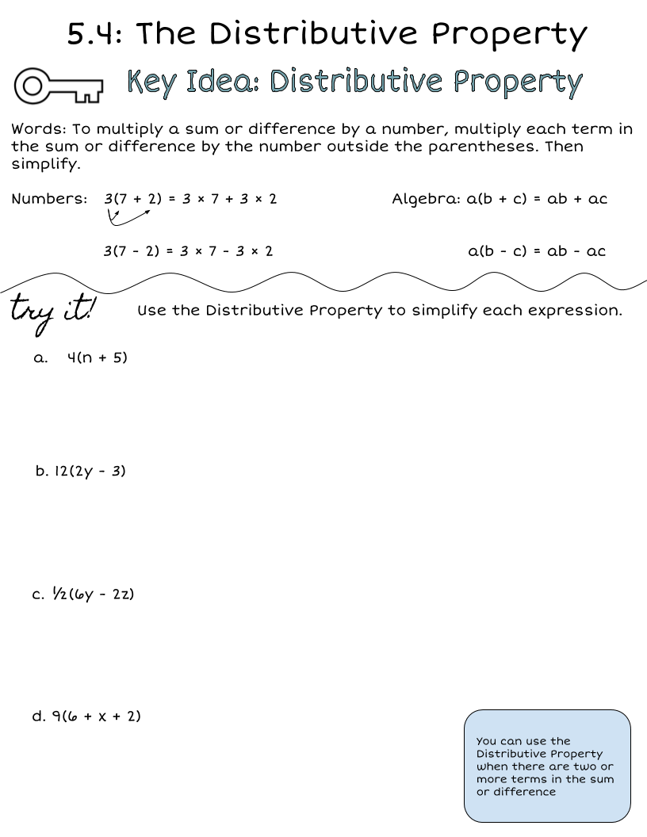

Slide 47
Wordbank:
Make copies of this box and type in it!

Slide 49
Wordbank:
Make copies of this box and type in it!

Slide 50
Chapter 5 Checklist
What are you missing?
Grades
Chapter 5A Quiz
Chapter 5B Quiz
Chapter 5 Test
Chapter 5 Notebook Check

Slide 51
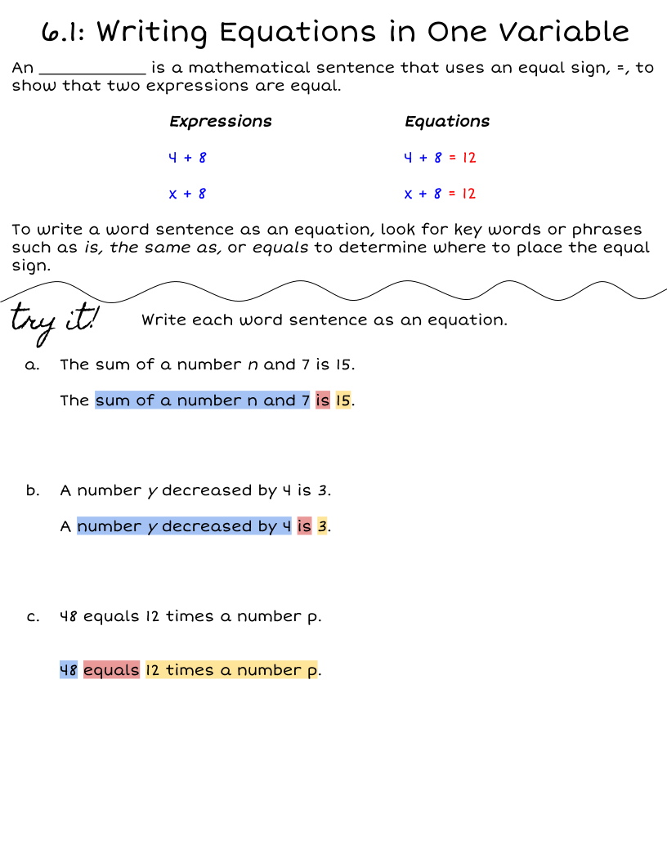

Slide 52
Wordbank:
Make copies of this box and type in it!

Slide 53
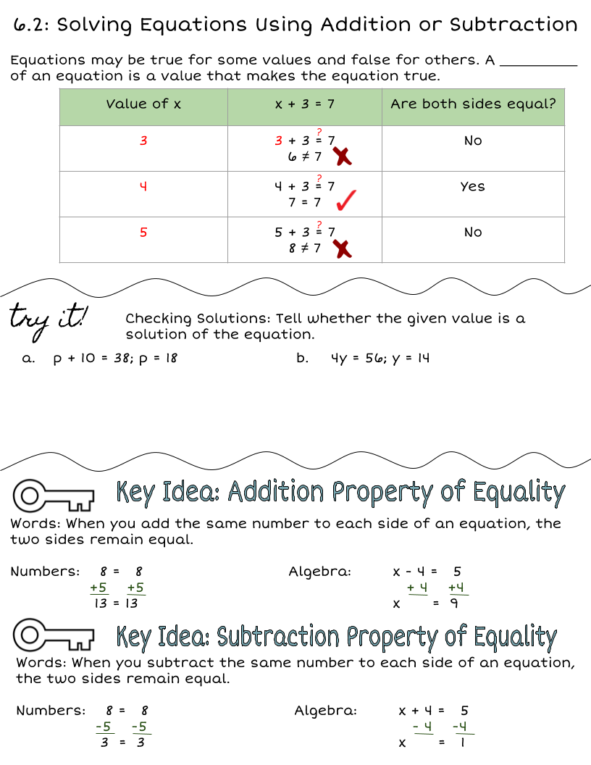
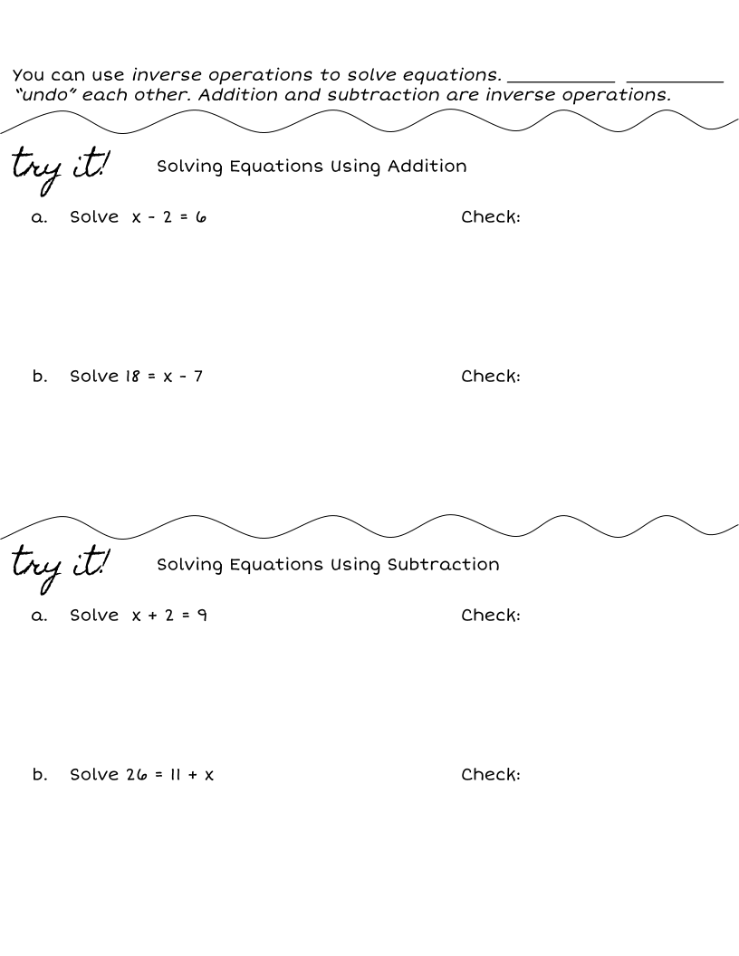

Slide 54
Wordbank:
Make copies of this box and type in it!

Slide 55
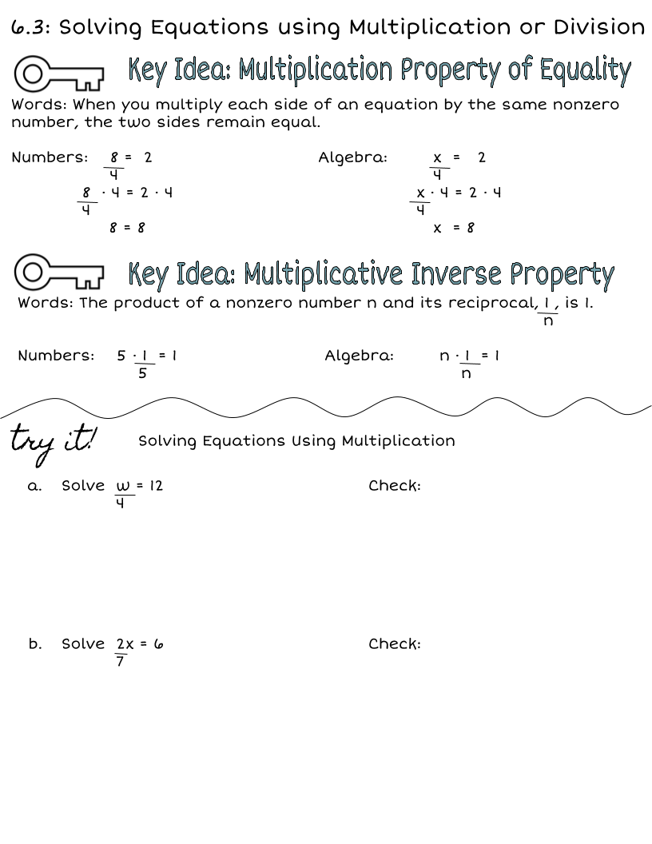
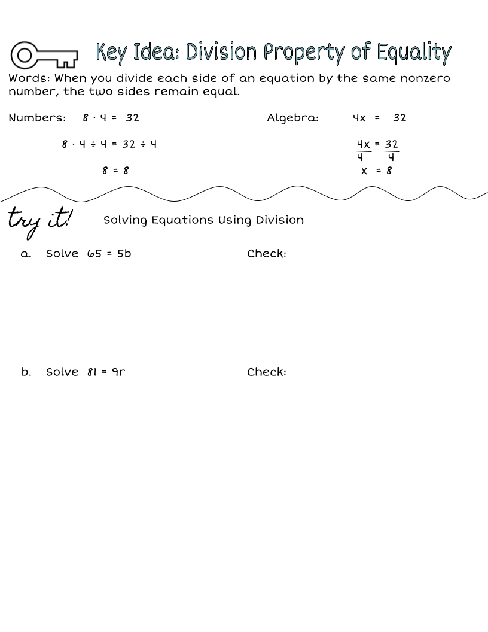

Slide 56
Wordbank:
Make copies of this box and type in it!

Slide 57
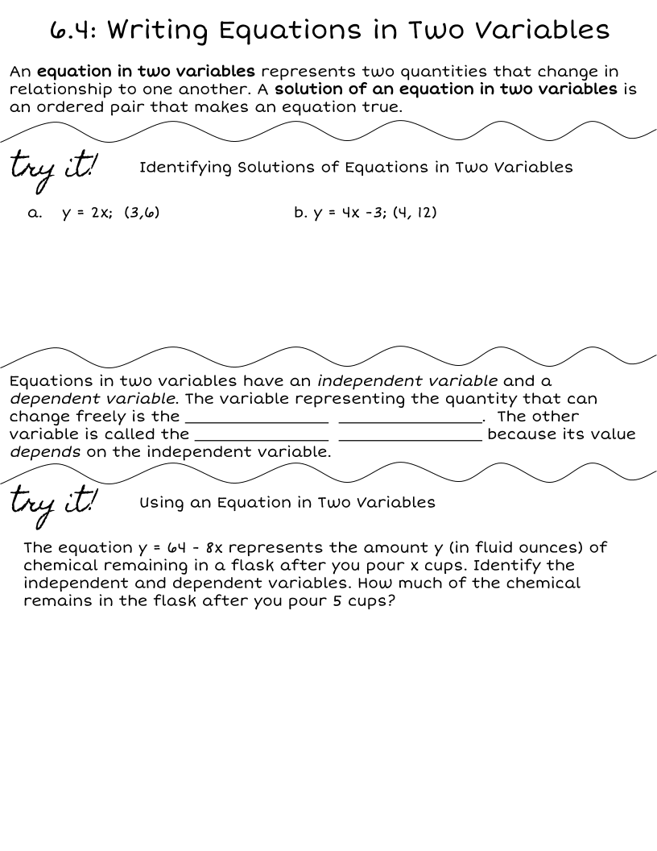
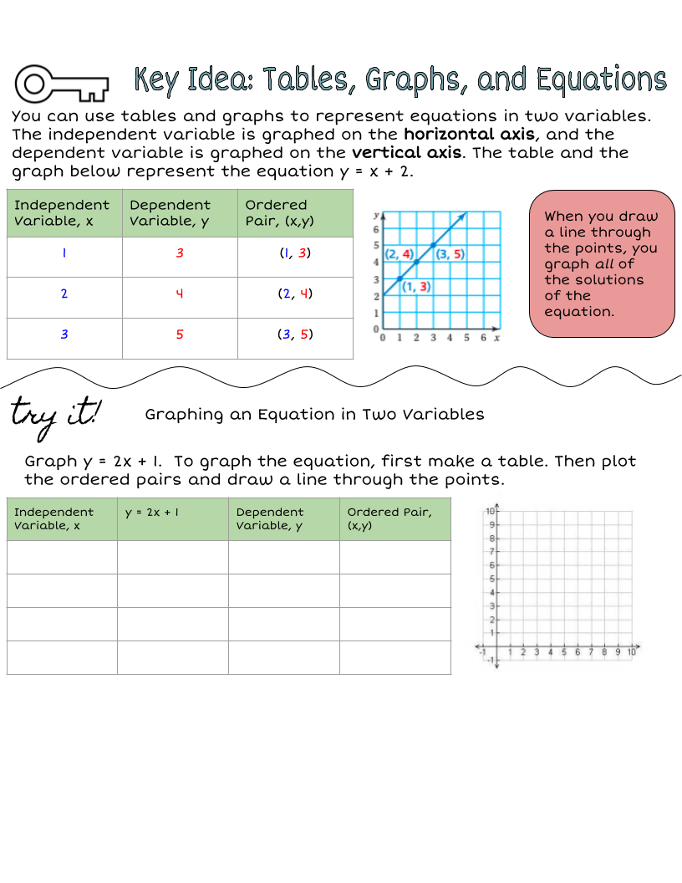

Slide 58
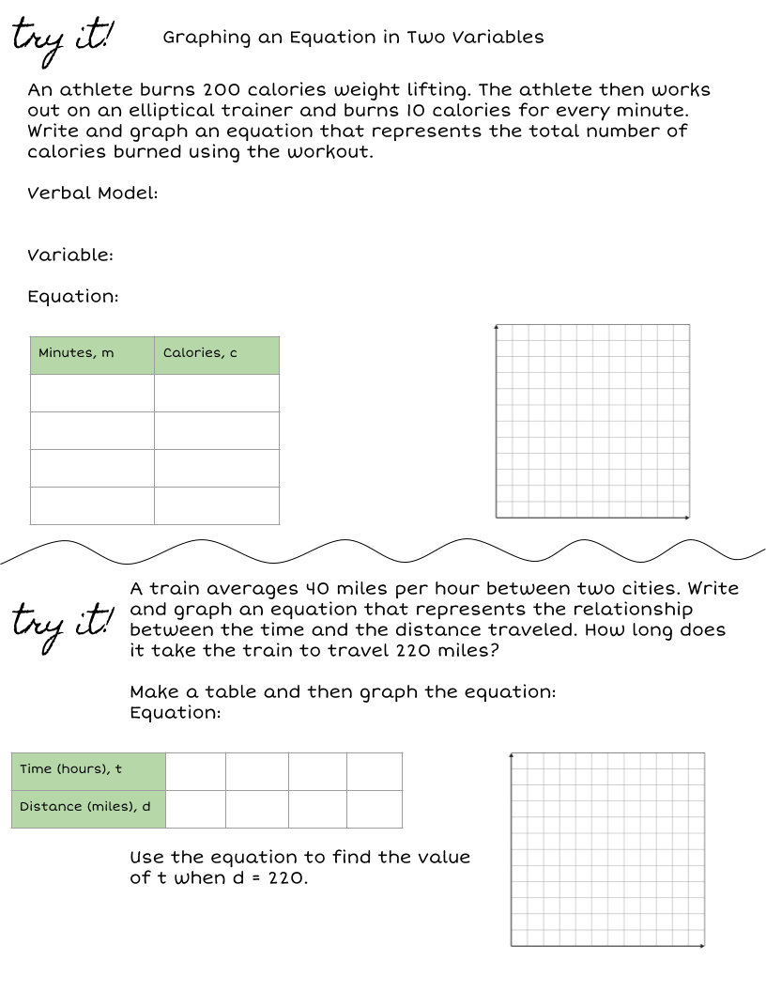
Wordbank:
Make copies of this box and type in it!

Slide 59
Chapter 6 Checklist
What are you missing?
Grades
Chapter 6A Quiz
Chapter 6B Quiz
Chapter 6 Test
Chapter 6 Notebook Check

Slide 60
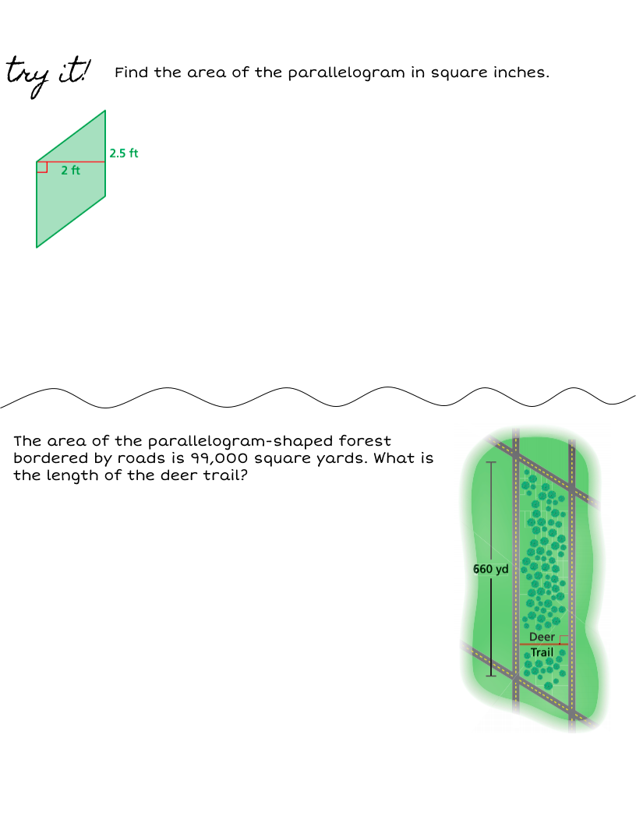

Slide 67
Chapter 7 Checklist
What are you missing?
Grades
Chapter 7A Quiz
Chapter 7B Quiz
Chapter 7 Test
Chapter 7 Notebook Check

Slide 78
Chapter 8 Checklist
What are you missing?
Grades
Chapter 8A Quiz
Chapter 8B Quiz
Chapter 8 Test
Chapter 8 Notebook Check

Slide 85
Chapter 9 Checklist
What are you missing?
Grades
Chapter 9A Quiz
Chapter 9B Quiz
Chapter 9 Test
Chapter 9 Notebook Check

Slide 92
Chapter 10 Checklist
What are you missing?
Grades
Chapter 10A Quiz
Chapter 10B Quiz
Chapter 10 Test
Chapter 10 Notebook Check

Slide 93
SC READY REVIEW
Stations and HW:

Slide 94
Thank you!

