Slide 1
C.T. Walker School Council
August 30, 2022

Slide 2
Purpose of School Council
The purpose of school councils is to “bring communities and schools closer together in a spirit of cooperation to solve difficult education problems, improve academic achievement, provide support for teachers and administrators, and bring parents into the school-based decision-making process.”

Slide 3
Officer Positions (2 year term)
President: Develop meeting agenda based on feedback from the council, preside and conduct 4 meetings, represent school council if needed at the district level . Currently Beth Dixon
Vice President: Serve in the absence of the President
Secretary: Record all votes and minutes, give notice of meetings, provide Principal with minutes to post on school website.

Slide 4
Nominations for Officers
Type name into chat with position interested
Send email to snowbal@boe.richmond.k12.ga.us
Voting will take place at next meeting if more than one nomination is received for a position.

Slide 5
School Improvement Plan
Increase % of students scoring on grade level in Math
Increase the percentage of students scoring 1 or more grade levels below in iReady by 5%
Host 4 or more events that bring stakeholders into the school to foster a sense of community

Slide 6
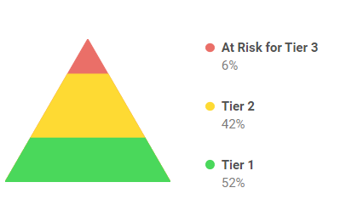
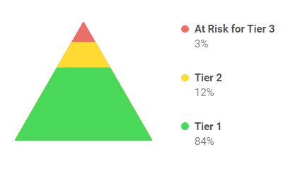
Reading Data

Slide 7
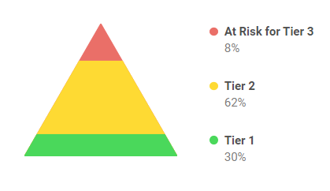
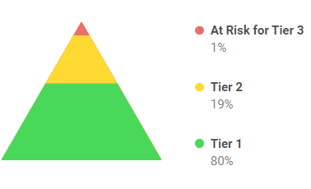
Math Data

Slide 8
Things on the horizon
Playground expansion
Centegix Crisis Alert System being installed
Intercom system upgrades

Slide 9
What would you like to see more info on?
Email Beth Dixon
Request topic to be added to agenda
Put topics in chat

Slide 10
Questions/Concerns

