Slide 1
DLE Lunch & Learn
How to support my student at home
10.22.2020
10:30 am- 12 noon

Slide 2
Agenda
Help at home (Virtual or Face to Face)
HealthMPowers
SEL Support
Lakes Market and Gem Closet​
Toys for Tots
Questions & Answers

Slide 3
Tips for Parents
As a parent, you can do your part at home to reinforce this important family-school partnership. To help prepare your children for school readiness to stay on track and expand their learning opportunities:
Set up a daily family routine, including healthy eating and sleeping habits
Provide a place and time at home for homework
Check on assignments, homework and projects
Talk each day with your child about his/her activities
Promote literacy by reading to your child and by reading yourself
Limit and monitor TV watching, gaming, social media and computer time
Express high expectations and standards for your child’s learning
Attend parent-teacher conferences, Open House and Back-To-School events to participate in decisions that affect your child’s education
Tap into community resources with visits to a library, museum, zoo or theater and encourage participation in after-school clubs, sports and art activities

Slide 4
Academic help at home
Academic help at home
In order to provide our students with academic support outside of their class time, we have partnered with FEV Tutor: FEV Tutor provides engaging, 1-to-1 virtual tutoring services that are driven by data and personalized for each student. The result is a live service designed to truly drive measured student achievement gains available to all Richmond County Online Academy students in all subjects. We encourage our online students to take advantage of this opportunity.
Your student’s teacher website (https://www.rcboe.org/diamondlakes)
Other Resources
Learn at Home Materials: Materials designed to help students reinforce the concepts they learn in school, and equip them for learning at home.
Audible Stories: Hundreds of titles available completely free. The collection is a mix of stories to entertain, engage, and inform young people, ages 0–18. There are selections in English, Spanish, German, French, Japanese and Italian.
Universal School Library: This website offers a growing collection of digitized books that have been curated by a national advisory group of school librarians, librarian educators and researchers. Currently, you can search and find selected books from a selection of school libraries across the country, as well as from nationally recognized book award and recommendation lists.

Slide 5
Mix It Up! - Video
Improving Learning through Healthy Eating and Physical Activity
October
Notes:
Hello, my name is ____________and I’m glad you are able to join us today. During our time together we will be asking you a few questions. You have the choice not to answer any of them. Your participation is voluntary. All responses are kept confidential and your individual answers and personal information will not be shared with anyone. Thank you for your time!
I want to welcome you to our family presentation that comes to us from HealthMPowers. Our school is working with HealthMPowers to help improve the healthy eating and physical activity behaviors of our students and their families. This partnership is important because of the strong link between a child’s health and their success in school. And that’s what we all have in common- wanting your child to succeed. ​
​
Our topic today is Mix It Up! Today, we are going to mix things up a little (pun-intended☺). In school, we are always discussing academic ways to help your children learn, like reading, math, and so on… But, did you know that mixing things up so that your child gets enough physical activity and a healthy diet can improve learning?!?!
Today we are going to discuss:
Increasing learning with a healthy diet
The effects that physical activity has on improving learning

Slide 6
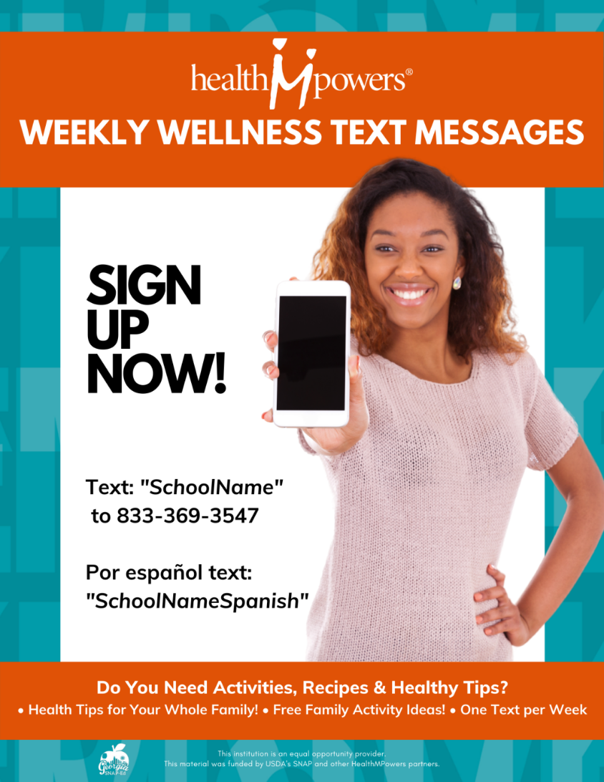
Sign Up for Weekly Wellness Text Messages (flyer sent home last week)
Text: DiamondLakes
To: 833-369-3547
Por espanol Text: DiamondLakesSpanish
To: 833-369-3547

Slide 7
What is Social Emotional Learning?
Social-Emotional Learning (SEL) is the process of developing self-awareness, self-control, and interpersonal skills that are vital for school, work, and life success. (source: cfchildren.org)
Examples of SEL Topics:
-Emotions and Emotional Regulation
- Mindfulness (the practice of placing your focus and awareness on the present moment)
-Getting along and working with others
Visit Mrs. Abellan’s Virtual Counseling Office for more SEL resources:
https://docs.google.com/presentation/d/1eziYNSF5Tw3b1VvT46SVnIYACq1vmNeQtOUcYzls4bc/edit?usp=sharing

Slide 8
Social Emotional Resources for Children
-Daniel Tiger’s Neighborhood is a great social-emotional resource for young children (ages 5 and below). This show explores many topics such as feeling sad, anger, mindfulness, and even how to talk about death. Go to pbskids.org/daniel for free episodes, clips, and games.
-Close Gap is an emotional wellness site that children can use daily and even has a wellness tracking feature. Visit closegap.org to explore.
-Cosmic Kids Yoga channel on youtube.com has many fun and easy yoga guided exercise videos just for kids. Yoga promotes mindfulness (paying attention to the moment and clearing your mind) which is supported by research to help emotional regulation and stress reduction in children, adolescents, and adults. Visit https://www.youtube.com/user/CosmicKidsYoga.

Slide 9
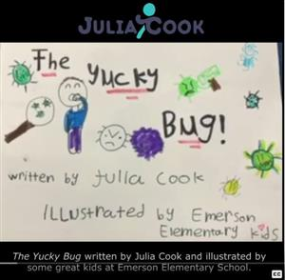
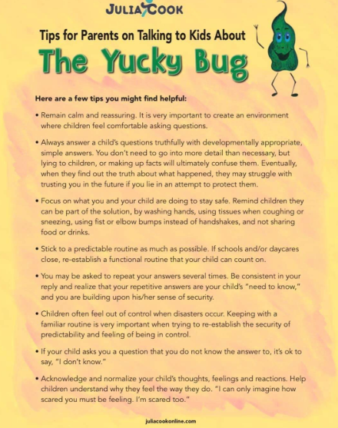
Helping Children Understand The Coronavirus
Books:
-Why We Stay Home by Samantha Harris & Devon Scott
-The Yucky Bug by Julia Cook
(read aloud on youtube.com)
Guide to talking with children about the Coronavirus (Julia Cook):
https://drive.google.com/file/d/18YfuC_l_2aW6CKVQrKiAvq96ik6p08K0/view

Slide 10
Lakes Market and Gem Closet​
We have partnered with Golden Harvest Food Bank to provide free shelf-stable foods for DLE families in need through our Lakes Market. Our market will be open by appointment on Fridays, but we would be happy to accommodate your schedule upon request. ​
Our Gems Closet, available to families upon request, is stocked with generously donated clothing (new and gently used) with a wide range of sizes (toddlers to adults).​
Please contact Mrs. Abellan, the school counselor, if you would like more information or fill out the survey using the link below:​
https://forms.office.com/Pages/ResponsePage.aspx?id=QC2yMGJzF0-DqSUwkntvZaiHlWrBRNdGh0ZPa3AvbAVURjM0WUZEMUNYWFpEMUkzSlpUOTJLUlU1My4u​

Slide 11
Toys for Tots
Do you need help with Christmas this year?
-Please call the school (Mrs. Watkins or Mrs. Abellan) to set up a time to pick up an application. 706-771-2881
All applications must be turned in by November 9th.

Slide 12
Questions & Answers

