Slide 1
Let’s OPEN Georgia Standards
Presented by
Charla Tedder Krahnke
OPEN National Trainer
charlaphysed@gmail.com
@ncpe4life

Slide 2
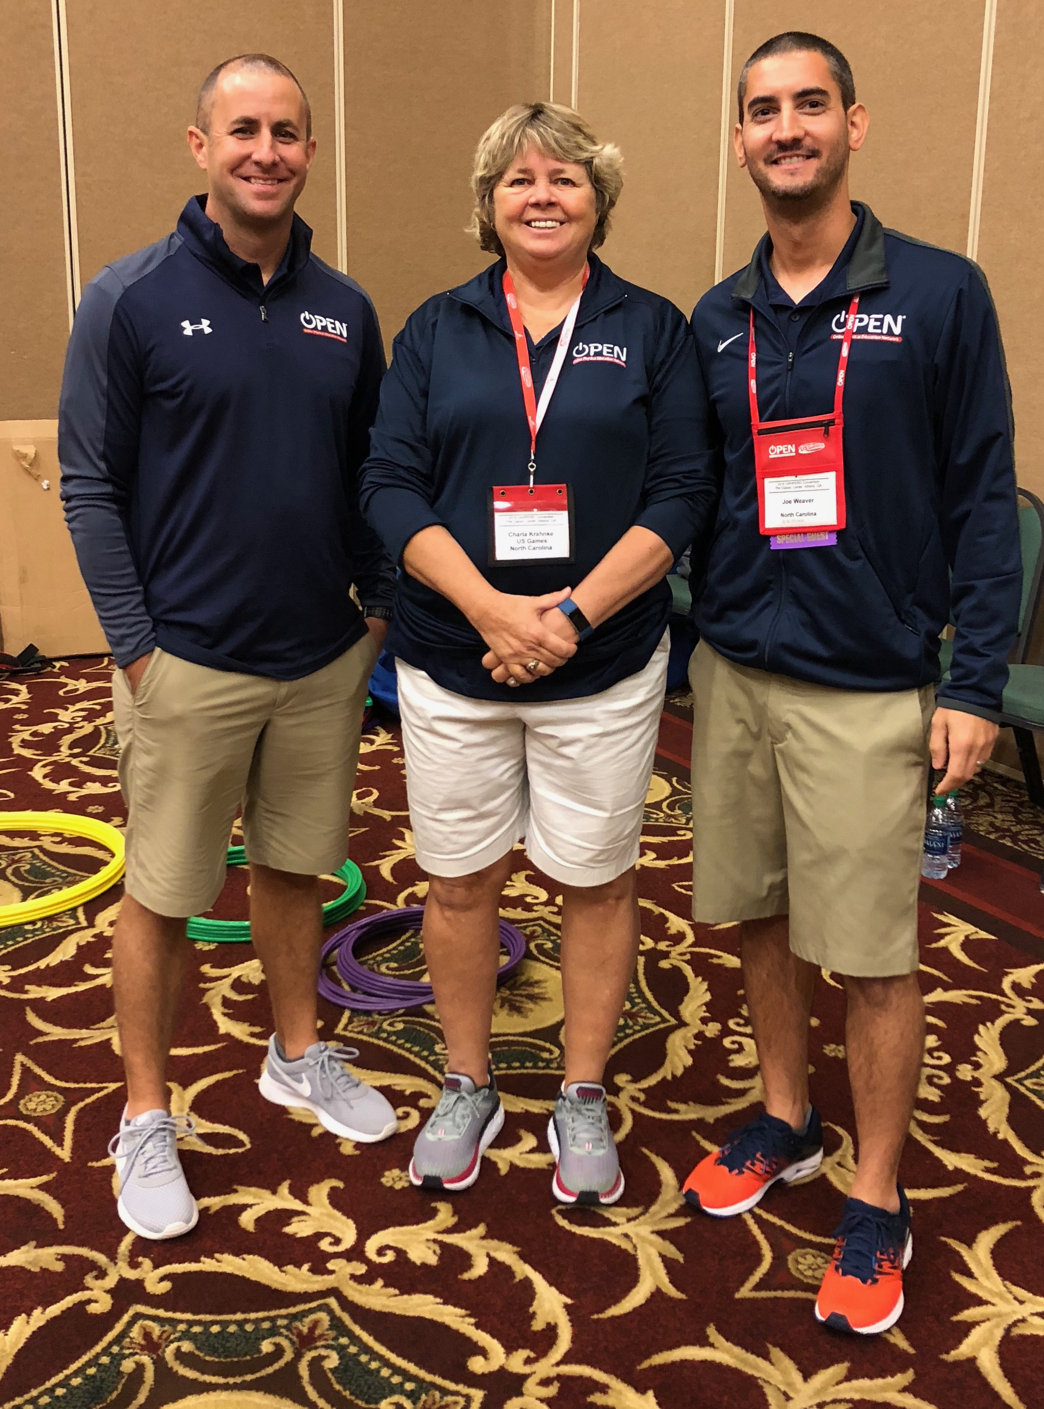
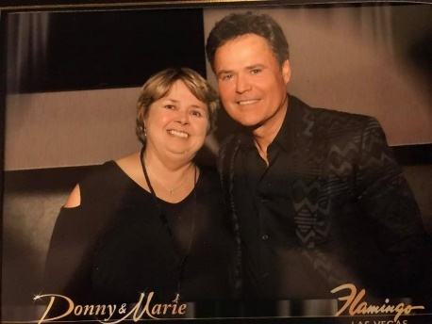
About Me!

Slide 3
Today’s Outcomes
Connect OPENphysed with Georgia Standards
Experience the modules and components
Registration

Slide 4
Ground Rules
Be Present
Be Respectful
Be Social
* Tag @OPENPhysEd in pictures and posts

Slide 5
THE WHY!

Slide 6
Georgia Middle School Standards
Tumbling Wrestling

Slide 7
Georgia Middle School Standards
Tumbling Wrestling
Standard | 6th grade | 7th grade | 8th grade
PE6.2 The physically educated student applies the knowledge of concepts, principles, strategies, and tactics related to movement and performance. | Describes basic strategies and motor skill techniques for offense and defense in small-sided game play. | Identifies and predicts the results of open space concepts in team sport activities by utilizing offensive and defensive tactics. | Assesses movement /strategies necessary for physical performance in individual activity and team situations (transition from defensive positioning; body position; weight transfer; communication skills.

Slide 8
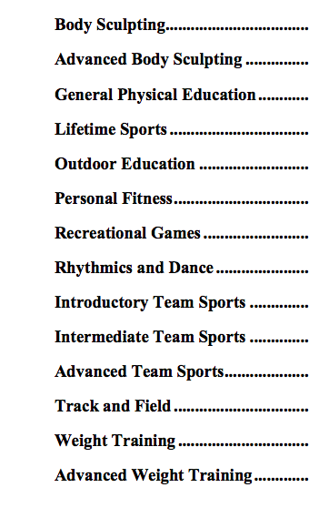
Georgia High School Standards

Slide 9
What Is OPEN?

Slide 10
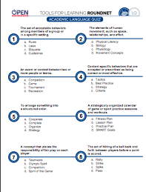
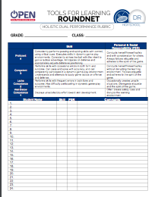
Assessments

Slide 11
Teaching Modules K-2
Ball Handling/Dribbling
Dance
Field Day
Flag Tag
Foot Skills
Instant Activities
Limited Equipment
Locomotor and Manipulative Skills
Next Gen Science Connections
Ninja Warriors
Parachute
Personal/Social Responsibility
Volleying/Striking

Slide 12
Teaching Modules Elem 3-5
Next Gen Science Connections
Ninja Warriors
Olympics
Paralympics
Personal and Social Pickleminton
Plug and Play Fitness
Skillastics Basketball
Basketball Skills
Bat and Ball Games
Dance
Field Day
Fitness Knowledge
Invasion Basics
Instant Activities
Jump Rope
Lacrosse

Slide 13
Teaching Modules Middle School
Basketball Skills Rugby
Circus Arts Tabata Training
Limited Equipment Ultimate
OPEN 8 Challenge Instant Activities
Plug & Play Fitness Roundnet

Slide 14
Teaching Modules High School
Badminton Limited Equipment
Creative Mode Fitness Instant Activities
Plug and Play Fitness Tai Chi
Roundnet/Spikeball

Slide 15
Let’s Move! Instant Activities
Toss 3
High 5 Bank Account
Aerobic Numbers
Darebee.com

Slide 16
Badminton
Badminton Bingo
Racquet Handling
Volley Challenge
Racquet Square
Move and Clear
Fronton
Champ of the Court

Slide 17
National Badminton Standards
Standard 1. Demonstrates competency in a variety of motor skills and movement patterns.
H1.L1&2. Demonstrates competency and/or refines activity-specific movement skills in two or more lifetime activities (net/wall games) (L1).
Standard 2. Applies knowledge of concepts, principles, strategies, and tactics related to movement and performance.
H1.L1&2. Applies the terminology associated with exercise and participation in selected individual-performance activities, dance, net/wall games, target games, aquatics, and/or outdoor pursuits appropriately (L1).

Slide 18
Ultimate
Uno Dos Tres
Hula Hut frisbee
6-way Frisbee
Hot Box
Ultimate Disc (Football)

Slide 19
Roundnet/Spikeball
Self Passing
Partner Passing
Selfie-Spikes
Tossing Drills
Rally Time
Royal Court Games

Slide 20
Academic Literacy

Slide 21
Depth of Knowledge:Selfie Spikes
DOK 1: What would you include on a list describing the pros and cons of hitting a Spikeball® with speed?
DOK 2: How would you summarize the speed/accuracy trade-off related to Roundnet spikes?
DOK 3: How is speed related to accuracy when spiking?

Slide 22
Plug & Play Fitness!
4 Corner Boogie
Upside Down
Bean Bag Blockers
Plank Races
Fitness Uno

Slide 23
Varsity Brands: Believe In You

Slide 24
Register For OPEN
Step 1: Visit www.OPENphysed.org
Step 2: Click “Login For Free,” then “Sign-up Now”
Step 3: “Click sign up now.”
Step 4: Login using new username & PW
Step 5: Go to “Curriculum Resources” to access content

Slide 25
Two more Things…
Complete our online evaluation at www.bit.ly/OPENPD

