Slide 1
ELA Get Started Notebook
2020-2021
Writing is fun!
Mr. Werth

Slide 2
Table of Contents
Week 1
Date | Title | Page #
 | Get Started 08/07
 | Get Started 08/08
 | Get Started 08/09
 | Get Started 08/10
 | Get Started 08/11
 | Week 1 Checklist

Slide 3
Table of Contents
Table of Contents
Week 2
Date | Title | Page #
 | Get Started 08/14
 | Get Started 08/15
 | Get Started 08/16
 | Get Started 08/17
 | Get Started 08/18
 | Week 2 Checklist
Week 3
Date | Title | Page #
 | Get Started 09/21
 | Get Started 09/22
 | Get Started 09/23
 | Get Started 09/24
 | Get Started 09/25
 | Get Started Week 3 Checklist

Slide 4
Table of Contents
Table of Contents
Chapter 4
Date | Title | Page #
 | 4.1: Percents and Fractions
 | 4.2: Percents and Decimals
 | 4.3: Comparing and Ordering Fractions, Decimals, and Percents
 | 4.4: Solving Percent Problems
 | Chapter 4 Checklist
Chapter 5
Date | Title | Page #
 | 5.1: Algebraic Expressions
 | 5.2: Writing Expressions
 | 5.3: Properties of Addition and Multiplication
 | 5.4: The Distributive Property
 | 5.5: Factoring Expressions
 | Chapter 5 Checklist

Slide 5
Table of Contents
Table of Contents
Chapter 6
Date | Title | Page #
 | 6.1: Writing Equations in One Variable
 | 6.2: Solving Equations Using Addition or Subtraction
 | 6.3: Solving Equations Using Multiplication or Division
 | 6.4: Writing Equations in Two Variables
 | Chapter 6 Checklist
Chapter 7
Date | Title | Page #
 | 7.1: Area of Parallelograms
 | 7.2: Area of Triangles
 | 7.3: Areas of Trapezoids and Kites
 | 7.4: Three-Dimensional Figures
 | 7.5: Surface Area of Prisms
 | 7.6: Surface Area of Pyramids
 | 7.7: Volumes of Rectangular Prisms
 | Chapter 7 Checklist

Slide 6
Table of Contents
Table of Contents
Chapter 8
Date | Title | Page #
 | 8.1: Integers
 | 8.2: Comparing and Ordering Integers
 | 8.3: Rational Numbers
 | 8.4: Absolute Value
 | 8.5: The Coordinate Plane
 | 8.6: Polygons in the Coordinate Plane
 | 8.7: Writing and Graphing Inequalities
 | 8.8: Solving Inequalities
 | Chapter 8 Checklist
Chapter 9
Date | Title | Page #
 | 9.1: Introduction to Statistics
 | 9.2: Mean
 | 9.3: Measures of Center
 | 9.4: Measures of Variation
 | 9.5: Mean Absolute Deviation
 | Chapter 9 Checklist

Slide 7
Table of Contents
Table of Contents
Chapter 10
Date | Title | Page #
 | 10.1: Stem-and-Leaf Plots
 | 10.2: Histograms
 | 10.3: Shapes of Distributions
 | 10.4: Choosing Appropriate Measures
 | 10.5: Box and Whisker Plots
 | Chapter 10 Checklist
SC READY REVIEW
Date | Title | Page #

Slide 8
Things to Remember
Get Started - Monday, September 7, 2020
Use proper punctuation (periods, commas, exclamation points, question marks, etc)
Capitalize the starts of sentences and proper nouns.
Use proper grammar (all formal writing assignments will need to be written without using slang, so practice makes perfect).
Be yourself; these entries will stay between you and I (unless you volunteer to share your response).
1
2

Slide 9
Things to Remember
Get Started - Tuesday, September 8, 2020
Use proper punctuation (periods, commas, exclamation points, question marks, etc)
Capitalize the starts of sentences and proper nouns.
Use proper grammar (all formal writing assignments will need to be written without using slang, so practice makes perfect).
Be yourself; these entries will stay between you and I (unless you volunteer to share your response).
3
4

Slide 10
Things to Remember
Get Started - Wednesday, September 9, 2020
Use proper punctuation (periods, commas, exclamation points, question marks, etc)
Capitalize the starts of sentences and proper nouns.
Use proper grammar (all formal writing assignments will need to be written without using slang, so practice makes perfect).
Be yourself; these entries will stay between you and I (unless you volunteer to share your response).
5
6

Slide 11
Things to Remember
Get Started - Thursday, September 10, 2020
Use proper punctuation (periods, commas, exclamation points, question marks, etc)
Capitalize the starts of sentences and proper nouns.
Use proper grammar (all formal writing assignments will need to be written without using slang, so practice makes perfect).
Be yourself; these entries will stay between you and I (unless you volunteer to share your response).
5
6

Slide 12
Things to Remember
Get Started - Friday, September 11, 2020
Use proper punctuation (periods, commas, exclamation points, question marks, etc)
Capitalize the starts of sentences and proper nouns.
Use proper grammar (all formal writing assignments will need to be written without using slang, so practice makes perfect).
Be yourself; these entries will stay between you and I (unless you volunteer to share your response).
5
6

Slide 13
What are you missing?
Week 1 Checklist:
Get Started 09/07
Get Started 09/08
Get Started 09/09
Get Started 09/10
Get Started 09/11
Grades
Get Started 09/07
Get Started 09/08
Get Started 09/09
Get Started 09/10
Get Started 09/11
Week 1 Notebook Check
5
6

Slide 14
Things to Remember
Get Started - Monday, September 14, 2020
Use proper punctuation (periods, commas, exclamation points, question marks, etc)
Capitalize the starts of sentences and proper nouns.
Use proper grammar (all formal writing assignments will need to be written without using slang, so practice makes perfect).
Be yourself; these entries will stay between you and I (unless you volunteer to share your response).
9
10

Slide 15
Things to Remember
Get Started - Tuesday, September 15, 2020
Use proper punctuation (periods, commas, exclamation points, question marks, etc)
Capitalize the starts of sentences and proper nouns.
Use proper grammar (all formal writing assignments will need to be written without using slang, so practice makes perfect).
Be yourself; these entries will stay between you and I (unless you volunteer to share your response).
12

Slide 16
Things to Remember
Get Started - Wednesday, September 16, 2020
Use proper punctuation (periods, commas, exclamation points, question marks, etc)
Capitalize the starts of sentences and proper nouns.
Use proper grammar (all formal writing assignments will need to be written without using slang, so practice makes perfect).
Be yourself; these entries will stay between you and I (unless you volunteer to share your response).
12

Slide 17
Things to Remember
Get Started - Thursday, September 17, 2020
Use proper punctuation (periods, commas, exclamation points, question marks, etc)
Capitalize the starts of sentences and proper nouns.
Use proper grammar (all formal writing assignments will need to be written without using slang, so practice makes perfect).
Be yourself; these entries will stay between you and I (unless you volunteer to share your response).
12

Slide 18
Things to Remember
Get Started - Friday, September 18, 2020
Use proper punctuation (periods, commas, exclamation points, question marks, etc)
Capitalize the starts of sentences and proper nouns.
Use proper grammar (all formal writing assignments will need to be written without using slang, so practice makes perfect).
Be yourself; these entries will stay between you and I (unless you volunteer to share your response).
12

Slide 19
What are you missing?
Week 2 Checklist:
Get Started 09/14
Get Started 09/15
Get Started 09/16
Get Started 09/17
Get Started 09/18
Grades
Get Started 09/14
Get Started 09/15
Get Started 09/16
Get Started 09/17
Get Started 09/18
Week 2 Notebook Check
12

Slide 20
Things to Remember
Get Started - Tuesday, September 20, 2020
What is the effect of the simile in the sentence, “Her voice was cold as ice as she told him goodbye.”
2. To show that she did not care about him
Use proper punctuation (periods, commas, exclamation points, question marks, etc)
Capitalize the starts of sentences and proper nouns.
Use proper grammar (all formal writing assignments will need to be written without using slang, so practice makes perfect).
Be yourself; these entries will stay between you and I (unless you volunteer to share your response).

Slide 21
Things to Remember
Get Started - Tuesday, September 22, 2020
Use proper punctuation (periods, commas, exclamation points, question marks, etc)
Capitalize the starts of sentences and proper nouns.
Use proper grammar (all formal writing assignments will need to be written without using slang, so practice makes perfect).
Be yourself; these entries will stay between you and I (unless you volunteer to share your response).

Slide 22
Things to Remember
Get Started - Wednesday, September 23, 2020
Use proper punctuation (periods, commas, exclamation points, question marks, etc)
Capitalize the starts of sentences and proper nouns.
Use proper grammar (all formal writing assignments will need to be written without using slang, so practice makes perfect).
Be yourself; these entries will stay between you and I (unless you volunteer to share your response).

Slide 23
Things to Remember
Get Started - Thursday, September 24, 2020
Use proper punctuation (periods, commas, exclamation points, question marks, etc)
Capitalize the starts of sentences and proper nouns.
Use proper grammar (all formal writing assignments will need to be written without using slang, so practice makes perfect).
Be yourself; these entries will stay between you and I (unless you volunteer to share your response).

Slide 24
Things to Remember
Get Started - Friday, September 25, 2020
Use proper punctuation (periods, commas, exclamation points, question marks, etc)
Capitalize the starts of sentences and proper nouns.
Use proper grammar (all formal writing assignments will need to be written without using slang, so practice makes perfect).
Be yourself; these entries will stay between you and I (unless you volunteer to share your response).

Slide 30
What are you missing?
Week 3 Checklist:
Get Started 09/21
Get Started 09/22
Get Started 09/23
Get Started 09/24
Get Started 09/25
Grades
Get Started 09/21
Get Started 09/22
Get Started 09/23
Get Started 09/24
Get Started 09/25
Week 3 Notebook Check

Slide 31
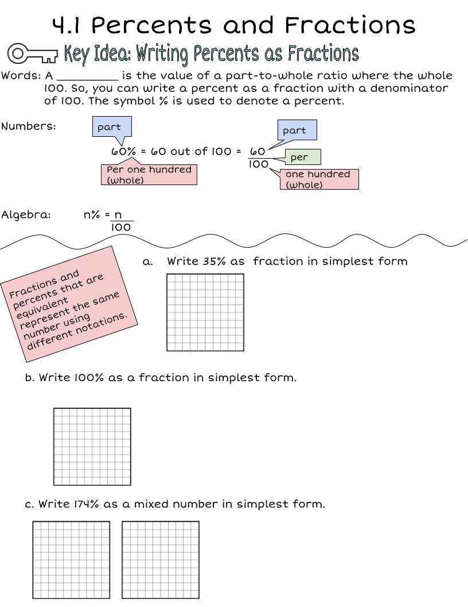
Wordbank:
Make copies of this box and type in it!

Slide 32
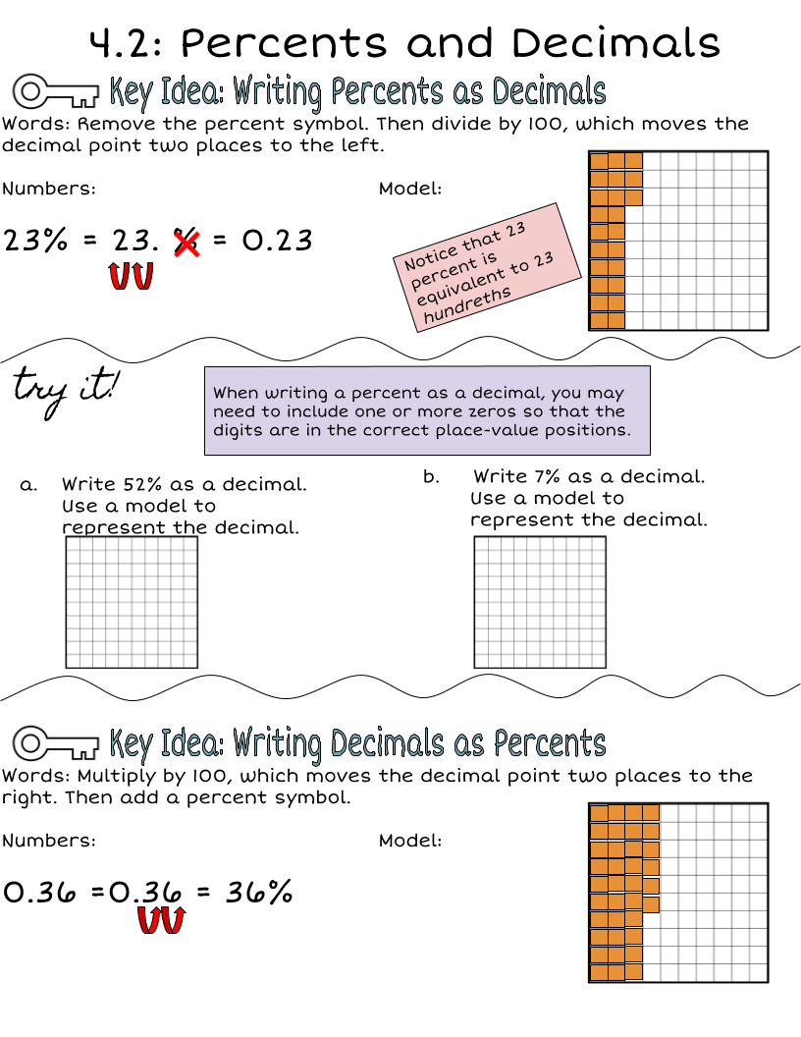
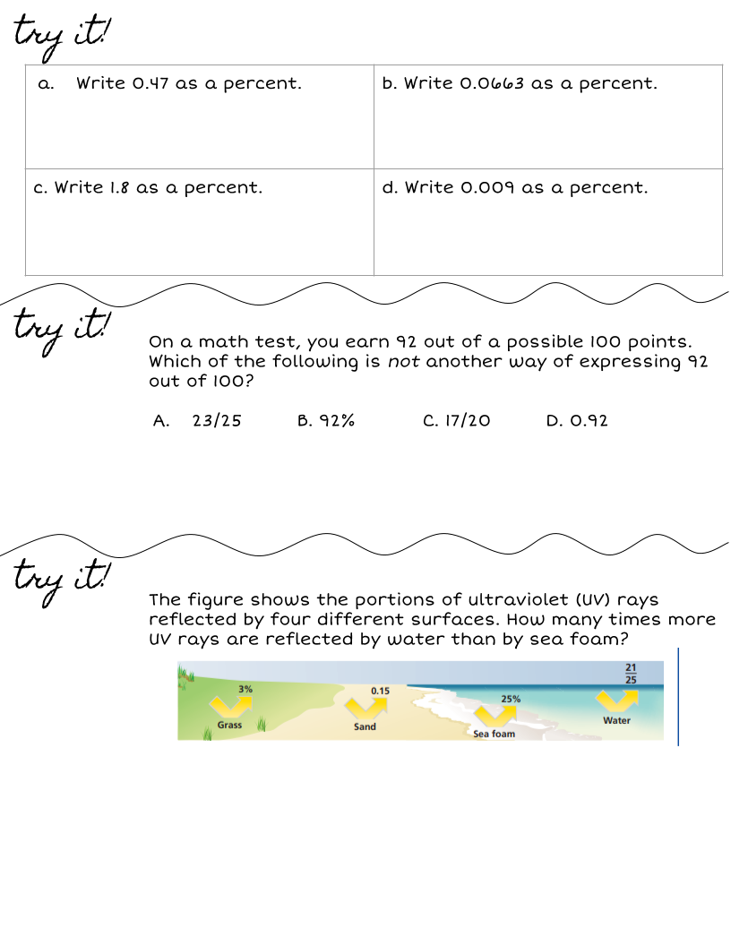

Slide 33
Wordbank:
Make copies of this box and type in it!

Slide 34
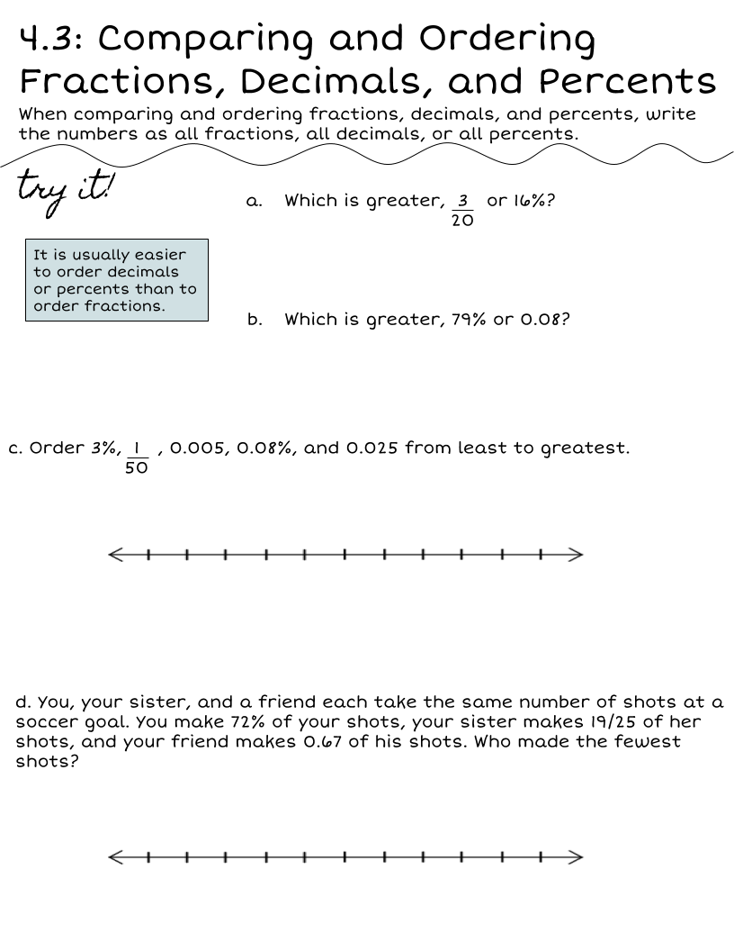
Wordbank
Make copies of this box and type in it!

Slide 35
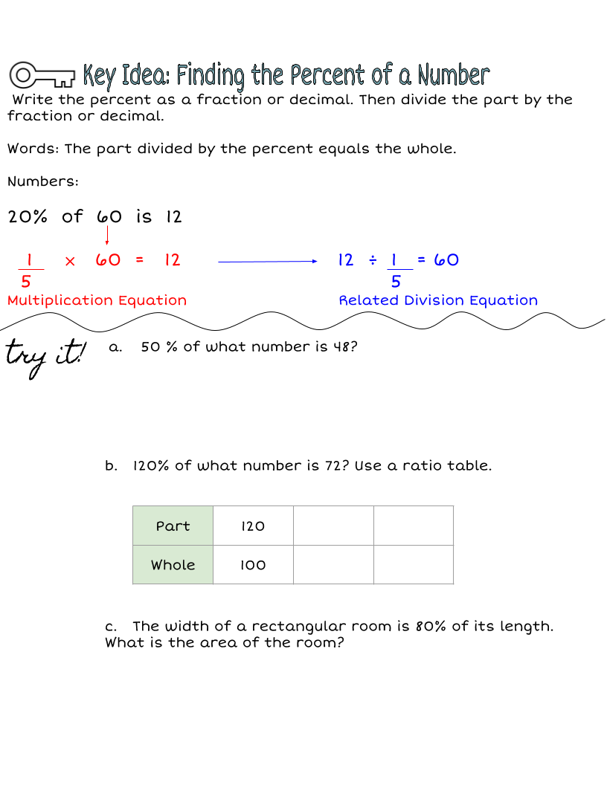

Slide 36
Wordbank:
Make copies of this box and type in it!

Slide 37
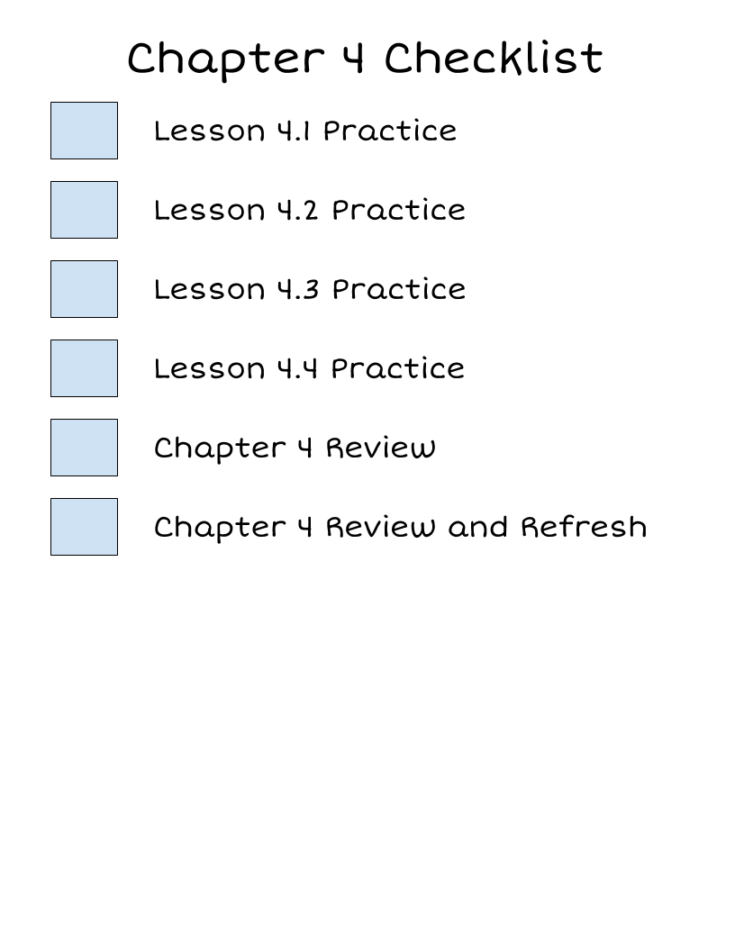
What are you missing?
Grades
Chapter 4A Quiz
Chapter 4B Quiz
Chapter 4 Test
Chapter 4 Notebook Check

Slide 38
Chapter 5 - Lesson 5.1
Wordbank:

Slide 39
Chapter 5 - Lesson 5.2
Wordbank:

Slide 40
Chapter 5 - Lesson 5.3
Wordbank:

Slide 41
Chapter 5 - Lesson 5.4
Wordbank:

Slide 42
Chapter 5 - Lesson 5.5
Wordbank:

Slide 43
Chapter 5 Checklist
What are you missing?
Grades
Chapter 5A Quiz
Chapter 5B Quiz
Chapter 5 Test
Chapter 5 Notebook Check

Slide 44
Chapter 6 - Lesson 6.1
Wordbank:

Slide 45
Chapter 6 - Lesson 6.2
Wordbank:

Slide 46
Chapter 6 - Lesson 6.3
Wordbank:

Slide 47
Chapter 6 - Lesson 6.4
Wordbank:

Slide 48
Chapter 6 Checklist
What are you missing?
Grades
Chapter 6A Quiz
Chapter 6B Quiz
Chapter 6 Test
Chapter 6 Notebook Check

Slide 49
Chapter 7- Lesson 7.1
Wordbank:

Slide 50
Chapter 7- Lesson 7.2
Wordbank:

Slide 51
Chapter 7- Lesson 7.3
Wordbank:

Slide 52
Chapter 7- Lesson 7.4
Wordbank:

Slide 53
Chapter 7- Lesson 7.5
Wordbank:

Slide 54
Chapter 7- Lesson 7.6
Wordbank:

Slide 55
Chapter 7- Lesson 7.7
Wordbank:

Slide 56
Chapter 7 Checklist
What are you missing?
Grades
Chapter 7A Quiz
Chapter 7B Quiz
Chapter 7 Test
Chapter 7 Notebook Check

Slide 57
Chapter 8- Lesson 8.1
Wordbank:

Slide 58
Chapter 8- Lesson 8.2
Wordbank:

Slide 59
Chapter 8- Lesson 8.3
Wordbank:

Slide 60
Chapter 8- Lesson 8.4
Wordbank:

Slide 61
Chapter 8- Lesson 8.5
Stations and HW:

Slide 62
Chapter 8- Lesson 8.6
Wordbank:

Slide 63
Chapter 8- Lesson 8.7
Wordbank:

Slide 64
Chapter 8- Lesson 8.8
Wordbank:

Slide 65
Chapter 8 Checklist
What are you missing?
Grades
Chapter 8A Quiz
Chapter 8B Quiz
Chapter 8 Test
Chapter 8 Notebook Check

Slide 66
Chapter 9- Lesson 9.1
Wordbank:

Slide 67
Chapter 9- Lesson 9.2
Wordbank:

Slide 68
Chapter 9- Lesson 9.3
Wordbank:

Slide 69
Chapter 9- Lesson 9.4
Wordbank:

Slide 70
Chapter 9- Lesson 9.5
Wordbank:

Slide 71
Chapter 9 Checklist
What are you missing?
Grades
Chapter 9A Quiz
Chapter 9B Quiz
Chapter 9 Test
Chapter 9 Notebook Check

Slide 72
Chapter 10- Lesson 10.1
Wordbank:

Slide 73
Chapter 10- Lesson 10.2
Wordbank:

Slide 74
Chapter 10- Lesson 10.3
Stations and HW:

Slide 75
Chapter 10- Lesson 10.4
Stations and HW:

Slide 76
Chapter 10- Lesson 10.5
Stations and HW:

Slide 77
Chapter 10 Checklist
What are you missing?
Grades
Chapter 10A Quiz
Chapter 10B Quiz
Chapter 10 Test
Chapter 10 Notebook Check

Slide 78
SC READY REVIEW
Stations and HW:

Slide 79
Thank you!

